Slide 1
Principles of Programming Languages
Lesson #10
Memoization,
Recursive Data Structures

Slide 2
What we learned
How to build modular, maintainable, and extensible programs?
Close connection between:
Functions - can be manipulated as data using higher-order functions
Data - can be endowed with behavior using message passing and an object system.

Slide 3
What we learned, cont.
How to build modular, maintainable, and extensible programs?
Techniques for organizing large programs:
Functional abstraction (i.e. generic sum, pipelines),
Data abstraction (i.e. rational numbers),
Class Inheritance (i.e. Account classes inheritance),
Generic functions (i.e. str, repr, +, *)
Pipeline

Slide 4
What we will learn
The 3rd fundamental element of programming: programs themselves
A Python program is a collection of text
Meaningful computation based on that text = process of interpretation

Slide 5
What we will learn
Interpreter – a program that carries out Python’s evaluation and execution procedures
We are designers of languages, rather than users of languages designed by others

Slide 6
Programming Languages
We can regard many programs as interpreters for some language
Example: constraint propagator, calculator, etc.
Specialized: provides a method for describing a certain class of mathematical relations
Programming languages vary in their syntactic structures, features, and domain of application
do not include an object system, higher-order functions, or even control constructs like while and for statements

Slide 7
Design of Interpreters
Interpreters are programs that can carry out any possible computation, depending on their input
Typical interpreters have an elegant common structure: two mutually recursive functions
The first evaluates expressions in environments
The second applies functions to arguments

Slide 8
Recursive functions of interpreter
Are defined in terms of each other:
applying a function requires evaluating the expressions in its body
evaluating an expression may involve applying one or more functions

Slide 9
Recursive Functions
A function is called recursive if the body of that function calls the function itself, either directly or indirectly
Recursive computation - computation by simplifying problems incrementally

Slide 10
The Anatomy of Recursive Functions
A common pattern of many recursive functions:
The body begins with a base case, a conditional statement that defines the function for the inputs that are simplest to process
The base cases are then followed by one or more recursive calls, that must simplify the original problem

Slide 11
Mutual Recursion
n is even if n-1 is odd
n is odd if n-1 is even
1 is odd
Recursive calls
Base case

Slide 12
Implementation
def isEven(n):
if n == 1: return False
return isOdd(n-1)
def isOdd(n):
if n == 1: return True
return isEven(n-1)
OR
return not isEven(n)

Slide 13
Tree Recursion
The sequence of Fibonacci numbers:
>>> def fib(n):
if n == 1:
return 0
if n == 2:
return 1
return fib(n-2) + fib(n-1)
>>> fib(6)
5

Slide 14
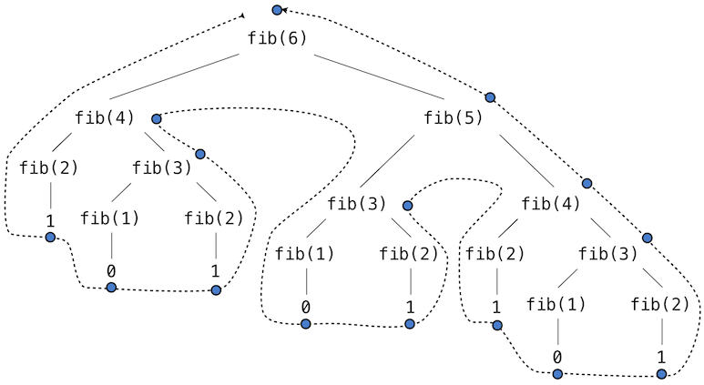
Notes:
the evolved process looks like a tree. Each blue dot indicates a completed computation of a Fibonacci number in the traversal of this tree

Slide 15
Efficiency
Functions that call themselves multiple times are said to be tree recursive.
It is a terrible way to compute Fibonacci numbers - it does redundant computation
Ex: the entire computation of fib(4) is duplicated

Slide 16
Memoization
A powerful technique for increasing the efficiency of recursive functions that repeat computation.
A memoized function stores the return value for any arguments it has previously received
A 2nd call to fib(4) would not evolve the computation process, but instead would return the stored result computed by the first call

Slide 17
Memoization
Can be expressed as a higher-order function
creates a cache of previously computed results, indexed by the arguments from which they were computed
If use a dictionary, the argument to the memoized function must be immutable

Slide 18
Implementation
>>> def memo(f):
"""Return a memoized version of single-argument function f."""
cache = {}
def memoized(n):
if n not in cache:
cache[n] = f(n)
return cache[n]
return memoized
>>> fib = memo(fib)
>>> fib(40)
63245986

Slide 19
Saved computation time
The memoized recursive fib function and
The iterative fib_iter function
both require a linear time (from input n)
Example: fib(40)
memoized: fib is executed 40 times,
unmemoized: 102,334,155 times

Slide 20
Space
Question: how memory is used, preserved, and reclaimed in our environment model of computation?
In evaluating an expression, we must preserve all active environments and all values and frames referenced by those environments
An environment is active if it provides the evaluation context for some expression in the current branch of the expression tree

Slide 21
Example: fib
The interpreter proceeds to compute each value, traversing the structure of the tree
Keeps track of those nodes that are above the current node
The memory used to evaluate the rest of the branches can be reclaimed because it cannot affect future computation
The space required for tree-recursive functions will be proportional to the maximum depth of the tree.
O(log ϕ^{n}) = O(log 2 ^{n}) ~ n

Slide 22
Diagram
The environment and expression tree generated by evaluating fib(3)

Slide 23
In the case of memo…
The environment defining memoized and cache must be preserved as long as some name is bound to that function in an active environment
Number of calls = number of entries in the cache dictionary
grows linearly with the input
input - unique args, without duplicates
O(n)

Slide 24
The iterative implementation…
Requires only two numbers to be tracked during computation:
prev
curr
giving it a constant size
O(1)

Slide 25
A common pattern in programming
Computation time can often be decreased at the expense of increased use of space, or vise versa

Slide 26
Example: Counting Change
Problem: How many different ways can we make change of 1 shekel, given 50, 20, 5, and 1 agorot?
write a function to compute the number of ways to change any given amount of money using any set of currency denominations

Slide 27
Recursive solution
Arrange the types of coins in some order.
The number of ways to change an amount A using n kinds of coins equals
the number of ways to change A using all but the first kind of coin +
the number of ways to change the smaller amount A - D using all n kinds of coins, where D is the denomination of the first kind of coin.

Slide 28
Reduction
Recursively reduce the problem of changing a given amount to the problem of changing smaller amounts using fewer kinds of coins.
Base cases:
If A = 0, we count that as 1 way to make change
If A < 0, we count that as 0 ways to make change.
If n = 0, we count that as 0 ways to make change.

Slide 29
Recursive function
>>> def count_change(a, kinds=(50, 20, 10, 5, 1)):
if a == 0:
return 1
if a < 0 or len(kinds) == 0:
return 0
d = kinds[0]
return count_change(a, kinds[1:]) + count_change(a - d, kinds)
>>> count_change(100)
292

Slide 30
Complexity
The count_change function generates a tree-recursive process with redundancies.
It will take quite a while to be computed, unless we memoize the function.
the tree-recursive process requires O(ϕ^{n}) steps, a function that grows exponentially with n

Slide 31
Recursive Data Structures
Pair - a primitive mechanism for glueing together two objects into one
Can be implemented using a built-in tuple
The closure property:
either element of a pair could itself be a pair
allowed us to implement the recursive list data abstraction, our first type of sequence

Slide 32
Today’s lesson
Recursive lists are naturally manipulated using recursive functions
Today, we discuss functions for creating and manipulating recursive lists and other recursive data structures.

Slide 33
Processing Recursive Lists
Recursive list ADT:
a first element and
the rest of the list
Class-based implementation:
the length (__len__)
element selection (__getitem__)
text representation __repr__
are written
recursively

Slide 34
>>> class Rlist(object):
"""A recursive list consisting of a first element and the rest."""
class EmptyList(object):
def __len__(self):
return 0
empty = EmptyList()
def __init__(self, first, rest=empty):
self.first = first
self.rest = rest
def __repr__(self):
args = repr(self.first)
if self.rest is not Rlist.empty:
args += ’, {0}’.format(repr(self.rest))
return ’Rlist({0})’.format(args)
def __len__(self):
return 1 + len(self.rest)
def __getitem__(self, i):
if i == 0:
return self.first
return self.rest[i-1]

Slide 35
How it works
The built-in Python functions:
len looks for a method called __len__
selection operator looks for a method __getitem__
when applied to a user-defined object argument
Our Rlist class definition interacts properly with Python’s built-in sequence and printing operations

Slide 36
Manipulating our Rlist
>>> s = Rlist(1, Rlist(2, Rlist(3)))
>>> s.rest
Rlist(2, Rlist(3))
>>> len(s)
3
>>> s[1]
2

Slide 37
Combining two lists
>>> def extend_rlist(s1, s2):
if s1 is Rlist.empty:
return s2
return Rlist(s1.first, extend_rlist(s1.rest, s2))
>>> extend_rlist(s.rest, s)
Rlist(2, Rlist(3, Rlist(1, Rlist(2, Rlist(3)))))

Slide 38
Mapping a function over a list
>>> def map_rlist(s, fn):
if s is Rlist.empty:
return s
return Rlist(fn(s.first), map_rlist(s.rest, fn))
>>> map_rlist(s, square)
Rlist(1, Rlist(4, Rlist(9)))

Slide 39
Filtering
>>> def filter_rlist(s, fn):
if s is Rlist.empty:
return s
rest = filter_rlist(s.rest, fn)
if fn(s.first):
return Rlist(s.first, rest)
return rest
>>> filter_rlist(s, lambda x: x % 2 == 1)
Rlist(1, Rlist(3))

Slide 40
Hierarchical Structures
Result from the closure property of data
Example: tuples can contain other tuples
>>> ((1, 2), 3, 4)
((1, 2), 3, 4)

Slide 41
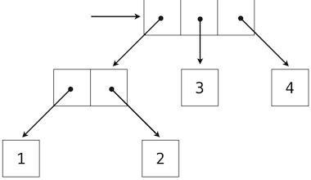
Example: a box-and-pointer diagram
((1, 2), 3, 4) can also be thought of as a tree with 4 leaves:
Recursion: each subtree is itself a tree
Base condition: any bare element that is not a tuple is itself a simple tree, with no branches (leaf)

Slide 42
Recursion on trees
A natural tool for dealing with tree structures
reduces operations on trees to operations on their branches, which reduce in turn to operations on the branches of the branches, and so on,
until we reach the leaves of the tree
Recursive calls
Base case

Slide 43
Counting a total number of leaves
>>> def count_leaves(tree):
if type(tree) != tuple:
return 1
return sum(map(count_leaves, tree))
>>> t = ((1, 2), 3, 4)
>>> count_leaves(t)
4
>>> big_tree = ((t, t), 5)
>>> big_tree
((((1, 2), 3, 4), ((1, 2), 3, 4)), 5)
>>> count_leaves(big_tree)
9

Slide 44
Mapping and recursion together
A powerful general form of computation for manipulating trees
Example: square all leaves of a tree using a higher-order recursive function map_tree:
>>> def map_tree(tree, fn):
if type(tree) != tuple:
return fn(tree)
return tuple(map_tree(branch, fn) for branch in tree)
>>> map_tree(big_tree, square)
((((1, 4), 9, 16), ((1, 4), 9, 16)), 25)

Slide 45
Internal values
Our trees (above) have values only at the leaves
Another common representation:
values for the internal nodes
can be implemented using a class

Slide 46
>>> class Tree(object):
def __init__(self, entry, left=None, right=None):
self.entry = entry
self.left = left
self.right = right
def __repr__(self):
args = repr(self.entry)
if self.left or self.right:
args += ’, {0}, {1}’.format(repr(self.left), repr(self.right))
return ’Tree({0})’.format(args)

Slide 47
Tree class usage
Can represent the values computed in an expression tree for the recursive implementation of fib
fib_tree(n) returns a Tree that has the n^{th} Fibonacci number as its entry and a trace of all previously computed Fibonacci numbers within its branches

Slide 48
>>> def fib_tree(n):
"""Return a Tree that represents a recursive Fibonacci calculation."""
if n == 1:
return Tree(0)
if n == 2:
return Tree(1)
left = fib_tree(n-2)
right = fib_tree(n-1)
return Tree(left.entry + right.entry, left, right)

Slide 49
Environment Diagram

Slide 50
>>> fib_tree(5)
Tree(3, Tree(1, Tree(0), Tree(1)), Tree(2, Tree(1), Tree(1, Tree(0),Tree(1))))
fib(5)
3
fib(3)
1
fib(4)
2
fib(1)
0
fib(2)
1
fib(2)
1
fib(3)
1
fib(1)
0
fib(2)
1

Slide 51
How does it relate to Interpreter?
Expression trees can be represented programmatically using tree-structured data
Central role in designing interpreters plays connection between nested expressions and tree-structured DT

