Slide 1

Retrieval Augmentation Generation

Slide 2
Why ?
Efficient use of resources (Input / Output Tokens)
Less Hallucination
Better accuracy

Slide 3
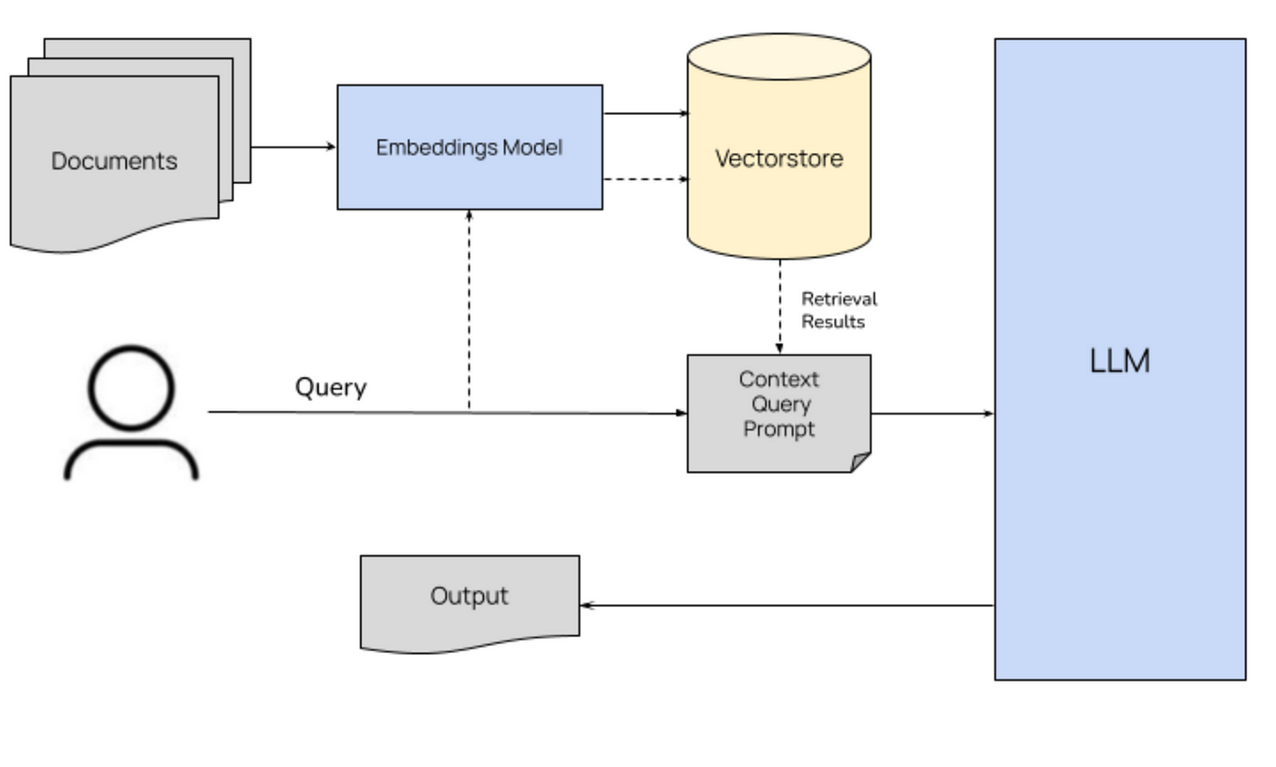
Architecture

Slide 4
Vector Stores
Easy to manage vectors (n-dimensional array)
Efficient retrieval
Metadata information for each vector
Filter option on metadata
Eg:
Pinecone,
Chroma,
FAISS,
Qdrant, etc.

Slide 5
Chunking
Breaking document into smaller, and manageable pieces
Each chunk to have relevant information
Easy while managing bigger document
Efficient retrieval (recall)
Types:
Fixed size chunking
Recursive character chunking
Sentence Splitting
Specialized Chunking
Semantic Chunking
Etc.

Slide 6
Retrieve Context Dynamically
Using query (same embedding model)
Get document / chunks from database based on similarity
Similarity score threshold
Top k

Slide 7
Prompt
Assign task with retrieved context and question
Provide model background to understand the context provided for given query
Structure of prompt

Slide 8
Context optimization
Re-Ranker
Chunking strategy optimization
Model Finetuning
Query re-writing
Clean input text

Slide 9
Evaluation
Context Relevance
Faithfullness
Answer Relevance

Slide 10

Questions ?

