Slide 1
Secure Data Hiding in Image Using Steganography
CAPSTONE PROJECT
Presented By: Kartik Shinde
Student Name : Kartik Vilasrao Shinde
College Name : Jawaharlal Darda Institute of Engineering and Technology,Yavatmal
Department : Computer Science and Engineering

Slide 2
OUTLINE
Problem Statement
Technology used
Wow factor
End users
Result
Conclusion
Git-hub Link
Future scope

Slide 3
Problem Statement
Develop a Java-based Image Steganography application with a user-friendly GUI to securely hide and retrieve text messages within images. The system should allow users to encrypt messages by modifying image pixels and decrypt them using a passcode. It must ensure security, data integrity, and ease of use.

Slide 4
Technology used
Programming Language:
Java (Core Java, Swing for GUI)
Libraries & APIs:
Java Swing – For GUI components (buttons, labels, text fields, file chooser)
Java AWT – For image processing and UI layout
Java ImageIO – For reading and writing image files
Java File Handling – For file selection and password storage
Platform Compatibility:
Operating System: Windows, macOS, Linux
Java Version: JDK 8 or later
Development Environment:
IDE: Eclipse, IntelliJ IDEA, or NetBeans
Build Tool: Optional (Maven/Gradle if needed)

Slide 5
Wow factors
Java-Based Implementation – Unlike common Python solutions, this project fully utilizes Java Swing for GUI.
Direct Pixel Manipulation – No external libraries like OpenCV; image processing is handled within Java.
Interactive GUI – Easy-to-use interface with file selection, status updates, and pop-up messages
Cross-Platform Compatibility – Runs smoothly on Windows, macOS, and Linux without extra setup.
Secure & Efficient Encoding – Embeds messages in RGB pixels with minimal image distortion, ensuring data integrity.

Slide 6
End users
Cybersecurity Researchers – Explore data hiding techniques and secure communication
Journalists & Whistleblowers – Hide sensitive information inside images for discreet sharing.
Students & Educators – Learn steganography, cryptography, and Java-based image processing
Forensic & Law Enforcement Experts – Detect hidden messages in digital images for investigations.
Privacy-Focused Users – Securely share messages without attracting attention.
Military & Intelligence Personnel – Use covert communication methods for classified information exchange

Slide 7
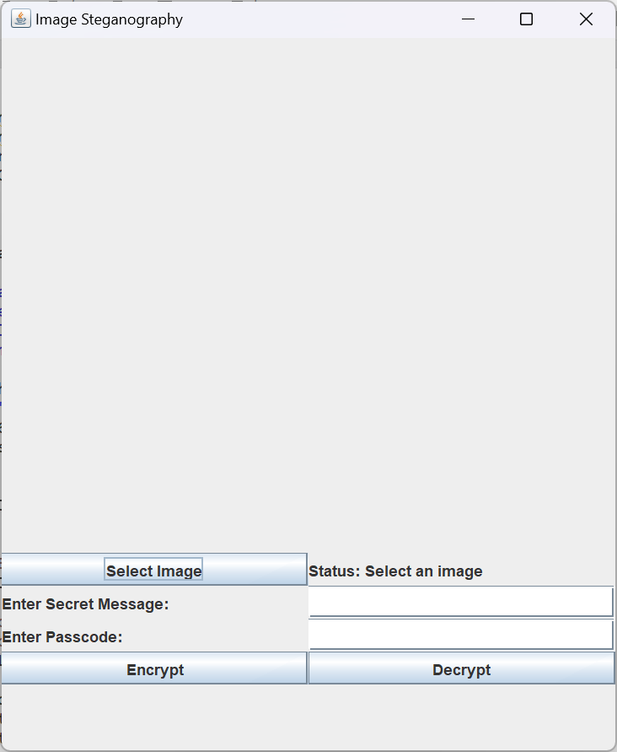
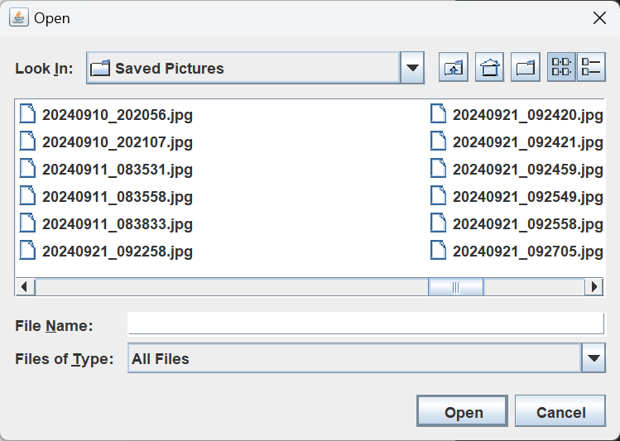
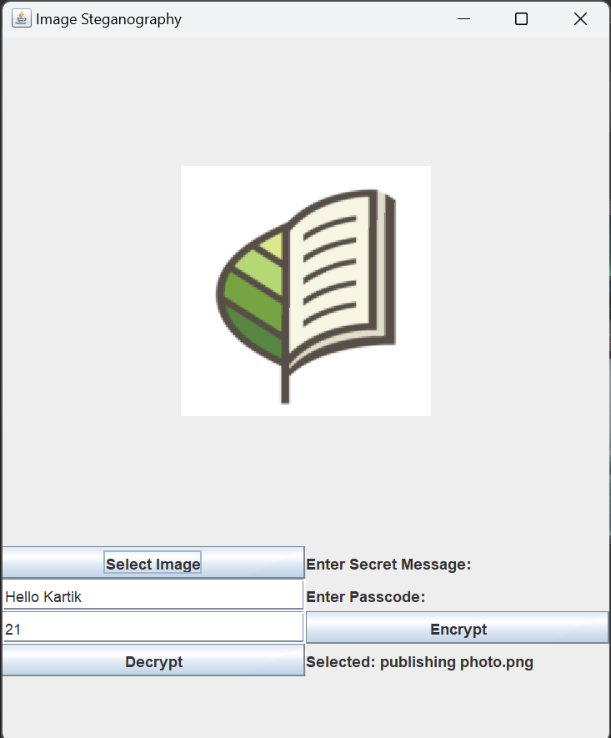
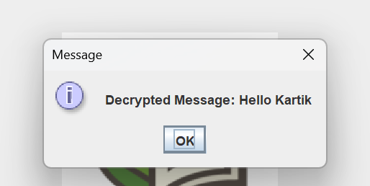

Results

Slide 8
Conclusion
Provides a secure method to hide and retrieve messages in images using Java.
Features a user-friendly GUI for easy interaction.
Ensures data protection and secure communication.
Useful for privacy, cybersecurity, and real-world security applications.

Slide 9
GitHub Link
https://github.com/karts43/Secure-Data-Hiding-in-image-using-Steganography-Java

Slide 10
Future scope(optional)
Digital Watermarking – Integrate watermarking for security and copyright protection
Video Steganography – Expand functionality to hide messages in videos.
Wider File Format Support – Add support for PNG, BMP, and TIFF files.
Advanced Encryption – Use stronger security algorithms like AES or RSA.
Real-Time Messaging – Enable secure live message encryption and decryption.
Mobile Application – Develop an Android/iOS version for convenience.

Slide 11
THANK YOU

