Slide 1
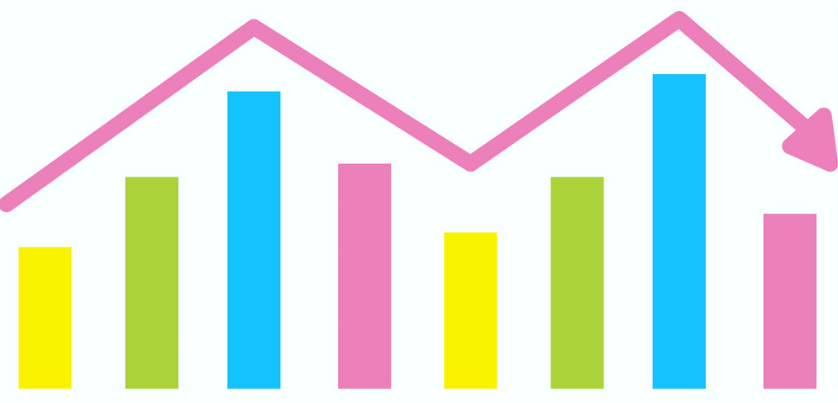
DEMAND
FORECASTING
Presented By:
Kartik Bhatia
Lakshay Vasuja
Janvi Arya
Mayank Gupta
Under the guidance of
Mr. Hitesh Kumar
Sharma

Slide 2
CONTENT
Objectives
Proposed Solution
Target Audience
Technologies used
Project Flow
Results
Conclusion

Slide 3

OBJECTIVES
Transactional Sales data of a cement company will be pulled into Azure SQL Database, using Azure DataFactory. The pulled data will then be read into Azure Databricks where a predictive model will be built. The predictions will be made into Azure Databricks. The predictions will then be exported to the SQL database and will then be visualized on PowerBI.

Slide 4
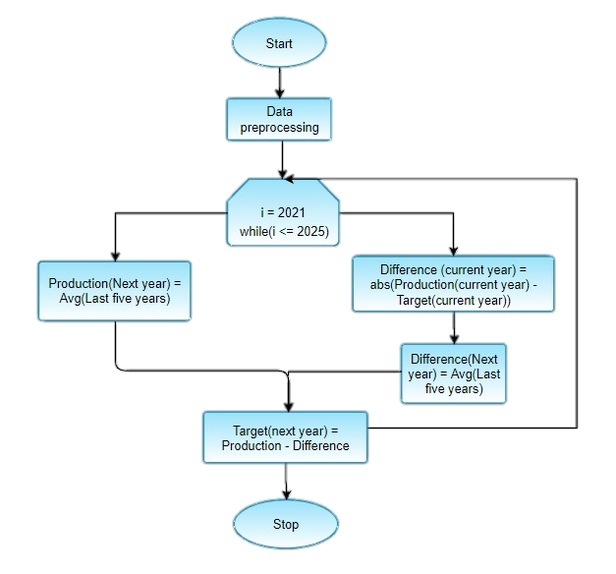
PROPOSED SOLUTION

Slide 5

TARGET AUDIENCE
All product based companies can be a possible customer as they can use it to predict and improve their future sales.
All small scale traders or businesses which usually sell imported products as they can analyze future demand and can supply respectively.

Slide 6

TECHNOLOGIES USED
MICROSOFT AZURE
DATAFACTORY, to create and maintain ETL pipeline connecting the various services used.
SQL DATABASE, to store and manage excel/csv data in tabular format.
BLOB STORAGE, to import local data into cloud.
DATABRICKS, to make the predictive model using PySpark.
POWERBI, to visualize the predictions.

Slide 7
PROJECT FLOW
Step 1: - First, deploy services to be used within the same resource group on Microsoft Azure, i.e. DataFactory, Storage Account, SQL Database, SQL Server, Databricks.
Step 2: - All the services are linked through DataFactory as an ETL pipeline.
Step 3: - Browse the dataset from Local File Storage and import this data in the BLOB storage under the created Storage account.
Step 4: - Then, we run SQL queries to import the dataset in a tabular format as a SQL Database. Use the CopyData function in DataFactory to transfer data from Blob to SQL Database.

Slide 8
Step 5: - This SQL data is used as an input for Azure Databricks, where we develop a model that generate predictions.
The input data that we have is from 2015 to 2020. And, the demand forecasting is done for 2021 to 2025. The prediction is done on the basis of the Target value and the Production value.
Predicted Target value = Average of previous 5 years target values.
Predicted Production value = Average of previous 5 years target values + Average of the Difference value
where, Difference value = Production value - Target value
Step 6: - The predictions made are then used as an input to Power BI where predictions are being visualized. In Power BI use the following attributes for the visualizations :
Target value, Production value, Plant ID, Year

Slide 9
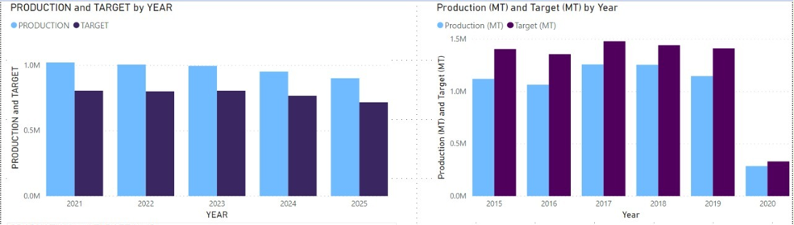
Results
Forecasted data(20201-2025) Vs Given Data(2015-2020)

Slide 10
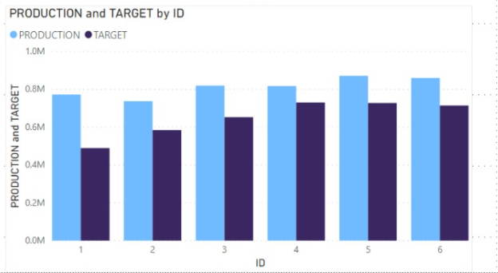
Total Production and Target value of Five years Grouped by PlantId

Slide 11
CONCLUSION
We built a predictive model to analyze or predict the future targets or sales so that any firm can work on their various factors to improve their future sales or productions based on the forecasting. In this model we are also visualizing the predictions on Power BI which proves to be user friendly. This model helps different sectors like the Cement Factory dataset on which we have performed the analysis to enhance their various fields.

