Slide 1


Slide 2
PLANT DISEASE CLASSIFICATION
Major Project - II
In
Fourth year – Eighth Semester of
Bachelor of Technology
specialization
In
BigData
Under
Mr. Vijendra Singh
By
S. No. | Roll Number | Name | Branch | Sap-Id
1 | R172218032 | Bhavanshu Arora | CSE-Big Data | 500067696
2 | R172218044 | Dipansh Mittal | CSE-Big Data | 500067347
3 | R172218058 | Kartik Bhatia | CSE-Big Data | 500068463
4 | R172218085 | Parth | CSE-Big Data | 500067724

Slide 3
INTRODUCTION
Modern technologies have given human society the ability to produce enough food to meet the demand of more than 7 billion people. However, food security remains threatened by a number of factors including climate change, the decline in pollinators, plant diseases, and others.
Plant diseases are not only a threat to food security at the global scale, but can also have disastrous consequences for small-holder farmers whose livelihoods depend on healthy crops. In the developing world, more than 80 percent of the agricultural production is generated by smallholder farmers, and reports of yield loss of more than 50% due to pests and diseases are common.
Furthermore, the largest fraction of hungry people (50%) live in smallholder farming households, making smallholder farmers a group that’s particularly vulnerable to pathogen-derived disruptions in food supply.

Slide 4
PROBLEM STATEMENT
Leaves, flowers, and fruits change throughout the season, indicating that they are always evolving. During the day, their appearance changes gradually as the amount and angle of incident solar radiation affect their spectral response.
Manual detection of plant health is a tedious job. Hence, it is required to develop computational methods which will make the process of health identification and classification using leaf images.
Plant diseases reduce both the quantity and quality of plant yield. Diseases interrupt vital functions of a plant such as photosynthesis, transpiration, pollination, fertilization, germination, etc.

Slide 5
MOTIVATION
Crop diseases are a major threat to food security, but their rapid identification remains difficult in many parts of the world due to the lack of the necessary infrastructure.
The combination of increasing global smartphone penetration and recent advances in computer vision made possible by deep learning has paved the way for smartphone-assisted disease diagnosis.
To prevent the crops from getting affected, we had to make a program which would identify whether a plant is healthy or not.

Slide 6
OBJECTIVE
The goal is to help novice plant owners determine if their plants are healthy or need some special attention. If the model can accurately classify an unhealthy plant, then users can take the next step to research and determine whether their plants are being over/under watered, receiving too much/too little sunlight, infested, etc.
Convolutional neural network (CNN) model which is trained with plant health dataset.

Slide 7
LITERATURE REVIEW
Identification of plant health is a new challenging area for researchers. Leaves, flowers, and fruits change throughout the season, indicating that they are always evolving. During the day, their appearance changes gradually as the amount and angle of incident solar radiation affect their spectral response. Several methodologies have been used to create crop disease identification tools, whether in controlled or real-world settings. The examination of visible and near-infrared reflectance, the development of specific vegetation indexes, and even pattern analysis were all used in these procedures. Studying the infected leaves, it has been observed that the greenness of the infected portion of the leaf changes significantly from the normal leaves. CNN model is used for identifying the health status of plants.

Slide 8
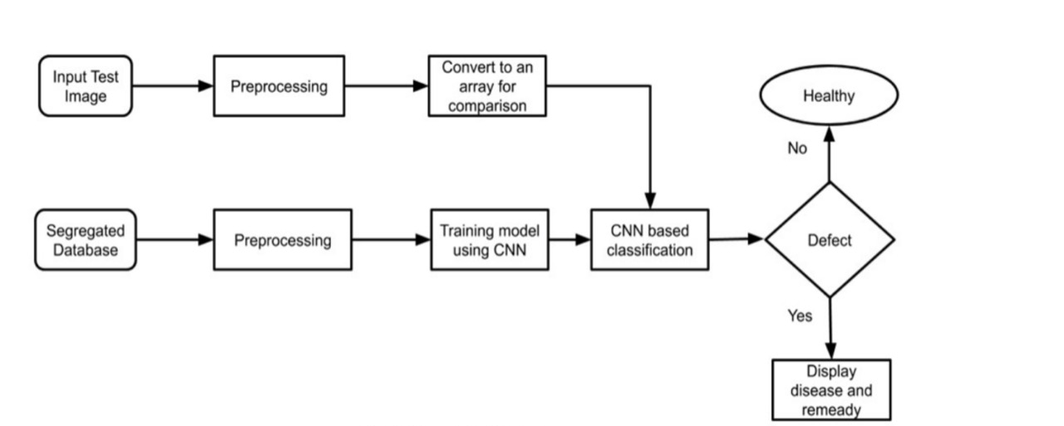
DESIGN

Slide 9
METHODOLOGY
Step 1 - Image Acquisition: This is the process of acquiring the images through a camera by going to the site or from other available sources such as image databases or online repositories. The captured images are in three colors, that is, Red, Green, and Blue (RGB), for which a color transformation structure is created, and a device-independent color space transformation is applied on it [8].
Step 2 - Image Pre-processing: To remove noise in an image, different pre-processing techniques are used. Clipping of leaf image is applied to extract the region of the image in which we are interested. The extracted plant leaf image is transferred to a digital system to remove the unnecessary areas. Some essential steps of pre-processing are: Resizing the image, Noise removal from the image, enhancement and smoothing of the image.
Step 3 - Image Segmentation: This method of image processing is used to partition an image into significant components according to similar characteristics. Various methods are available for image segmentation such as boundary and spot detection algorithm, region and edge-based methods, Otsu’s method, thresholding techniques and k-means clustering, etc.

Slide 10
Step 4 - Feature Extraction: It is a type of dimension reduction technique that effectively represent the useful part of the image. Various features such as texture, color, edges and morphology can be extracted for the detection of plant disease. Color co-occurrence method is used for feature extraction.
Step 5 - Classifiers: Classifiers are used to identify and categorize the different diseases that occur on plant leaves based on obtained features. Several classifiers that have been used in earlier work to detect diseases in plants are K-nearest neighbors (K-NN), Support Vector Machines (SVM), Convolutional Neural Network (CNN) and Artificial Neural Network (ANN), etc.

Slide 11
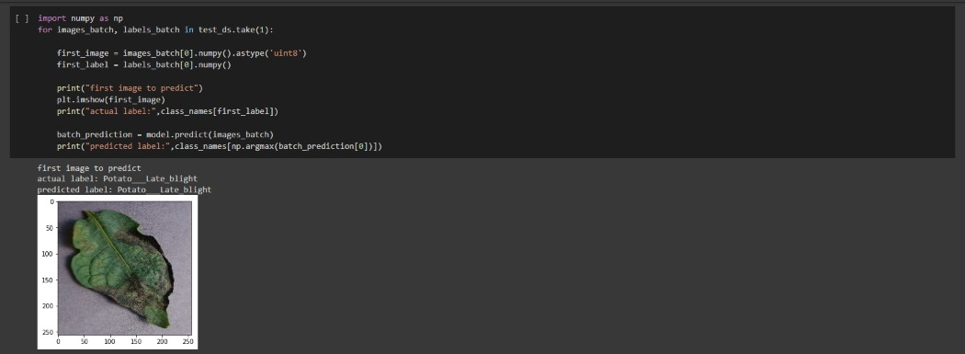
IMPLEMENTED CODE
Fig 1. Running prediction on a Sample Image

Slide 12
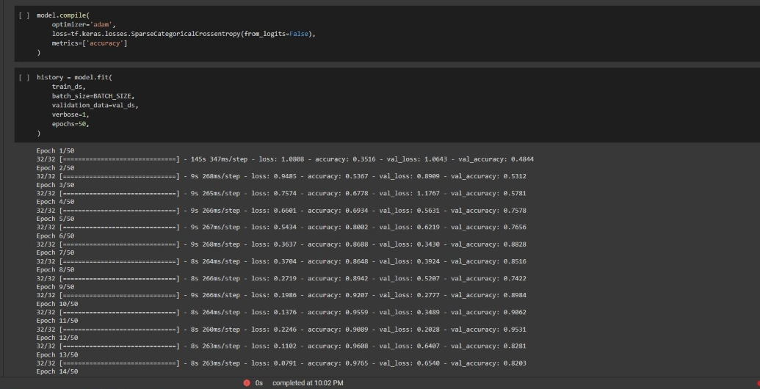
IMPLEMENTED CODE
Fig 2. Model Implementation

Slide 13

IMPLEMENTED CODE
Fig 3. Function for Inference

Slide 14
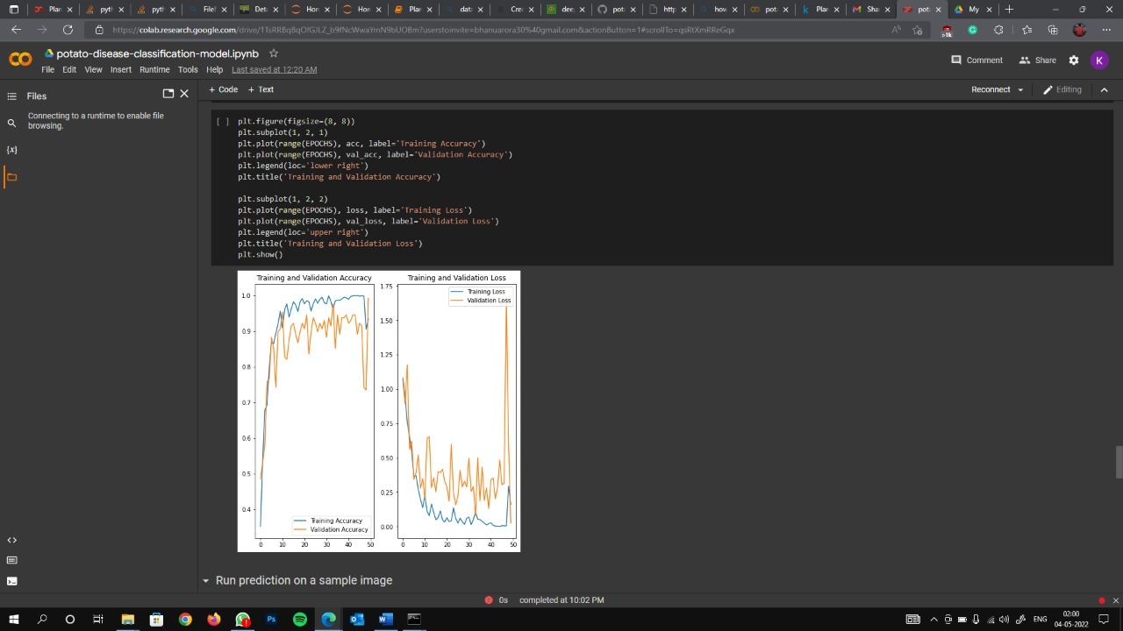
RESULT
Fig 4. Accuracy and Loss of Model

Slide 15
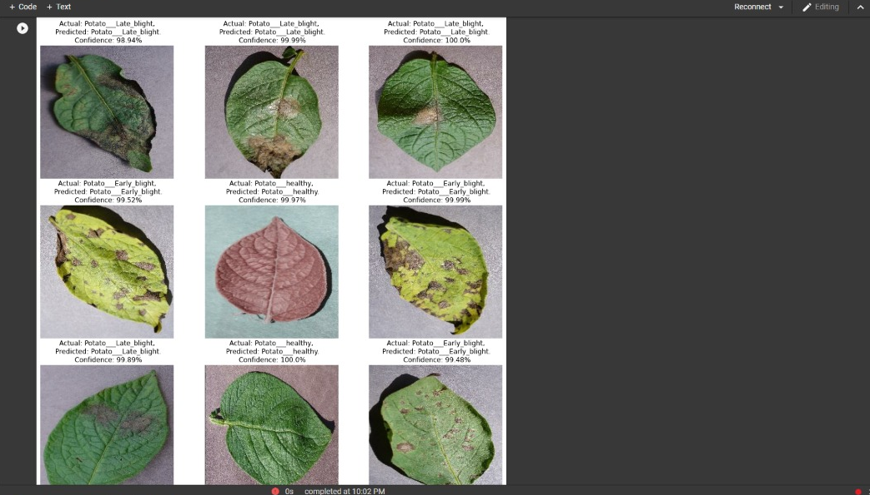
RESULT
Fig 5. Inference on a few images

Slide 16
RESULT
Fig 6. loss and accuracy

Slide 17
CONCLUSION AND FUTURE SCOPE OF PROJECT
The proposed system is based on python and provides an accuracy of around 99%. The accuracy and therefore the speed are often increased by use of Google’ s GPU for processing. The system is often installed on Drones in order that aerial surveillances of crop fields are often done
Agricultural department wants to automate the detecting the yield crops from eligibility process (real time).
To automate this process by showing the prediction end in web application or desktop application.
To optimize the work to implement in AI environment.

Slide 18
REFERENCES
A. Verma, “Precision Agriculture using Internet of Things: An Overview,” in International Journal of Management, IT and Engineering, vol. 9, no. 7, pp. 298-303, July 2019.
https://arxiv.org/ftp/arxiv/papers/1604/1604.03169.pdf
https://www.turcomat.org/index.php/turkbilmat/article/download/7743/6139/13981
Parismita Bharali, Chandrika Bhuyan, Abhijit Boruah, “Plant Disease Detection by Leaf Image Classification
Using Convolutional Neural Network” ICICCT 2019, pp.194-205.
Rahman Tashakkori, Timothy Jassmann, R. Mitchell Parry, “Leaf Classification Convolutional Neural Network App” , IEEE Southeast 2015
M. B. Riley, M. R. Williamson, and O. Maloy, “Plant disease diagnosis. The Plant Health Instructor,” 2002.
Srdjan Sladojevic, Marko Arsenovic, Andras Anderla, Dubravko Culibrk and Darko Stefanovic, “Deep Neural Networks Based Recognition of Plant Diseases by Leaf Image Classification”, 2016.

Slide 19
H. Cartwright, Ed., Artificial Neural Networks, Humana Press, 2015.
https://www.analyticsvidhya.com/blog/2017/06/architecture-of-convolutional-neural-networks-simplified- demystified/
https://en.wikipedia.org/wiki/Convolutional_neural_network
S. Ajantha, G. Mahapriya, J. Mispa, S. Nithya, Measurement of Multimodal Brain Tumor Segmentation using Neural Network in IJERT vol. 5, issue 13.
Mohammad El-Helly, Ahmed Rafea, Salwa El-Gammal, “An Integrated Image Expert Processing System for Leaf Disease Detection and Diagnosis”, Central Lab. For Agricultural System(CLAES), Agricultural Research Center(ACR), Giza,Egypt
https://www.geeksforgeeks.org/cnn-introduction-to-pooling-layer/.

