Slide 1
DEVOPS FINAL CAPSTONE
Homework Tracker
Kartik Jangid
React, FastAPI and PostgreSQL
Azure deployment with K3s
01
Notes:
Introduce the assignment tracker and explain how the application and delivery workflow fit together. Source: https://github.com/karttikjangid/homework-tracker-capstone

Slide 2
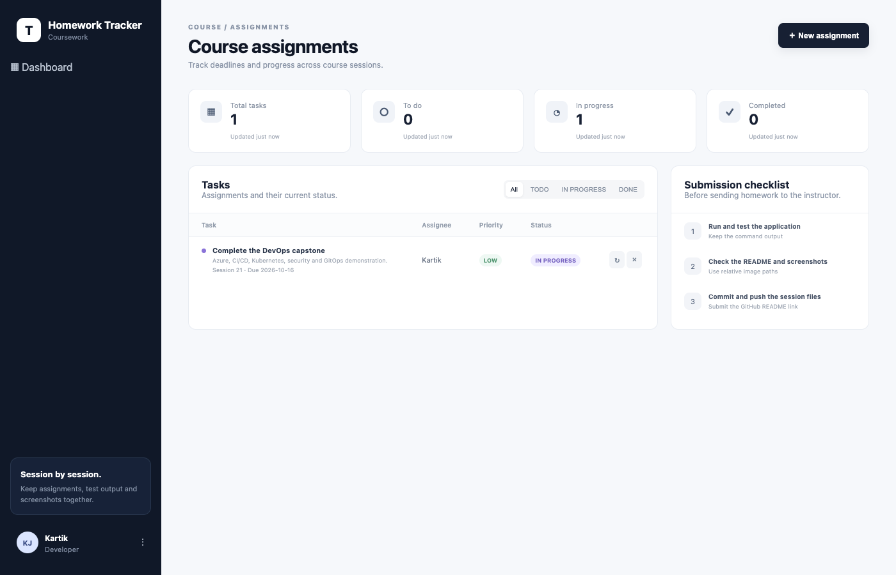
The application
Assignments for Sessions 1–21
Deadline, assignee and priority
Create, edit, filter and track status
Application after the Azure upgrade, October 2026
02
Notes:
Show the frontend and create an assignment. Explain how the session and due-date fields make this application specific to the course. Source: README.md and screenshots/terminal/cloud-after.png in the project repository.

Slide 3
Application and delivery architecture
Release delivery
GitHub
Actions + gates
GHCR images
Helm on K3s
Application requests
Browser + Ingress
React / Nginx
FastAPI
PostgreSQL PVC
Terraform provisions the Azure VM and network. CI verifies the chart in Kind.
Prometheus scrapes FastAPI metrics. Grafana displays the results.
03
Notes:
Describe the request path first, then the delivery path. CI uses an isolated Kind cluster. The Azure deployment is a separate Helm promotion through a private Kubernetes API over an SSH tunnel. Do not describe the CI Kind deployment as an automatic Azure deployment. Sources: README.md, .github/workflows/ci-cd.yml, terraform/, helm/taskboard/.

Slide 4
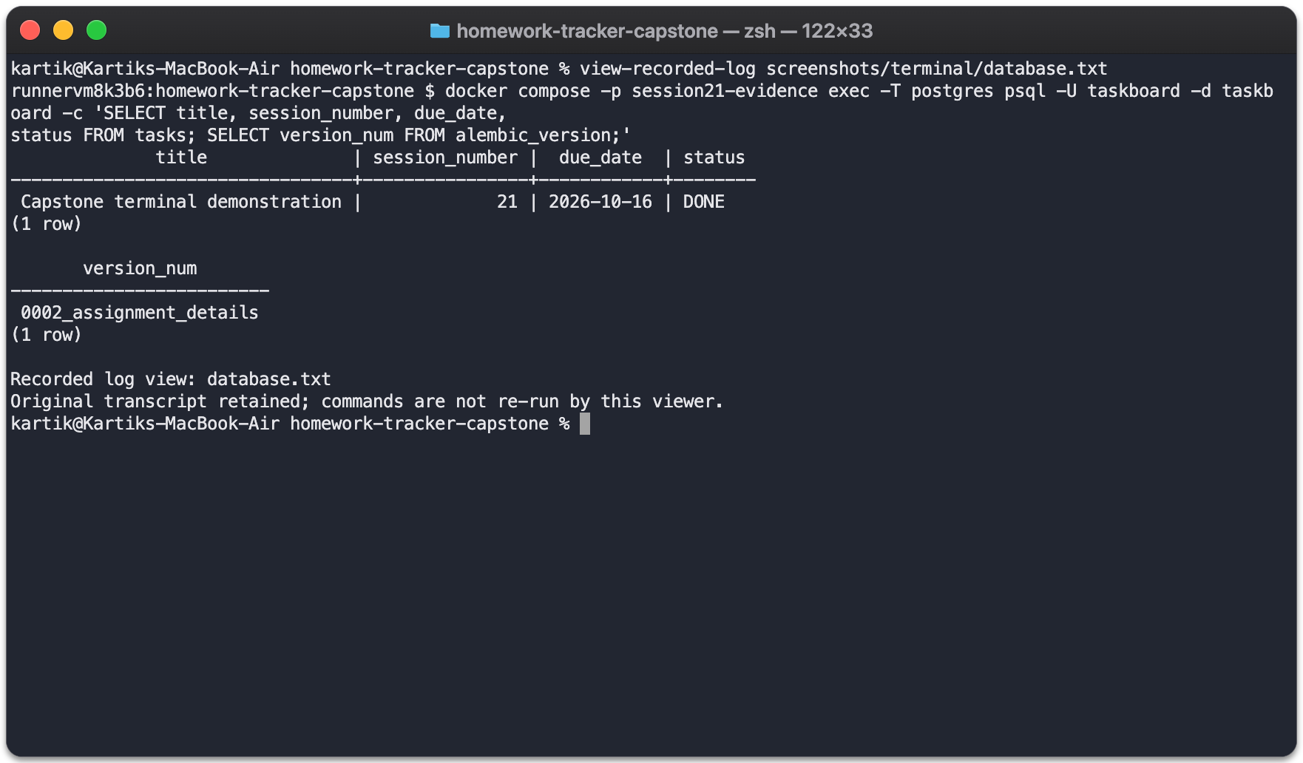
API and database
CRUD endpoints manage assignments
Swagger documents the API
Alembic versions database changes
PostgreSQL retained data through the upgrade
Recorded database output viewed in Mac zsh
04
Notes:
Open /docs for the API demonstration. Show create, read, update and delete, then explain the database row and Alembic version. Source: docs/development.md, screenshots/terminal/database.txt, screenshots/terminal/cloud-api-after.txt. The screenshot views recorded output and is not a fresh deployment.

Slide 5
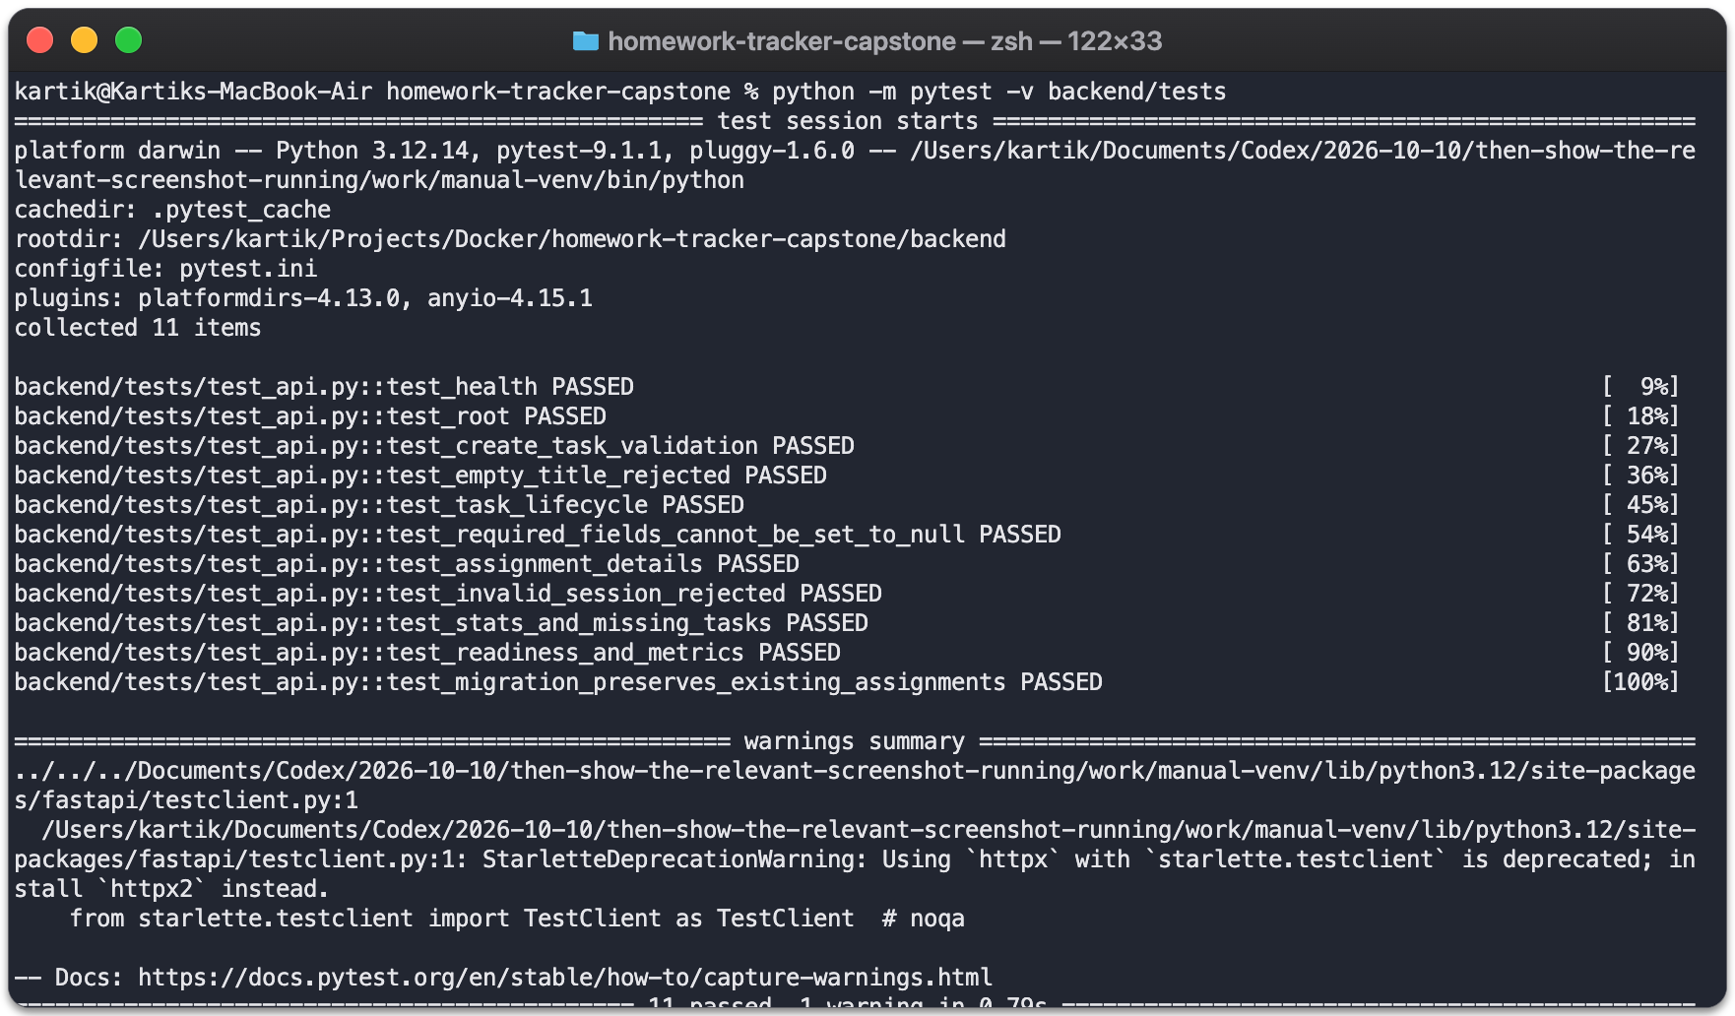
Automated tests
11 API and migration tests passed
Tests use an isolated test database
Failures stop the pipeline
The run reported one deprecation warning
Local backend test rerun, 17 October 2026
05
Notes:
Explain one endpoint test and the migration test. The recorded CI result also reports 11 passed and one Starlette deprecation warning. Sources: backend/tests/, screenshots/mac/pytest.txt, screenshots/verification/standalone-review-tests.txt.

Slide 6
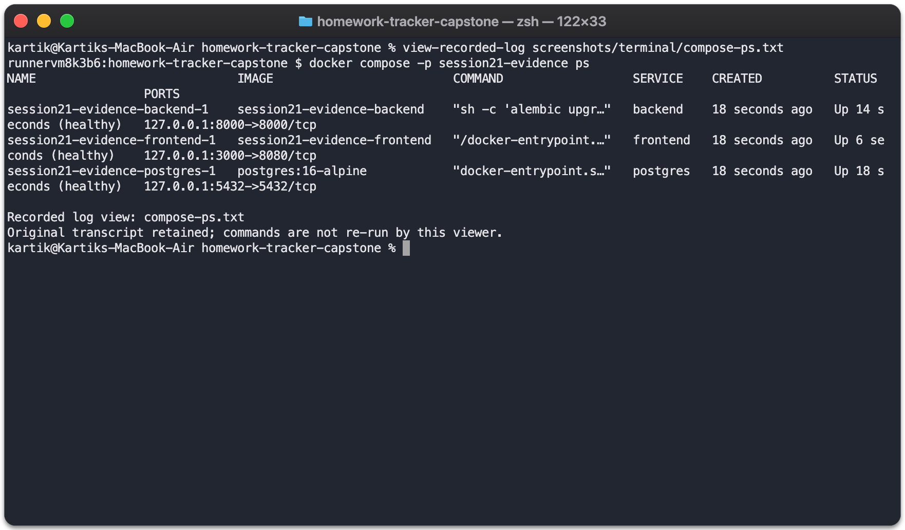
Docker and Compose
Frontend, backend and PostgreSQL
Multi-stage frontend image
Both application images run as non-root
Health checks verify readiness
Recorded clean Compose verification viewed in Mac zsh
06
Notes:
Run docker compose up -d --build --wait for a live local demonstration, then docker compose ps. Explain the named database volume and the difference between down and down -v. Sources: docker-compose.yml, backend/Dockerfile, frontend/Dockerfile, screenshots/terminal/compose-commands.json. This slide shows recorded verification.

Slide 7
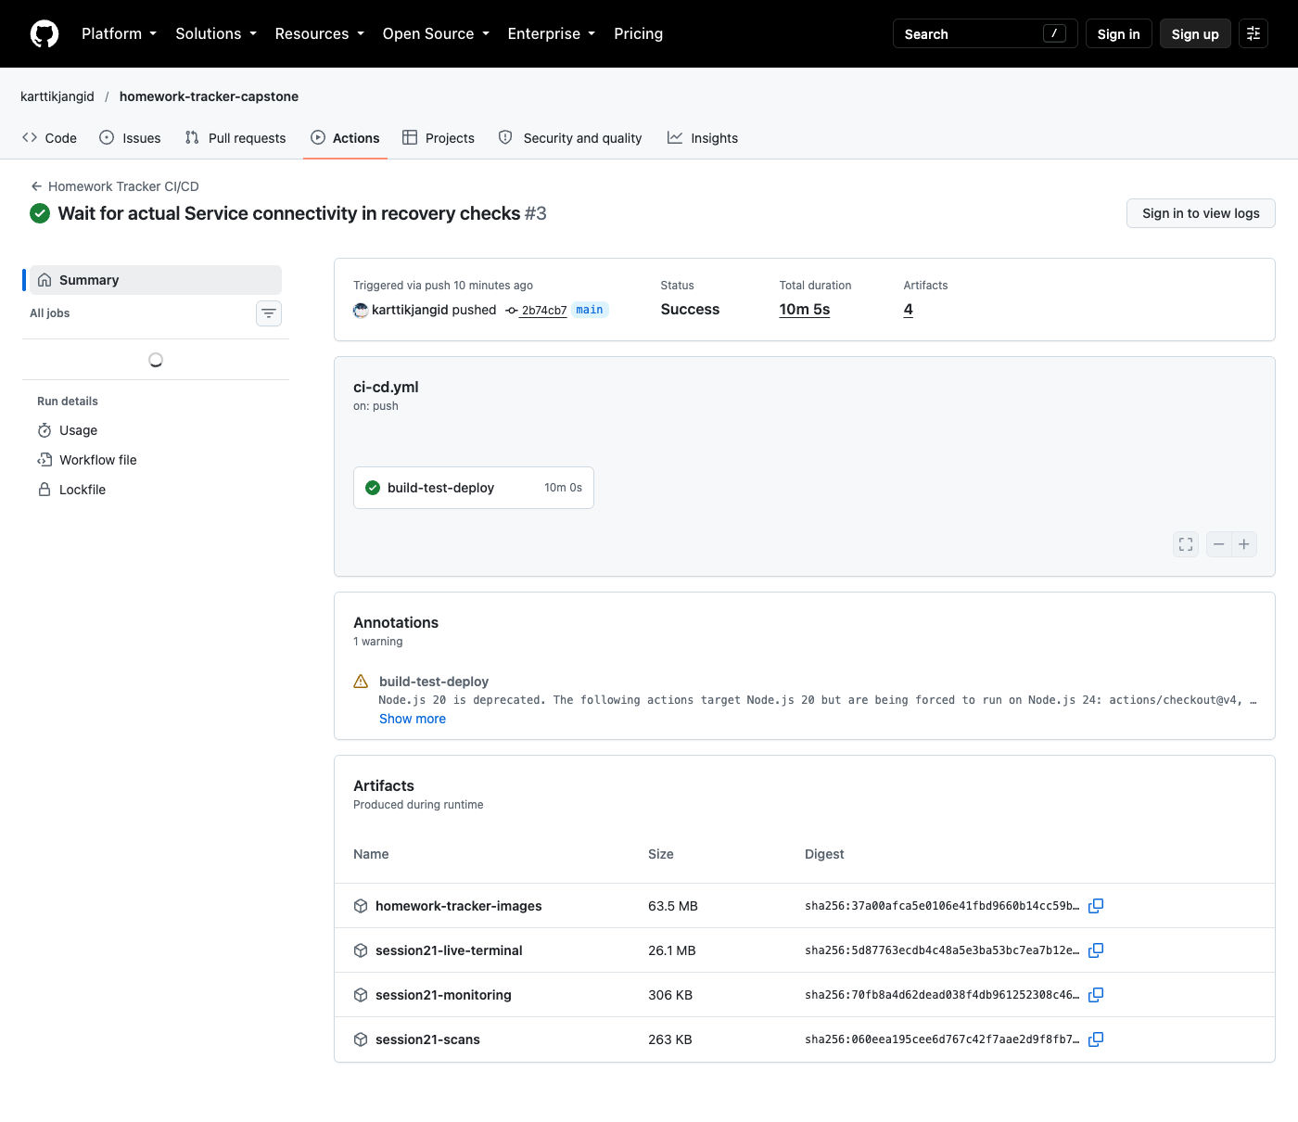
GitHub Actions and image delivery
Tests and frontend build
Security gates before publication
Two images published to GHCR
Commit SHA identifies the image release
Successful application pipeline, run 38812142701
07
Notes:
Open the successful application pipeline and show its build, scans and deployment checks. The workflow now triggers on every push to main, including documentation changes. Application image SHA: 2b74cb7f4da3cbb2dccc8faaab52b23c68f46f98. The recording shows the earlier release. Source: .github/workflows/ci-cd.yml and docs/verification.md.

Slide 8
Security gates
Bandit checks Python source
The saved release scans passed
pip-audit and npm audit inspect dependencies
A clean result covers that scan and dependency set
Trivy scans the repository for secrets
New dependency or image changes require another scan
Trivy scans both container images
HIGH or CRITICAL image findings fail the build
08
Notes:
Show the actual pipeline scan steps. Explain that a clean image scan means no reported findings at the configured severity threshold for that run, not a guarantee that the application has no vulnerabilities. Sources: .github/workflows/ci-cd.yml, screenshots/verification/standalone-backend-scan.txt, screenshots/verification/standalone-frontend-scan.txt.

Slide 9
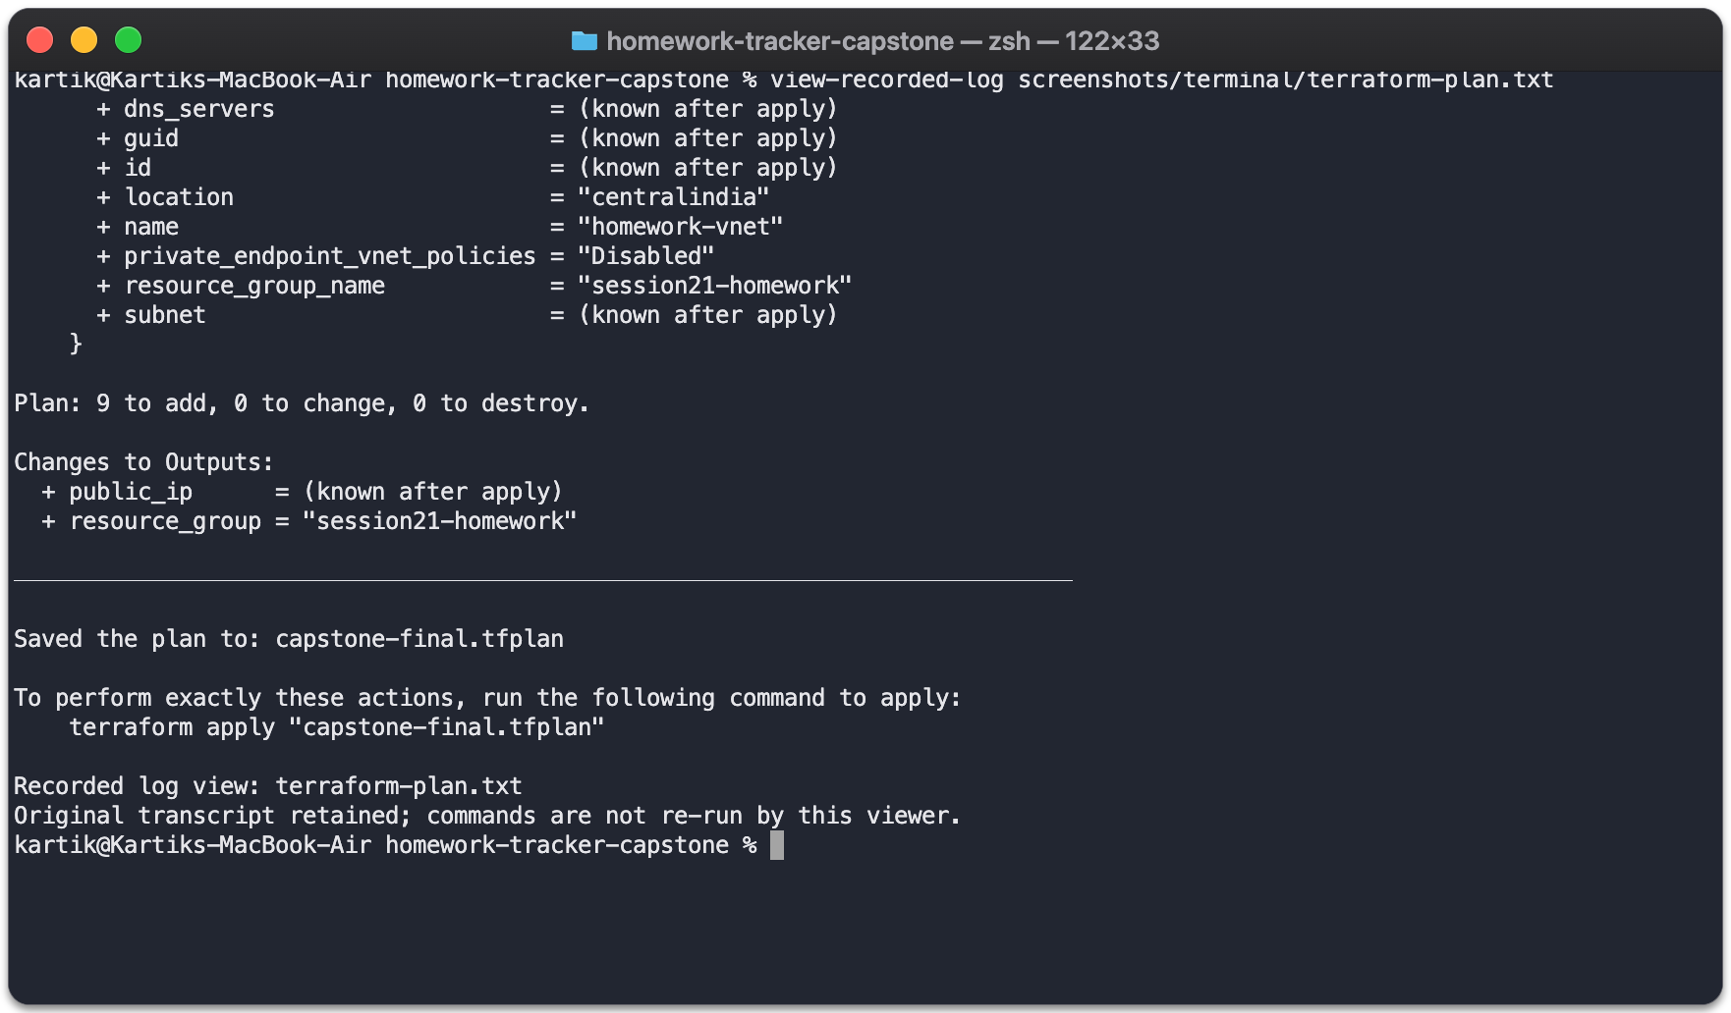
Terraform on Azure
VNet, subnet and restricted NSG
One Standard_B2als_v2 VM
K3s runs the Kubernetes workload
Kubernetes API access uses an SSH tunnel
Recorded Terraform plan viewed in Mac zsh
09
Notes:
Explain provider, variables, resources, outputs and state using terraform/. Azure/K3s is the implementation chosen for this project. The reference rubric specifies AWS VPC and EKS, so this is a substitution and instructor acceptance is not recorded. Never claim it is an EKS deployment. Sources: terraform/, docs/deployment.md, docs/course/requirements.md.

Slide 10
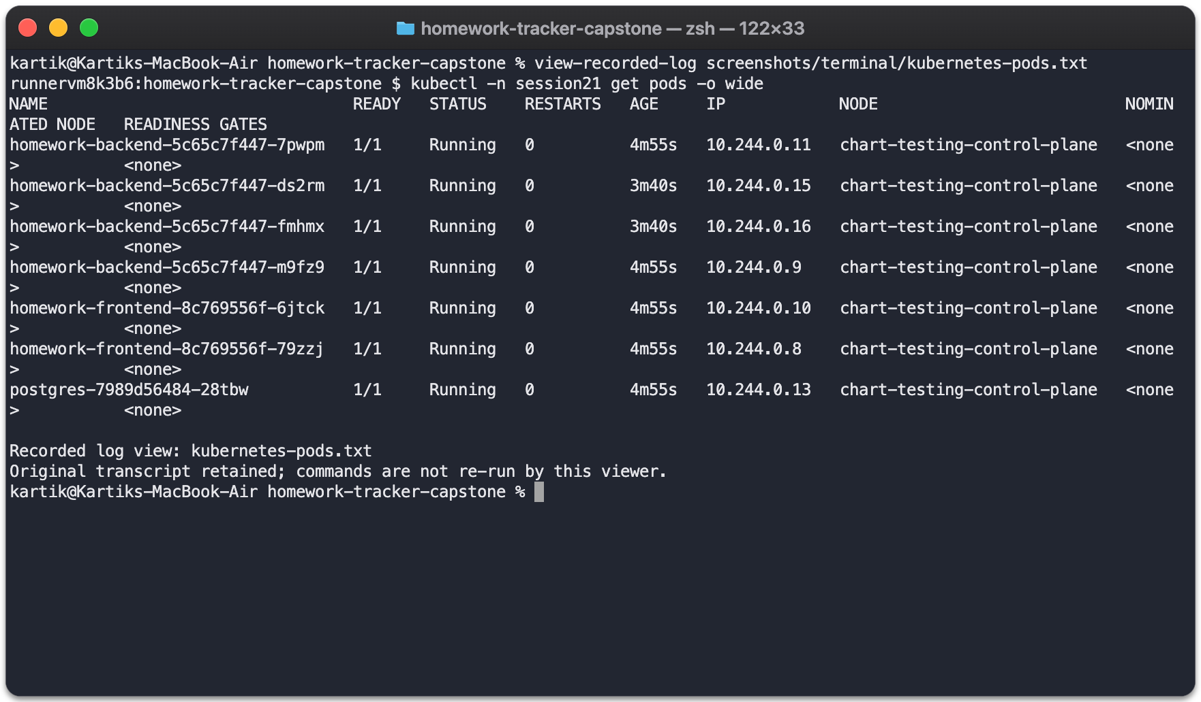
Kubernetes and Helm
Frontend and backend Deployments
ClusterIP Services and Ingress
ConfigMap, Secret and readiness probes
PostgreSQL PVC keeps application data
Recorded Pod status viewed in Mac zsh
10
Notes:
Show kubectl get pods, kubectl get svc and helm list for the project namespace in a live demo. Explain values.yaml and helm upgrade --install. CI checks the Helm release in Kind, while the cloud walkthrough shows K3s. Sources: helm/taskboard/, k8s/, docs/deployment.md, screenshots/terminal/kubernetes-pods.txt.

Slide 11
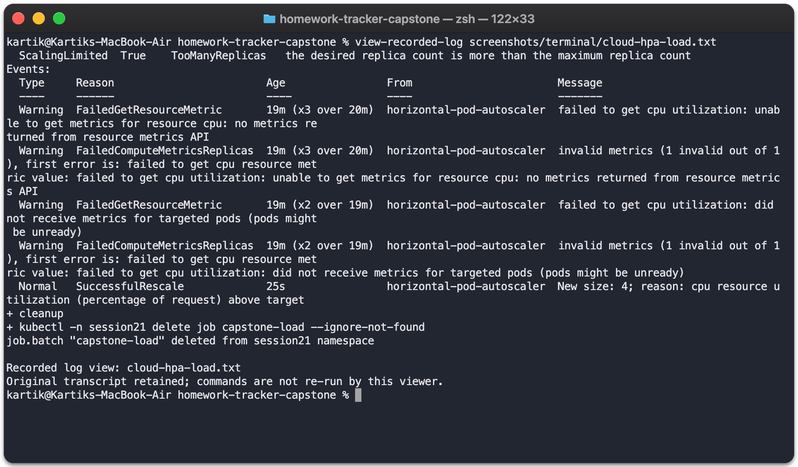
Autoscaling under load
HTTP load increases backend CPU use
HPA observes CPU metrics
Backend scaled from 2 to 4 Pods
The load test uses bounded duration
Recorded Azure HPA results viewed in Mac zsh
11
Notes:
Explain CPU requests, Metrics Server and the HPA target before showing the output. Refer to the cloud load recording at 02:34 in the walkthrough. Sources: screenshots/terminal/cloud-hpa-load.txt, scripts/load-test.sh, helm/taskboard/templates/.

Slide 12
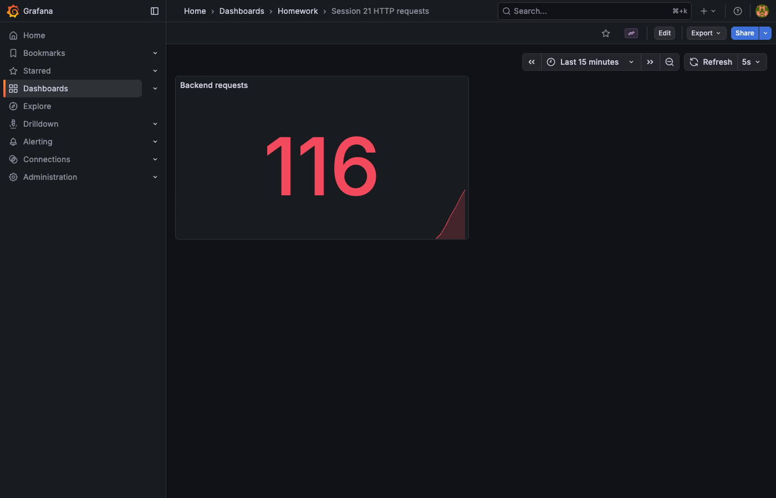
Prometheus and Grafana
FastAPI exposes /metrics
Prometheus scrapes the backend
The target reported UP
Grafana shows application request metrics
Grafana dashboard during the Azure demonstration
12
Notes:
Show the Prometheus Targets screenshot and its UP state, then explain a populated Grafana panel. Distinguish HTTP request metrics from container CPU metrics used by HPA. Sources: monitoring/, screenshots/terminal/cloud-prometheus-targets.png, screenshots/terminal/cloud-grafana-dashboard.png.

Slide 13
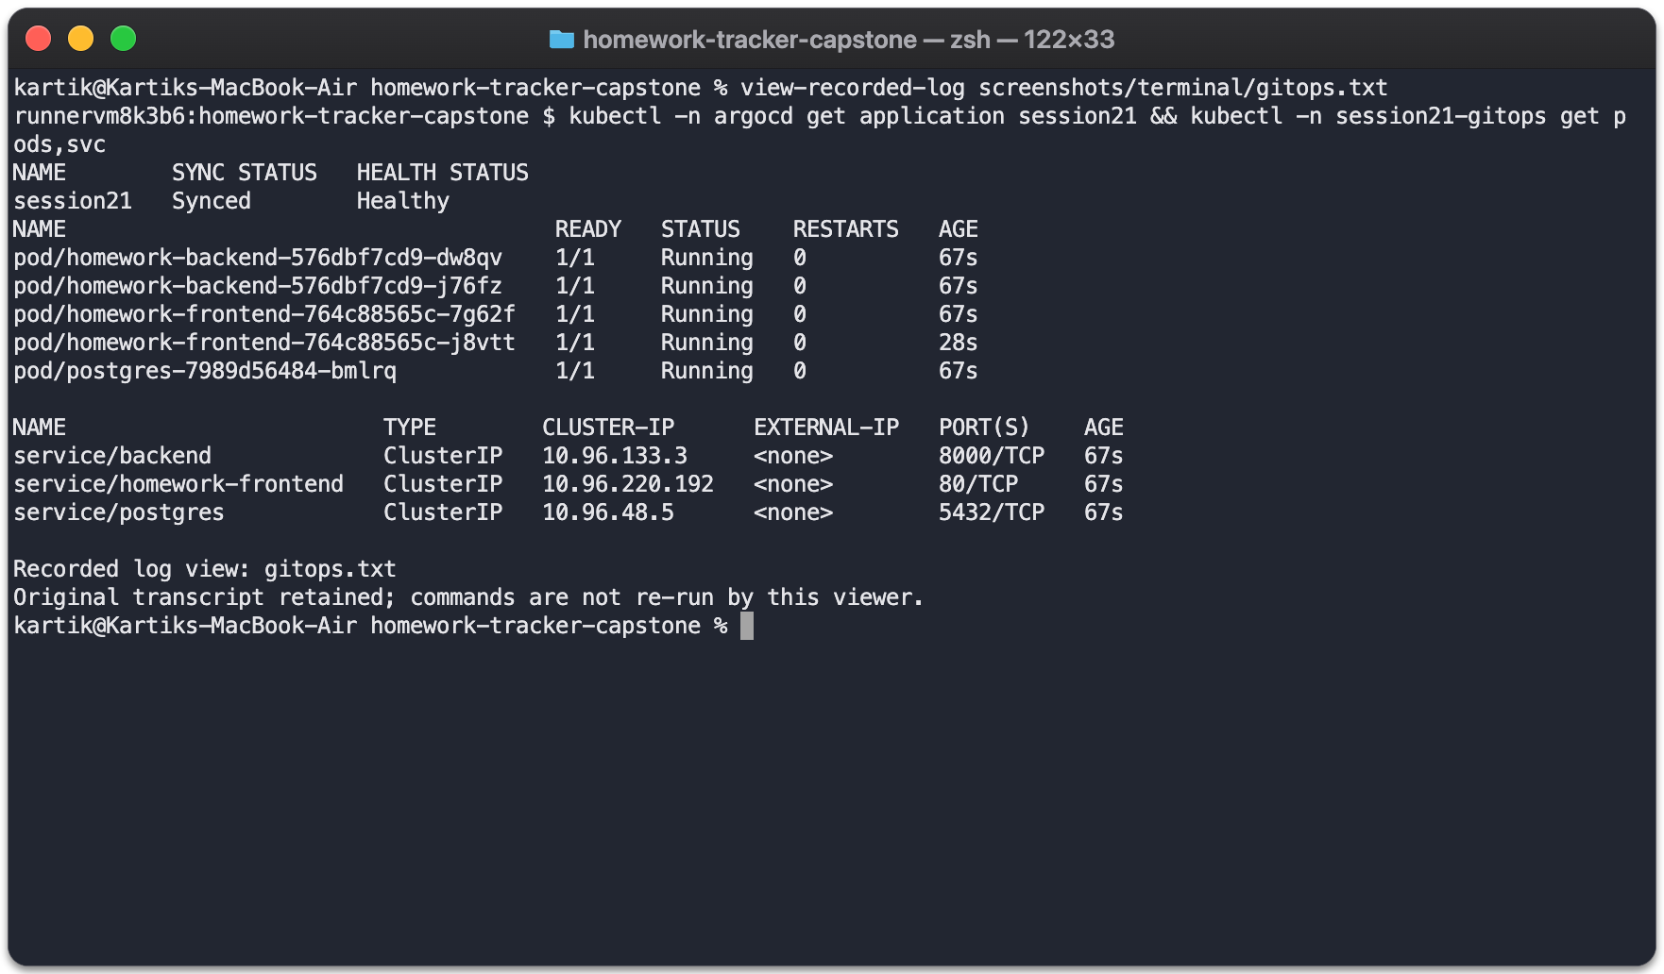
GitOps reconciliation
Git stores the declared configuration
Argo CD compares desired and live state
The CI exercise changes a replica count
Self-healing restores Synced and Healthy
Recorded isolated CI GitOps verification viewed in Mac zsh
13
Notes:
Explain the AppProject and Application manifests. The GitOps demonstration uses an isolated CI namespace and is not a claim of a continuously running Argo CD installation on Azure. Sources: gitops/, screenshots/verification/standalone-review-gitops.yaml, .github/workflows/ci-cd.yml.

Slide 14
Failure investigation and recovery
Invalid image tag: inspect Pod events, fix the tag, verify rollout
A first standalone recovery check failed
The corrected check passed in the successful run
Wrong Service selector: inspect labels and EndpointSlices, restore the selector, test HTTP
Both the failure and recovery records remain available
Early HTTP probe: retry for a bounded period while requiring a successful response
14
Notes:
Explain how events distinguish an image pull failure from a running Pod with no Service traffic. Show the recorded troubleshooting exercise, then the successful rerun. Sources: docs/troubleshooting.md, scripts/troubleshoot.sh, screenshots/terminal/cloud-troubleshooting.txt, screenshots/terminal/service-check-first-attempt.txt. Do not describe every issue as an accidental production incident.

Slide 15
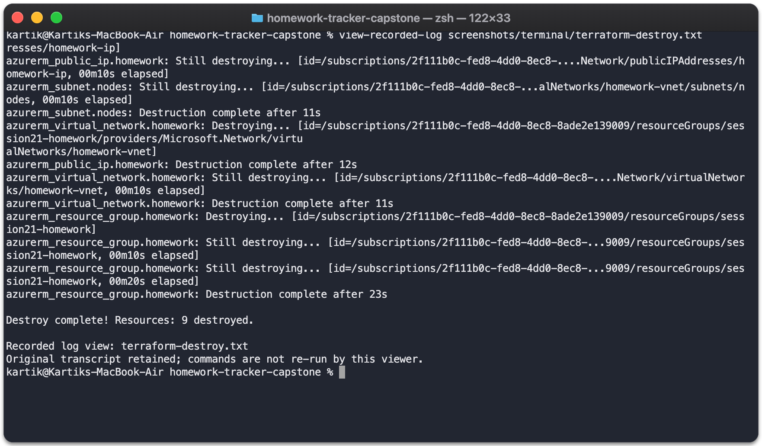
Cleanup and project limits
Terraform destroyed all 9 cloud resources
The saved group-existence check returned false
The Azure demo endpoint is no longer hosted
Authentication remains outside this classroom demo
Recorded Terraform destroy viewed in Mac zsh
15
Notes:
The cleanup result is historical evidence from October 2026, not a new Azure account audit. Explain why temporary infrastructure was removed and why a live cloud demo would require another provision. Sources: screenshots/terminal/terraform-destroy.txt, screenshots/terminal/azure-cleanup.txt, docs/verification.md.

Slide 16
Key learnings
Database readiness must come before application traffic
Pod readiness alone does not prove Service connectivity
SHA tags identify exactly which images were deployed
Inspect raw test failures and preserve recovery evidence
Destroy temporary cloud infrastructure after verification
16
Notes:
Explain one example for each lesson. These came from the migration test, initial Service timeout, release promotion and Terraform cleanup. Sources: docs/troubleshooting.md, docs/verification.md, .github/workflows/ci-cd.yml.

Slide 17
Presentation demo and references
Create an assignment and show the API and database
Repository and source code
Commit a small change, push and follow the pipeline
github.com/karttikjangid/homework-tracker-capstone
Verify the image SHA and deploy the approved release
Recorded walkthrough: docs/walkthrough.md
Check Ingress, autoscaling and monitoring
Instructor brief and rubric: docs/course/
Explain a failure, recovery and cleanup
17
Notes:
Use the existing walkthrough as supporting material. Live classroom presentation or a remote recording should explain each component. Demo order follows the instructor README Part O and GRADING.md M10. Sources: https://github.com/Nency-Ravaliya/devops-heros/blob/main/session21-python/README.md#part-o--final-demo and https://github.com/Nency-Ravaliya/devops-heros/blob/main/session21-python/GRADING.md#m10--final-presentation--documentation-5-points. Project walkthrough: https://github.com/karttikjangid/homework-tracker-capstone/blob/main/docs/walkthrough.md

