Slide 1
Software Solution for Movie Studio Management
Overview of a modular cloud native software solution.

Slide 2
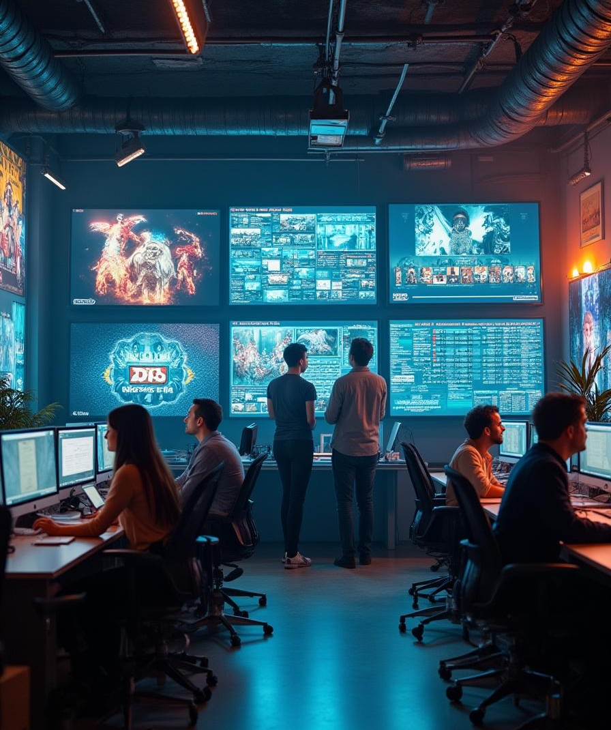
Introduction
Managing a movie studio involves complex workflows—from production planning and asset tracking to HR and access control. To streamline these operations, we’ve designed a modular, cloud-native solution built on SAP CAP best practices.
This solution ensures clear separation of concerns, offering dedicated modules for core functions while meeting critical non-functional requirements like multi-language support, mobile accessibility, and role-based security.
In this presentation, we’ll explore how our architecture delivers flexibility, scalability, and efficiency for modern studio management.

Slide 3
01
Software Solution Overview

Slide 4
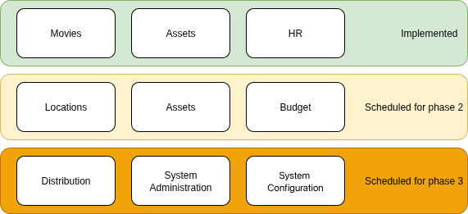
Modular, Cloud-Native Architecture
Our solution follows SAP CAP’s separation of concerns, with independent modules for core functions, ensuring scalability and maintainability.
Core Modules:
Movies
Assets
HR
Admin/Config
Cross-Cutting Features:
RBAC
I18n
Cloud-Native Deployment

Slide 5
Key Functional Modules
Movie Management - Add/edit movies, metadata, and production timelines.
Asset Tracking - Digital/physical asset lifecycle (scripts, props, contracts).
HR & Crew Management - Staff roles, schedules, payroll integration.
Admin & Configuration - studio-wide settings.

Slide 6
Built for Flexibility & Security
i18n: UI/UX supports multiple languages for global studios.
RBAC: Fine-grained permissions (e.g., "Editor", "Finance", “Director”, “Admin” etc.).
Mobile-Friendly: Responsive design for on-set access.
Cloud-Native

Slide 7
Fits Your Studio’s Ecosystem
Pre-built connectors for:
SAP S/4HANA (finance, procurement)
Adobe Suite (asset collaboration)
Azure AD (RBAC sync)
Possible connectors:
Artists DB
Casting agencies
Content distibutors
Assets leasing companies

Slide 8
Best Practices of SAP CAP Guidelines
Our solution adheres to SAP Cloud Application Programming (CAP) guidelines, ensuring scalability, robustness, and ease of use. By following these best practices, we can create an intuitive and professional environment that streamlines processes and enhances user experience across all modules.

Slide 9
02
Functional Requirements

Slide 10
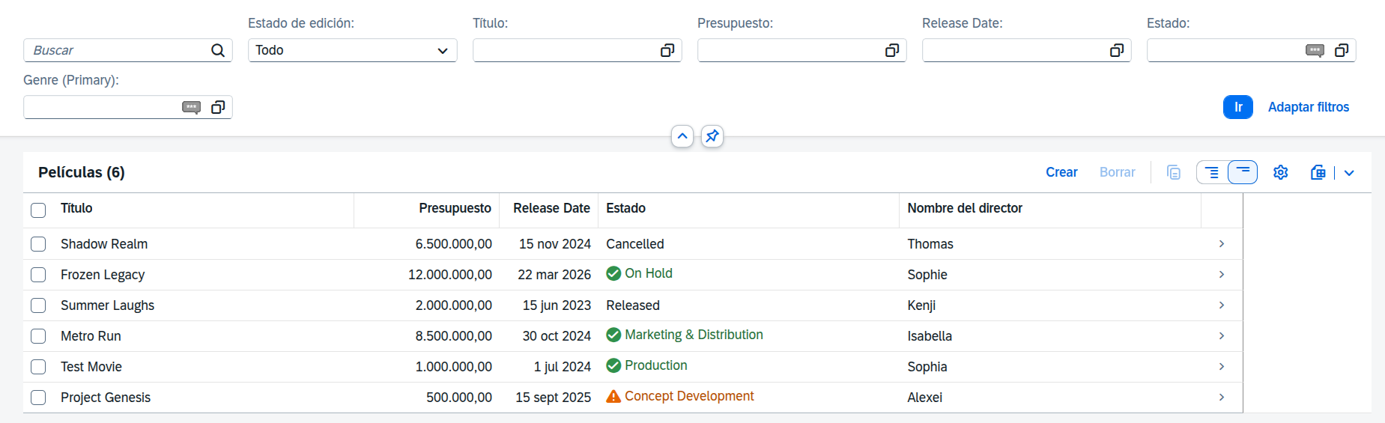
Adding/Modifying Movies
The application allows users to effortlessly add or modify movie entries. It supports inputting essential details such as title, genre, cast, and production notes, ensuring accurate database management. The intuitive interface also enables easy updates to existing movie information, promoting data integrity and effective resource management.

Slide 11
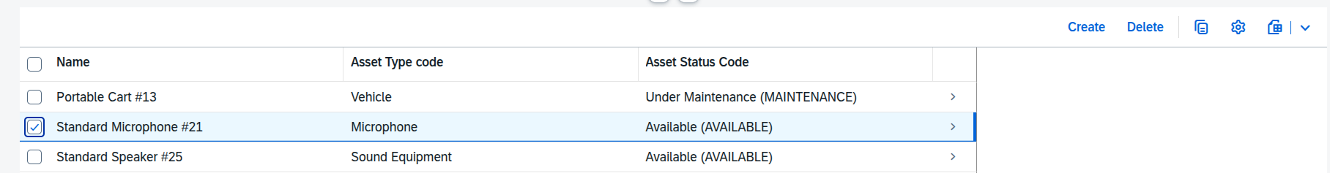
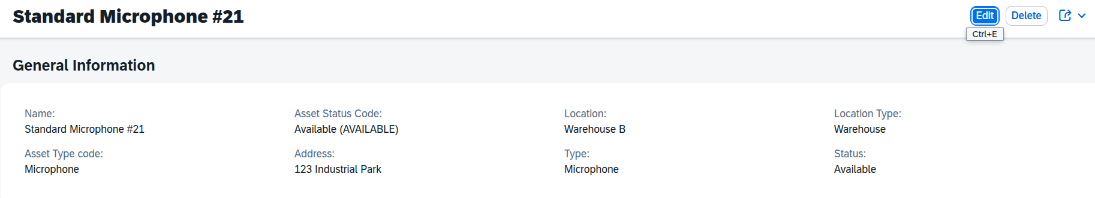
Asset Management
The asset management module provides comprehensive tools for tracking and organizing all studio assets, including props, costumes, and equipment. Users can easily categorize assets, and manage inventory, ensuring efficient resource allocation.
For next release it’s planned to enhance module by facilitating quick searches and reports, track usage frequency improving decision-making regarding asset utilization.

Slide 12
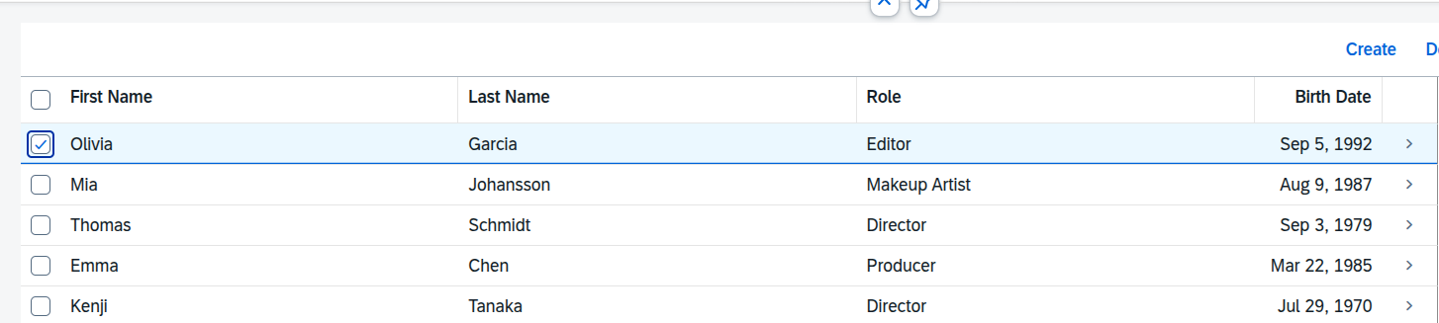
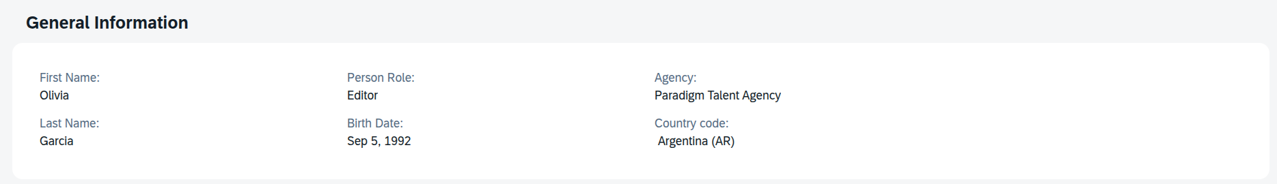
Human Resource Management
The human resource management module is designed to streamline staffing processes. It supports functionalities such as recruitment tracking, employee onboarding, and scheduling.

Slide 13
03
Non-Functional Requirements

Slide 14

Internationalization (i18n)
The software solution incorporates internationalization features, enabling support for multiple languages and localization options. This ensures that users from different regions can operate the application comfortably. By accommodating various languages and cultural formats, we enhance user accessibility and broaden the software's market potential.
Currently solution is translated into:
English
Russian
Spanish

Slide 15
Mobile-Friendly Design
A mobile-friendly design ensures that users can access the application seamlessly across all devices. The responsive interface adapts to different screen sizes, allowing for effective use on smartphones and tablets. This feature enhances user engagement and accessibility, making workflow flexible and efficient in various environments.

Slide 16
Role-Based Access Control (RBAC)
The RBAC module allows for precise control over user permissions and access levels within the system. Assigning roles ensures that users have access to only those features and data necessary for their responsibilities. This enhances security and compliance, protecting sensitive information while maintaining operational effectiveness.
Notes:
Ias screenshot

Slide 17
Cloud-Native Architecture
The cloud-native architecture enables scalability and high availability for the software solution. By leveraging cloud technologies, we ensure that resources can easily adjust to varying workloads. This architecture supports continuous deployment and integration, facilitating rapid updates and enhancing the overall system resilience.

Slide 18
Conclusions
The software solution for managing a movie studio is designed around the principles of modularity, scalability, and best practices. By addressing both functional and non-functional requirements, this solution meets the diverse needs of modern studios, enhancing efficiency in managing movies, assets, and human resources while ensuring a secure, user-friendly experience.

Slide 19
Thank you!
Do you have any questions?

