Slide 1
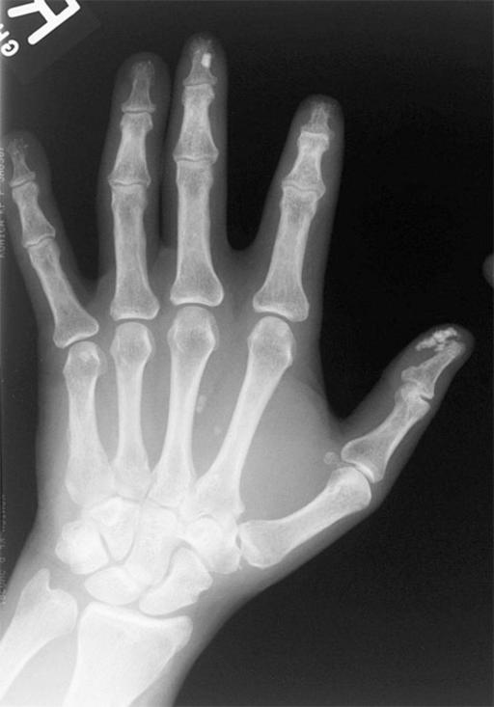
Title-goes-here
Notes:
Note-goes-here

