Slide 1


Introduction to Scope

Slide 2
Agenda:
What is Scope?
Benefits of Scope
HMVC design pattern
Scope components:
  Controllers and sub-controllers
  Models
  Views
    Scope’s “SObjects”
Making the MVC triangle
Mapping Model to View
Issuing and Handling Controls
Example Application
Why Scope is cool

Slide 3
What is Scope?
Scope is an open source framework built around an extensible implementation of the Hierarchical Model-View-Controller (HMVC) design pattern.
It provides an easy-to-use Java library that can be used as a basis for component-oriented application development following a layered architecture.

Slide 4
Benefits of Scope:
An HMVC implementation in which Controllers respond to Control objects issued from Views as a result of user interaction, or from child Controllers in the chain of responsibility.
Infrastructure for binding models to views with full two-way synchronisation: change the view and the model is updated, and vice-versa.
Wrappers around common Swing components to implement full data binding with validation.
Infrastructure that allows Scope to act on arbitrary JavaBean model objects. This infrastructure is designed to be decoupled in such a way that an alternative can be plugged in, for example to act on JMX MBeans.
An implementation of "active" model objects that broadcast changes in their state to allow views to update automatically. A set of "active" collection models are also provided. Use of these base classes is optional but convenient in complex applications that use a rich GUI, eg Swing, in which fully automated synchronisation between model and view is desirable. However, even where this is not feasible, Scope's Swing implementation without "active" models enables simple semi-automatic data-binding -- see the samples.
Support for localisation of user messages.
Support for conversion of arbitrary datatypes to and from their String representation.
A comprehensive unit test suite to ensure a known quality level.

Slide 5
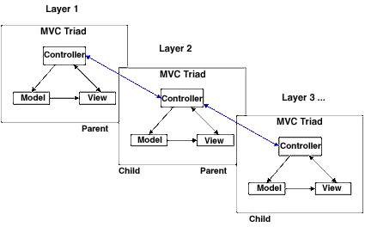
Hierarchical Model-View-Controller
The HMVC pattern decomposes the client tier into a hierarchy of parent-child MVC layers. The repetitive application of this pattern allows for a structured client-tier architecture.

Slide 6
Scope components
Controllers
  Controls
Models
View
Scope wrapper objects – “SObjects”

Slide 7
Scope Controller Objects
Controllers are created by extending the Scope API’s Basic Controller
Controllers have three responsibilities:
1. Set the model and the view (usually in the constructor)
public LoginController() {
setModel(new CheckoutModel());
setView(mainView);
}
2. Handle controls in the doHandleControl method
        protected void doHandleControl(Control inControl) throws ControlException {
        if (inControl.matchesID(VALIDATE_LOGIN)) {
        doValidateLogin();
        }
        }
Controllers respond to Control objects from two sources:
        Issued from Views as a result of user interaction
        Issued from child Sub-Controllers in the chain of responsibility
        Issued locally using the handleControl command
3. Startup
public void startup() {
        LoginView myView = (LoginView)getView();
        myView.setViewBounds(myView.CENTRED);
        showView(myView);
        }

Slide 8
Scope Sub-Controllers
The application main controller creates sub-controllers to control discrete modules.
  In a main controller, handle a control and then create a subcontroller to handle the functionality:
  protected void doHandleControl(Control inControl) throws ControlException {
  if (inControl.matchesID(LAUNCH)) {
  doLaunch();
  } else if (inControl.matchesID(NavTreeView.PATIENTSEARCH)) {
  showPatientSearch();
  }
  protected void showPatientSearch(){
  searchcontrol = new PatientSearchController((FoboLauncherView)getView());
  this.addChild(searchcontrol);
  searchcontrol.startup();
  }

Slide 9
Scope Model Objects
The Model Objects have variables to hold data from the screen components and methods to act on the data:
public class Hello2Model {
private String name;
public void setName(String inName) {
name = inName;
}
public String getName() {
return name;
}
public void changeNameToFred() {
setName("Fred");
}
}

Slide 10
Scope View Objects
Scope Views are the presentation layout only.
Data bearing components are Scope SObjects, objects which wrap Swing objects with the addition of data binding methods to associate SObjects with objects in the Scope model class.
There is no event handling in Scope Views. Scope view components issue controls which are intercepted by controllers and executed in models.
public class Hello2View1 extends SPanel {
public Hello2View1() {
setLayout(new BorderLayout(12, 12));
JLabel l = new JLabel("What's your name?");
add(l, BorderLayout.WEST);
STextField t = new STextField();
t.setColumns(20);
t.setSelectorString("name");
t.setControlID(Hello2Controller.GOT_NAME);
add(t, BorderLayout.EAST);
add(new SButton(Hello2Controller.CHANGE_TO_FRED), BorderLayout.SOUTH);
}
}

Slide 11


Slide 12
Scope SObjects
Scope version .9 supports these wrapper objects to provide automatic binding with the model class:
SButton
SCheckBox
SComboBox
SComboBoxEditor
SComboBoxModel
SDefaultTableCellRenderer
SLabel
SList
SListCellRenderer
SListModel
SMenuItem
SPanel
SPasswordField
SRadioButton
SSingleListSelection
SSlider
STable
STableModel
STableTextCellEditor
STextArea
STextCellEditor
STextField
SUnboundPanel
JList
JComboBox
JTable

Slide 13
Making the MVC triangle
The controller or sub-controller sets its model and view, linking the two.
  public PatientSearchController(FoboLauncherView mainView) {
  setModel(new PatientSearchModel());
  setView(mainView);
  }

Slide 14
Mapping Model to View
    Step 1: In the Model, provide a “SelectorString” for the screen component:
public class HelloModel {
private String name;//this is the selectorstring for a name STextfield
public void setName(String inName) {
name = inName;
}
public String getName() {
return name;
}
}

Slide 15
Mapping Model to View
    Step 2: In the View, associate the model selectorstring with the Swing component:
STextField t = new STextField();
t.setColumns(20);
t.setSelectorString("name");//associate this component with a variable called name in the model
add(t, BorderLayout.EAST);

Slide 16
Issuing and Handling Controls
From a View, a control can be fired via:
  issueControl(new ControlID(“SAVE”));
  Sbutton save = new SButton(SwingFormController.SAVE_FORM);
  STextField name = new STextField();
name.setControlID("SAVE");
From a Controller or Sub-Controller:
handleControl(new ControlID(“SAVE”);

Slide 17
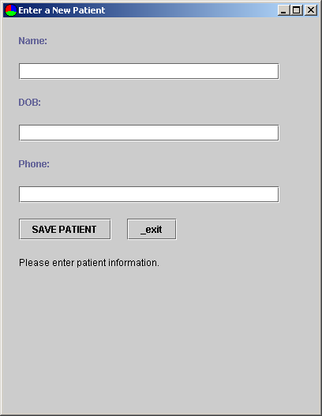
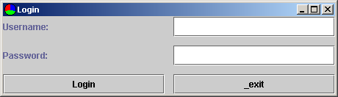
Example Application

Slide 18
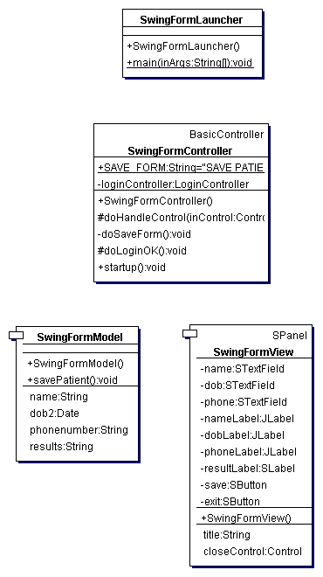
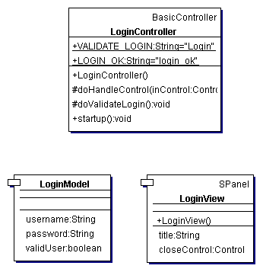
Example Application
subcontroller

Slide 19
Why Scope is Cool
The Scope framework provides many application functions:
  Textfield validation
  Built in logging
  The ability to “bubble up” controls to the main controller
  Easy to get data from screens
  Easy to populate data to screens
  Event handling is separated from presentation

