Slide 1
Communicating research results
Shem Kuyah
Head of Research and Innovations,
Jomo Kenyatta University of Agriculture and Technology (JKUAT)
DGM - COHRED Sensitization Workshop. Assembly Hall. 24 April 2024

Slide 2



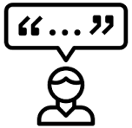

Scientific communication
Aims to bridge the gap between scientists and the public
Is primarily achieved through writing
Why do we write?
To be read
To be understood
To be followed
To be cited
To influence
Attitudes and practices
Create awareness
Raise interest
Inform policy

Slide 3
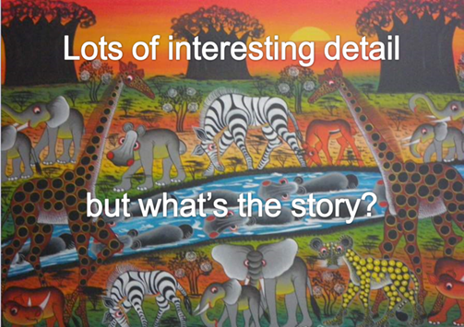
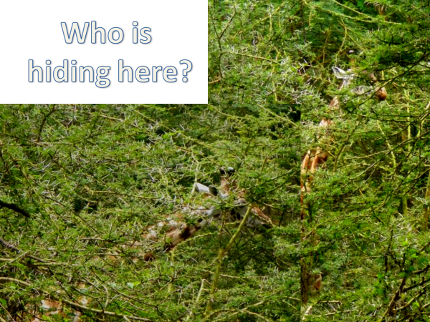
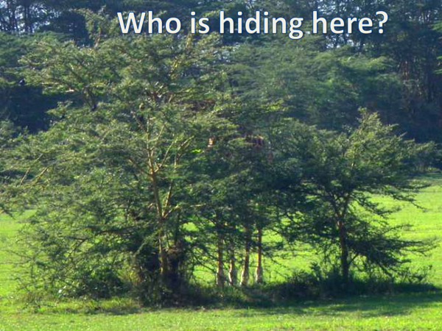
How to realize impact
The story
Ways to transport ideas
The story
The story
Ways to transport ideas
What is the story?
What is the story?
What is the story?
Images: Meine van Noordwijk

Slide 4
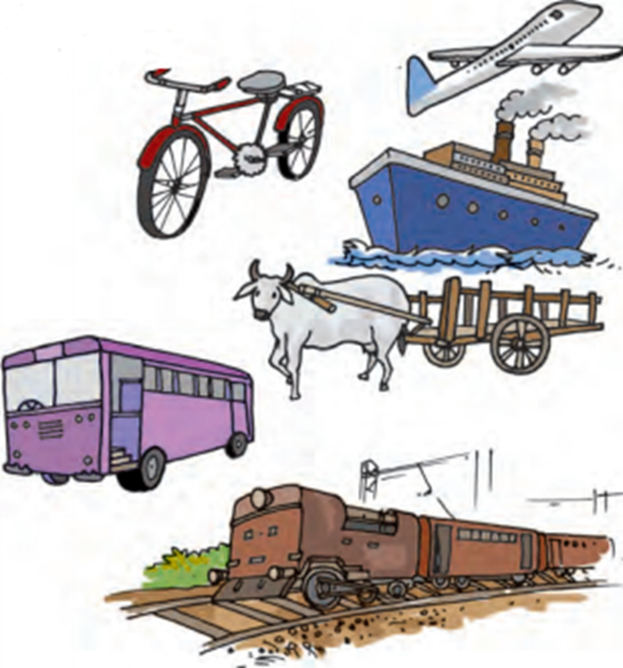
How to realize impact
Ways to transport ideas
Emphasis 1. Timely dissemination
Rapid submission of manuscripts
Rapid publication of submitted manuscripts
Emphasis 2. Amplifying impact
Social media
Rapid dissemination is needed for timely application of research
Many ways to transport ideas, some are faster

Slide 5
Some hints for writing
Schedule specific times to write
Start with whatever part you find easiest
Set small targets (time, or words) and be consistent
Switch projects if you get bored or stuck
Don’t interrupt the writing to search for small details
Explore internal (peer) reviews
Know when to stop and submit
Avoid redundant publication

Slide 6
Some hints for writing
Select 2-3 journal early
Read guidelines before writing, when writing, before submission
Scout for fee-waiver or discount for OA publication.
Avoid questionable journals
Try publisher’s journal finder, suggester
Collaboration and the power of synergies
Capitalize on corporate intelligence
Possibility for open access

Slide 7
Hints to continue writing
Become a peer reviewer
Improves your research and writing
Broadens knowledge; you stay updated
Build new networks for collaborations
Consider systematic reviews
Establish state of existing knowledge
Identify areas for further research
Boosts your authority, gets you cited
Join a journal club
Attend write-shops
Attend conferences, seminars
Joint grant writing teams.
Systematic reviews and meta-analyses have several benefits
Advance knowledge in an area
Establish the state-of-the art
Identify areas for further research
Identify flaws in scientific writing
Provide evidence for practice and policy-making
Join a team of subject experts
Boosts your authority, citations

Slide 8
Grant writing
Explore the types of projects funded in your area
Create a list of call for proposals, their focus, dates
Allows an early start; contact with program official
Build a database of concept notes, or ideas for research
Reach out to collaborators with your ideas
Look for complementary skills and expertise
Join experienced researchers
Review the funder’s requirements and guidelines to align your project to the priorities of the funder

Slide 9
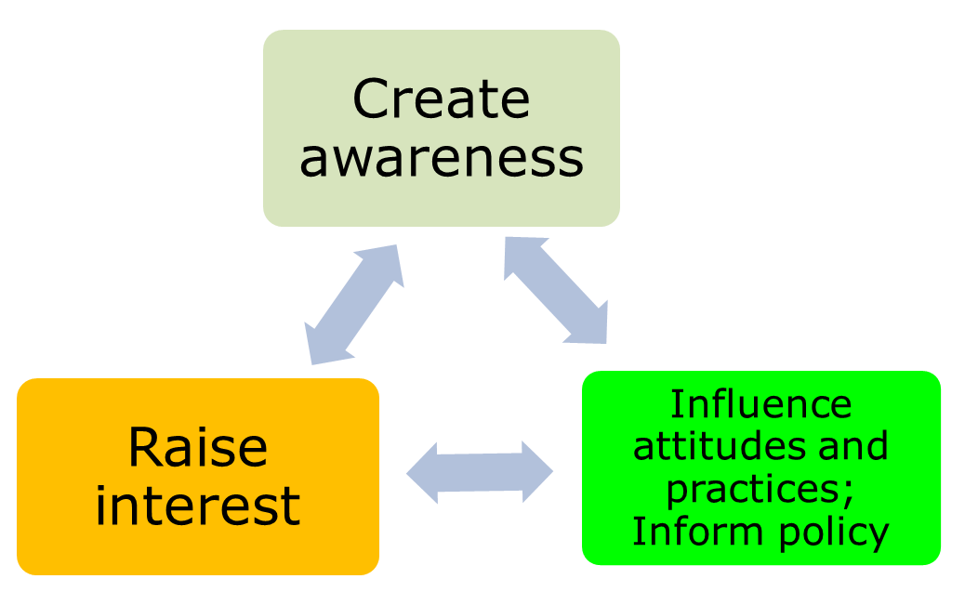
Thank You
Contact details
Directorate of research and Innovations,
Jomo Kenyatta University of Agriculture and Technology
Nairobi, Kenya
Email: kshem@jkuat.ac.ke
Research: Director.research@jkuat.ac.ke

