Slide 1
Introduction
Support vector machines were invented by V. Vapnik and his co-workers in 1970s in Russia and became known to the West in 1992.
SVMs are linear classifiers that find a hyperplane to separate two class of data, positive and negative.
Kernel functions are used for nonlinear separation.
SVM not only has a rigorous theoretical foundation, but also performs classification more accurately than most other methods in applications, especially for high dimensional data.
It is perhaps the best classifier for text classification.
CS583, Bing Liu, UIC

Slide 2
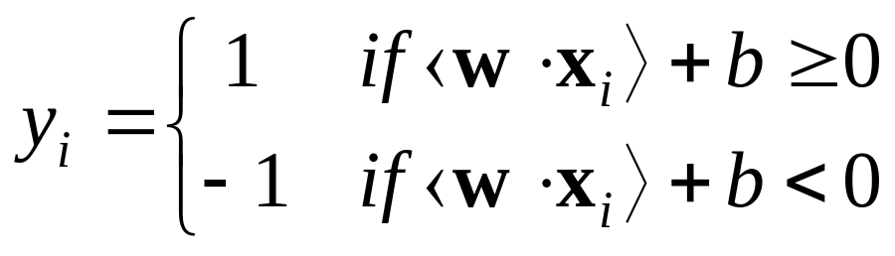
Basic concepts
Let the set of training examples D be
{(x₁, y₁), (x₂, y₂), …, (x_{n}, y_{n})},
where x_{i} = (x₁, x₂, …, x_{r}) is an input vector in a real-valued space X ⊆ R^{r} and y_{i} is its class label (output value), y_{i} ∈ {1, -1}.
1: positive class and -1: negative class.
SVM finds a linear function of the form (w: weight vector)
f(x) = ⟨w ⋅ x⟩ + b
CS583, Bing Liu, UIC

Slide 3
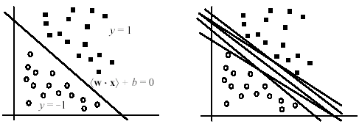
The hyperplane
The hyperplane that separates positive and negative training data is
⟨w ⋅ x⟩ + b = 0
It is also called the decision boundary (surface).
So many possible hyperplanes, which one to choose?
CS583, Bing Liu, UIC

Slide 4
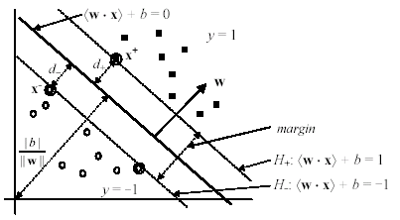
Maximal margin hyperplane
SVM looks for the separating hyperplane with the largest margin.
Machine learning theory says this hyperplane minimizes the error bound
CS583, Bing Liu, UIC

Slide 5

Linear SVM: separable case
Assume the data are linearly separable.
Consider a positive data point (x⁺, 1) and a negative (x⁻, -1) that are closest to the hyperplane
<w ⋅ x> + b = 0.
We define two parallel hyperplanes, H₊ and H₋, that pass through x⁺ and x⁻ respectively. H₊ and H₋ are also parallel to <w ⋅ x> + b = 0.
CS583, Bing Liu, UIC

Slide 6
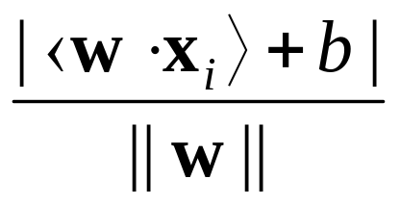
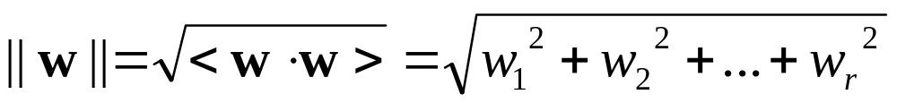
Compute the margin
Now let us compute the distance between the two margin hyperplanes H₊ and H₋. Their distance is the margin (d₊ + d₋ in the figure).
Recall from vector space in algebra that the (perpendicular) distance from a point x_{i} to the hyperplane ⟨w ⋅ x⟩ + b = 0 is:
where ||w|| is the norm of w,
(36)
(37)
CS583, Bing Liu, UIC

Slide 7
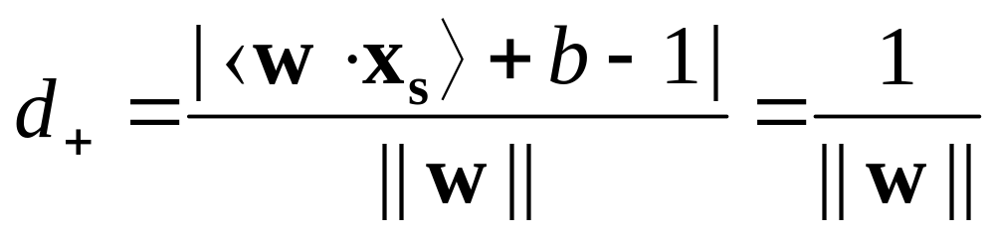
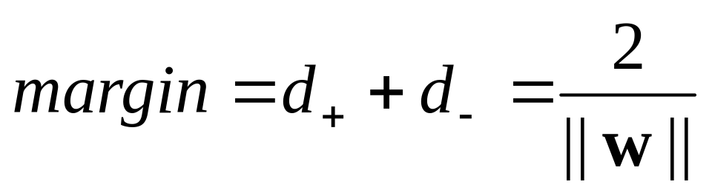
Compute the margin (cont …)
Let us compute d₊.
Instead of computing the distance from x⁺ to the separating hyperplane ⟨w ⋅ x⟩ + b = 0, we pick up any point x_{s} on ⟨w ⋅ x⟩ + b = 0 and compute the distance from x_{s} to ⟨w ⋅ x⁺⟩ + b = 1 by applying the distance Eq. (36) and noticing ⟨w ⋅ x_{s}⟩ + b = 0,
(38)
(39)
CS583, Bing Liu, UIC

Slide 8
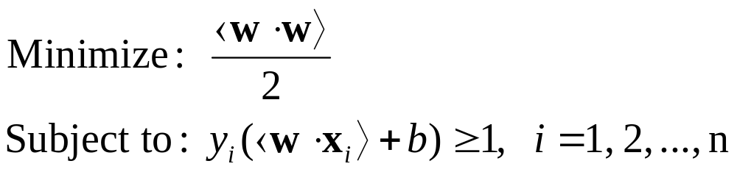

A optimization problem!
Definition (Linear SVM: separable case): Given a set of linearly separable training examples,
D = {(x₁, y₁), (x₂, y₂), …, (x_{n}, y_{n})}
Learning is to solve the following constrained minimization problem,
summarizes
⟨w ⋅ x_{i}⟩ + b ≥ 1 for y_{i} = 1
⟨w ⋅ x_{i}⟩ + b ≤ -1 for y_{i} = -1.
(40)
CS583, Bing Liu, UIC

Slide 9
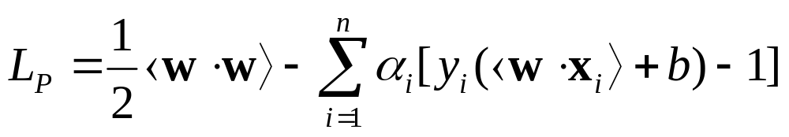
Solve the constrained minimization
Standard Lagrangian method
where α_{i} ≥ 0 are the Lagrange multipliers.
Optimization theory says that an optimal solution to (41) must satisfy certain conditions, called Kuhn-Tucker conditions, which are necessary (but not sufficient)
Kuhn-Tucker conditions play a central role in constrained optimization.
(41)
CS583, Bing Liu, UIC

Slide 10

Linear SVM: Non-separable case
Linear separable case is the ideal situation.
Real-life data may have noise or errors.
  Class label incorrect or randomness in the application domain.
Recall in the separable case, the problem was
With noisy data, the constraints may not be satisfied. Then, no solution!
CS583, Bing Liu, UIC

Slide 11
Relax the constraints
To allow errors in data, we relax the margin constraints by introducing slack variables, ξ_{i} (≥ 0) as follows:
⟨w ⋅ x_{i}⟩ + b ≥ 1 − ξ_{i} for y_{i} = 1
⟨w ⋅ x_{i}⟩ + b ≤ −1 + ξ_{i} for y_{i} = -1.
The new constraints:
Subject to: y_{i}(⟨w ⋅ x_{i}⟩ + b) ≥ 1 − ξ_{i}, i =1, …, n,
ξ_{i} ≥ 0, i =1, 2, …, n.
CS583, Bing Liu, UIC

Slide 12
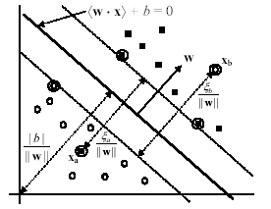
Geometric interpretation
Two error data points x_{a} and x_{b} (circled) in wrong regions
CS583, Bing Liu, UIC

Slide 13
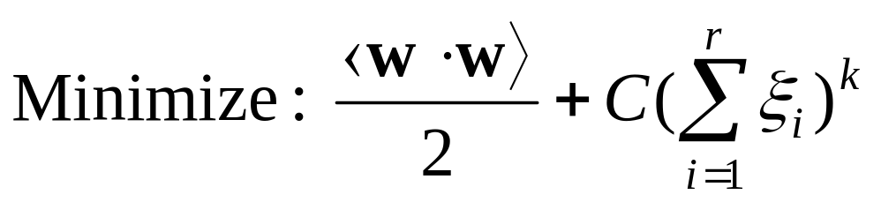
Penalize errors in objective function
We need to penalize the errors in the objective function.
A natural way of doing it is to assign an extra cost for errors to change the objective function to
k = 1 is commonly used, which has the advantage that neither ξ_{i} nor its Lagrangian multipliers appear in the dual formulation.
(60)
CS583, Bing Liu, UIC

Slide 14
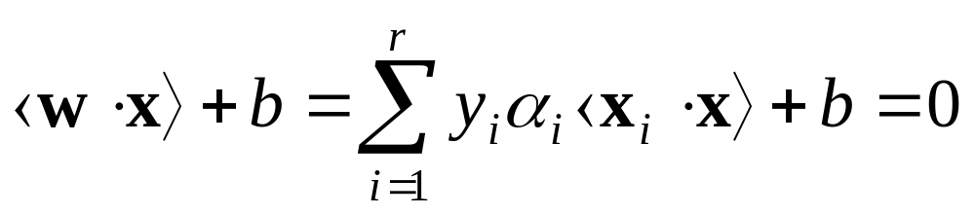
The final decision boundary
The final decision boundary is (we note that many α_{i}’s are 0)
The decision rule for classification (testing) is the same as the separable case, i.e.,
sign(⟨w ⋅ x⟩ + b).
Finally, we also need to determine the parameter C in the objective function. It is normally chosen through the use of a validation set or cross-validation.
(75)
CS583, Bing Liu, UIC

Slide 15
How to deal with nonlinear separation?
The SVM formulations require linear separation.
Real-life data sets may need nonlinear separation.
To deal with nonlinear separation, the same formulation and techniques as for the linear case are still used.
We only transform the input data into another space (usually of a much higher dimension) so that
  a linear decision boundary can separate positive and negative examples in the transformed space,
The transformed space is called the feature space. The original data space is called the input space.
CS583, Bing Liu, UIC

Slide 16
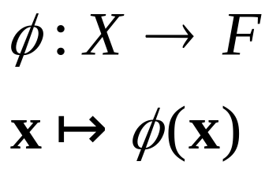
Space transformation
The basic idea is to map the data in the input space X to a feature space F via a nonlinear mapping φ,
After the mapping, the original training data set {(x₁, y₁), (x₂, y₂), …, (x_{r}, y_{r})} becomes:
{(φ(x₁), y₁), (φ(x₂), y₂), …, (φ(x_{r}), y_{r})}
(76)
(77)
CS583, Bing Liu, UIC

Slide 17
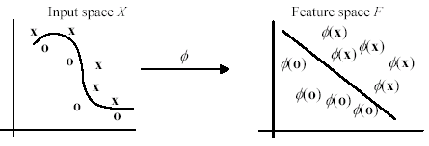
Geometric interpretation
In this example, the transformed space is also 2-D. But usually, the number of dimensions in the feature space is much higher than that in the input space
CS583, Bing Liu, UIC

Slide 18
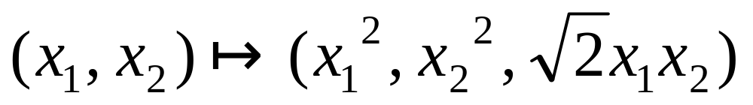
An example space transformation
Suppose our input space is 2-dimensional, and we choose the following transformation (mapping) from 2-D to 3-D:
The training example ((2, 3), -1) in the input space is transformed to the following in the feature space:
((4, 9, 8.5), -1)
CS583, Bing Liu, UIC

Slide 19
Kernel functions
We notice that in the dual formulation both
  the construction of the optimal hyperplane (79) in F and
  the evaluation of the corresponding decision function (80)
  only require dot products ⟨φ(x) ⋅ φ(z)⟩ and never the mapped vector φ(x) in its explicit form. This is a crucial point.
Thus, if we have a way to compute the dot product ⟨φ(x) ⋅ φ(z)⟩ using the input vectors x and z directly,
  no need to know the feature vector φ(x) or even φ itself.
In SVM, this is done through the use of kernel functions, denoted by K,
K(x, z) = ⟨φ(x) ⋅ φ(z)⟩
(82)
CS583, Bing Liu, UIC

Slide 20
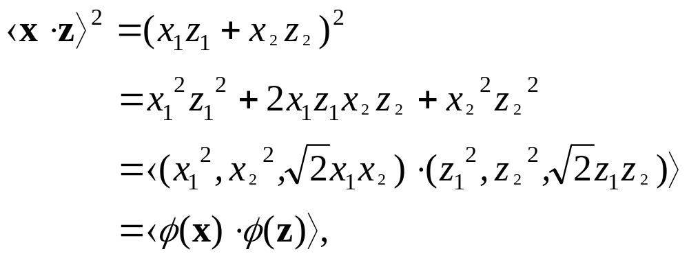
An example kernel function
Polynomial kernel
K(x, z) = ⟨x ⋅ z⟩^{d}
Let us compute the kernel with degree d = 2 in a 2-dimensional space: x = (x₁, x₂) and z = (z₁, z₂).
This shows that the kernel ⟨x ⋅ z⟩² is a dot product in a transformed feature space
(83)
(84)
CS583, Bing Liu, UIC

Slide 21
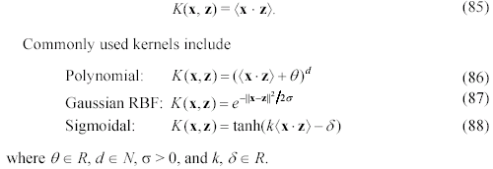
Commonly used kernels
It is clear that the idea of kernel generalizes the dot product in the input space. This dot product is also a kernel with the feature map being the identity
CS583, Bing Liu, UIC

Slide 22
Some other issues in SVM
SVM works only in a real-valued space. For a categorical attribute, we need to convert its categorical values to numeric values.
SVM does only two-class classification. For multi-class problems, some strategies can be applied, e.g., one-against-rest, and error-correcting output coding.
The hyperplane produced by SVM is hard to understand by human users. The matter is made worse by kernels. Thus, SVM is commonly used in applications that do not required human understanding.
CS583, Bing Liu, UIC

