Slide 1

MDaS Bootcamp
Fall 2023
Karuna Bhaila, Alycia Carey, Xintao Wu

Slide 2
MDaS Bootcamp Day 1
*Slides heavily adapted from https://open.ed.ac.uk/introduction_to_python/

Slide 3
Structure
Divided into two 1.5h sessions.
Try to follow within your notebook and run all examples shown.
Python programming is often a 3-hour course.

Slide 4

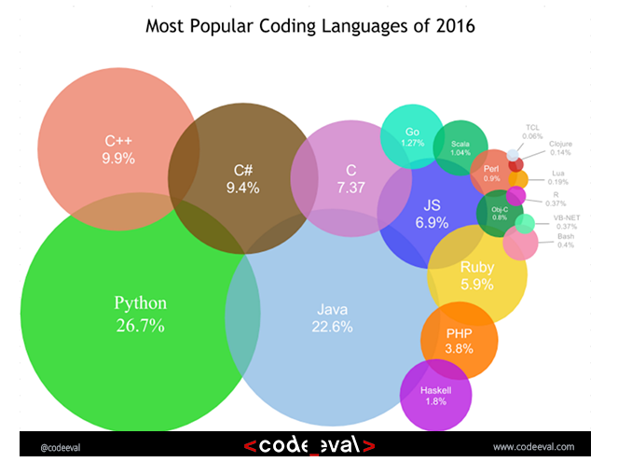
History
Started by Guido Van Rossum as a hobby
Now widely spread
Open Source! Free!
Versatile
Guido Van Rossum by Doc Searls on Flickr CC-BY-SA

Slide 5
Python today
Developed a large and active scientific computing and data analysis community
Now one of the most important languages for
Data science
Machine learning
General software development
Packages: NumPy, pandas, matplotlib, SciPy, scikit-learn, statsmodels
Notes:
Why choose it instead of MATLAB, R, SAS, Stata and others?
- It is free and open source
- Intuitive and easy to learn
- Extremely versatile – examples – websites, planes, robots, data
- Large and friendly community
- packages
Very important in industry and academia

Slide 6
Usage Modes
IPython
Python can be run interactively
Used extensively in research
2. Python scripts
What if we want to run more than a few lines of code?
Then we must write text files in .py
Notes:
Python has 2 modes of running
- IPython stands for Interactive Python
Python can be interpreted – good for a calculator
Live demo!

Slide 7
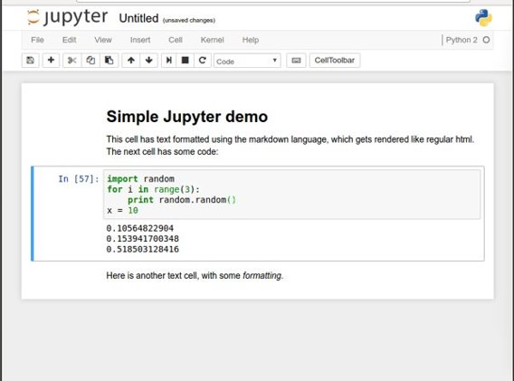
Jupyter notebooks
Easy to use environment
Web-based
Combines both text and code into one
Come with a great number of useful packages
Notes:
We will be using Noteable, just another service Jupyter Notebooks. It is free and open source
Web environment focused at Python
Easy to use – nice gui and no setup required
Block based. Has blocks which execute the code within it. Single type only
Allows to combine text and code into same page. Helps with readability

Slide 8


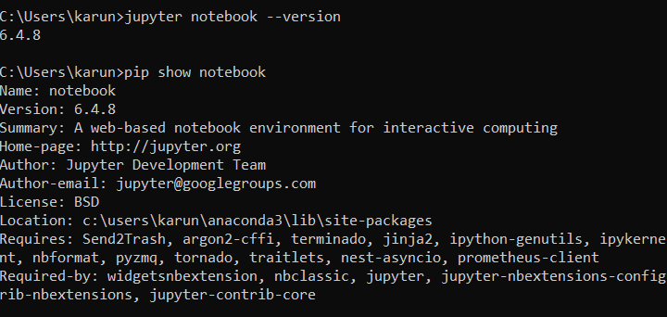
Install Python and Notebook
Instructions in readme
Install Python from https://www.python.org/downloads/
Check Python installation
Install jupyter notebook using pip

Slide 9
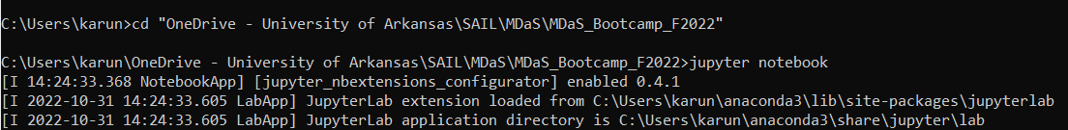
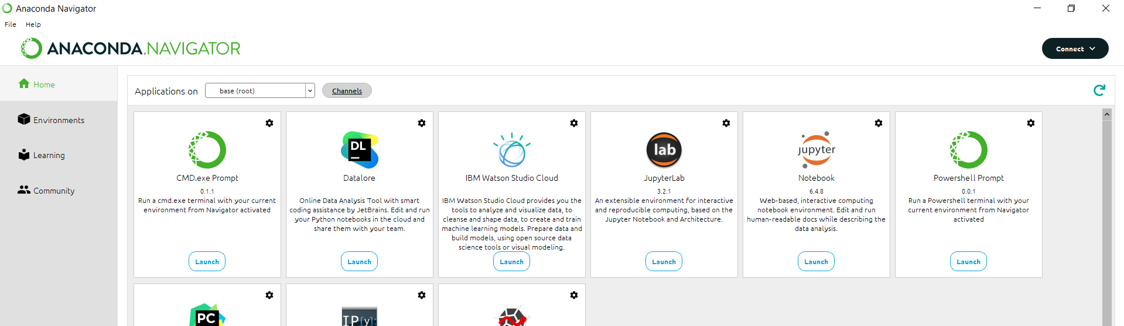
Starting Jupyter Notebook
From Command Prompt
Navigate to project folder and type command: jupyter notebook
From Anaconda

Slide 10
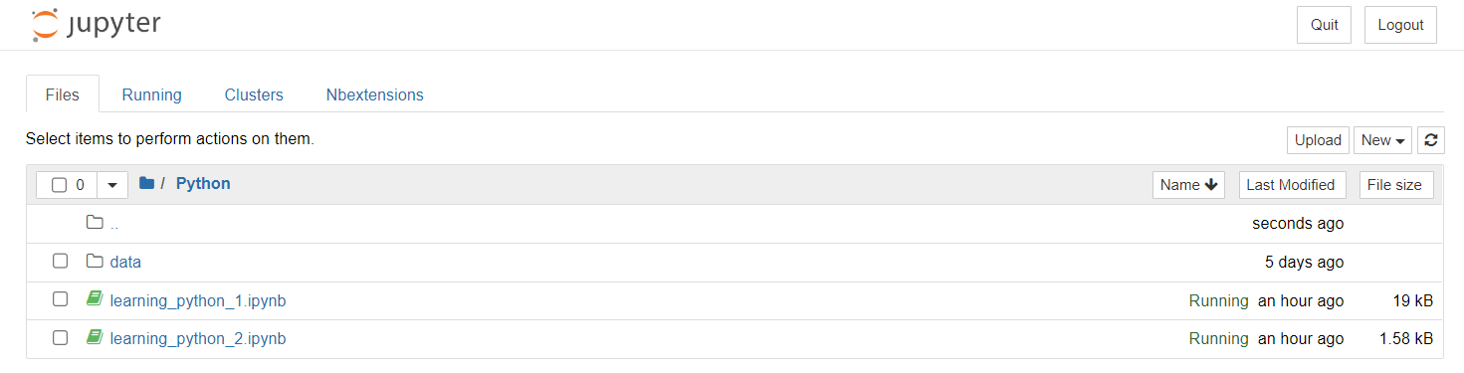
Folders/Upload/Rename

Slide 11

Notebook Toolbar
Stop execution
Save
Cut, copy
paste
Block type
New block
Move block
Reset block
And clear output
Notes:
Autosave

Slide 12
Running cells/blocks
Some shortcuts
Ctrl + Enter – runs current cell
Shift + Enter – runs current cell and goes to next cell
Alt + Enter – runs current cell and inserts new cell below
Esc + a – creates a new cell above current cell
Esc + b – creates a new cell above current cell
Esc + m – turns current cell into a markdown cell
Esc + y – turns current cell into a code cell
Esc + x/c – cut/copy current cell
Esc + v – paste cell
Esc + d – delete cell
Notes:
Run button but its best with shortcut Shift + Return/Enter
Alt + Return/Enter which creates a new block after the on you are currently on.

Slide 13
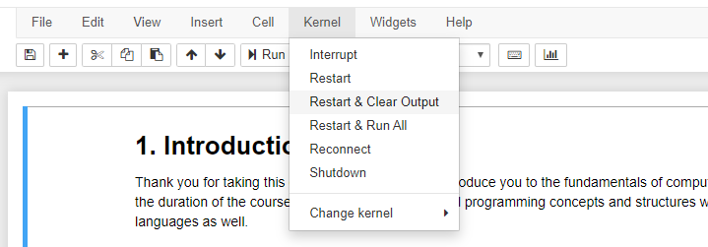
Kernel/Restart & Clear output

Slide 14
Agenda
Variables
Types
Operators: Arithmetic, Logical, and Comparison
Printing
Lists and Sets
Conditionals
Files
Functions
Packages – Numpy, Pandas
Data Preprocessing

Slide 15

Python as a calculator
Let us calculate the distance between Edinburgh and London in km
Notes:
Let's run our first block.
That's great
Writing numbers is very tedious
Run this in your notebooks
How can we improve that?

Slide 16
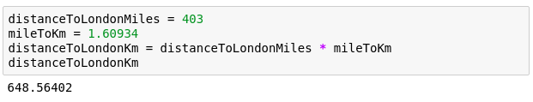

Variables
Great calculator but how can we make it store values?
Do this by defining variables
Can later be called by the variable name
Variable names are case sensitive and unique
We can now reuse the variable mileToKm in the next block without having to define it again!
Notes:
Can we save values? By defining a variable.
Can have values assigned
Variables must be declared and can then be called by name.
Code example
Check the code yourself

Slide 17
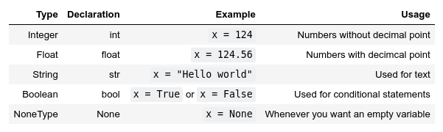
Types
Variables actually have a type, which defines the way it is stored.
The basic types are:
Notes:
So far - storing values in memory; how exactly are they stored?
defined by the type.
Go over all types

Slide 18
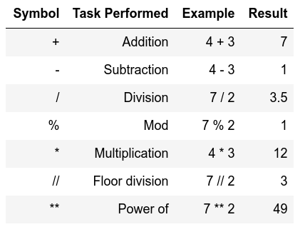
Arithmetic operations
Similar to actual Mathematics
Order of precedence is the same as in Mathematics
We can also use parenthesis ()
Notes:
Note of order precedence.
Table doesn't show this
Should be intuitive for all of you.

Slide 19
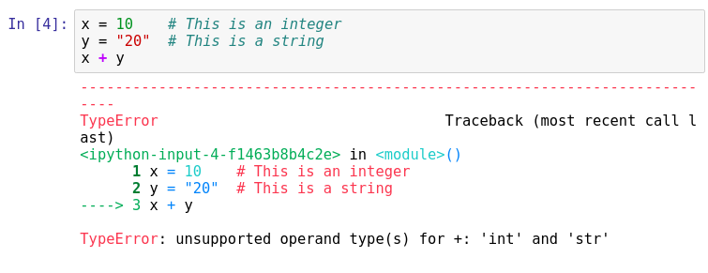
Arithmetic operations
Important lesson to remember!
We can't do arithmetic operations on variables of different types. Therefore, make sure that you are always aware of your variable types!
You can find the type of a variable using type()

Slide 20

Casting types
Luckily, Python offers us a way of converting variables to different types!
Casting – the operation of converting a variable to a different type
Similar methods exist for other data types: int(), float(), str()
Notes:
Casting – the operation of converting a variable to a different type
Let's try it on the previous code snippet.
Take note that this works only in a sensible way!

Slide 21
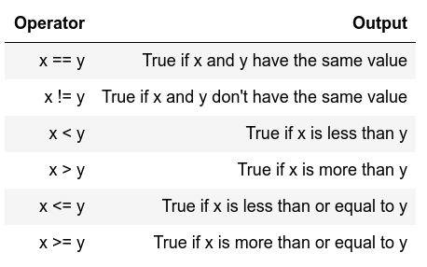
Comparison operators
Return Boolean values (i.e. True or False)
Used extensively for conditional statements

Slide 22
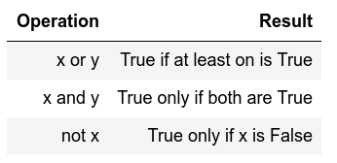
Logical operators
Allows us to extend the conditional logic
Will become essential later on

Slide 23
Printing
When writing scripts, your outcomes aren't printed on the terminal.
Thus, you must print them yourself with the print() function.
Beware to not mix up the different type of variables!

Slide 24
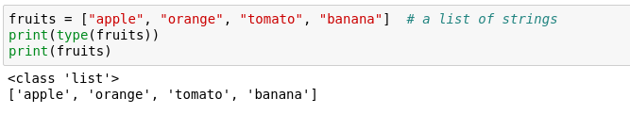
Lists
One of the most useful concepts
Group multiple variables together (a kind of container!)
Are mutable
Notes:
lots of data of the same type?
example, various fruits.
Can be grouped in a list
Allows us to process data as a group. Write a manipulation once, do it many times.
I.e. to find the sugar content of each fruit.

Slide 25

Indexing and Slicing
Indexing
Accessing items within a data structure
Indexing a list is not very intuitive...
The first element of a list has an index 0
Slicing
Obtain a particular set of sub-elements from a data structure.
Very useful and flexible.
Notes:
How to access?
called indexing - not very intuitive.
get a particular item using square brackets

Slide 26
Sets
Effectively lists that can't contain duplicate items
Similar functionality to lists but immutable
Can't be indexed or sliced
Can be created with {} or you can convert a list to a set
Notes:
Essentially a list of unique items

Slide 27

For loop
Allows us to iterate over a set amount of variables within a data structure. During that we can manipulate each item however we want
Indentation is important here!
Notes:
lists and others are useful when loops
Loops allow us to iterate over containers
For loops are the more controllable
Code explanation
Item is a subset of itemList

Slide 28
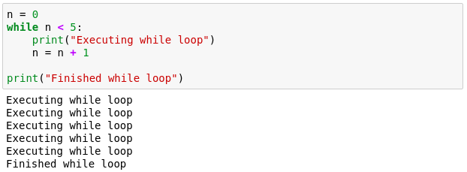
While loop
Another useful loop. Similar to the for loop.
A while loop doesn't run for a predefined number of iterations, like a for loop. Instead, it stops as soon as a given condition becomes true/false.
Notes:
While less controllable than for
Manual control inside.
We must tell it when to stop
While loop that executes 5 times

Slide 29

If Else
Fundamental building block of software
Conditional statement
Executed if answer is True
Executed if answer is False
Notes:
ask very politely "Do you really want to close me", answers Yes and No that is essentially a if-else block.
press Yes the program closes else, you press no and the program continues.
All programs build on if-else blocks, a lot of if-else blocks
The expression in the brackets after the if is the boolean evaluation expression.
If True, execute the code between if and else, if False execute code after else.

Slide 30
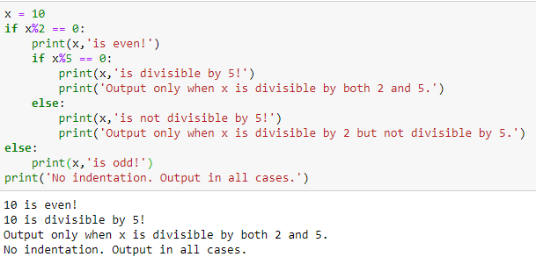
Indentation matters!
Code is grouped by its indentation
Indentation is the number of whitespace or tab characters before the code.
If you put code in the wrong block, then you will get unexpected behaviour
Notes:
What is indentation? amount of whitespace or tab characters in front of your code.
important in Python because it groups blocks of code together

Slide 31
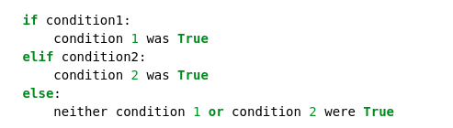
Extending if-else blocks
We can add infinitely more if statements using elif
elif = else + if which means that the previous statements must be false for the current one to evaluate to true
Notes:
extend if block to many different conditions.
done with the elif
previous statements have been false and the current condition is true then execute the current elif block.
Relevant bitcoin example in your code.

Slide 32
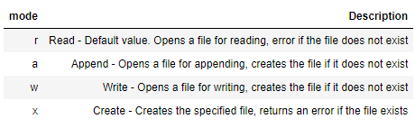
Files
Open files
Open text file with built-in open() function
Specify the location of file starting from the current working directory
Also specify the mode to open the file in
Close files
Using close() method
You should always close your files, in some cases, due to buffering, changes made to a file may not show until you close the file.

Slide 33
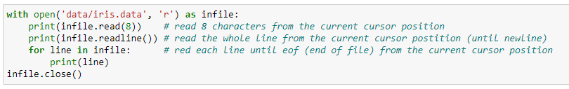
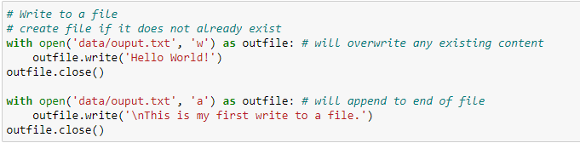

Files
Read only
Open files with ‘r’ mode
Read $n$ characters or a whole line
Write to files
Open files with ‘w’ or ‘a’ mode

Slide 34
MDaS Bootcamp Day 2
*Slides heavily adapted from https://www.cis.upenn.edu/~cis1920/tliu/f21/

Slide 35
Agenda
Variables
Types
Operators: Arithmetic, Logical, and Comparison
Printing
Lists and Sets
Conditionals
Files
Functions
Packages – Numpy, Pandas, Matplotlib
Data Preprocessing

Slide 36
Functions
Allow us to package functionality in a nice and readable way
Reuse it without writing it again
Make code modular and readable
Rule of thumb - if you are planning on using very similar code more than once, it may be worthwhile writing it as a reusable function.
Notes:
Print() is actually a function that we have been using

Slide 37
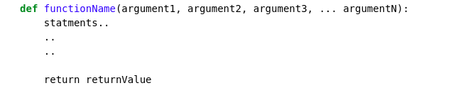
Function declaration
Functions accept arguments and execute a piece of code
Often, they also return values (the result of their code)
keyword
Any number of arguments
[Optional] Exits the function and returns some value

Slide 38
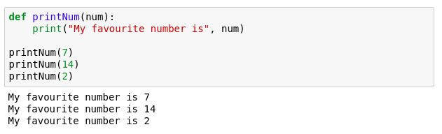

Function example
Write a function to scale a value between a range
$$\frac{\left(val−src\left[0\right]\right)}{src\left[1\right]−src\left[0\right]}∗(dst\left[1\right]−dst[0])+dst[0]$$
Function declaration
Function call
Notes:
Quick print statement

Slide 39
Global & Local variables
Global variables
Not defined inside any function instance
Global scope
Accessible everywhere inside program
Local variables
Defined inside a function instance
Scope is limited to the function only
Accessible only inside the function
Notes:
Quick print statement

Slide 40
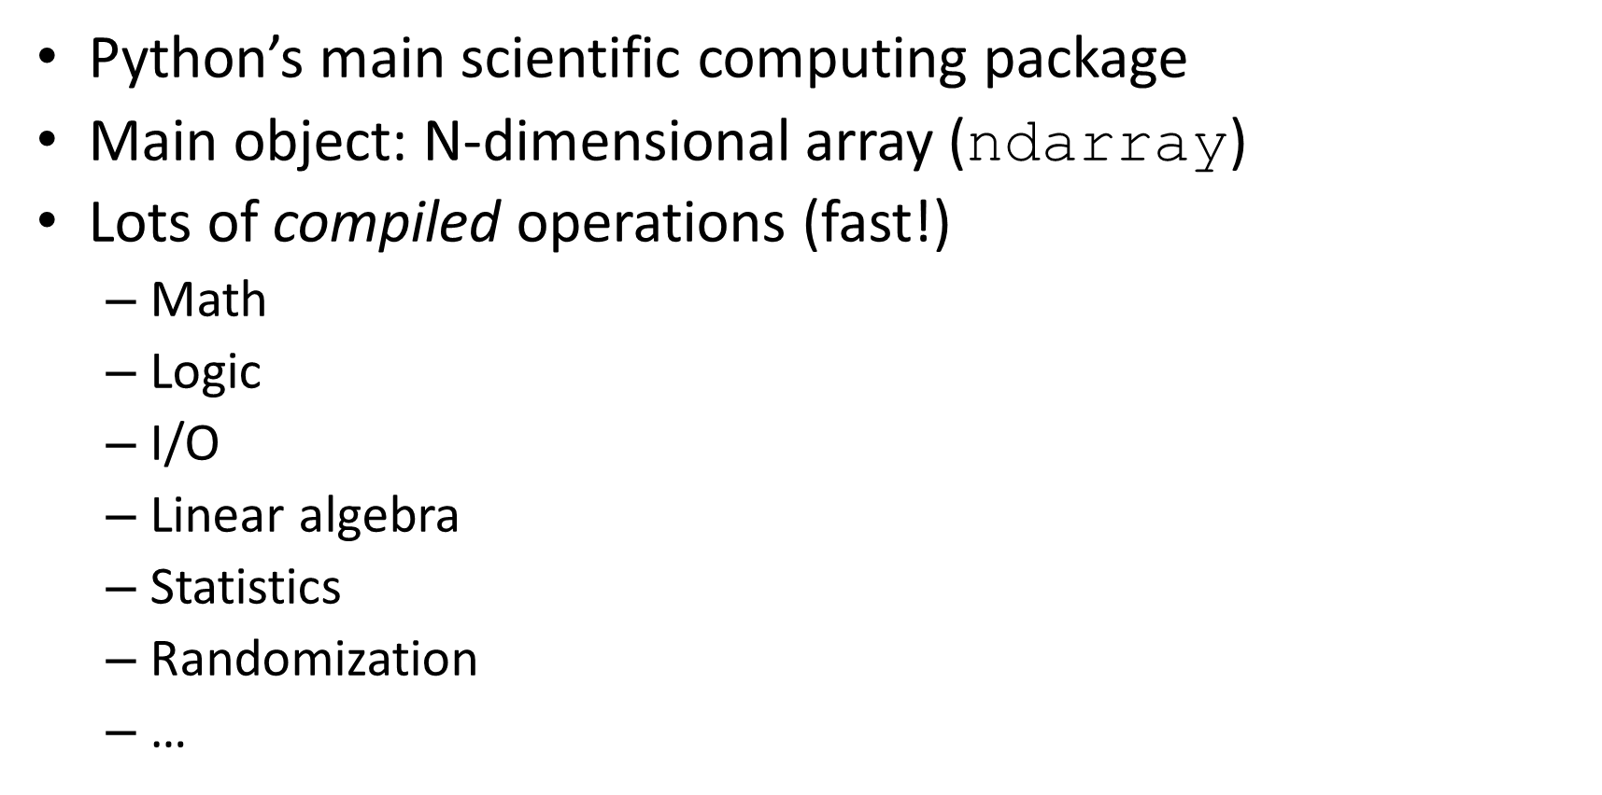
NumPy
Python’s main scientific computing package
Main object: N-dimensional array ($\text{ndarray}$)
Lots of compiled operations (fast!)
Math
Logic
I/O
Linear algebra
Statistics
Randomization
…

Slide 41
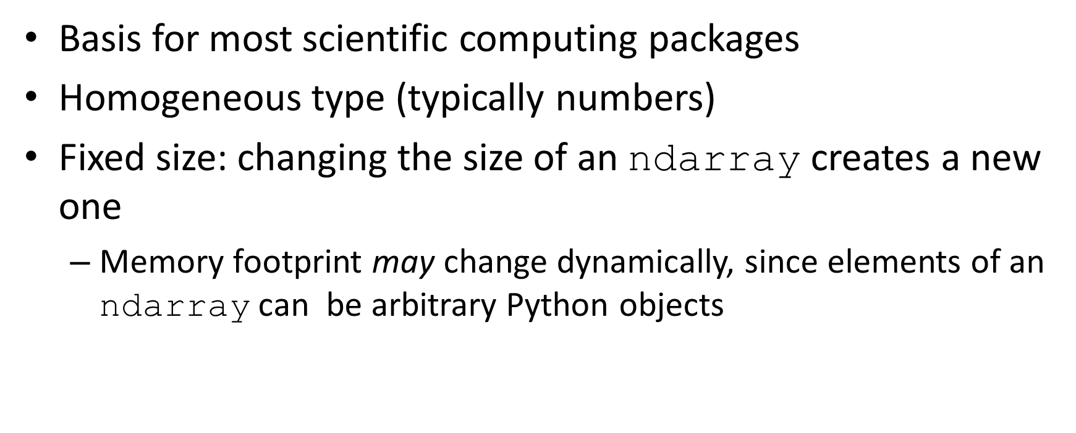
$$\text{ndarray}$$
Basis for most scientific computing packages
Homogeneous type (typically numbers)
Fixed size: changing the size of an $\text{ndarray}$ creates a new one
Memory footprint may change dynamically, since elements of an $\text{ndarray}$ can be arbitrary Python objects

Slide 42
$$\text{ndarray}$$
Supports advanced operations on large amounts of data with less code and more efficiently
Element-by-element operations (+, -, *, ...) are default
Each dimension is an axis
In a 2darray, rows are on axis 0 and columns are on axis 1

Slide 43
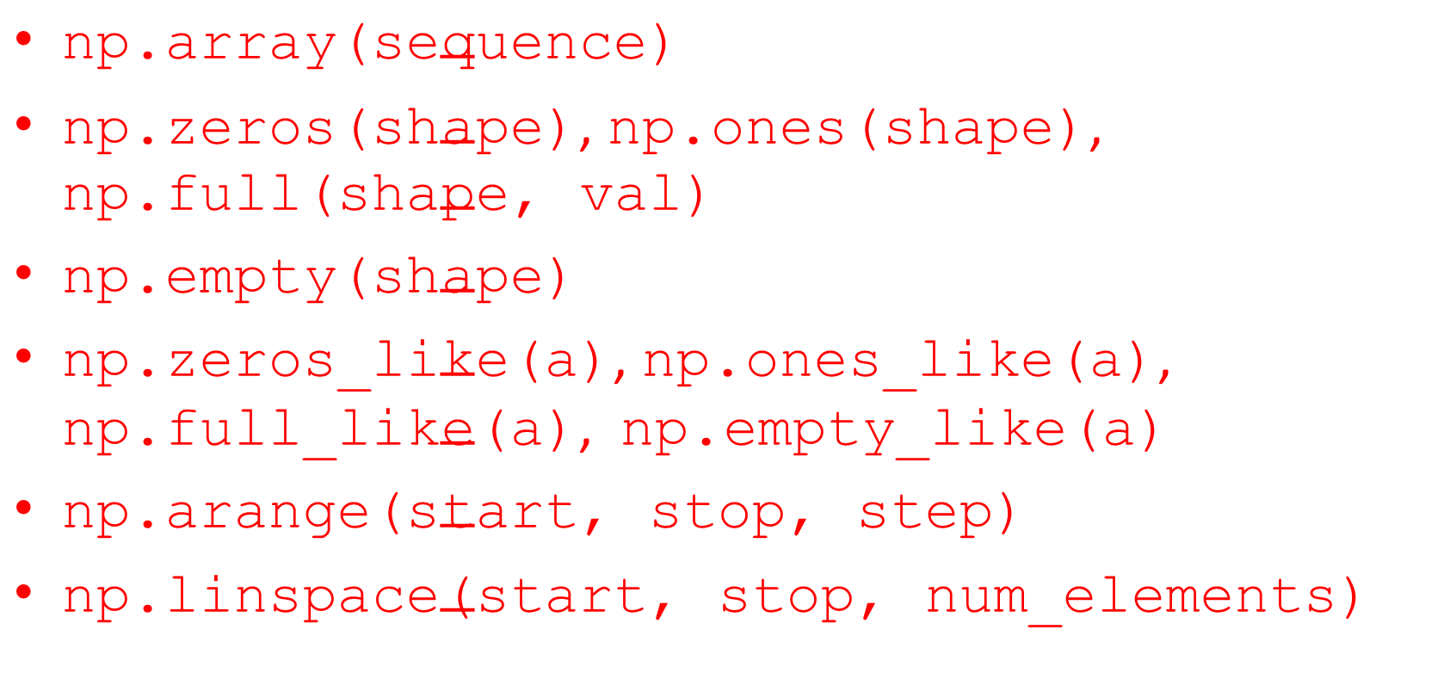
Creating arrays
$\text{np}\text{.}\text{array}\text{(}\text{sequence}\text{)}$
$\text{np}\text{.}\text{zeros}\text{(}\text{shape}\text{)}\text{, }\text{np}\text{.}\text{ones}\text{(}\text{shape}\text{)}\text{, }\text{np}\text{.}\text{full}\text{(}\text{shape}\text{, }\text{val}\text{)}$
$\text{np}\text{.}\text{empty}\text{(}\text{shape}\text{)}$
$\text{np}\text{.}\text{zeros}\text{_}\text{like}\text{(}\text{a}\text{)}\text{, }\text{np}\text{.}\text{ones}\text{_}\text{like}\text{(}\text{a}\text{)}\text{, }\text{np}\text{.}\text{full}\text{_}\text{like}\text{(}\text{a}\text{)}\text{, }\text{np}\text{.}\text{empty}\text{_}\text{like}\text{(}\text{a}\text{)}$
$\text{np}\text{.}\text{arange}\text{(}\text{start}\text{, }\text{stop}\text{, }\text{step}\text{)}$
$\text{np}\text{.}\text{linspace}\text{(}\text{start}\text{, }\text{stop}\text{, }\text{num}\text{_}\text{elements}\text{)}$

Slide 44
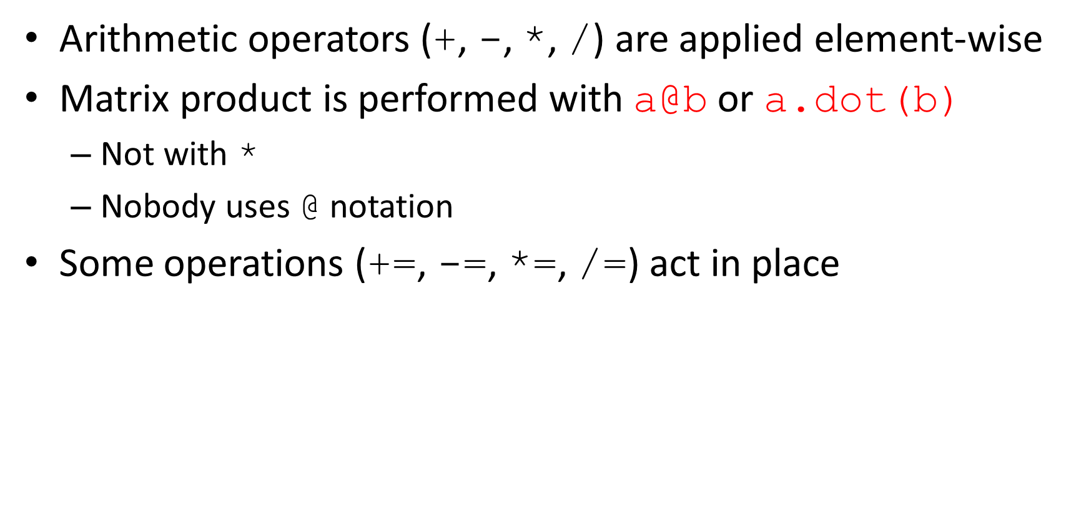
Basic operations
Arithmetic operators (+, -, *, /) are applied element-wise
Matrix product is performed with $\text{a}\text{@}\text{b}$ or $\text{a}\text{.}\text{dot}\text{(}\text{b}\text{)}$
Not with *
Nobody uses @ notation
Some operations (+=, -=, *=, /=) act in place

Slide 45
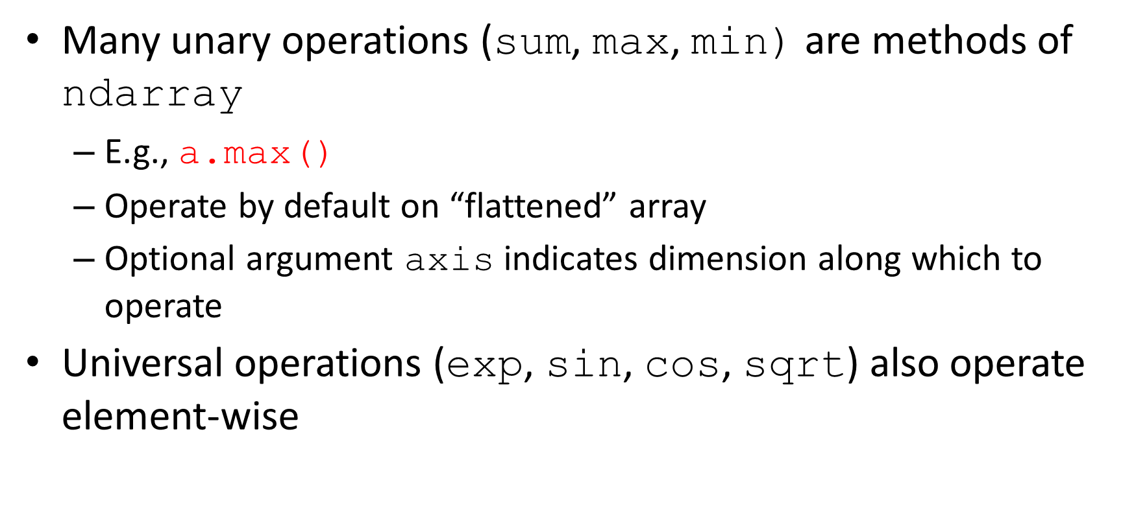
Unary and universal operations
Many unary operations (sum, max, min) are methods of $\text{ndarray}$
E.g., $\text{a}\text{.}\text{max}\text{()}$
Operate by default on “flattened” array
Optional argument axis indicates dimension along which to operate
Universal operations (exp, sin, cos, sqrt) also operate element-wise

Slide 46
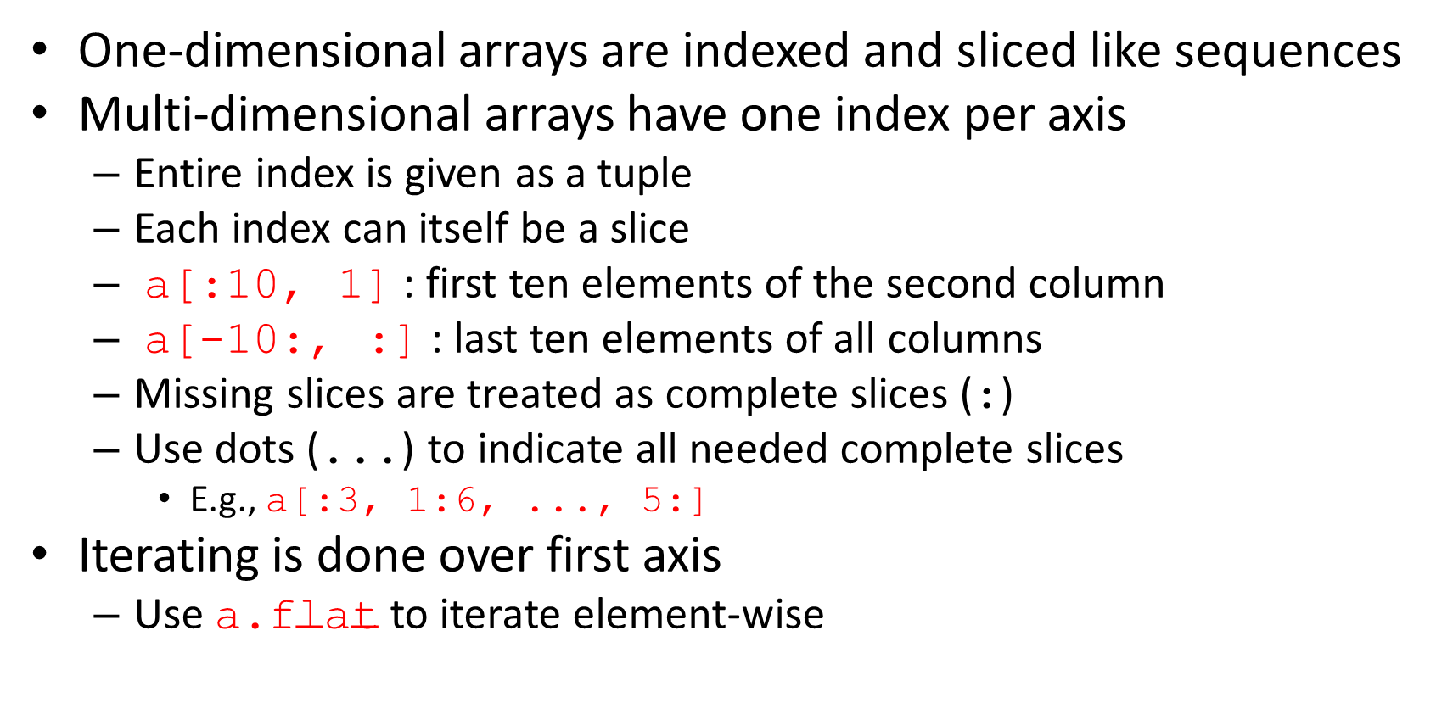
Indexing, slicing, and iterating
One-dimensional arrays are indexed and sliced like sequences
Multi-dimensional arrays have one index per axis
Entire index is given as a tuple
Each index can itself be a slice
a[:10, 1] : first ten elements of the second column
a[-10:, :] : last ten elements of all columns
Missing slices are treated as complete slices (:)
Use dots (...) to indicate all needed complete slices
E.g., a[:3, 1:6, ..., 5:]
Iterating is done over first axis
Use $\text{a}\text{.}\text{flat}$to iterate element-wise

Slide 47
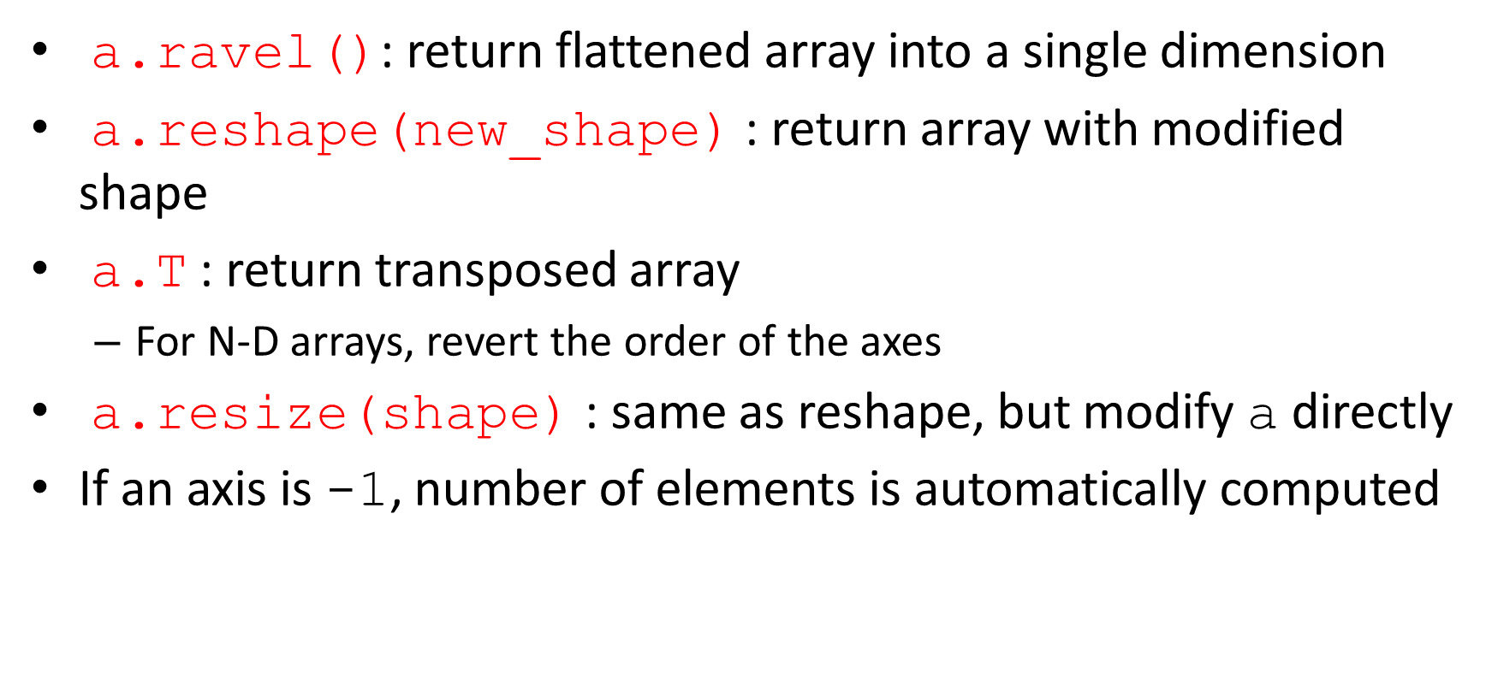
Modifying an array’s shape
$\text{a}\text{.}\text{ravel}\text{()}$: return flattened array into a single dimension
$\text{a}\text{.}\text{reshape}\text{(}\text{new}\text{_}\text{shape}\text{)}$ : return array with modified shape
$\text{a}\text{.}\text{T}$ : return transposed array
For N-D arrays, revert the order of the axes
$\text{a}\text{.}\text{resize}\text{(}\text{shape}\text{)}$ : same as reshape, but modify a directly
If an axis is -1, number of elements is automatically computed

Slide 48
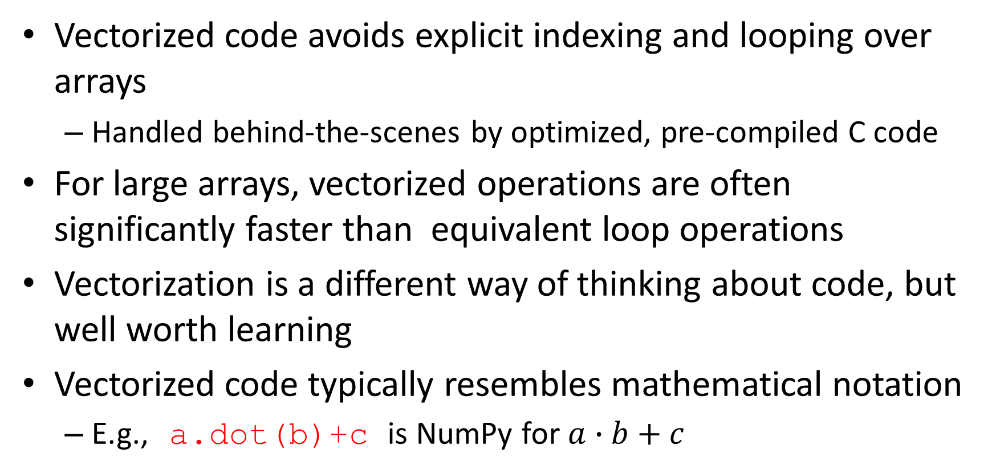
Vectorization
Vectorized code avoids explicit indexing and looping over arrays
Handled behind-the-scenes by optimized, pre-compiled C code
For large arrays, vectorized operations are often significantly faster than equivalent loop operations
Vectorization is a different way of thinking about code, but well worth learning
Vectorized code typically resembles mathematical notation
E.g., $\text{a}\text{.}\text{dot}\text{(}\text{b}\text{)+}\text{c}$ is NumPy for $a∙b+c$

Slide 49
Broadcasting
Many functions can operate on arrays that do not have the same shape
Broadcasting prescribes the behavior of all functions in these cases
Two simple rules
If not all arrays have the same number of axes, 1s are prepended to smaller arrays until all arrays have the same number of dimensions
Every axis of size 1 is treated as if it were the same size as the largest array along that axis, assuming all values are the same as the singleton element
At this point, it must hold that all arrays have the same shape, or they can’t be broadcast together

Slide 50
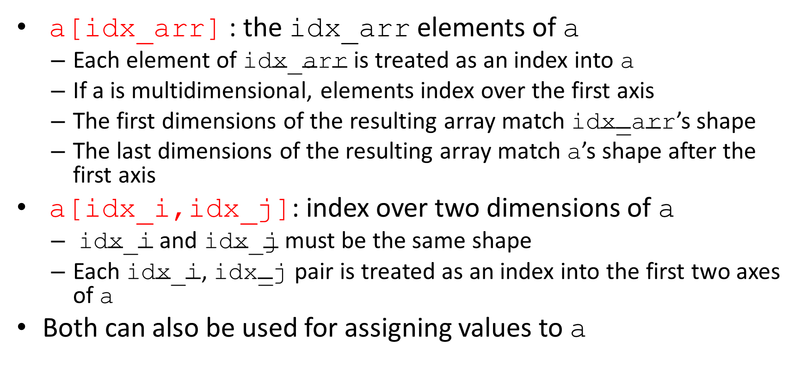
Indexing with arrays of indices
$\text{a}\text{[}\text{idx}\text{_}\text{arr}\text{]}$ : the $\text{idx}\text{_}\text{arr}$ elements of a
Each element of $\text{idx}\text{_}\text{arr}$ is treated as an index into a
If a is multidimensional, elements index over the first axis
The first dimensions of the resulting array match $\text{idx}\text{_}\text{arr}$’s shape
The last dimensions of the resulting array match a’s shape after the first axis
$\text{a}\text{[}\text{idx}\text{_}\text{i}\text{,}\text{idx}\text{_}\text{j}\text{]}$: index over two dimensions of a
$\text{idx}\text{_}\text{i}$ and $\text{idx}\text{_}\text{j}$ must be the same shape
Each $\text{idx}\text{_}\text{i}$, $\text{idx}\text{_}\text{j}$ pair is treated as an index into the first two axes of a
Both can also be used for assigning values to a

Slide 51
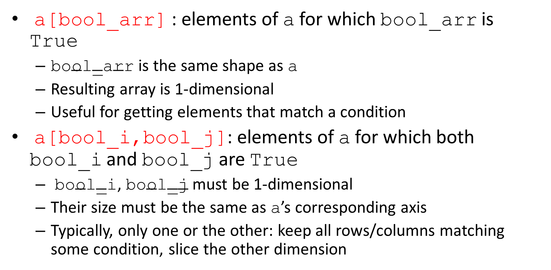
Indexing with Boolean arrays
$\text{a}\text{[}\text{bool}\text{_}\text{arr}\text{]}$ : elements of a for which $\text{bool}\text{_}\text{arr}$ is True
$\text{bool}\text{_}\text{arr}$ is the same shape as a
Resulting array is 1-dimensional
Useful for getting elements that match a condition
$\text{a}\text{[}\text{bool}\text{_}\text{i}\text{,}\text{bool}\text{_}\text{j}\text{]}$: elements of a for which both $\text{bool}\text{_}\text{i}$ and $\text{bool}\text{_}\text{j}$ are True
$\text{bool}\text{_}\text{i}$, $\text{bool}\text{_}\text{j}$ must be 1-dimensional
Their size must be the same as a’s corresponding axis
Typically, only one or the other: keep all rows/columns matching some condition, slice the other dimension

Slide 52
There’s much more to NumPy
This barely covers NumPy’s quick start tutorial!
It’s impossible to learn all of NumPy’s functionality
So how do you know when NumPy has the function you need?
Usually, if you are looping through an array, you can vectorize your code
If fancy indexing is not enough, then there might be a NumPy function for what you need

Slide 53
Pandas
Opensource data analysis library
Built on NumPy
Optimized for wide variety of data analysis operations
I/O to/from formatted files and data bases
Missing data handling
Slicing, indexing, reshaping, adding columns
Powerful grouping for aggregating and transforming data sets
Merging and joining data sets
Time-series functionality
Virtually no modeling capabilities (easy to integrate with scikit-learn)

Slide 54
Pandas: DataFrame
2-dimensional labeled structure
Possibly heterogeneous type (common across columns)
Intuition: spreadsheet or SQL table
Each column is an attribute
Each row is a record
Also: like a dictionary of Series objects

Slide 55
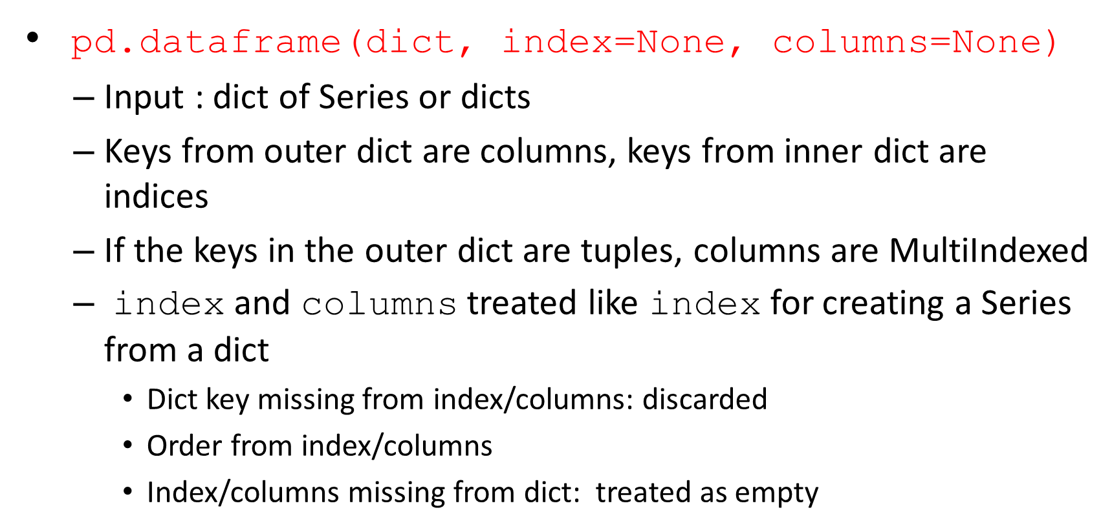
DataFrame constructors
$\text{pd}\text{.}\text{dataframe}\text{(}\text{dict}\text{, }\text{index}\text{=}\text{None}\text{, }\text{columns}\text{=}\text{None}\text{)}$
Input : dict of Series or dicts
Keys from outer dict are columns, keys from inner dict are indices
If the keys in the outer dict are tuples, columns are MultiIndexed
index and columns treated like index for creating a Series from a dict
Dict key missing from index/columns: discarded
Order from index/columns
Index/columns missing from dict: treated as empty

Slide 56
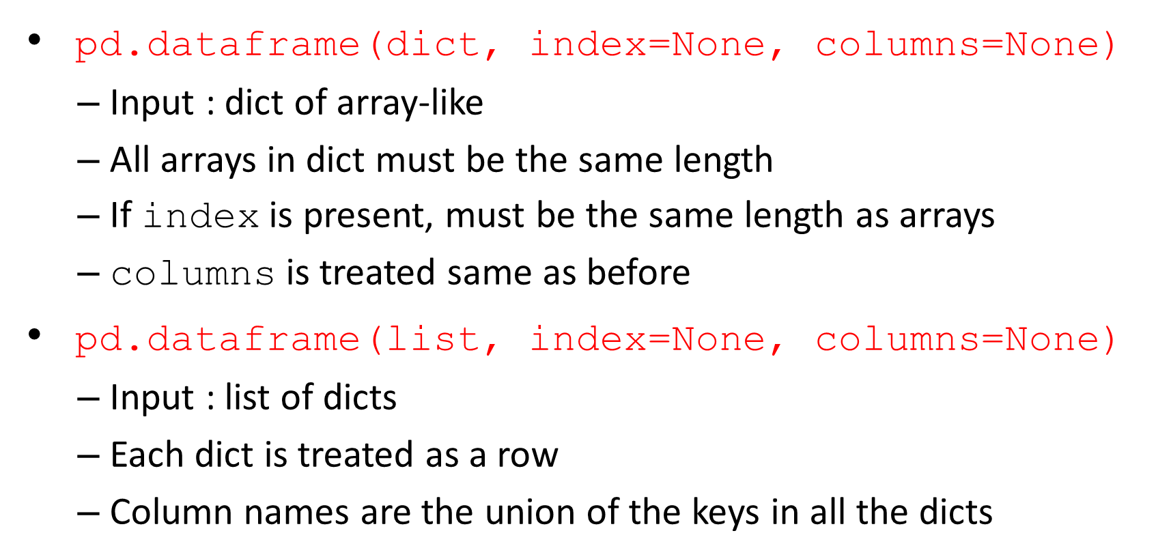
DataFrame constructors
$\text{pd}\text{.}\text{dataframe}\text{(}\text{dict}\text{, }\text{index}\text{=}\text{None}\text{, }\text{columns}\text{=}\text{None}\text{)}$
Input : dict of array-like
All arrays in dict must be the same length
If index is present, must be the same length as arrays
columns is treated same as before
$\text{pd}\text{.}\text{dataframe}\text{(}\text{list}\text{, }\text{index}\text{=}\text{None}\text{, }\text{columns}\text{=}\text{None}\text{)}$
Input : list of dicts
Each dict is treated as a row
Column names are the union of the keys in all the dicts

Slide 57
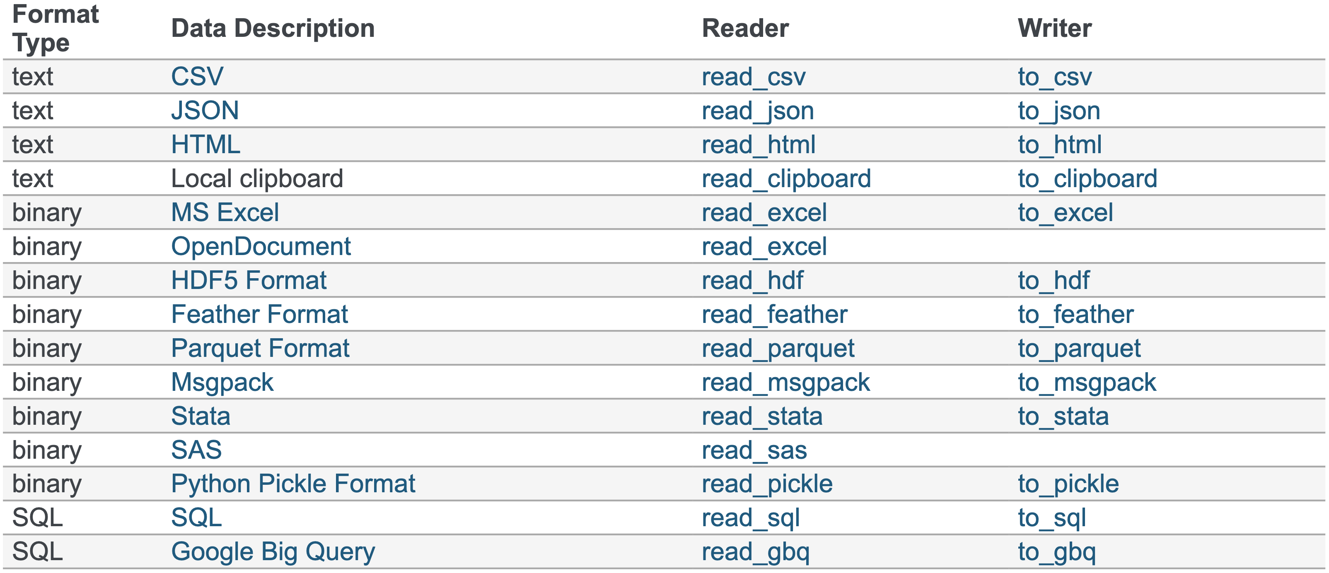
Construct DataFrame from files

Slide 58
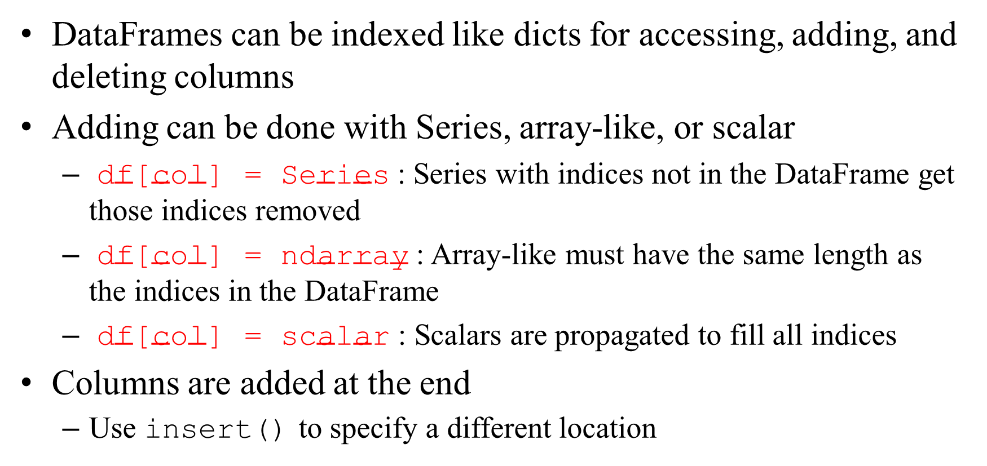
Accessing DataFrame columns
DataFrames can be indexed like dicts for accessing, adding, and deleting columns
Adding can be done with Series, array-like, or scalar
$\text{d}\text{f}\text{[}\text{col}\text{] = }\text{Series}$: Series with indices not in the DataFrame get those indices removed
$\text{df}\text{[}\text{col}\text{] = }\text{ndarray}$ : Array-like must have the same length as the indices in the DataFrame
$\text{df}\text{[}\text{col}\text{] = }\text{scalar}$ : Scalars are propagated to fill all indices
Columns are added at the end
Use insert() to specify a different location

Slide 59
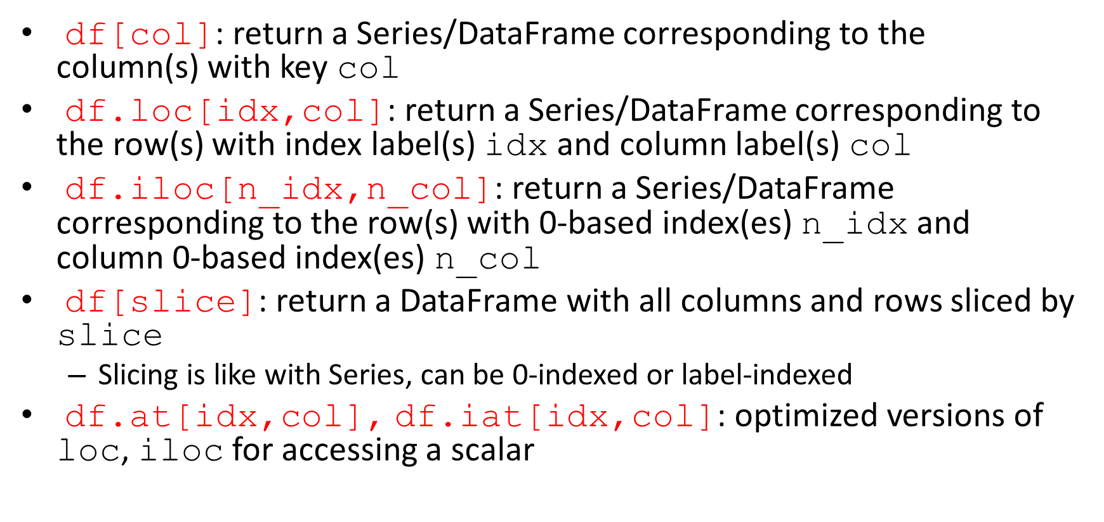
Indexing DataFrame
$\text{df}\text{[}\text{col}\text{]}$: return a Series/DataFrame corresponding to the column(s) with key col
$\text{df}\text{.}\text{loc}\text{[}\text{idx}\text{,}\text{col}\text{]}$: return a Series/DataFrame corresponding to the row(s) with index label(s) $\text{idx}$ and column label(s) $\text{col}$
$\text{df}\text{.}\text{i}\text{loc}\text{[}\text{n}\text{_}\text{idx}\text{,}\text{n}\text{_}\text{col}\text{]}$: return a Series/DataFrame corresponding to the row(s) with 0-based index(es) $\text{n}\text{_}\text{idx}$and column 0-based index(es) $\text{n}\text{_}\text{col}$
$\text{df}\text{[}\text{slice}\text{]}$: return a DataFrame with all columns and rows sliced by slice
Slicing is like with Series, can be 0-indexed or label-indexed
$\text{df}\text{.}\text{at}\text{[}\text{idx}\text{,}\text{col}\text{]}$, $\text{df}\text{.}\text{iat}\text{[}\text{idx}\text{,}\text{col}\text{]}$: optimized versions of $\text{loc}$, $\text{iloc}$ for accessing a scalar

Slide 60
Boolean indexing of DataFrames
df[bool_vec] — return a DataFrame with all columns and rows indexed by a Boolean array
df[bool_df] — return DataFrame with original values where bool_df is True and NaN where it is False
df.mask(bool_df) — return DataFrame with original values where bool_df is False and NaN where it is True
df.duplicated(subset=None) — return Boolean DataFrame with True where a row is duplicated and False where it is not
df.drop_duplicates(subset=None) — return DataFrame with original values but with duplicated rows removed (optional inplace argument)

Slide 61
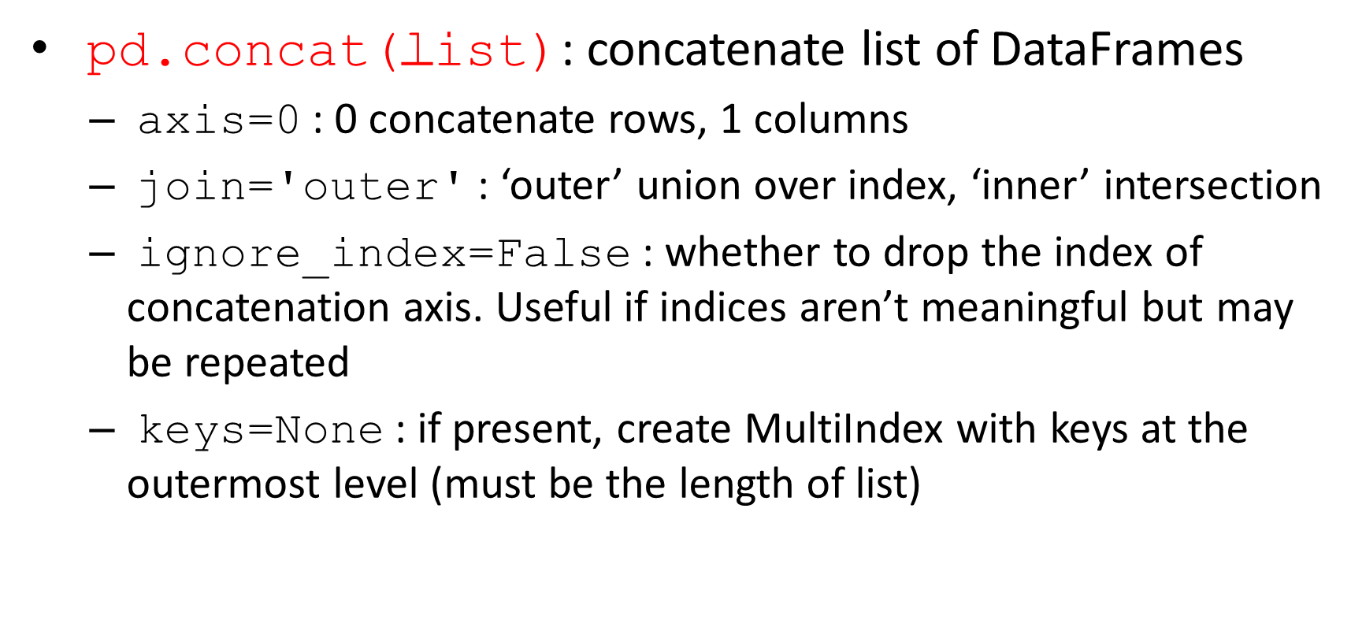
Combining DataFrames
$\text{pd}\text{.}\text{concat}\text{(}\text{list}\text{)}$: concatenate list of DataFrames
$\text{axis}\text{=0}$: 0 concatenate rows, 1 columns
$\text{join}\text{=′}\text{outer}\text{′}$: ‘outer’ union over index, ‘inner’ intersection
$\text{ignore}\text{_}\text{index}\text{=}\text{False}$: whether to drop the index of concatenation axis. Useful if indices aren’t meaningful but may be repeated
$\text{keys}\text{=}\text{None}$: if present, create MultiIndex with keys at the outermost level (must be the length of list)

Slide 62
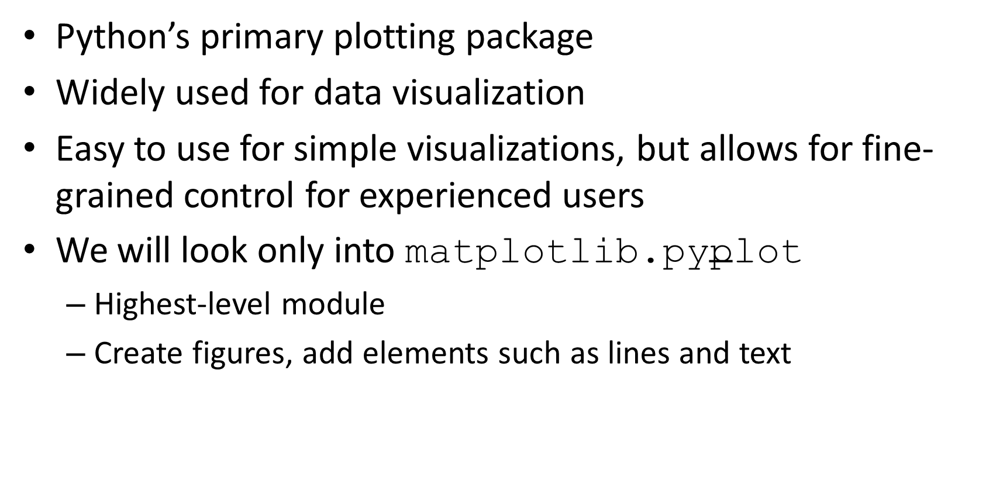
Matplotlib
Python’s primary plotting package
Widely used for data visualization
Easy to use for simple visualizations, but allows for fine-grained control for experienced users
We will look only into $\text{matplotlib}\text{.}\text{pyplot}$
Highest-level module
Create figures, add elements such as lines and text

Slide 63
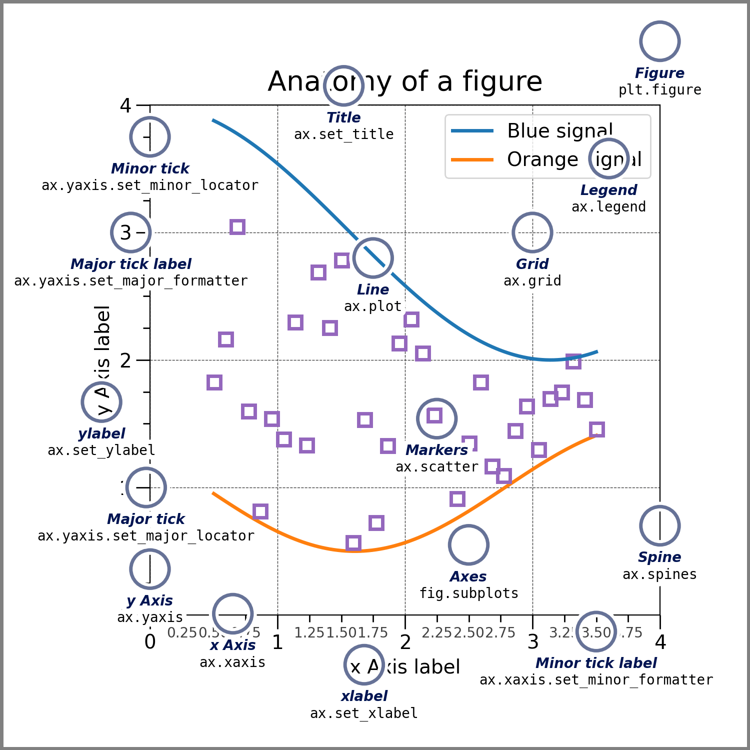
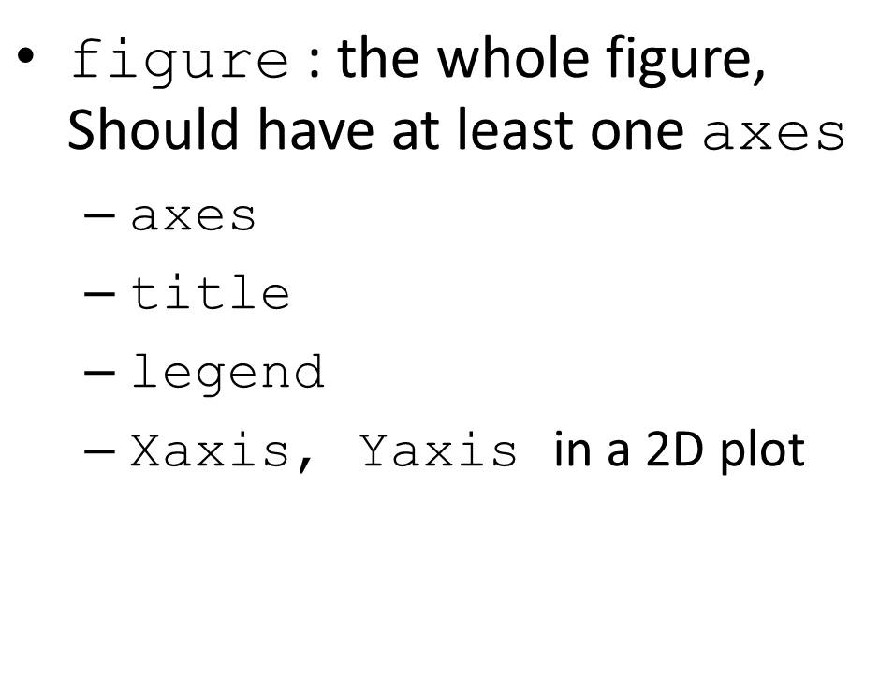
Parts of a figure
$\text{figure}$: the whole figure, Should have at least one $\text{axes}$
$\text{axes}$
$\text{title}$
$\text{legend}$
$\text{Xaxis}$, $\text{Yaxis}$ in a 2D plot
https://matplotlib.org/stable/gallery/showcase/anatomy.html

Slide 64
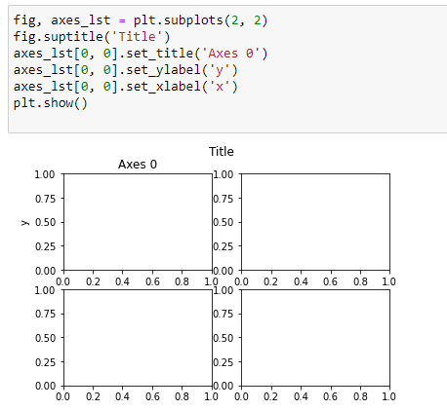
Parts of a figure
Axes: a plot. There may be more than one per Figure. Contains Axis objects (2 for 2-D plots, 3 for 3-D). Has a title, an x-label, and a y-label.
Axis: number-line objects. Set graph limits and ticks

Slide 65
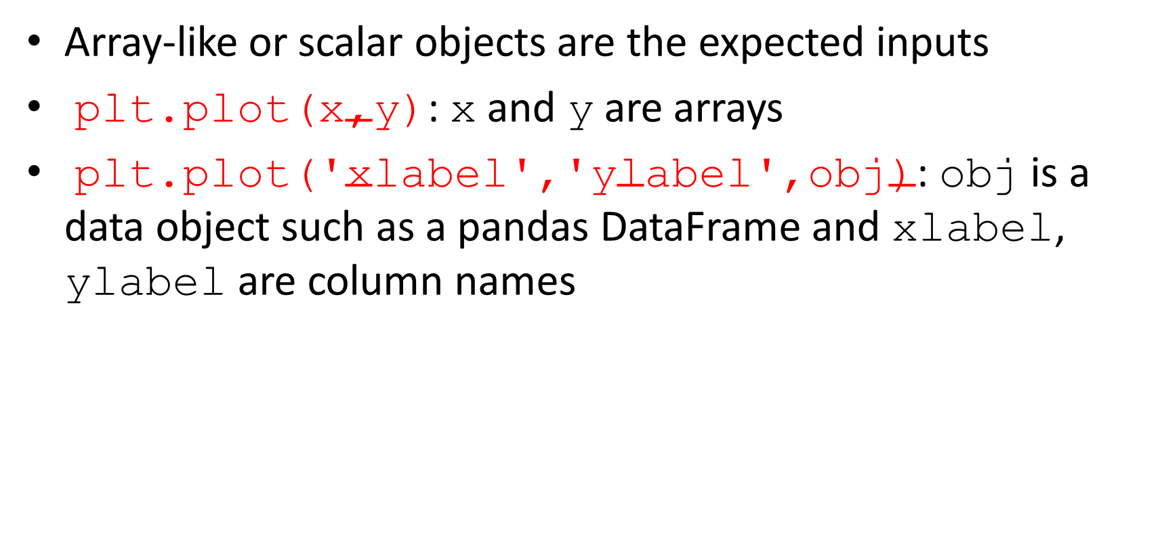
Inputs to plotting functions
Array-like or scalar objects are the expected inputs
$\text{plt}\text{.}\text{plot}\text{(}\text{x}\text{,}\text{y}\text{)}$: $\text{x}$ and $\text{y}$ are arrays
$\text{plt}\text{.}\text{plot}\text{(′}\text{xlabel}\text{′,′}\text{ylabel}\text{′,}\text{obj}\text{)}$: $\text{obj}$ is a data object such as a pandas DataFrame and $\text{x}\text{label}$, $\text{ylabel}$ are column names

Slide 66
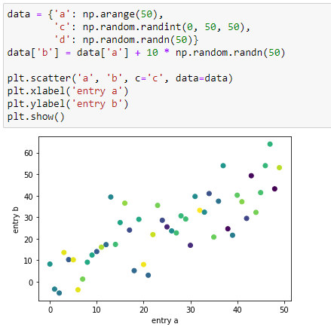
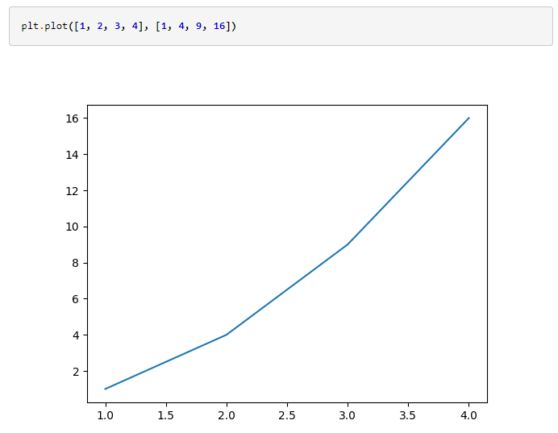
Examples
A line plot
A scatter plot

Slide 67
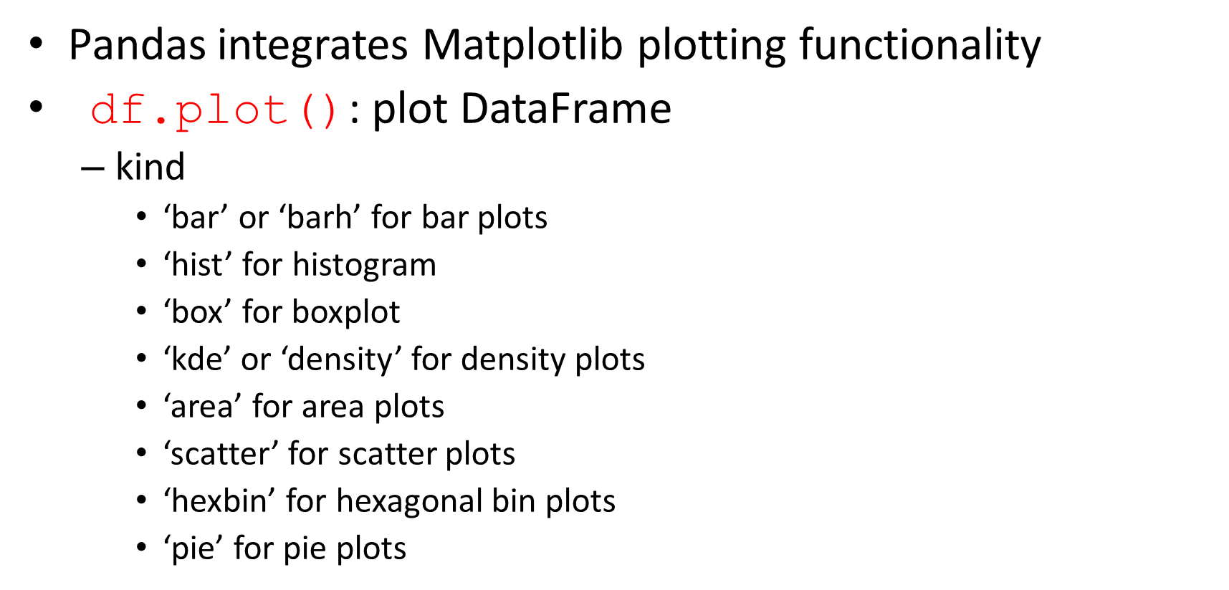
Visualization with Pandas
Pandas integrates Matplotlib plotting functionality
$\text{df}\text{.}\text{plot}\text{()}$: plot DataFrame
kind
‘bar’ or ‘barh’ for bar plots
‘hist’ for histogram
‘box’ for boxplot
‘kde’ or ‘density’ for density plots
‘area’ for area plots
‘scatter’ for scatter plots
‘hexbin’ for hexagonal bin plots
‘pie’ for pie plots

Slide 68
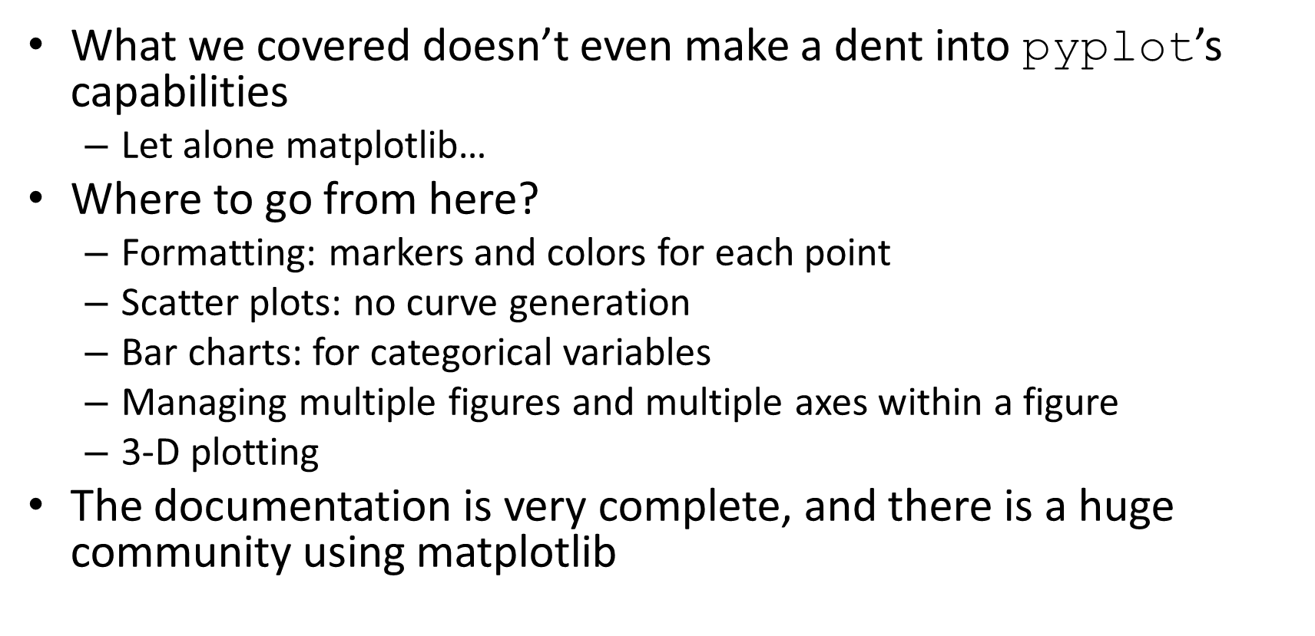

LOTS more to $\text{pyplot}$
What we covered doesn’t even make a dent into $\text{pyplot}$’s capabilities
Let alone matplotlib…
Where to go from here?
Formatting: markers and colors for each point
Scatter plots: no curve generation
Bar charts: for categorical variables
Managing multiple figures and multiple axes within a figure
3-D plotting
The documentation is very complete, and there is a huge community using matplotlib

Slide 69
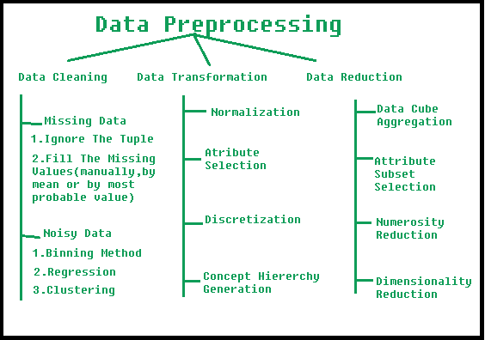
Data Preprocessing
Analyzing or training with unprocessed data may lead to misleading results
Transform raw data into a format that can be understood and analyzed by computers and machine learning algorithms
https://www.geeksforgeeks.org/data-preprocessing-in-data-mining/

Slide 70

Data Preprocessing
Normalization: Scale data into a regularized range for more accurate comparison
Min-max Normalization
$$X_{new}= \frac{X −X_{min}}{X_{max} −X_{min}}$$
rescales the range of the data to [0,1]
Standardization (Z-Normalization)
$$X_{new}= \frac{X −\overline{X}}{σ}$$
sets the mean of data to 0 and the standard deviation to 1

Slide 71
Data Preprocessing
Discretization:
Pool data into smaller intervals
Convert continuous values into discrete (categorical) values

Slide 72
Resources
Some resources for python:
Official documentation: https://docs.python.org/3/tutorial/
Tutorial: https://bugs.python.org/file47781/Tutorial_EDIT.pdf
UPenn course: https://cis192.github.io/
Find other Python for data science courses on https://www.coursera.org/
Package User guides:
NumPy: https://numpy.org/doc/stable/reference/index.html
Pandas: https://pandas.pydata.org/docs/user_guide/index.html
Matplotlib: https://matplotlib.org/stable/gallery/index.html
Notes:
error checking code , don't change it

