Slide 1
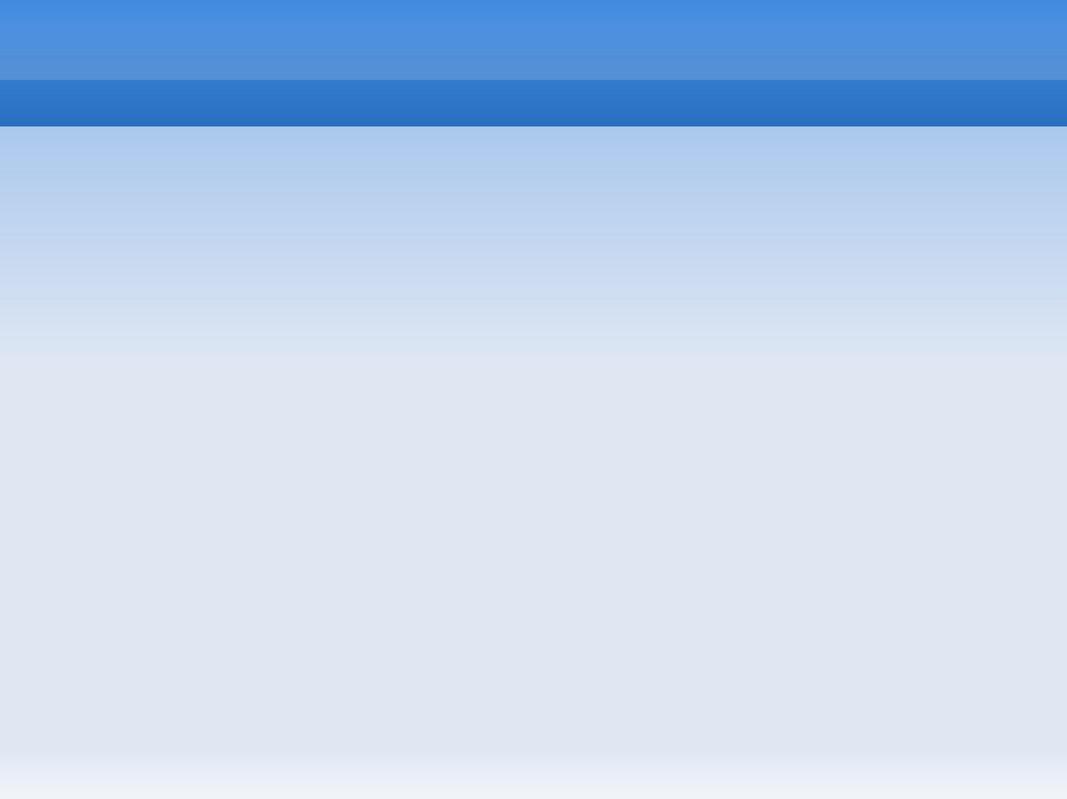
node.js
Presentation, June 3rd 2011

Slide 2
Installation
Install node.js dependencies
sudo apt-get install build-essential libev3 libev-dev openssl libssl-dev libc6-dev libstdc++6-4.4-dev

Slide 3
Installation
Install node.js dependencies
sudo apt-get install build-essential libev3 libev-dev openssl libssl-dev libc6-dev libstdc++6-4.4-dev
Download and installation
$ wget -t0 -c http://nodejs.org/dist/node-v0.4.8.tar.gz
$ tar xzvf node-v.0.4.8.tar.gz
$ cd node-v0.4.8

Slide 4
Installation
Install node.js dependencies
sudo apt-get install build-essential libev3 libev-dev openssl libssl-dev libc6-dev libstdc++6-4.4-dev
Download and installation
$ wget -t0 -c http://nodejs.org/dist/node-v0.4.8.tar.gz
$ tar xzvf node-v.0.4.8.tar.gz
$ cd node-v0.4.8
configure and installation
$ ./configure --prefix=/usr
$ make
$ sudo make install

Slide 5
Hello World!
Create file hello.js
console.log('Hello world!');

Slide 6
Hello World!
Create file hello.js
console.log('Hello world!');
$ node hello.js

Slide 7
Hello World! 2
var http = require('http');
http.createServer(function (req, res) {
res.writeHead(200, {'Content-Type': 'text/plain'});
res.end('Hello World!\n');
}).listen(3000, "127.0.0.1");
console.log('Server running at http://127.0.0.1:3000');

Slide 8
npm
Search npm modules on: http://npm.mape.me

Slide 9
npm
Search npm modules on: http://npm.mape.me
Installing npm using single command line
$ curl http://npmjs.org/install.sh | sh

Slide 10
npm
Search http://npm.mape.me
Installing npm using single command line
$ curl http://npmjs.org/install.sh | sh
Example
npm list installed
npm install coffee-script

Slide 11
Example chat client
$ sudo npm install -g socket.io
$ cd Socket.IO-node/example
$ node server.js
Open localhost:8080

Slide 12
THE END

