Slide 1


Tech Updates October 2011
Redis and GC

Slide 2
REDIS

Slide 3
REDIS - Introduction
- extremely fast, atomic key-value store
- store strings, sets, sorted sets, lists and hashes
- keeps all data in RAM like memcached
- periodically writes to disk, giving it persistence

Slide 4
REDIS - Installation
wget http://redis.googlecode.com/files/redis-2.2.2.tar.gz
tar xzf redis-2.2.2.tar.gz
cd redis-2.2.2
make
cp src/redis-server src/redis-cli /usr/bin
Or
sudo apt-add-repository ppa:rwky/redis
sudo apt-get update
sudo apt-get install redis-server

Slide 5
REDIS - Configuration
redis-server
or
redis-server /path/to/configuration
Default configuration:
/etc/redis/redis.conf
daemonize yes
port 6379
unixsocket /tmp/redis.sock

Slide 6
REDIS – Gem
sudo gem install redis
irb
require 'rubygems'
require 'redis'
$redis = Redis.new(:host => 'localhost', :port => 6379)
$redis.set('test', 'ajep')
$redis.get('test')
quit
irb
require 'rubygems'
require 'redis'
$redis = Redis.new(:host => 'localhost', :port => 6379)
$redis.get('test')

Slide 7
REDIS – RoR
Bundler:
gem 'redis', '2.1.1'
bundle install
config/initializers/redis.rb
$redis = Redis.new(:host => 'localhost', :port => 6379)
#$redis = Redis.new(:path => "/tmp/redis.sock")
class User < ActiveRecord::Base
# follow a user
def follow!(user)
$redis.multi do
$redis.sadd(self.redis_key(:following), user.id)
$redis.sadd(user.redis_key(:followers), self.id)
end
end
end

Slide 8
REDIS – RoR
class User < ActiveRecord::Base
def ajep
$redis.smembers("#{self.id}:ajep")
end
def ajep=(content)
$redis.multi do
$redis.sadd("#{self.id}:ajep", content)
end
end
def remove_ajep=(content)
$redis.multi do
  $redis.srem("#{self.id}:ajep", content)
end
end
end

Slide 9
REDIS – Set
sadd Add member to the set stored at key
srem Remove member from the set stored at key
smembers Returns all the members of the set value
sinter Returns the members of the intersection set scard Returns the set cardinality
sismember Returns if member is a member of the set multi Marks the start of a transaction block
Example:
$redis.sadd("key1", "value1")
$redis.sadd("key1", "value2")
$redis.sadd("key2", "value1")
$redis.smembers("key1")
$redis.sinter("key1", "key2")
$redis.srem("key1", "value1")

Slide 10
REDIS – Sorted Set
zadd(key, score, value)
zrem(key, value)
zrevrank(key, start, stop)
zrevrankbyscore(key, min, max)
zrank(key, value)
zscore(key, value)

Slide 11
REDIS – Cache Store
Page cache, fragment cache, action cache
gem 'redis-store', '1.0.0.1'
config/environments/production.rb
config.cache_store = :redis_store

Slide 12
REDIS – Links
http://redis.io/
https://github.com/ezmobius/redis-rb
http://rdoc.info/github/ezmobius/redis-rb/master/Redis
http://jimneath.org/2011/03/24/using-redis-with-ruby-on-rails.html
https://github.com/jodosha/redis-store

Slide 13
GC: Garbage Collector

Slide 14
GC - Memory
Other programming language:
int *p_var = new int;
delete p_var;
int *p_array = new int[50];
delete[] p_array;
Programmers allocate and deallocate dynamic memory

Slide 15
GC – Ruby Memory
Ruby:
test = String.new("test")
There's no delete / destroy / deconstruct
You can do:
test = nil

Slide 16
GC – Ruby Memory
Pros:
- 90% of our work is on the surface
- You can focus on the core of your application
- Develop business value
Cons:
- no way to allocate / deallocate memory
- bloat
- slow

Slide 17

GC – Mark & Sweep

Slide 18
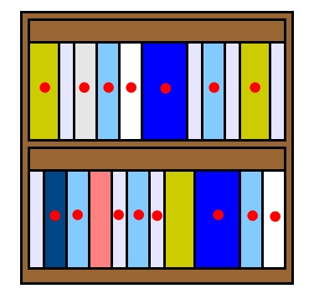
GC – Mark & Sweep

Slide 19

GC – Mark & Sweep

Slide 20
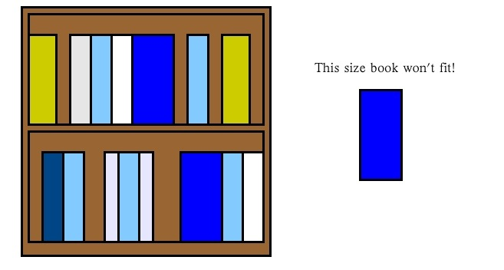
GC – Mark & Sweep

Slide 21
GC – ruby < 1.9.3
- No memory “sorting” (lazy sweeping)
- Fragmentation
- Assign new heap (memory bloat)

Slide 22
GC – GC.start
>> x = []
>> puts `grep VmSize /proc/#{$$}/status`
VmSize: 33716 kB
>> 1000000.times {|i|x << "#{i}"}
>> puts `grep VmSize /proc/#{$$}/status`
VmSize: 112052 kB
>> x = []
=> []
>> puts `grep VmSize /proc/#{$$}/status`
VmSize: 112052 kB
>> GC.start
>> puts `grep VmSize /proc/#{$$}/status`
VmSize: 92136 kB

Slide 23

GC – GC.start
When GC called, the whole ruby world is stopped
Takes a lot of cpu resource :(
Don't use it too often

Slide 24
GC – REE
RUBY_HEAP_MIN_SLOTS
- the initial heap size in number of slots used
RUBY_HEAP_SLOTS_INCREMENT
- how many additional slots to allocate when Ruby allocates
new heap slots
RUBY_HEAP_SLOTS_GROWTH_FACTOR
- multiplicator used to increase heap block size for the next
allocation.
RUBY_GC_MALLOC_LIMIT
- the amount of C data structures which can be allocated
without triggering a GC (if this is set too low, GC will be
started even if there are empty slots available)
RUBY_HEAP_FREE_MIN
- number of free slots that should be available after GC
if fewer slots are available, additional heap will be allocated
(Ruby >= 1.8.5 ensures the freelist has at least heapsize*0.2 entries)

Slide 25
GC – REE
RUBY_GC_MALLOC_LIMIT=60000000
- the amount of C data structures which can be allocated without triggering a GC
- defaults to 8MB
- high traffic ruby servers can allocate and free more than 8mb in a single request
Suggestions:
(24MB - 128MB)

Slide 26
GC – REE
RUBY_HEAP_MIN_SLOTS=500000
- number of slots in the first slab
- defaults to 10k
- a new rails app boots up with almost 500k objects on the heap (mostly nodes)

Slide 27
GC – REE
HEAP_SLOTS_GROWTH = 1
- defaults to 1.8x
- each new slab is almost twice as big as the last
normal growth:
10k
10k + 18k = 28k
10k + 18k + 36k = 64k
tuned growth:
500k
500k + 500k = 1M

Slide 28
GC – REE
/etc/environment
~/.bashrc
#!/bin/bash
export RUBY_HEAP_MIN_SLOTS=1250000
export RUBY_HEAP_SLOTS_INCREMENT=100000
export RUBY_HEAP_SLOTS_GROWTH_FACTOR=1
export RUBY_GC_MALLOC_LIMIT=60000000
export RUBY_HEAP_FREE_MIN=12500

Slide 29
GC – REE
/usr/bin/ruby-with-env
#!/bin/bash
export RUBY_HEAP_MIN_SLOTS=1250000
export RUBY_HEAP_SLOTS_INCREMENT=100000
export RUBY_HEAP_SLOTS_GROWTH_FACTOR=1
export RUBY_GC_MALLOC_LIMIT=60000000
export RUBY_HEAP_FREE_MIN=12500
exec "/usr/bin/ruby" "$@"
PassengerRuby /usr/bin/ruby-with-env

Slide 30
GC – REE
37signals (basecamp)
RUBY_HEAP_MIN_SLOTS=600000
RUBY_GC_MALLOC_LIMIT=59000000
RUBY_HEAP_FREE_MIN=100000
Twitter
RUBY_HEAP_MIN_SLOTS=500000
RUBY_HEAP_SLOTS_INCREMENT=250000
RUBY_HEAP_SLOTS_GROWTH_FACTOR=1
RUBY_GC_MALLOC_LIMIT=50000000
Twitter claims that these settings give them about 20% to 40% average performance improvement, at the cost of slightly higher peak memory usage.

Slide 31
GC – REE
How to determine your soft spot?
TEST
- Run your test using several configuration
- Compare time needed

Slide 32
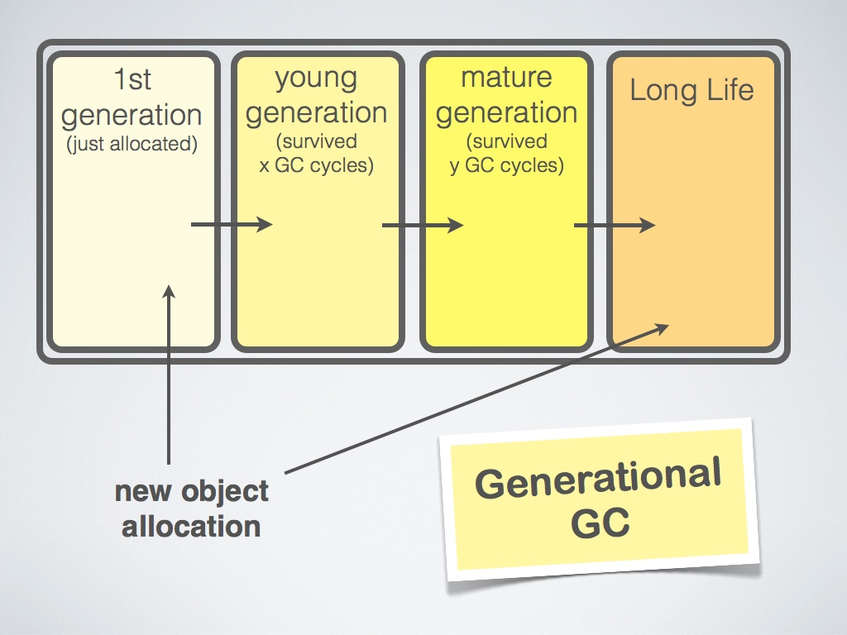
GC – KIJI

Slide 33
GC – KIJI
I can never installed it :(

Slide 34
GC – 1.9.2
curl https://raw.github.com/gist/999435/fc2718ac3f488ab2341b65dc2ae5c123f8859bff/fast-require-ruby-19.2-p180 > /tmp/ruby192-require.patch
curl https://raw.github.com/gist/856296/patch-1.9.2-gc.patch > /tmp/ruby192-gc.patch
cd ruby-1.9.2-p290
patch -p1 < /tmp/ruby192-require.patch
patch -p1 < /tmp/ruby192-gc.patch
./configure –prefix=/usr && make && sudo make install

Slide 35
GC – 1.9.2
curl -O https://raw.github.com/gist/1008945/4edd1e1dcc1f0db52d4816843a9d1e6b60661122/ruby-1.9.2p290.patch > /tmp/ruby-1.9.2p290.patch
curl -O https://raw.github.com/gist/856296/a19ac26fe7412ef398bd9f57e61f06fef1f186fe/patch-1.9.2-gc.patch > /tmp/patch-1.9.2-gc.patch
rvm install 1.9.2-p290 --patch /tmp/ruby-1.9.2p290.patch,/tmp/patch-1.9.2-gc.patch
rm /tmp/ruby-1.9.2p290.patch /tmp/patch-1.9.2-gc.patch
# GC-tune:
# http://metaskills.net/2011/03/09/gc-tune-ruby-1.9.2-with-rvm/
mkdir -p ~/.rvm/hooks
cat <<EOF > ~/.rvm/hooks/after_use
case "\$rvm_ruby_string" in
*ree*|*p290*)
export RUBY_HEAP_MIN_SLOTS=1000000
export RUBY_HEAP_SLOTS_INCREMENT=1000000
export RUBY_HEAP_SLOTS_GROWTH_FACTOR=1
export RUBY_GC_MALLOC_LIMIT=1000000000
export RUBY_HEAP_FREE_MIN=500000
export RUBY_FREE_MIN=$RUBY_HEAP_FREE_MIN
;;
*)
unset RUBY_HEAP_MIN_SLOTS RUBY_HEAP_SLOTS_INCREMENT RUBY_HEAP_SLOTS_GROWTH_FACTOR RUBY_GC_MALLOC_LIMIT RUBY_HEAP_FREE_MIN RUBY_FREE_MIN
;;
esac
EOF

Slide 36
GC – 1.9.2 (rvm)
curl -O https://raw.github.com/gist/1008945/4edd1e1dcc1f0db52d4816843a9d1e6b60661122/ruby-1.9.2p290.patch > /tmp/ruby-1.9.2p290.patch
curl -O https://raw.github.com/gist/856296/a19ac26fe7412ef398bd9f57e61f06fef1f186fe/patch-1.9.2-gc.patch > /tmp/patch-1.9.2-gc.patch
rvm install 1.9.2-p290 --patch /tmp/ruby-1.9.2p290.patch,/tmp/patch-1.9.2-gc.patch
rm /tmp/ruby-1.9.2p290.patch /tmp/patch-1.9.2-gc.patch
# GC-tune:
# http://metaskills.net/2011/03/09/gc-tune-ruby-1.9.2-with-rvm/
mkdir -p ~/.rvm/hooks
cat <<EOF > ~/.rvm/hooks/after_use
case "\$rvm_ruby_string" in
*ree*|*p290*)
export RUBY_HEAP_MIN_SLOTS=1000000
export RUBY_HEAP_SLOTS_INCREMENT=1000000
export RUBY_HEAP_SLOTS_GROWTH_FACTOR=1
export RUBY_GC_MALLOC_LIMIT=1000000000
export RUBY_HEAP_FREE_MIN=500000
export RUBY_FREE_MIN=$RUBY_HEAP_FREE_MIN
;;
*)
unset RUBY_HEAP_MIN_SLOTS RUBY_HEAP_SLOTS_INCREMENT RUBY_HEAP_SLOTS_GROWTH_FACTOR RUBY_GC_MALLOC_LIMIT RUBY_HEAP_FREE_MIN RUBY_FREE_MIN
;;
esac
EOF

Slide 37
GC – Links
http://www.ruby-doc.org/core-1.9.2/GC.html
http://www.rubyenterpriseedition.com/documentation.html
https://gist.github.com/856296
http://rubyconf11.merbist.com/
http://www.scribd.com/doc/27174770/Garbage-Collection-and-the-Ruby-Heap

Slide 38
https://github.com/karuna/presentation

