Slide 1
Tech Updates
November 2011

Slide 2
October – November
Code quality
Communication
Confidence
Troubleshooting
Golden Hammer
SOP

Slide 3
Code quality
Refactor

Slide 4
Code quality
Refactor
Redundant codes → methods → libraries

Slide 5
Code quality
Refactor
Redundant codes → methods → libraries
Optimize query (n+1, select)
Indent

Slide 6
Code quality
Refactor
Redundant codes → methods → libraries
Optimize query (n+1, select)
Indent
Bad habits is hard to break

Slide 7
Code quality
Refactor
Redundant codes → methods → libraries
Optimize query (n+1, select)
Indent
Bad habits is hard to break
Pull, checkout, and watch commit

Slide 8
Communication
We need more time to …

Slide 9
Communication
We need more time to …
Don't blame ourself

Slide 10
Communication
We need more time to …
Don't blame ourself
Professional

Slide 11
Communication
We need more time to …
Don't blame ourself
Professional
Always guide developers

Slide 12
Confidence
Never use this
Instead of analogy about doctors, let me give an analogy about computer store

Slide 13
Confidence
Never use this
Instead of analogy about doctors, let me give an analogy about computer store

Slide 14
Troubleshooting
Log (Apache, PHP, Rails, Nginx, Cron)

Slide 15
Troubleshooting
Log (Apache, PHP, Rails, Nginx, Cron)
Debugging tools

Slide 16
Troubleshooting
Log (Apache, PHP, Rails, Nginx, Cron)
Debugging tools
Unix tools

Slide 17
Troubleshooting
Log (Apache, PHP, Rails, Nginx, Cron)
Debugging tools
Unix tools
Exception notifier / Airbrake (Hoptoad)

Slide 18
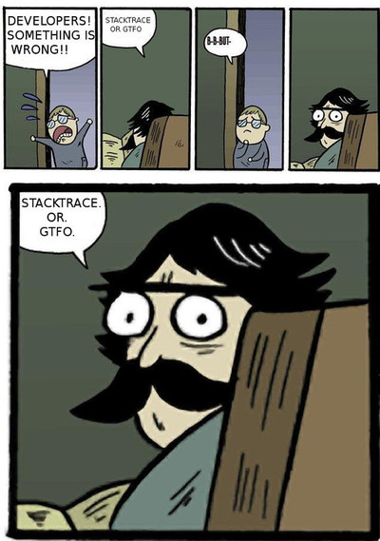
Troubleshooting

Slide 19

Golden Hammer

Slide 20
Golden Hammer
If you only have hammer
everything looks like nail

Slide 21
Golden Hammer
- Ruby, Sinatra, Merb
- JavaScript
- Test
- Bash
- Python, Perl

Slide 22
SOP
- Not for your inconvinience

Slide 23
SOP
- Not for your inconvinience
- Based on experience

Slide 24
SOP
- Not for your inconvinience
- Based on experience
- For everybody

