Slide 1

TECH UPDATES 2011
PHP SCALING

Slide 2


Slide 3
Scalability:
As your customer grow up,
you'll need to grow too

Slide 4
Refactoring
"… a disciplined technique for restructuring an existing body of code, altering its internal structure without changing its external behavior"

Slide 5
Refactoring
"… a disciplined technique for restructuring an existing body of code, altering its internal structure without changing its external behavior"
Rename

Slide 6
Refactoring
"… a disciplined technique for restructuring an existing body of code, altering its internal structure without changing its external behavior"
Rename
Extract. Unite duplicate code to function
Tools: ide, zend development tool, rephactor, scisr

Slide 7
Scale the Server
Load balancing

Slide 8
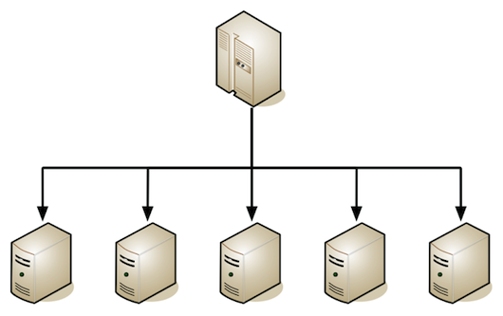
Scale the Server
Load balancing
the webserver

Slide 9
Scale the Server
Load balancing
the webserver
Lightweight server → lighthttpd / nginx

Slide 10
Scale the Server
Load balancing
the webserver
Lightweight server → lighthttpd / nginx
Load balance the database

Slide 11

Scale the Server
Load balancing
the webserver
Lightweight server → lighthttpd / nginx
Load balance the database

Slide 12
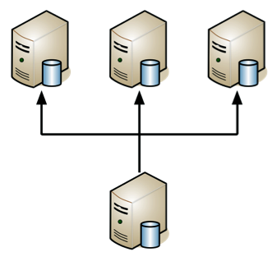
Scale the Server
Load balancing
the webserver
Lightweight server → lighthttpd / nginx
Load balance the database

Slide 13
Scale the PHP
PHP Accellerator:

Slide 14
Scale the PHP
PHP Accellerator:
PHP extension designed to improve the performance of software applications written in the PHP programming language.

Slide 15
Scale the PHP
PHP Accellerator:
PHP extension designed to improve the performance of software applications written in the PHP programming language.

Slide 16
Scale the PHP
PHP Accellerator:
Source

Slide 17
Scale the PHP
PHP Accellerator:
Source → Interpreter

Slide 18
Scale the PHP
PHP Accellerator:
Source → Interpreter → Bytecode

Slide 19
Scale the PHP
PHP Accellerator:
Source → Interpreter → Bytecode → Cache
→ Webserver

Slide 20
Scale the PHP
PHP Optimization:
Source → Interpreter → Bytecode → Cache
→ Webserver
List:
http://en.wikipedia.org/wiki/List_of_PHP_accelerators

Slide 21
Scale the PHP
APC: Alternative PHP Cache

Slide 22
Scale the PHP
APC: Alternative PHP Cache
Will be included in 5.4

Slide 23
Scale the PHP
APC: Alternative PHP Cache
Will be included in 5.4
Installation:

Slide 24

Scale the PHP
APC
Will be included in 5.4
Installation:
PEAR

Slide 25
Scale the PHP
APC
Will be included in 5.4
Installation:
PEAR
sudo apt-get install php-pear php5-dev libcurl3-openssl-dev

Slide 26
Scale the PHP
APC
Will be included in 5.4
Installation:
PEAR
sudo apt-get install php-pear php5-dev libcurl3-openssl-dev
sudo pear install apc

Slide 27
Scale the PHP
APC
Will be included in 5.4
Installation:
PEAR
sudo apt-get install php-pear php5-dev libcurl3-openssl-dev
sudo pear install apc
Load php extention
php.ini → apc.enabled „1“

Slide 28
Scale the PHP
APC
Will be included in 5.4
Installation:
Or: sudo apt-get install php-apc
Or: http://downloads.php.net/pierre/ (windows)

Slide 29
Scale the PHP
APC
Will be included in 5.4
Installation:
Or: sudo apt-get install php-apc
Or: http://downloads.php.net/pierre/ (windows)
Load php_apc.dll
php.ini : apc.enabled „1“

Slide 30
Scale the PHP
APC
Link:
http://downloads.php.net/pierre/
http://pecl.php.net/package/APC
Documentation:
http://php.net/apc
http://php.net/manual/en/apc.configuration.php

Slide 31
Scale the PHP
PHP Optimization:
Source → Interpreter → Bytecode → Cache
→ Webserver

Slide 32
Scale the PHP
PHP Optimization:
Source → Interpreter → Bytecode → Cache
→ Webserver
Why don't we optimize further?

Slide 33
Scale the PHP
PHP Optimization:
Source → Interpreter → Bytecode → Cache
→ Webserver
Why don't we optimize further?
Source → Binary

Slide 34

Scale the PHP
Introducing:

Slide 35
Scale the PHP
PHP HIPHOP: source code transformer for PHP

Slide 36
Scale the PHP
PHP HIPHOP: source code transformer for PHP
Released by Facebook

Slide 37
Scale the PHP
PHP HIPHOP: source code transformer for PHP
Released by Facebook
Convert php to c++ and compile it

Slide 38
Scale the PHP
PHP HIPHOP
Released by Facebook
Convert php to c++ and compile it
Unix only

Slide 39
Scale the PHP
PHP HIPHOP
Released by Facebook
Convert php to c++ and compile it
Unix only
It's own server

Slide 40
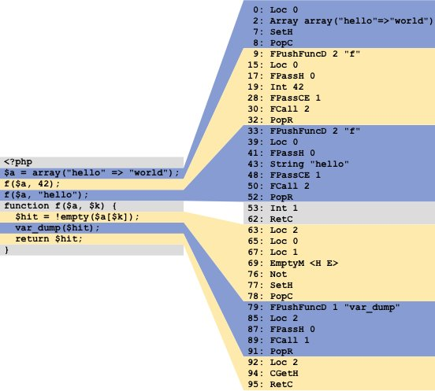
Scale the PHP

Slide 41
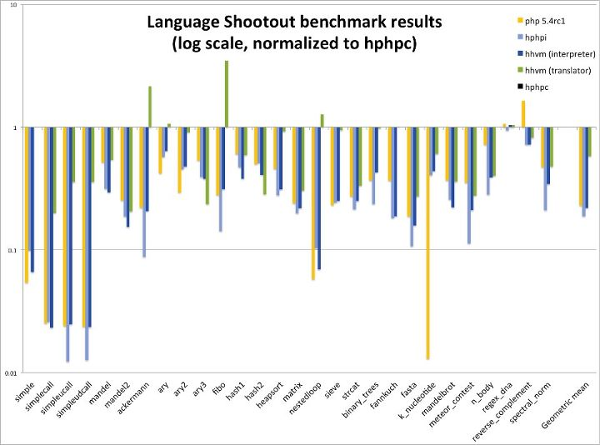
Scale the PHP

Slide 42
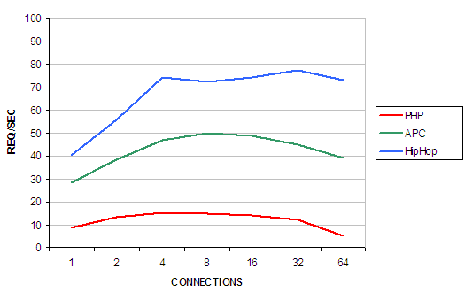
Scale the PHP

Slide 43
Scale the PHP
PHP HIPHOP
Requirements:
cmake 2.6.4 is the minimum version, g++/gcc 4.3 is the minimum version, Boost 1.39 is the minimum version, flex, bison, re2c 0.13.0 is the minimum version, libmysql, libxml2, libmcrypt, libicu 4.2 is the minimum version, openssl, binutils and binutils-dev, libcap, gd, zlib, tbb Intel’s Thread, Building Blocks 2.2 is the minimum version, libmbfl, Oniguruma, libpcre3, libexpat, libmemcached 0.39 is the minimum version, libc-client2007e-dev, libbz2-dev, libreadline-dev, openldap-dev

Slide 44
Scale the PHP
PHP HIPHOP
Requirements:
cmake 2.6.4 is the minimum version, g++/gcc 4.3 is the minimum version, Boost 1.39 is the minimum version, flex, bison, re2c 0.13.0 is the minimum version, libmysql, libxml2, libmcrypt, libicu 4.2 is the minimum version, openssl, binutils and binutils-dev, libcap, gd, zlib, tbb Intel’s Thread, Building Blocks 2.2 is the minimum version, libmbfl, Oniguruma, libpcre3, libexpat, libmemcached 0.39 is the minimum version, libc-client2007e-dev, libbz2-dev, libreadline-dev, openldap-dev
Git: https://github.com/facebook/hiphop-php

Slide 45
Scale the PHP
PHP HIPHOP
Requirements:
cmake 2.6.4 is the minimum version, g++/gcc 4.3 is the minimum version, Boost 1.39 is the minimum version, flex, bison, re2c 0.13.0 is the minimum version, libmysql, libxml2, libmcrypt, libicu 4.2 is the minimum version, openssl, binutils and binutils-dev, libcap, gd, zlib, tbb Intel’s Thread, Building Blocks 2.2 is the minimum version, libmbfl, Oniguruma, libpcre3, libexpat, libmemcached 0.39 is the minimum version, libc-client2007e-dev, libbz2-dev, libreadline-dev, openldap-dev
Git: https://github.com/facebook/hiphop-php
Compile

Slide 46
Scale the PHP
PHP HIPHOP
Requirements:
cmake 2.6.4 is the minimum version, g++/gcc 4.3 is the minimum version, Boost 1.39 is the minimum version, flex, bison, re2c 0.13.0 is the minimum version, libmysql, libxml2, libmcrypt, libicu 4.2 is the minimum version, openssl, binutils and binutils-dev, libcap, gd, zlib, tbb Intel’s Thread, Building Blocks 2.2 is the minimum version, libmbfl, Oniguruma, libpcre3, libexpat, libmemcached 0.39 is the minimum version, libc-client2007e-dev, libbz2-dev, libreadline-dev, openldap-dev
Git: https://github.com/facebook/hiphop-php
Compile
https://github.com/facebook/hiphop-php/wiki/Building-and-installing-on-ubuntu-10.10

Slide 47
Scale the PHP
PHP HIPHOP
Usage: find php file → list → hphp list

Slide 48
Scale the PHP
PHP HIPHOP
Usage: find php file → list → hphp list
find . -name „*.php“ > ajep.list
/opt/hiphop/hphp.sh --input-list=ajep.list -k 1 --log=3 --force=1 -v "AllDynamic=true" -v "AllVolatile=true" -c /home/karuna/config.hdf
sudo /tmp/hphp_83hJAd/program -m server -v "Server.SourceRoot=`pwd`" -v "Server.DefaultDocument=index.php"

Slide 49
Scale the PHP
PHP HIPHOP
Site: http://github.com/facebook/hiphop-php/
Documentation: https://github.com/facebook/hiphop-php/wiki

Slide 50
Questions?

