Slide 1
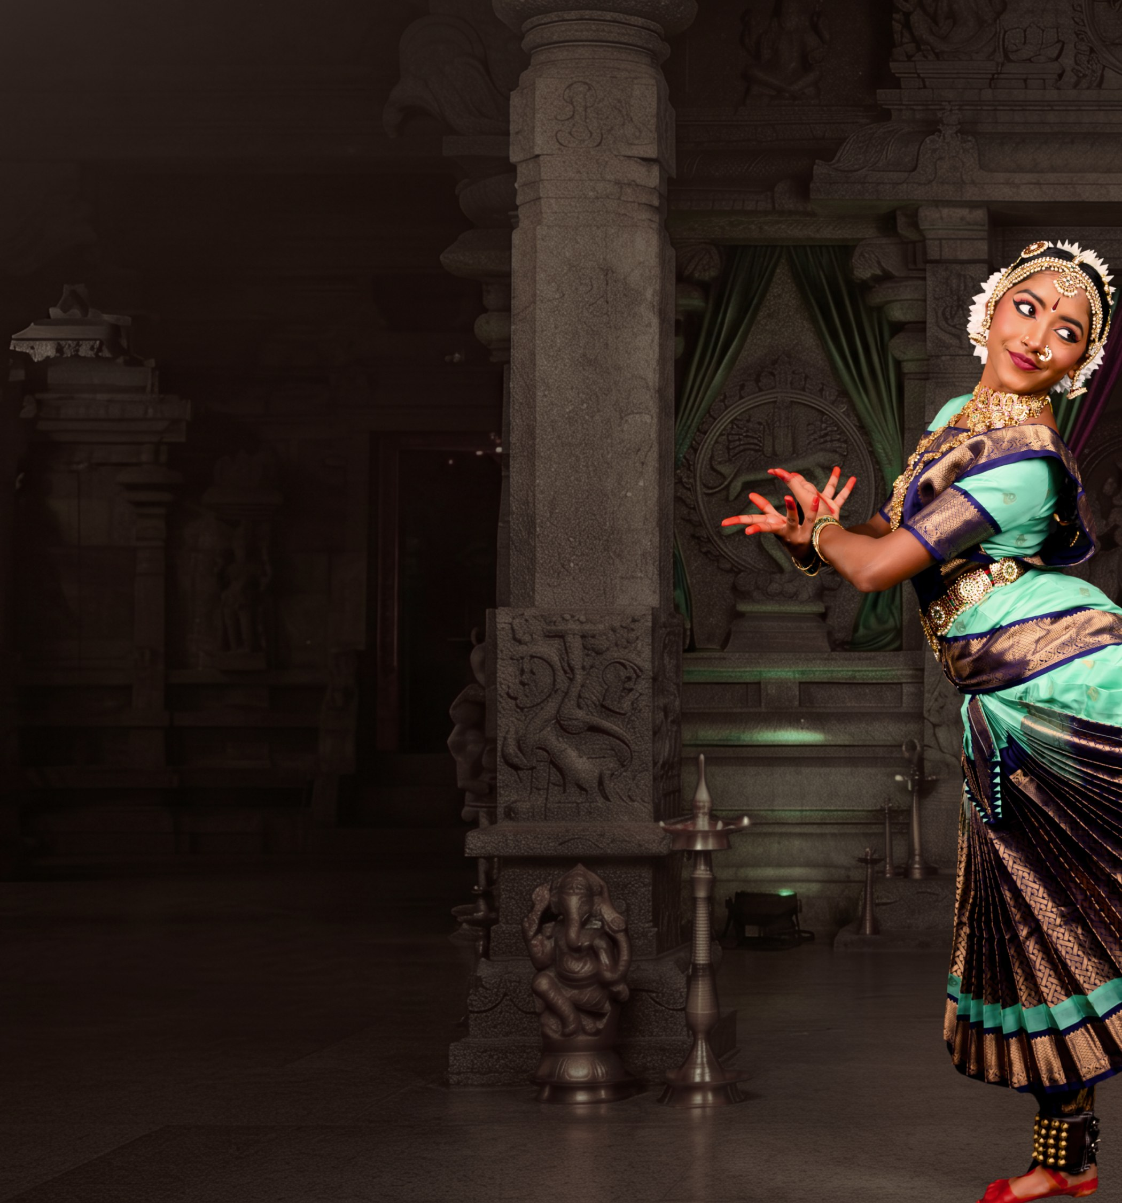
BHARATHANATYAM · ARANGETRAM
Shakthi
THE POWER WITHIN
Program
Tanvika Karupakula
Saturday, September 5, 2026
2:30 PM PDT
Dublin High School
8151 Village Parkway, Dublin, CA 94568

Slide 2
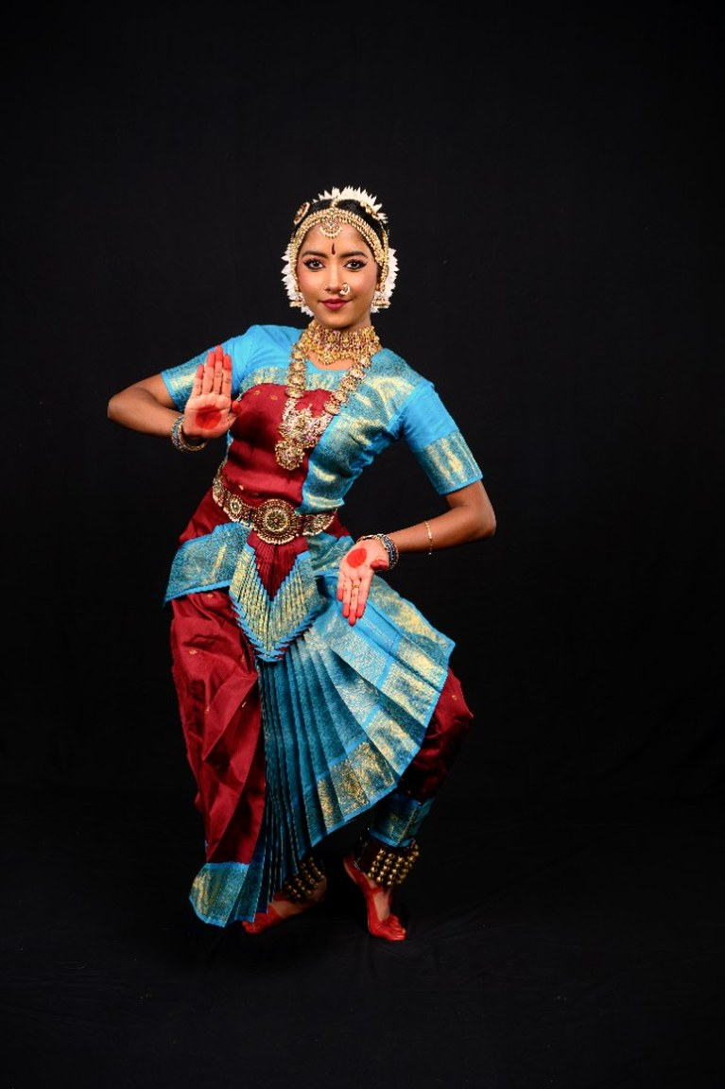
PUSHPANJALI
RAGAM
VAGDHESHWARI
THALAM
ADI
CHOREOGRAPHY
GURU SMT. CHANDNA TALLURI

Slide 3
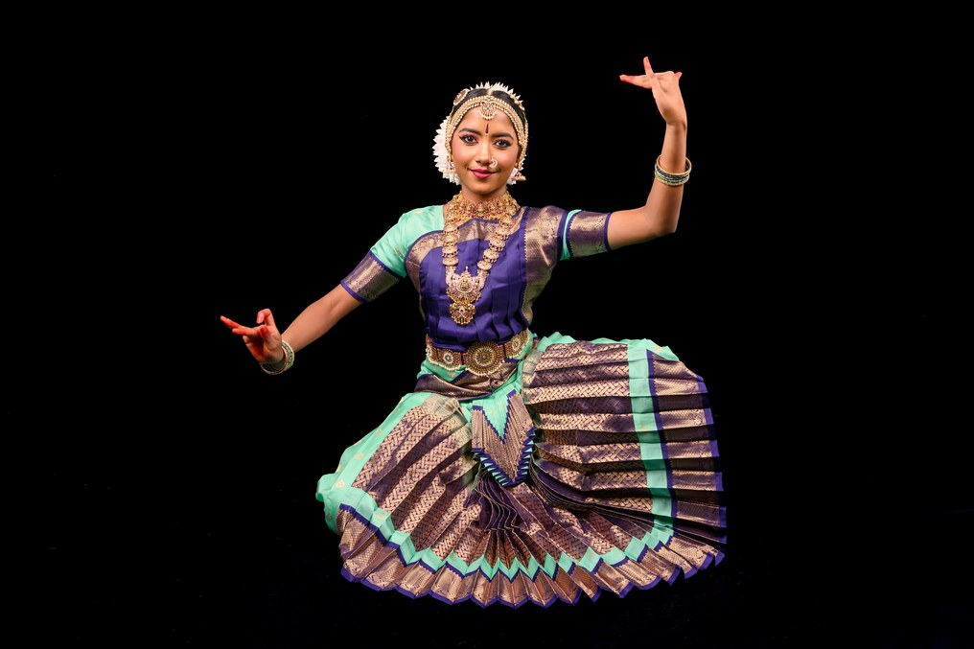
SARASWATHI KOUTHVAM
RAGAM
VAGDHESHWARI
THALAM
CHATURASHRA EKA (TRADITIONAL KOUTHVAM RHYTHM STRUCTURE)
CHOREOGRAPHY
GURU SMT. CHANDNA TALLURI

Slide 4
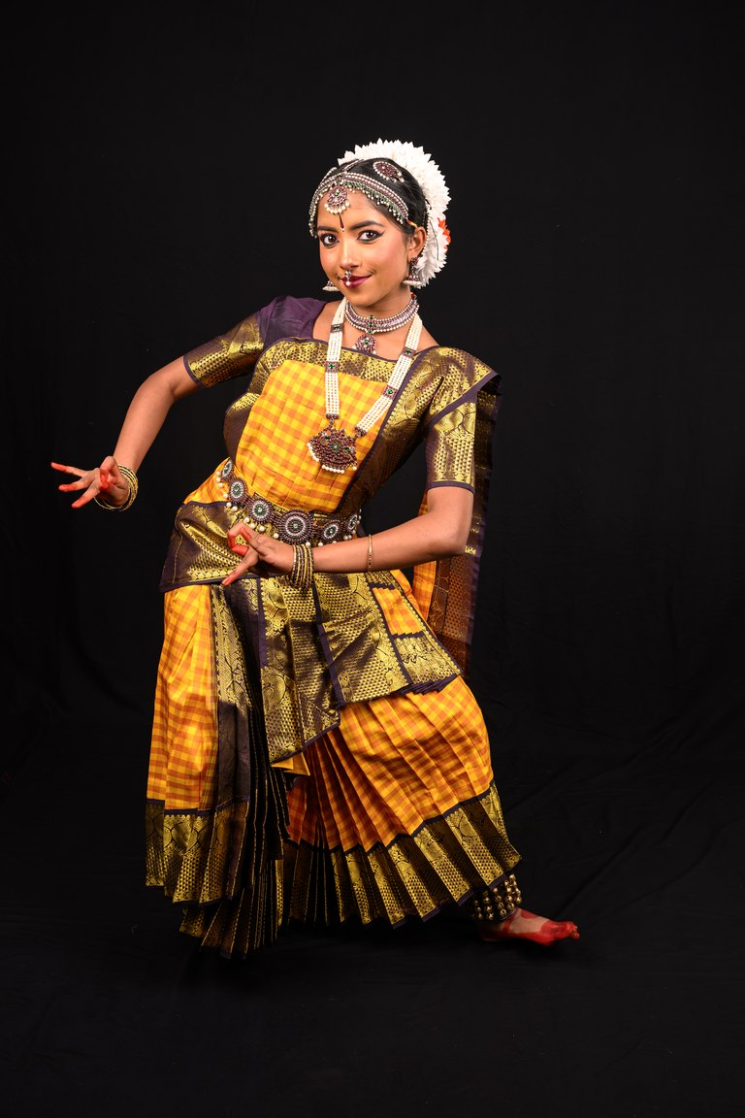
MAHALAKSHMI ASHTAKA ALARIPPU
RAGAM
RAGAMALIKA
THALAM
MISRA CHAPU
CHOREOGRAPHY
DR SRIDHAR VASUDEVAN

Slide 5
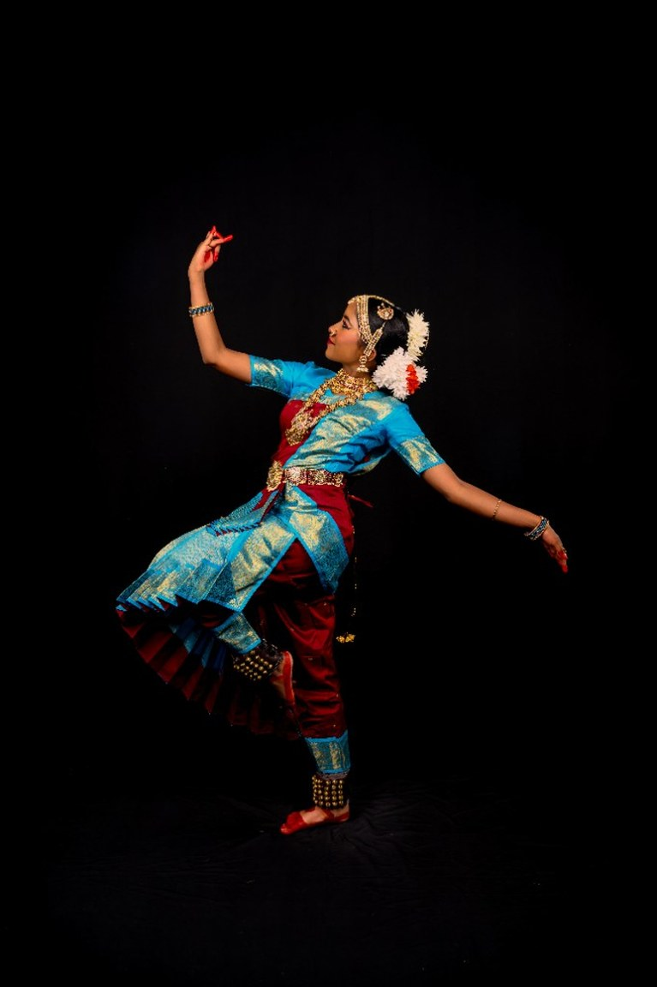
KIRTANA — SHARADE SHYAMALA, SHYAMALE SHARADA
RAGAM
SHYAMALA (MALAYAMARUTHAM / DERIVED CLASSICALS)
THALAM
ADI
CHOREOGRAPHY
GURU SMT. CHANDNA TALLURI

Slide 6
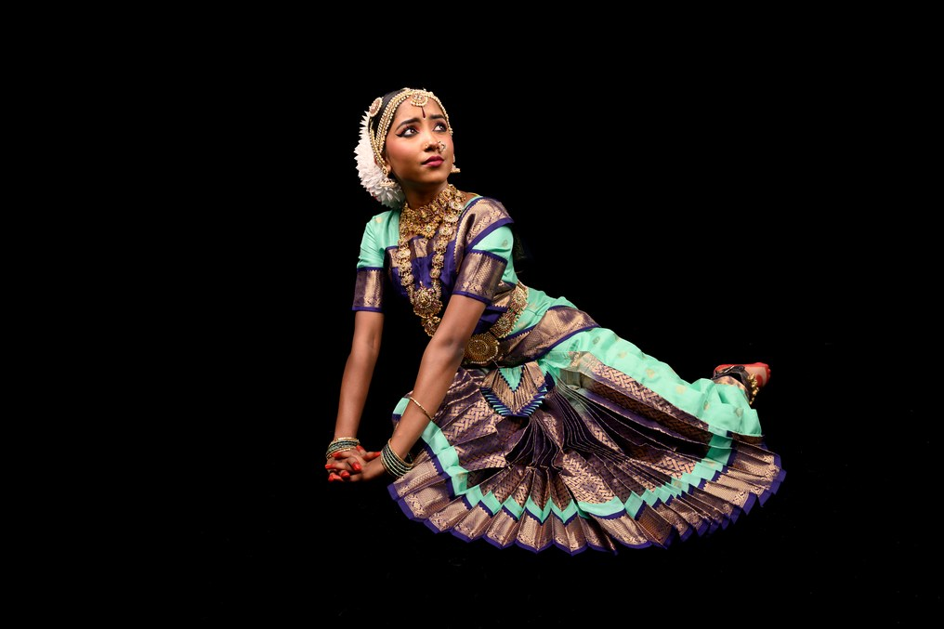
VARNAM DRISHYA BHARATHAM
RAGAM
RAGAMALIKA
THALAM
ADI
CHOREOGRAPHY
GURU SMT. CHANDNA TALLURI

Slide 7
SHAKTHI · THE POWER WITHIN
BHARATHANATYAM ARANGETRAM
Interval
Bathukamma
Tanvika Karupakula · Saturday, September 5, 2026 · Dublin, California
07 / 13

Slide 8
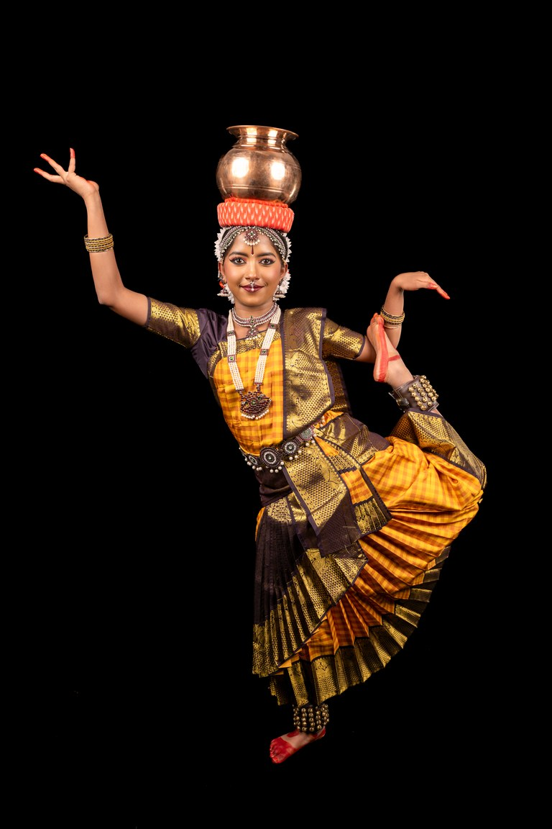
BATHUKAMMA
RAGAM
FOLK MELODY
THALAM
TRADITIONAL FOLK BEAT (DAPPU RHYTHM ALIGNMENT)
CHOREOGRAPHY
GURU SMT. CHANDNA TALLURI

Slide 9
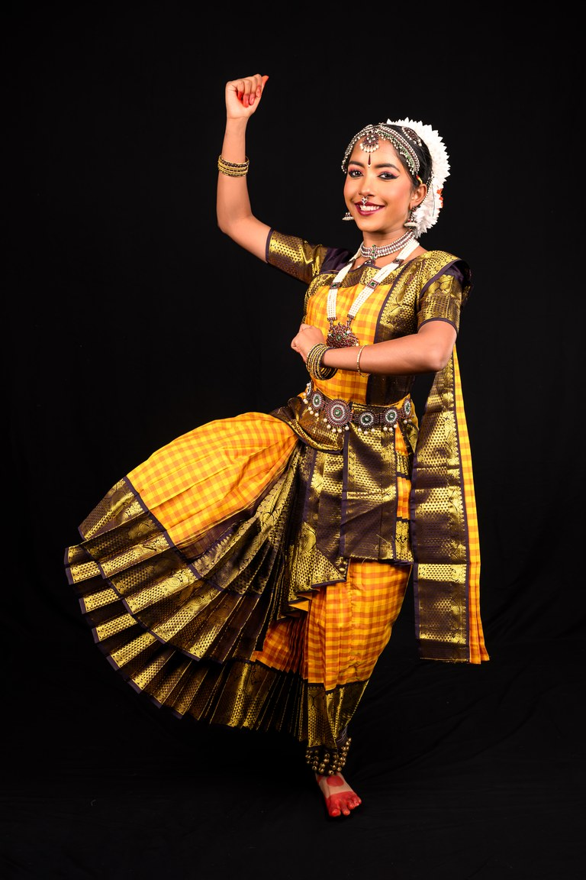
KURUVANJI
RAGAM
RAGAMALIKA (TRADITIONAL FOLK-CLASSICAL BLEND)
THALAM
ADI / MISRA CHAPU
CHOREOGRAPHY
GURU SMT. CHANDNA TALLURI

Slide 10
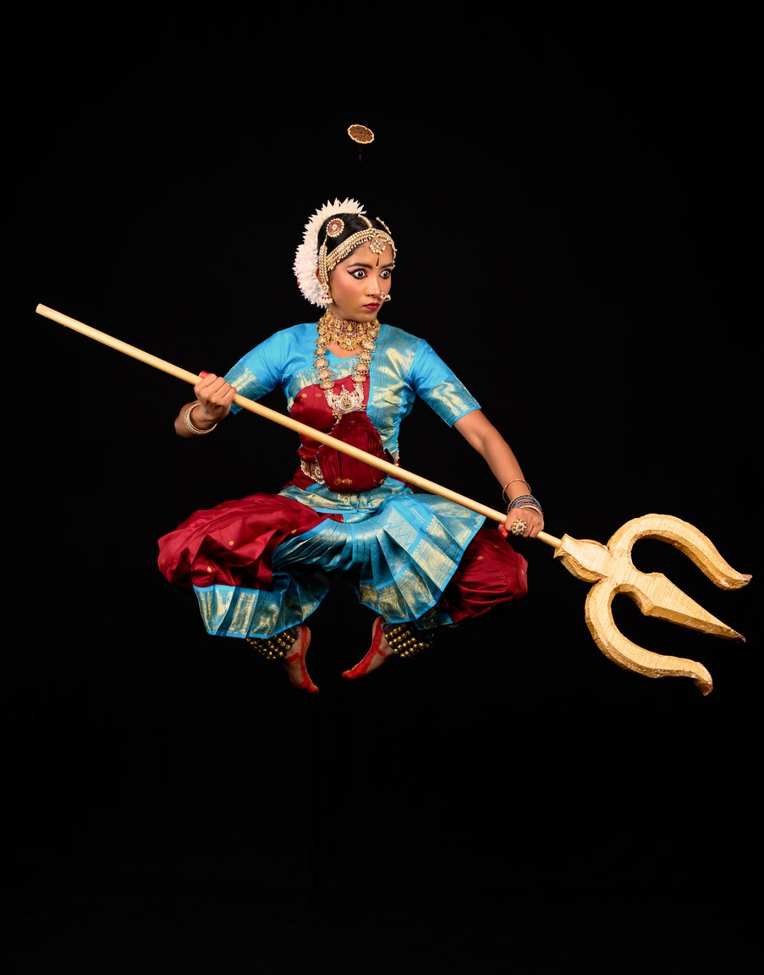
MAHISHASURA MARDINI
RAGAM
REVATHI
THALAM
ADI
CHOREOGRAPHY
GURU SMT. CHANDNA TALLURI

Slide 11
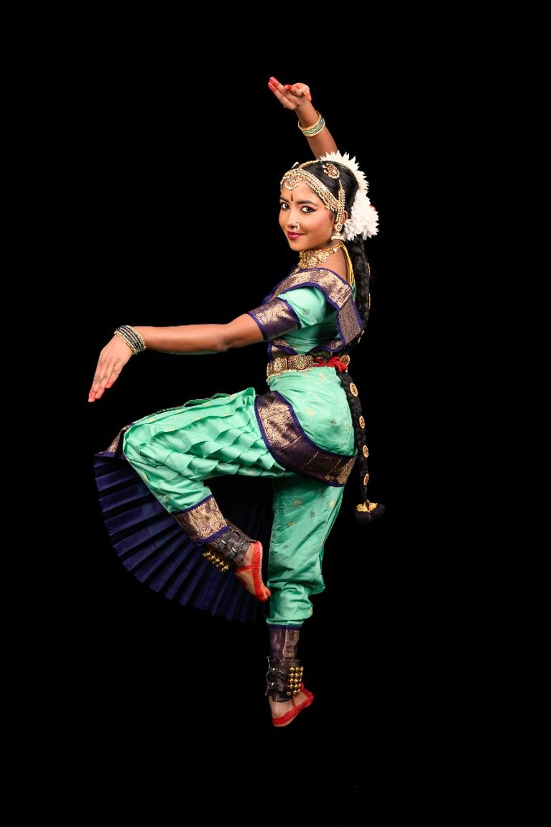
THILLANA — HAMSANANDI
RAGAM
HAMSANANDI
THALAM
ADI
CHOREOGRAPHY
GURU SMT. CHANDNA TALLURI

Slide 12
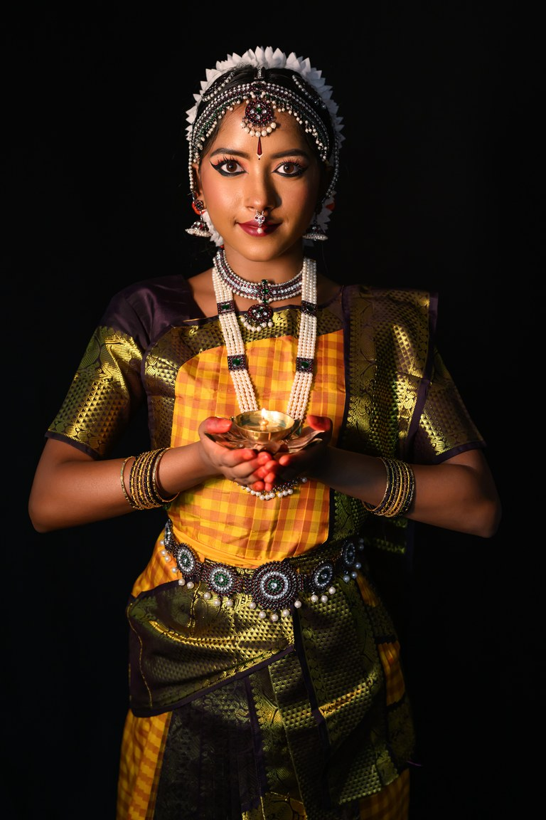
MANGALAM
RAGAM
MADHYAMAVATHI / SAURASHTRAM
THALAM
ADI
CHOREOGRAPHY
GURU SMT. CHANDNA TALLURI

Slide 13
SHAKTHI · THE POWER WITHIN
BHARATHANATYAM ARANGETRAM
MANGALAM
Thank you
Shakthi — The Power Within
Tanvika Karupakula
September 5, 2026
Tanvika Karupakula · Saturday, September 5, 2026 · Dublin, California
13 / 13

