Slide 1
RetailXcel India Pvt. Ltd
Sales Performance
& Loss Analysis
Presented by:
Karunakaran s
₹4.9 Cr
970
21.6%
Revenue
Orders
Margin

Slide 2
TABLE OF CONTENTS
KPI Summary
Category Analysis
01
05
10 KPIs vs targets
Best & worst performers
Business Problem
Regional Performance
02
06
What went wrong & why
Sales by geography
Dashboard
Root Cause - loss Analysis
03
07
Sales and profit overview
3 causes of loss
Monthly Sales Trend
Conclution
04
08
Revenue pattern over time
Find next step

Slide 3
KPI SUMMARY — ACTUAL vs TARGET
BELOW
ABOVE
ABOVE
BELOW
ABOVE
₹4.92 Cr
₹1.06 Cr
21.6%
970
₹50,768
Total Revenue
Total Profit
Profit Margin %
Total Orders
Avg Order Value
Target: ₹8.5 Cr
Target: ₹90 L
Target: 11%
Target: 1,000
Target: ₹8,500
ABOVE
⚠ HIGH
REF
REF
REF
971
14.5%
₹1.63 Cr
₹1.54 Cr
₹1.64 Cr
Unique Customers
Return Rate %
North Revenue
South Revenue
Electronics Rev.
Target: 300
Target: 10%

Slide 4

BUSINESS PROBLEM STATEMENT
Company Background
RetailXcel is a mid-size Indian retail company selling electronics, laptops, audio, appliances & accessories across 4 regions.
FY21-23 analysis covers 970 orders, 971 unique customers, and ₹4.92 Cr in revenue.
Despite healthy order volume, the company is significantly under-target on revenue AND overall margin is fragile.

Slide 5
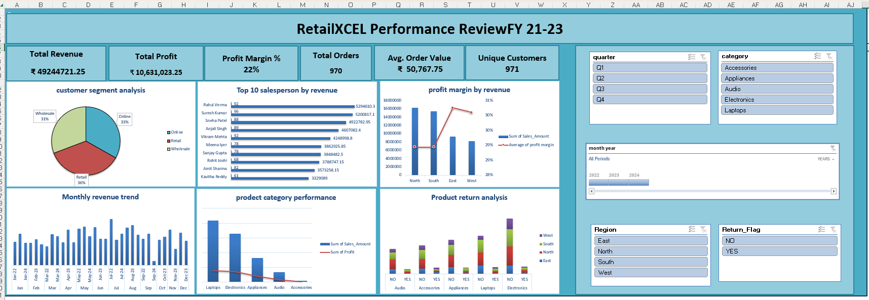
Dashboard

Slide 6
MONTHLY SALES TREND
Business is driven mainly by Laptops & Electronics
Mid-year is the strongest sales period
Other categories play a supporting role
Sales are highest during mid-year (May–Aug) across most categories
July and August show peak performance 📈
Laptops and Electronics contribute the most to overall sales
Accessories provide steady support every month
Appliances and Audio have comparatively lower contribution
“Mid-year peak, Laptops & Electronics dominate, others support the sales.”

Slide 7
PRODUCT CATEGORY ANALYSIS
Margin by Category
Category | Margin% | Signal
Accessories | 56% | ⭐ Best
Audio | 30% | ✅ Good
Appliances | 25% | ✅ OK
Electronics | 24% | ⚠️ Watch
Laptops | 19% | ❌ Worst
⚠️ KEY INSIGHT
Laptops = 42% of revenue but only 19% margin. Accessories = 56% margin but only 0.8% of revenue. Massive untapped opportunity!

Slide 8
REGIONAL PERFORMANCE
Profit Margin by Region
Region | Revenue | Margin
North | ₹1.63 Cr | 29%
South | ₹1.54 Cr | 29%
East | ₹93.5 L | 30%
West | ₹81.9 L | 30%
North – Highest revenue performer (~₹1.63 Cr) with stable margin (29%)
South – Strong revenue (~₹1.54 Cr) and consistent margin (29%)
East – Moderate sales (~₹93.5 L) but better margin (30%)
West – Lowest revenue (~₹81.9 L) and average margin (30%)

Slide 9
ROOT CAUSE ANALYSIS — WHY IS THE COMPANY LOSING PROFIT?
RC 01
RC 02
Discount Is Killing Margin
Returns Eating Revenue
• 0% discount → 35.1% margin
• 14.5% return rate vs 10% target
• 20% discount → 6.4% margin (−80% drop)
• ₹66.3L in total returned revenue
• Laptops at 20% disc = near zero profit
• Laptops: ₹29L returns alone

Slide 10
ROOT CAUSE - Discount Is Killing Margin
RC 01
Impact of Discount on Profit Margin
Observation:
Profit margin consistently decreases as discount levels increase across all product categories.
Supporting Insight:
At 0% discount, profit margins are highest (~50–60%)
At 10–20% discount, profit margins drop significantly (~5–25%)
Categories like Laptops and Electronics show very low margins at higher discounts
“More discount = Less profit”

Slide 11
ROOT CAUSE - Returns Eating Revenue
RC 02
Returns Eating Revenue
 | Column Labels
 | NO |  | YES |  | Total Sum of Sales_Amount | Total Count of Order_ID
Row Labels | Sum of Sales_Amount | Count of Order_ID | Sum of Sales_Amount | Count of Order_ID
Laptops | 17949285.8 | 175 | 2901796.1 | 30 | 20851081.9 | 205
Electronics | 14462671.35 | 252 | 1915988.95 | 33 | 16378660.3 | 285
Audio | 2946759.75 | 115 | 469318.1 | 20 | 3416077.85 | 135
Appliances | 6955209.65 | 157 | 1259215.3 | 29 | 8214424.95 | 186
Accessories | 303720.05 | 130 | 80756.2 | 29 | 384476.25 | 159
Grand Total | 42617646.6 | 829 | 6627074.65 | 141 | 49244721.25 | 970
Observation:
Returns are reducing overall revenue, especially in high-value categories like Electronics and Laptop
Supporting Data:
Total Return Orders: 141
Total Return Value: ₹6.6 Lakhs
Highest returns seen in Electronics & Laptops
Root Cause:
Possible product quality issues
Customer expectation mismatch
Delivery or damage problems
Impact:
Revenue loss
Reduced profitability

Slide 12
CONCLUSION & NEXT STEPS
Proposed Next Steps
Summary of Findings
▸ Revenue ₹4.92 Cr — 58% of ₹8.5 Cr target
Q1
Cap discounts
▸ 2 root causes identified for profit leakage
▸ Discount policy is the #1 fixable issue
Q2
Push Accessories marketing
Q3
Returns analysis deep-dive
Thank You

