Slide 1

Presentation Nvidia
Karunanayake Dinura, Hussain Haris, N’Guessan Yannis

Slide 2
Summary
History
Activities
Size
Values
Career prospects

Slide 3
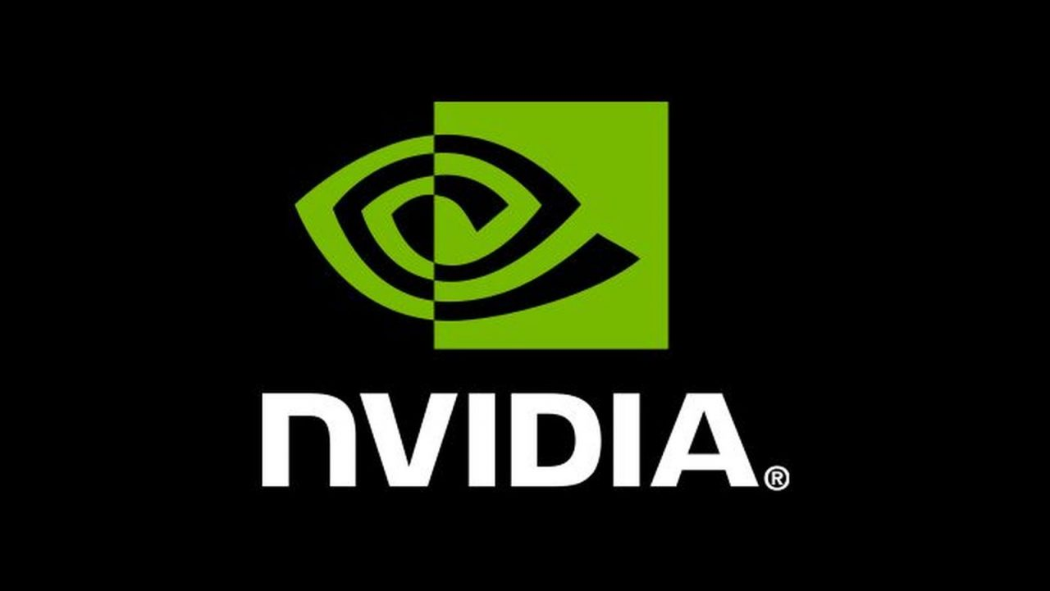
History
1993 → Fondation Nvidia
1994 → First partnership
1995 → First market product
1998 → Second partnership
2001 → Chipset market
2009 → First collaboration

Slide 4
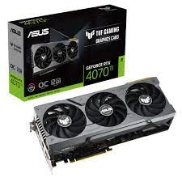
Activities
Design/sellsGPUS → gaming/cryptomining/ professionnal software
Sells chips → vehicles/robotic

Slide 5
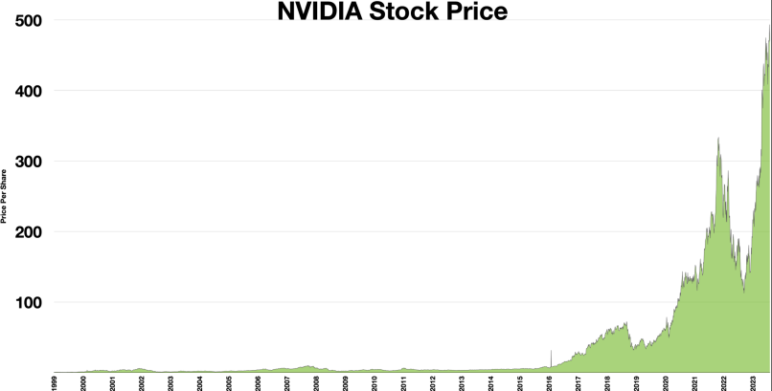
Size
26k employes
Stock price 430$
1999 → First capitalisation market
2022 → 24 billions$ revenue
Increase →117% last 5 years
in 1999

Slide 6
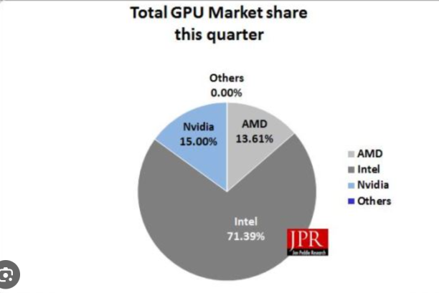
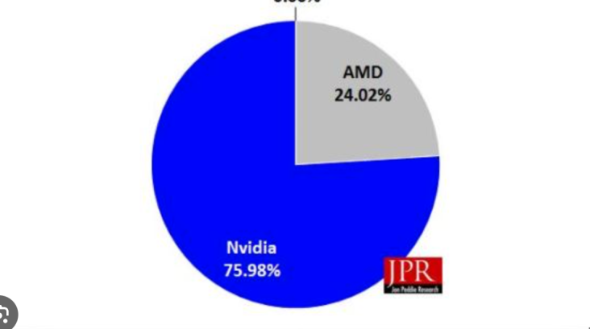
Size

Slide 7
Values

Slide 8
Carrer prospects

Slide 9
Thanks for your attention !!

