Slide 1
HCI Project

Slide 2
AGENDA
Problem Statement
Concept Video
Need finding
Low Fidelity Prototype
High Fidelity Prototype

Slide 3
TEAM COMPOSITION
SAHANA BHAT
PES1201700300
ECE
sahanabhatp@gmail.com
2. KARUNASAGAR KS
PES1201701905
EEE
skarunasagar3@gmail.com

Slide 4
PROBLEM STATEMENT
Design an interaction flow for how to behave at a traffic stop (Cops, EMTs, Civilians, etc)

Slide 5
Traffic stops are an effective way for law enforcement officers to serve and protect.
Effective traffic stops will impact violent crime, illegal drugs, and traffic crashes ◦
Traffic crashes are the leading cause of death for young people ages 15-24
Fatal crash occurs every 13 minutes in the US
Introduction

Slide 6
Low Fidelity Prototype
Goal
Design an interaction flow for how to behave at a traffic stop (Cops, EMTs, Civilians, etc)

Slide 7
Typical Traffic website has its logo, Color scheme, Options , About and so on.
The Website which has the potential Civilians as targeted users is made accordingly.

Slide 8
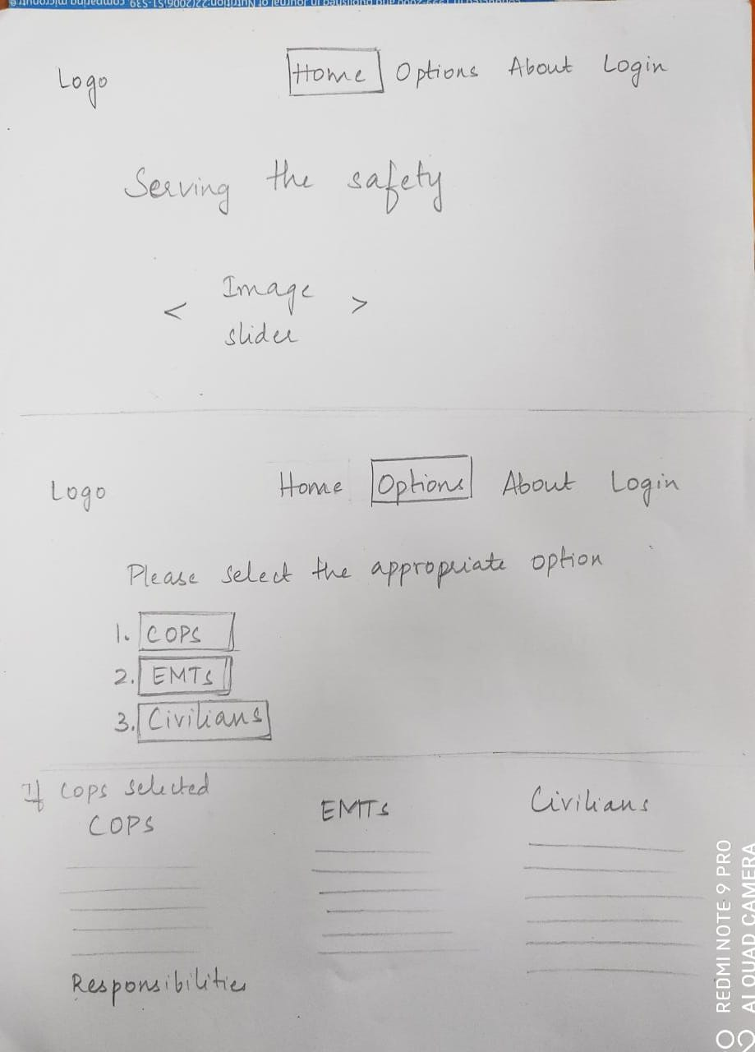

Slide 9
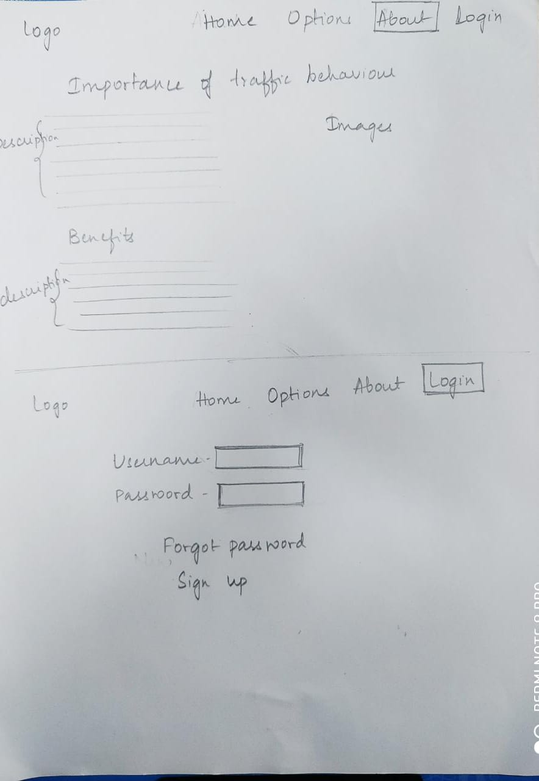

Slide 10
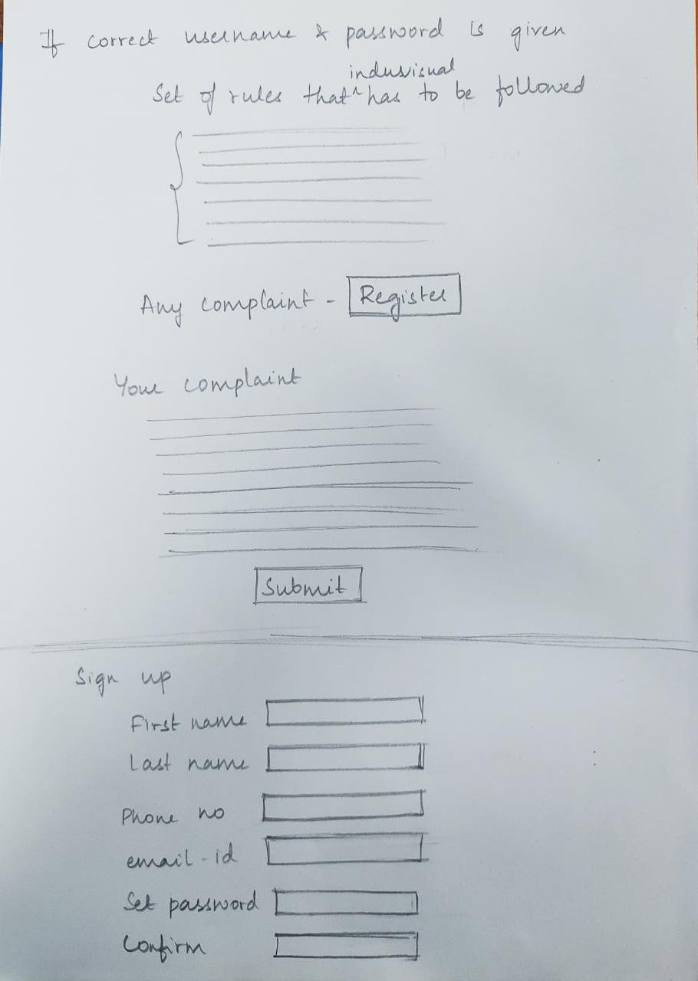

Slide 11
