Slide 1
Team 01
Using Git Successfully

Slide 2




Team Members
Karun Bourishetty Aawaj Joshi Dristi Marasini Sirisha Devineni

Slide 3
SSH
Presented by Karun

Slide 4
What is SSH?
Secure Shell (SSH) is a cryptographic network protocol for operating network services securely over an unsecured network.
Typical applications include remote command-line login and remote command execution, but any network service can be secured with SSH.
Presented by Karun

Slide 5
• Transmission is secure.
• Transmission can be compressed.
• No login password required
Features of SSH
Presented by Karun

Slide 6
Steps for setting up SSH
First, we will generate a SSH key using PuttyKeyGEN
Save the private using a phrase into the local machine In the folder C:\Users\<S-ID>\.ssh
Save the public key in GitHub https://github.com/settings/keys
Clone down the repo, and set the path where you have saved the private key in the machine
Enter the passphrase when prompted.
Successfully the repo will be cloned.
Presented by Karun

Slide 7
Generation of SSH key
Presented by Karun

Slide 8
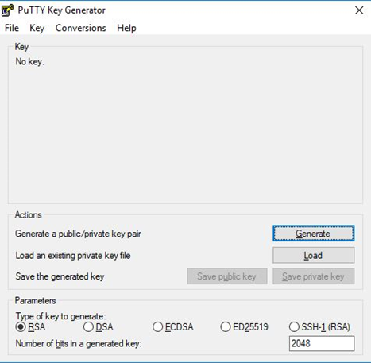
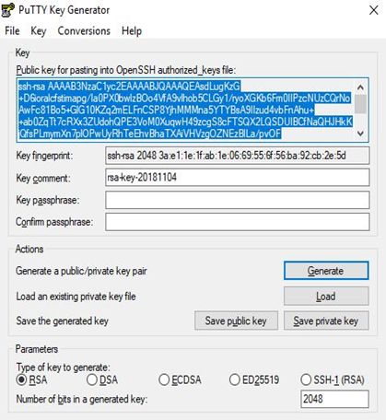
Presented by Karun

Slide 9
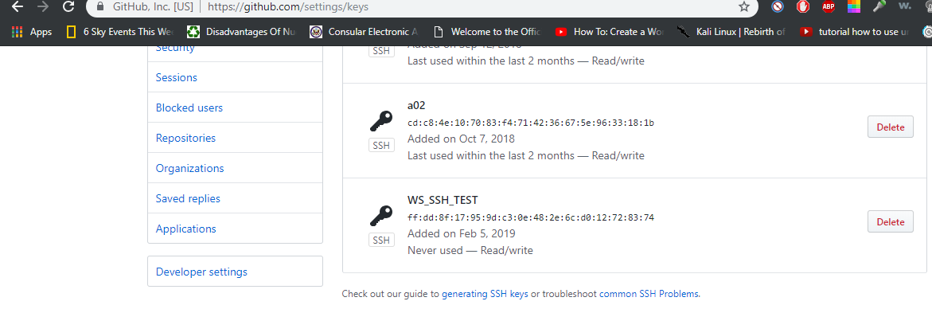
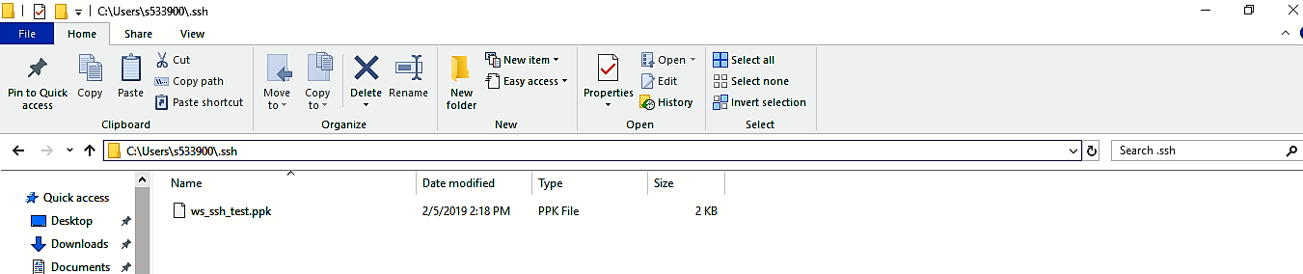
Presented by Karun

Slide 10
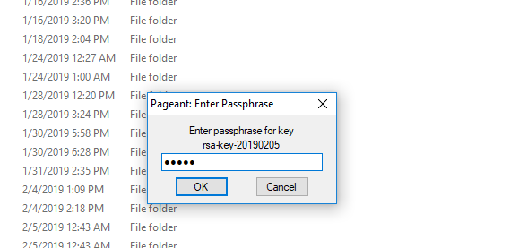
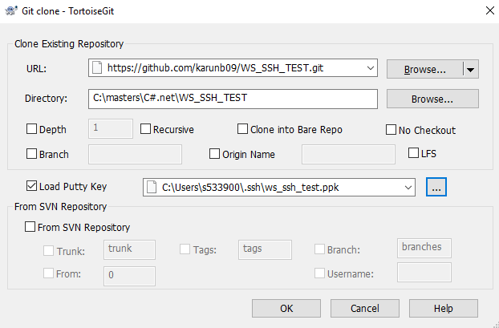
Presented by Karun

Slide 11
Merge conflicts
Presented by Aawaj

Slide 12
Merging
In Git, “merging” is the act of integrating another branch into your current working branch.
Presented by Aawaj
Notes:
You're taking changes from another context (that's what a branch effectively is: a context) and combine them with your current working files.

Slide 13
Merge Conflict
A merge conflict generally occurs when your current branch and the branch you want to merge into the current branch have diverged.
Presented by Aawaj
Notes:
In simple terms, you have commits in your current branch which are not in the other branch, and vice versa.

Slide 14
Merge Conflict
Often, a merge conflict occurs when you and your teammate make different changes to the same lines of the same file or when you edit a file and your teammate deletes the same file.
Presented by Aawaj
Notes:
Git can often resolve differences between branches and merge them automatically. Usually, the changes are on different lines, or even in different files, which makes the merge simple for computers to understand. However, sometimes there are competing changes that Git can't resolve without your help.

Slide 15
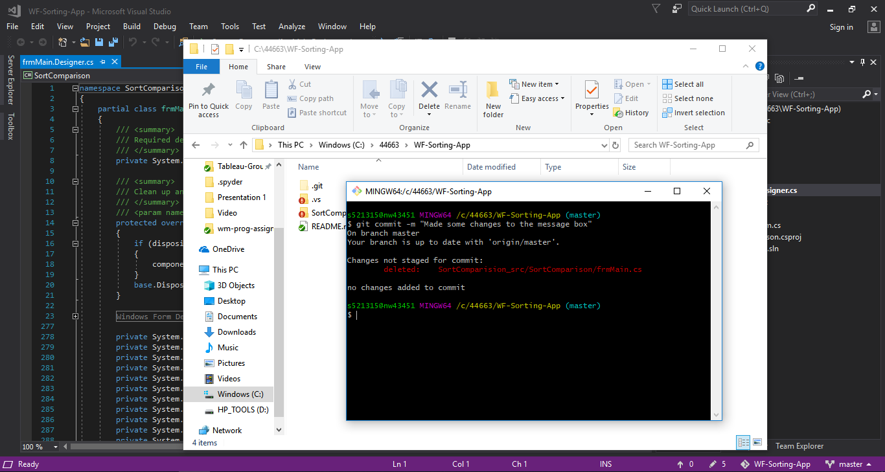
Presented by Aawaj
Notes:
Here is a conflict that occured because I deleted a file that Karun had modified.

Slide 16
Simulation of a Merge Conflict
Presented by Aawaj

Slide 17
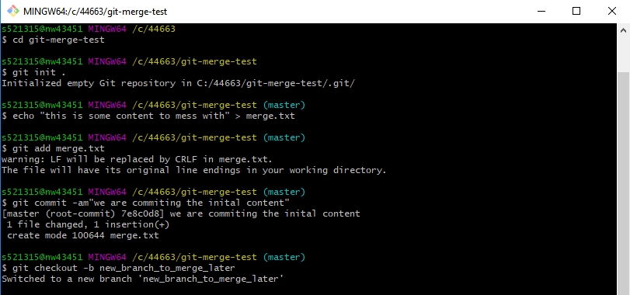
Presented by Aawaj

Slide 18
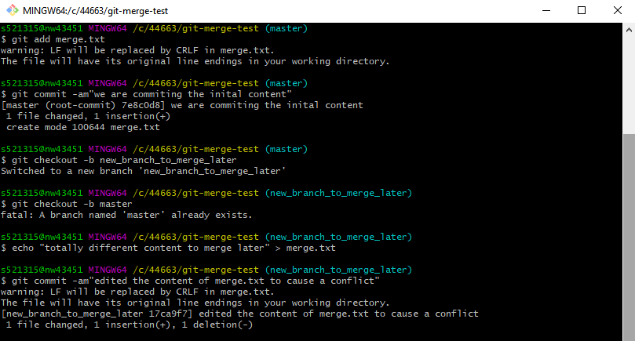
Presented by Aawaj

Slide 19
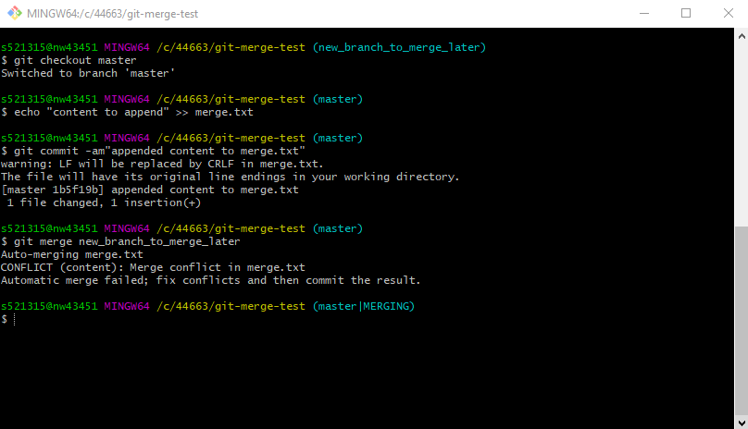
Presented by Aawaj

Slide 20
Fixing the Merge Conflict
Presented by Aawaj

Slide 21
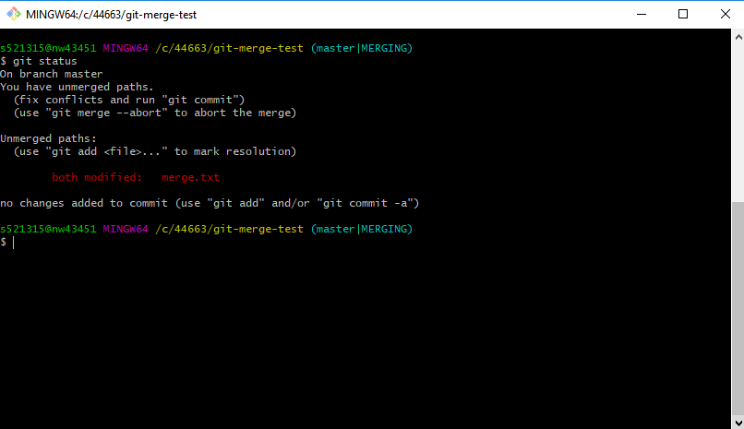
Presented by Aawaj

Slide 22
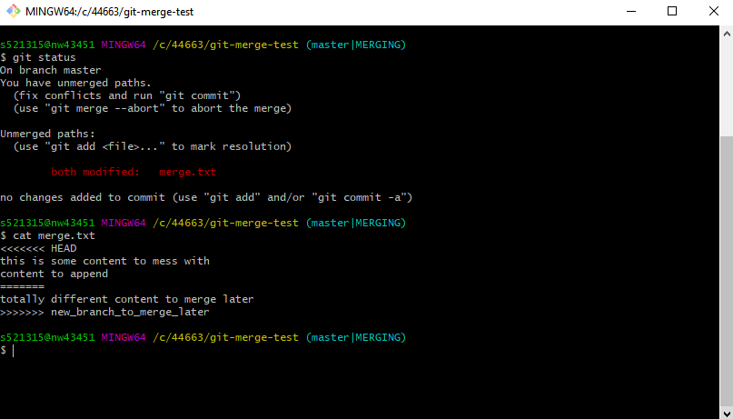
Presented by Aawaj

Slide 23
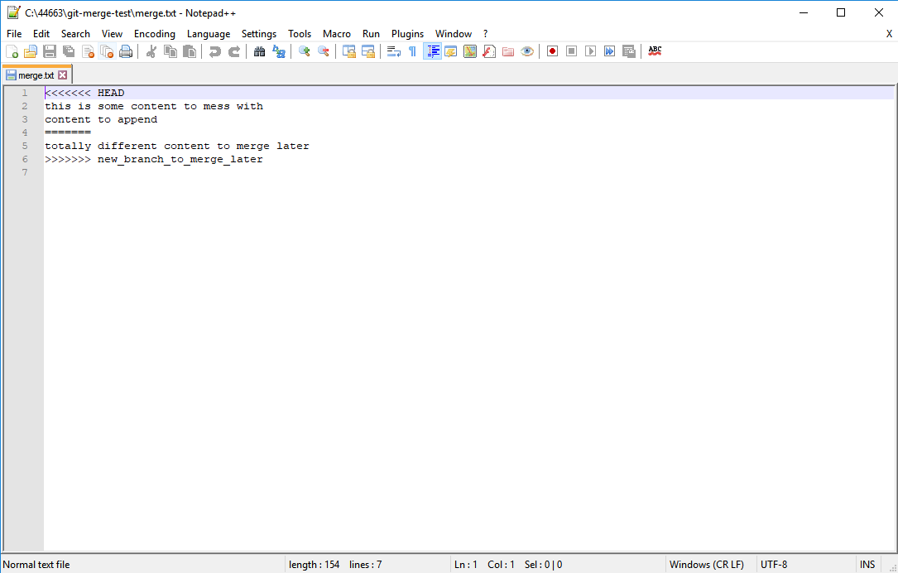
Presented by Aawaj

Slide 24
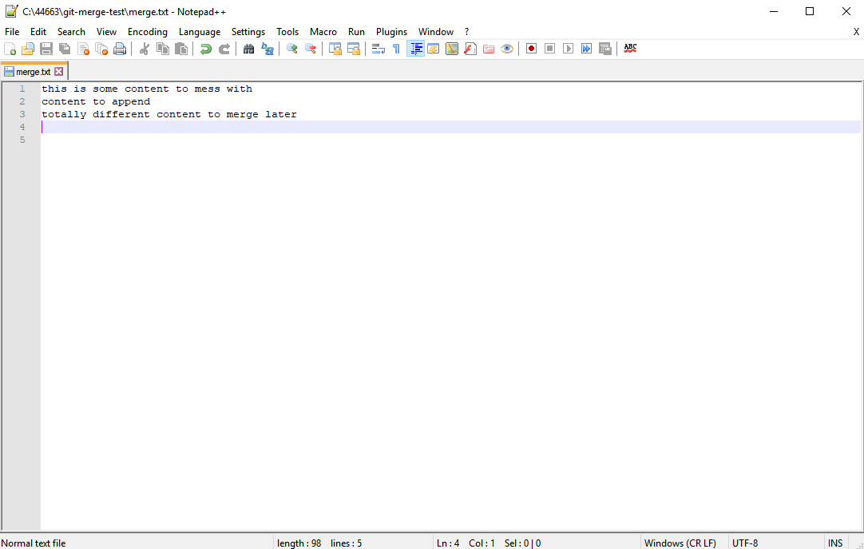
Presented by Aawaj

Slide 25
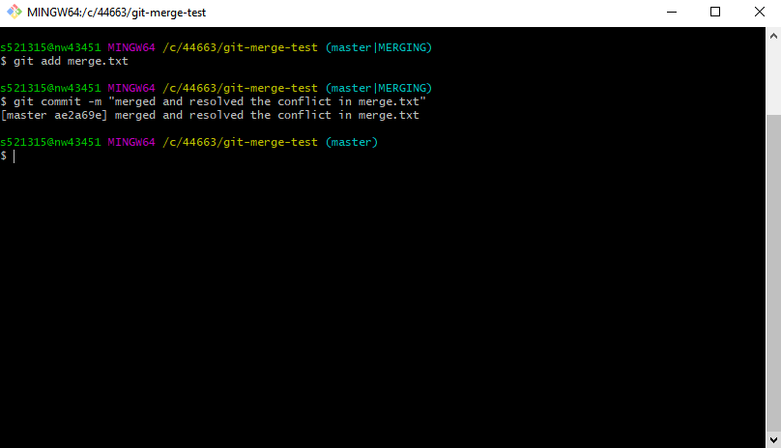
Presented by Aawaj

Slide 26
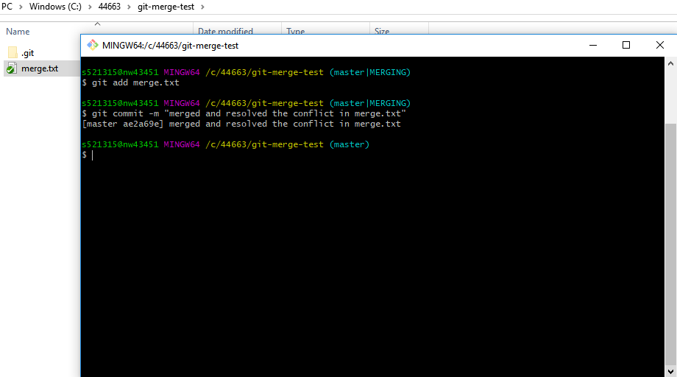
Presented by Aawaj

Slide 27
Incremental commits
Presented by Dristi

Slide 28
Git Commit
Used to save the changes to the local repository
Commit early and often
Make Useful commit messages
Make few changes per commit
Presented by Dristi

Slide 29
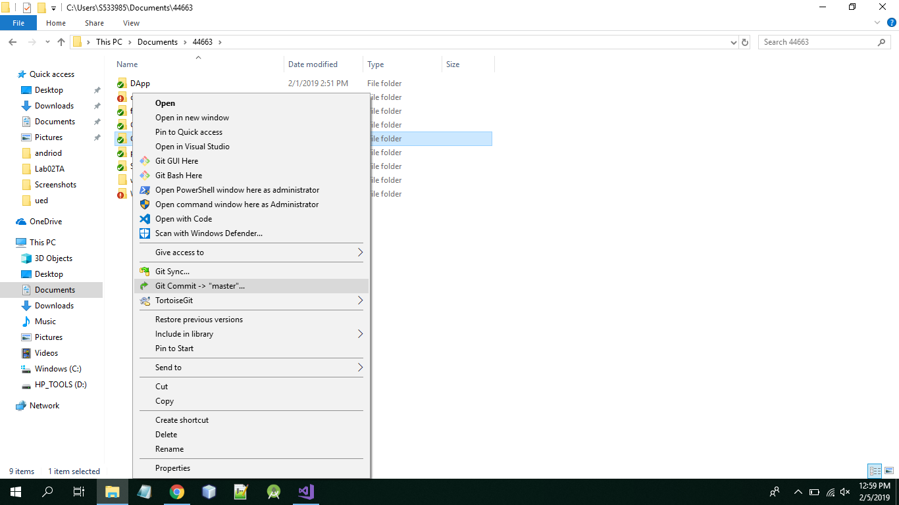
Incremental Commit Process
Presented by Dristi

Slide 30
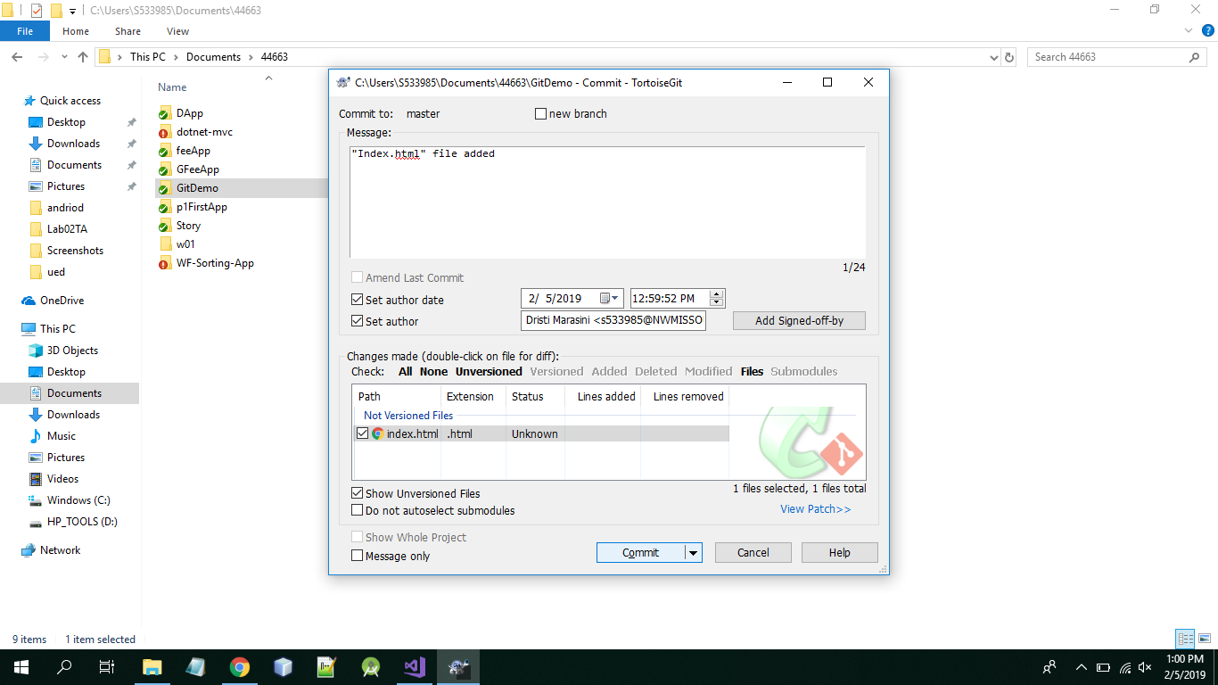
Presented by Dristi

Slide 31
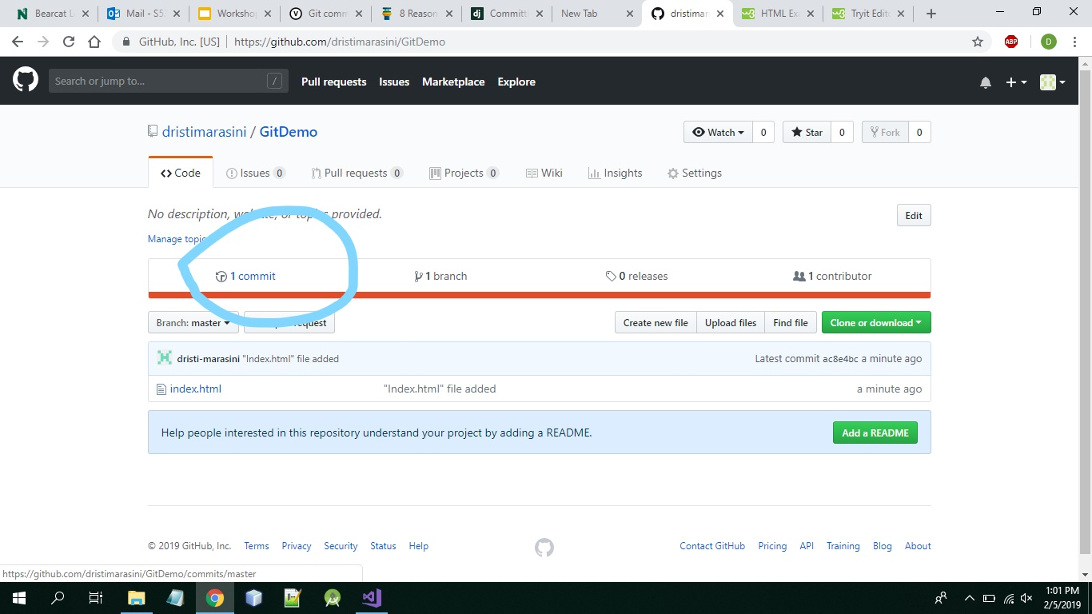
Presented by Dristi

Slide 32
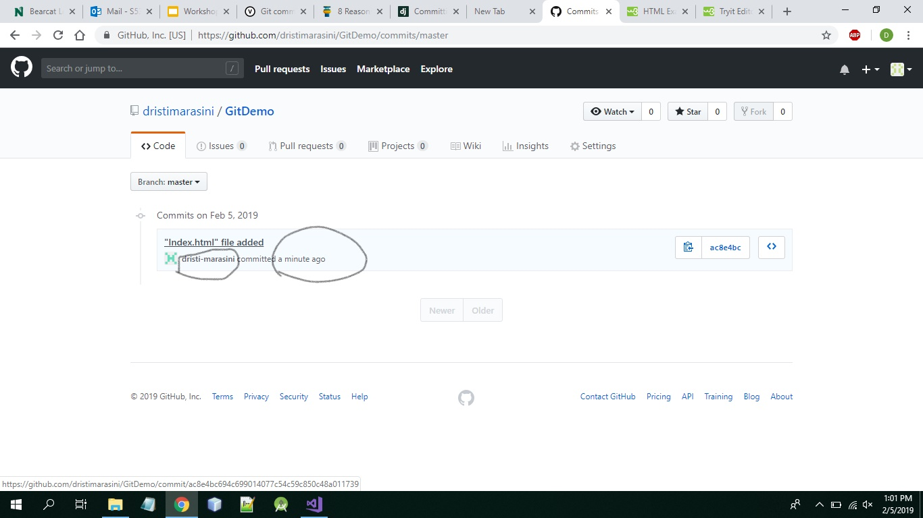
Presented by Dristi

Slide 33
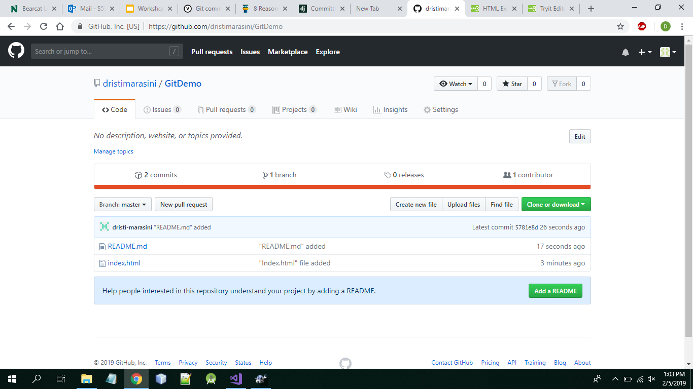
Presented by Dristi

Slide 34
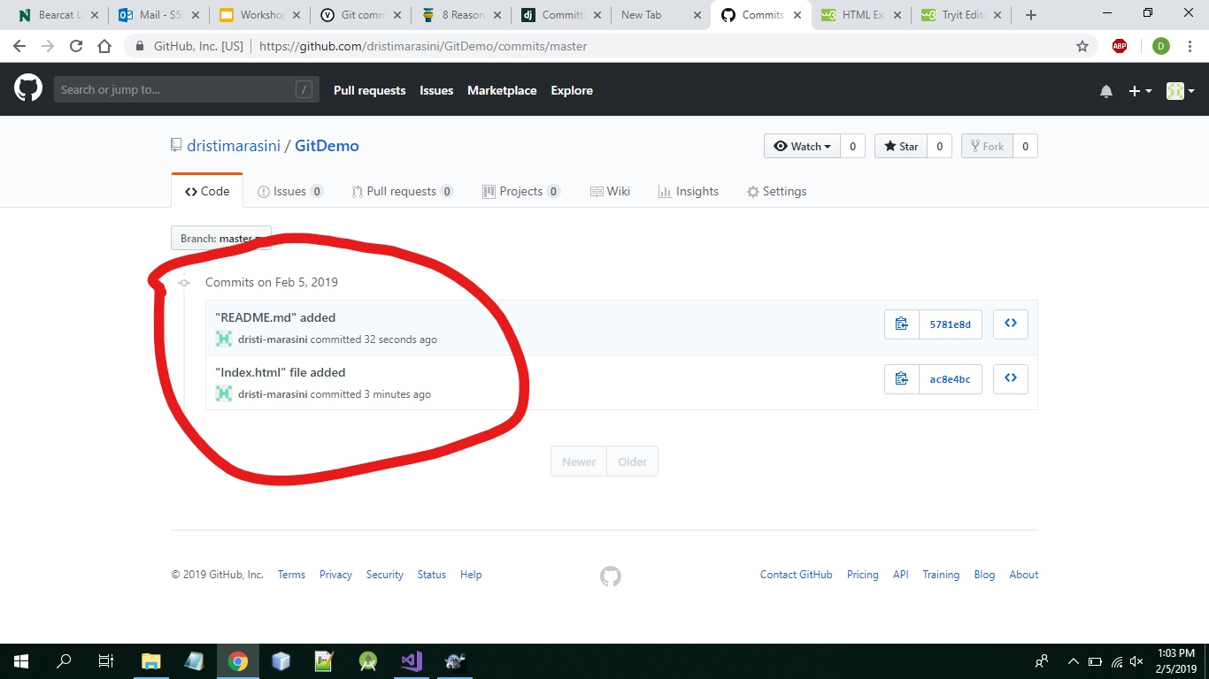
Presented by Dristi

Slide 35
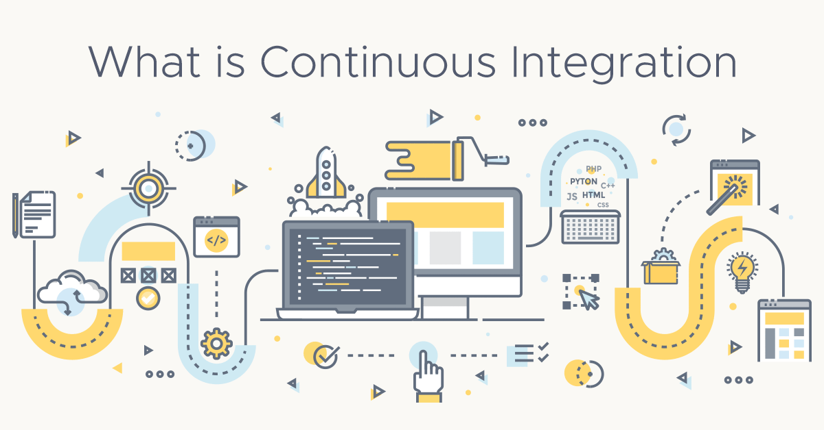
Presented by Sirisha

Slide 36
Why Continuous Integration ?
A typical software development workflow.
What if the developer’s changeset is not acceptable for integration of the project?
Who or what are responsible for other steps?
Step 1
Step 2
Step 3
A developer writes new code (eg: add a feature or fix a bug) that represents change to the codebase.
Then merge their changes into code repository(eg: GitHub)
Source code is compiled and built into deployable versions
Presented by Sirisha
Notes:
High level process
Questions?
How can we know that a developer’s changeset (from step 1) is acceptable for integration into the project?
Who (or what) is responsible for performing steps 2-3?
Continuous Integration (CI) is a development practice where developers integrate code into a shared repository frequently, preferably several times a day. Each integration can then be verified by an automated build and automated tests. While automated testing is not strictly part of CI it is typically implied.

Slide 37
A simple CI workflow
Branching
Testing
Pull requests
Quality Assurance
Build
Code Review
Tagging, Versioning, and storing the built artifact
Presented by Sirisha

Slide 38
Benefits of CI
Speeds up the workflow
Encourages each team member to push their changeset without fear of breaking anything.
Errors can be detected and located quickly.
Application deployable at any point.
Presented by Sirisha

Slide 39
CI tools
Travis CI
Jenkins
GitLab Continuous Integration/Continuous Delivery
Bamboo
Circle CI
Presented by Sirisha

Slide 40
References
https://livebook.manning.com/#!/book/continuous-integration-in-dot-net/about-this-book/
https://codeship.com/continuous-integration-essentials
https://blog.codeship.com/benefits-of-continuous-integration/?__hstc=753710.ec4cb22c00f2635a21980e0b5dae14b2.1477583947804.1477583947804.1477583947804.1&__hssc=753710.1.1477583947805&__hsfp=4231963282
https://code.tutsplus.com/courses/continuous-integration-workflow
https://help.github.com/articles/connecting-to-github-with-ssh/
Presented by Sirisha

