Slide 1
BI
Business Intelligence
Case Study
E-Commerce Sales Analysis
Python • Pandas
MySQL • SQL
Power BI
Prepared by Karun Krishnan | Student Support – Business Intelligence Team Interview | Olist Brazilian E-Commerce Dataset

Slide 2
OVERVIEW
Agenda
A structured walkthrough of the complete BI workflow
01
02
03
Business Objective
Dataset & Data Cleaning
SQL Analysis
What the business wanted to understand
Python-based preparation of 5 CSV files
Four targeted business questions
04
05
06
Power BI Dashboard Insights
Recommendations
Conclusion & Q&A
5 visuals: required + optional
Actionable business outcomes

Slide 3






BUSINESS OBJECTIVE
What Does Management Want to Know?
E-commerce company needs clarity on sales, customers, and growth
Sales Performance
Customer Behaviour
Seasonal Trends
Where is revenue being generated?
How and when do customers buy?
When do demand spikes occur?
Regional Performance
Operational Anomalies
Top Categories
Which geographies lead in sales?
What is causing revenue leakage?
Which products drive the most value?

Slide 4
DATA FOUNDATION
Dataset Overview
Olist Brazilian E-Commerce — 5 interconnected CSV files from Kaggle
Source Files
Customers
olist_customers_dataset.csv
Customer records & location
olist_orders_dataset.csv
Order status & timestamps
Orders
Products
olist_order_items_dataset.csv
Line items — price & freight
Order Items
olist_products_dataset.csv
Product catalog & categories
product_category_name_translation.csv
EN translation of PT categories
Key Join Columns
customer_id
order_id
product_id
category_name

Slide 5


DATA CLEANING & PREPARATION
Python-Based Data Cleaning
Every decision documented; analysis-ready dataset exported for SQL
Data Quality Issues Found
Cleaning Steps Performed
Missing delivery timestamps in orders
Loaded all 5 CSVs; profiled shape, nulls, types
Missing product weight / dimensions
Converted datetime columns with pd.to_datetime()
Unmatched category name translations
Filled / dropped missing values — per column logic
Duplicate merge columns after join
Merged tables on customer_id, order_id, product_id
Dropped duplicate columns from merge artifacts
Inconsistent date formats
Exported clean CSV for MySQL import
Output: analysis_ready_dataset.csv → imported into MySQL for SQL analysis

Slide 6
SQL ANALYSIS
Four Business Questions Answered with SQL
Aggregation, joins, grouping, filtering, conditional logic
Q1
Revenue & Volume by Category
Top 10 categories by total revenue and order count using GROUP BY + ORDER BY DESC
Q2
Monthly Sales Trends
Revenue & volume trend by month using DATE_FORMAT() to identify seasonal patterns
Q3
Customer Distribution by State
Revenue and orders per customer state with aggregation on geographic dimension
Q4
Anomaly: Canceled Orders
Filtered on order_status = 'canceled' — quantified revenue leakage per category
Q5*
Avg Revenue per Order (Bonus)
SUM(price) / COUNT(DISTINCT order_id) per category — uncovers high-value segments

Slide 7
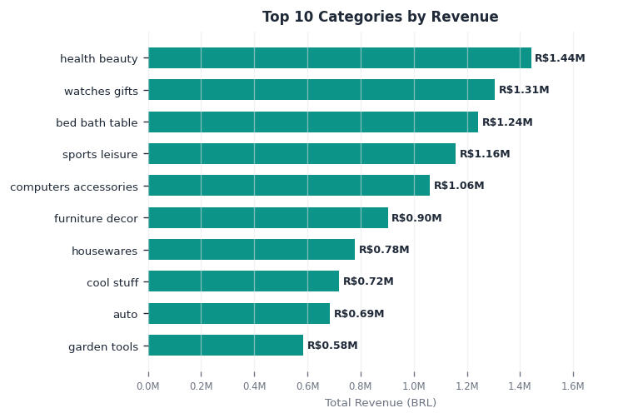



ANALYSIS 1 — CATEGORY REVENUE
Top 10 Product Categories by Revenue
Health & Beauty leads in revenue; Bed Bath Table leads in order volume
KEY INSIGHTS
Top earner
Health & Beauty generated the highest total revenue
Order volume
Bed Bath Table had the most orders — suggesting lower AOV
Hidden value
Watches & Gifts: high revenue with fewer orders = premium AOV
Concentration
Top 3 categories account for ~40% of total revenue

Slide 8
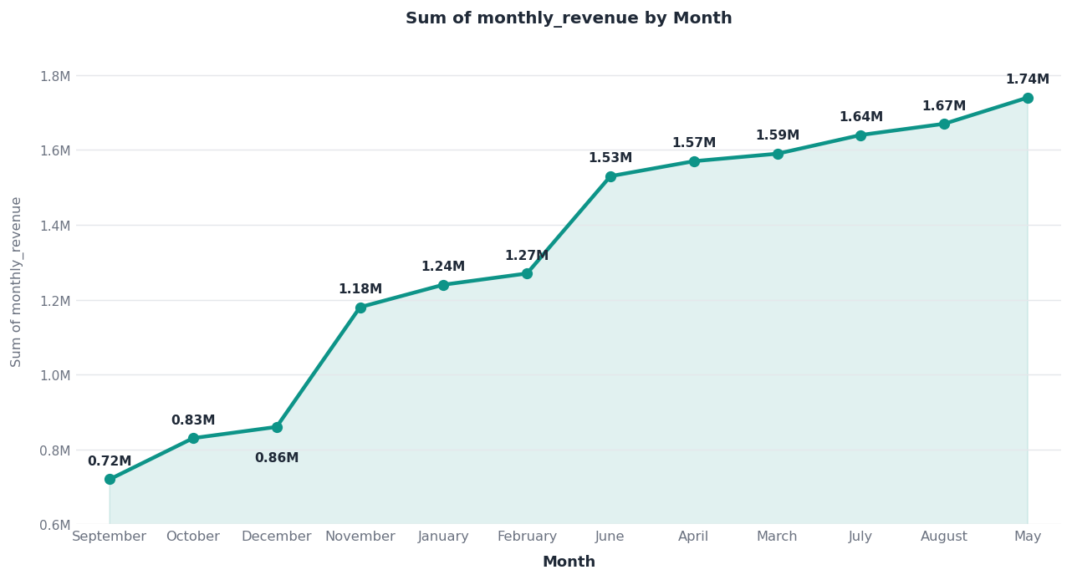
ANALYSIS 2 — SALES TRENDS
Monthly Revenue & Order Trends
Strong growth trajectory with seasonal peaks visible in Nov/Dec
Nov/Dec Peaks
YoY Growth
Implication
Holiday season drives 40-60% above monthly average
Revenue nearly doubled from 2017 to 2018 year-end
Inventory & marketing campaigns must be pre-planned by Sep

Slide 9
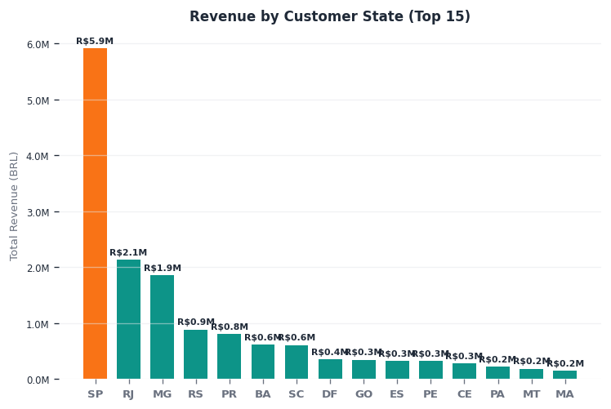
ANALYSIS 3 — GEOGRAPHIC DISTRIBUTION
Revenue & Orders by Customer State
São Paulo dominates; significant opportunity in underserved regions
~39%
of revenue from São Paulo alone
Top 3
states = 60%+ of total revenue
7 states
generated <5% each
Business Implication: Geographic concentration risk — growth strategy should target RJ, MG, and underserved southern states.

Slide 10
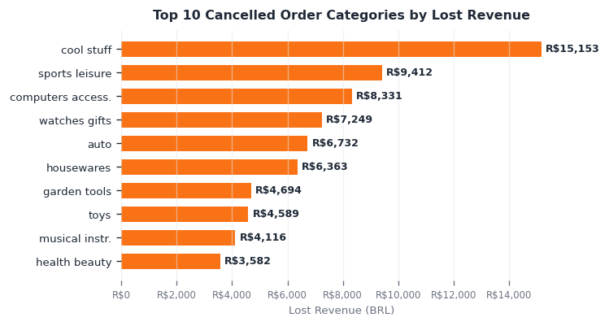
ANALYSIS 4 — DATA QUALITY & ANOMALIES
Canceled Order Analysis
Canceled orders = direct revenue leakage + operational signal
Revenue Leakage
Each cancellation in high-ticket categories represents significant lost revenue
Operational Risk
High cancel rate suggests stockouts, delivery failures, or pricing issues
Action Item
Investigate root cause per category; track cancel-to-deliver ratio monthly
Additional anomaly:
Some orders had no matching product metadata — flagged with LEFT JOIN + IS NULL check. Products without any sales were also identified. These gaps indicate data pipeline issues that must be resolved before relying on product-level analysis.

Slide 11
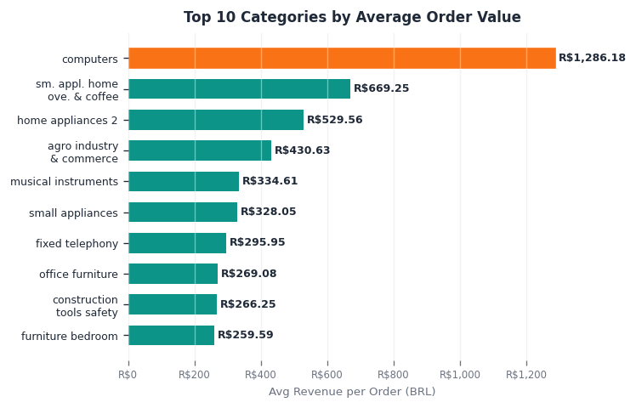
ANALYSIS 5 — OPTIONAL: AVG ORDER VALUE
Average Revenue per Order by Category
Reveals premium segments — not visible from total revenue alone
WHY THIS MATTERS
A category with fewer orders can generate MORE revenue per transaction.
Computers has 4× the AOV of Housewares — a completely different customer and margin profile.
This view enables:
• Targeted upsell strategies
• Smarter ad-spend allocation
• Loyalty program design
• Premium tier identification

Slide 12
Power BI Dashboard
All 5 visuals built in Power BI — interactive slicers on date, state, and category
1. Category Revenue
2. Monthly Trend
Horizontal bar — top 10 by BRL
Line chart — revenue & orders 2017-18
3. State Map / Bar
4. Canceled Orders
Geo + column chart by state
Bar chart by category (anomaly)
5. Avg Order Value ★
Bonus — premium segment view

Slide 13
BUSINESS RECOMMENDATIONS
Actionable Recommendations
Evidence-based actions derived directly from the analysis
1
Double down on Health & Beauty
Highest revenue category — increase marketing budget, negotiate better supplier terms, expand SKU range.
2
Fix the cancellation pipeline
Investigate top 5 categories for cancel root causes (OOS, logistics, payment). Target < 2% cancel rate.
3
Launch regional growth campaigns
RJ and MG are under-penetrated vs SP. City-level campaigns can expand the customer base significantly.
4
Build premium category strategy
Watches & Computers have 3-4× avg order value. Bundle offers, loyalty perks, and upsell paths will amplify ROI.
5
Pre-plan for seasonal peaks
Nov/Dec spikes demand 6-week lead in inventory & staffing. Build an alert dashboard that fires at 70% stock.

Slide 14



CONCLUSION
Summary
Python + SQL + Power BI: raw data → business decisions
Data Cleaned
SQL Analysis
Dashboard Built
5 CSV files merged into one analysis-ready dataset using Python/Pandas
4 targeted queries answered category, trend, geo, and anomaly questions
5 Power BI visuals designed for business storytelling and decision-making
Insights Found
Recommendations
Revenue concentration, seasonal peaks, geo gaps, and cancel leakage identified
5 actionable strategies with clear evidence and business rationale

Slide 15
Thank You
Questions & Discussion
Walk me through your SQL
How did you handle missing data?
Why this anomaly analysis?
Ready to walk through any part of the analysis in detail
Karun Krishnan | GitHub: github.com/karunkrishnan2002/BI-Ecommerce-Sales-Analysis

