Slide 1
Routing surface runoff to a basin outlet
Learning objectives
Be able to use stationary linear response methods (unit hydrograph) to calculate catchment response
Be able to estimate the unit hydrograph from data
Be able to describe the assumptions, limitations and uses of linear response methods
Chow, V. T., D. R. Maidment and L. W. Mays, (1988), Applied Hydrology, McGraw Hill, 572 p. Chapter 7

Slide 2
Goal is to quantify watershed response without consideration of detailed subscale processes
Runoff (mm/hr)
Runoff and Flow
Flow (m³/s)
Time
Flow = f(Runoff, Watershed hydrologic properties)

Slide 3

Systems approach to event flow
From Dingman, 2002, Physical Hydrology

Slide 4
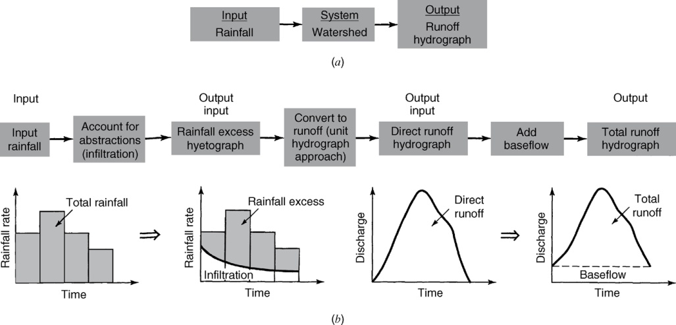
Rainfall – Runoff Analysis
From Mays, 2011, Ground and Surface Water Hydrology

Slide 5

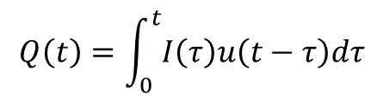
Linear Systems
Assume superposition, i.e. the principle of additivity
Convolution integral
$$Q\left(t\right)=\int_{0}^{t}{I\left(τ\right)u\left(t−τ\right)dτ}$$
$$3u\left(t−τ_{1}\right)+2u(t−τ_{2})$$
From Chow et al., 1988, Applied Hydrology

Slide 6
Linear Response at Discrete Time Steps
Excess Precipitation

Slide 7
A D_{u} hour unit hydrograph is the characteristic response of a given watershed to a unit volume (e.g. 1 in or cm) of effective water input (usually rain) applied at a constant rate for D_{u} hours
Runoff (mm/hr)
Runoff and Flow
Flow (m³/s)
Time

Slide 8
Assumptions (Chow P 214)
Excess rainfall has constant intensity within effective duration
Excess rainfall is uniformly distributed over watershed
The base time of the direct runoff hydrograph from an increment of excess rainfall is constant
The ordinates of all direct runoff hydrographs are proportional to the amount of direct runoff
For a given watershed the hydrograph resulting from a given excess rainfall reflects the unchanging characteristics of the watershed

Slide 9
Limitations
Linearity is violated when deeper water flows faster.
Rainfall is seldom uniform in space
Effective input is very uncertain and depends on antecedent conditions

Slide 10
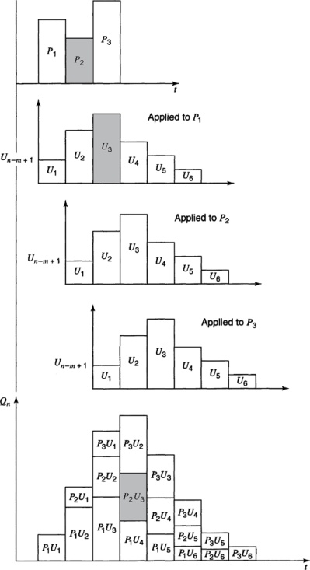
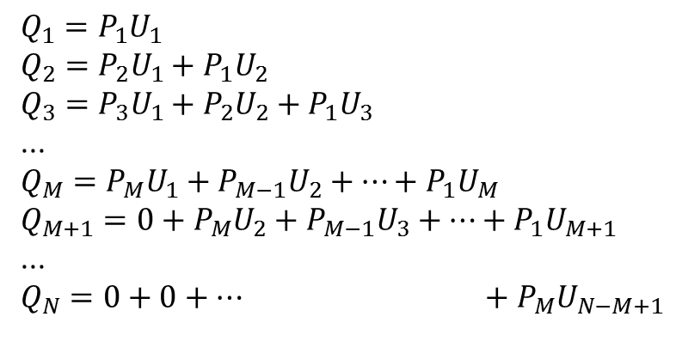
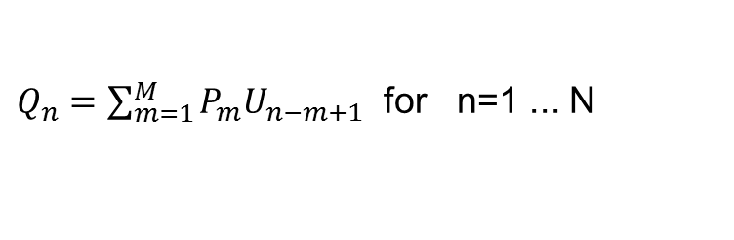
Calculating a Hydrograph from a Unit Hydrograph
$$Q_{1}=P_{1}U_{1}$$
$$Q_{2}=P_{2}U_{1}+P_{1}U_{2}$$
$$Q_{3}=P_{3}U_{1}+P_{2}U_{2}+P_{1}U_{3}$$
...
$$Q_{M}=P_{M}U_{1}+P_{M−1}U_{2}+…+P_{1}U_{M}$$
$$Q_{M+1}=0+P_{M}U_{2}+P_{M−1}U_{3}+…+P_{1}U_{M+1}$$
...
$$Q_{N}=0+0+… +P_{M}U_{N−M+1}$$
$Q_{n}=\sum_{m=1}^{M}{P_{m}U_{n−m+1}}$ for n=1 ... N
Chow page 217
From Mays, 2011, Ground and Surface Water Hydrology

Slide 11
Example
The 1- hr unit hydrograph for a watershed is given below. Determine the runoff from this watershed for the storm pattern given. The abstractions have a constant rate of 0.3 in/ h.
Time ( hr) | 1 | 2 | 3 | 4 | 5 | 6
Precipitation ( in) | 0.5 | 1 | 1.5 | 0.5
Unit hydrograph ( cfs) | 10 | 100 | 200 | 150 | 100 | 50

Slide 12
Example

Slide 13
Example
Determine the 1- hr unit hydrograph for a watershed using the precipitation pattern and runoff hydrograph below. The abstractions have a constant rate of 0.3 in/ hr, and the baseflow of the stream is 0 cfs.
Time (h) | 1 | 2 | 3 | 4 | 5 | 6 | 7 | 8 | 9 | 10
Precipitation (in) | 0.5 | 1 | 1.5 | 0.5
Runoff (cfs) | 2 | 27 | 122 | 292 | 385 | 300 | 185 | 80 | 10 | 0

Slide 14
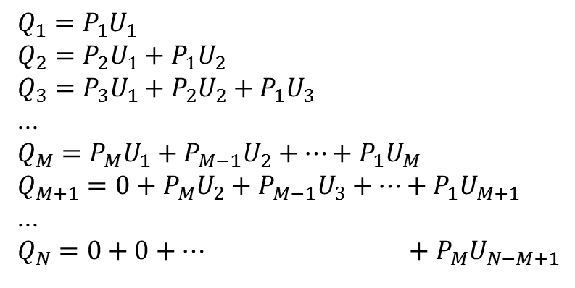
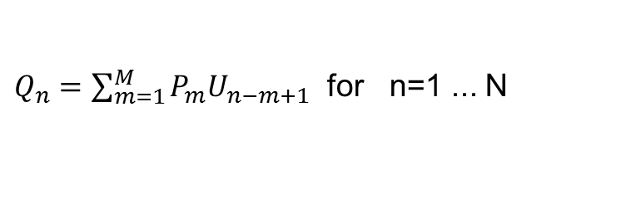


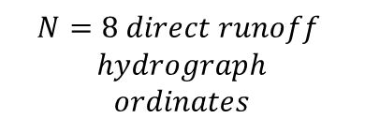

Calculating a Hydrograph from a Unit Hydrograph and visa versa
$$Q_{1}=P_{1}U_{1}$$
$$Q_{2}=P_{2}U_{1}+P_{1}U_{2}$$
$$Q_{3}=P_{3}U_{1}+P_{2}U_{2}+P_{1}U_{3}$$
...
$$Q_{M}=P_{M}U_{1}+P_{M−1}U_{2}+…+P_{1}U_{M}$$
$$Q_{M+1}=0+P_{M}U_{2}+P_{M−1}U_{3}+…+P_{1}U_{M+1}$$
...
$$Q_{N}=0+0+… +P_{M}U_{N−M+1}$$
$Q_{n}=\sum_{m=1}^{M}{P_{m}U_{n−m+1}}$ for n=1 ... N
$$M=3 precip inputs$$
$$L=6 unit hydrograph$$
$$ordinates$$
$$N=8 direct runoff$$
$$hydrograph$$
$$ordinates$$
$$N=L+M−1$$
From Mays, 2011, Ground and Surface Water Hydrology

Slide 15
Determining the Unit Hydrograph from Direct Runoff Hydrograph Observations
M =4 precip values
N=9 Direct Runoff Hydrograph Ordinates
L=N=M+1=6 Unit Hydrograph ordinates
9 equations to solve for 6 U values
(Overdetermined system – use least squares with Solver)
Any 6 initial U values
Minimize this by changing these

Slide 16
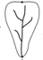
Which hydrograph is associated with each watershed
A
1
B
2
3
C

Slide 17
Time Area Diagram
Distribution function of area by travel time to outlet
Under assumptions of constant velocity
t = d/v
This provides a geomorphological basis for defining the unit response function.

Slide 18
Channel Network “Width” Function
x
x
The number of channels at a distance x from the outlet

Slide 19
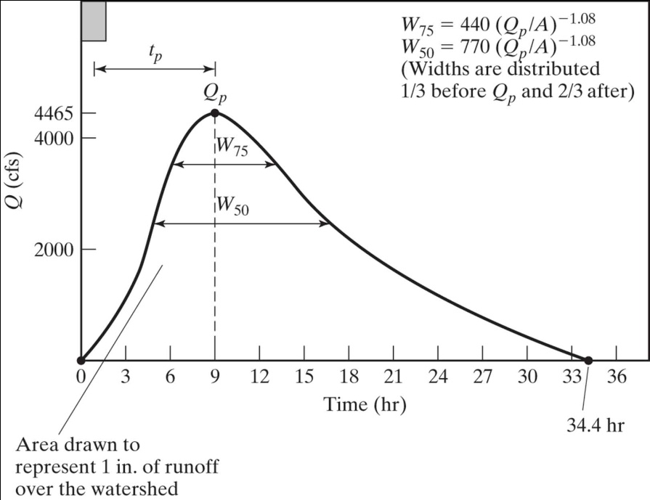
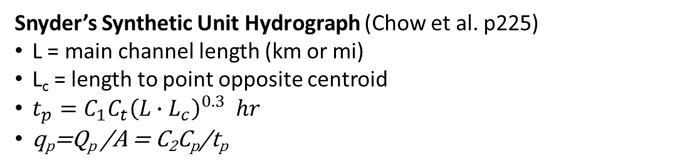
Synthetic Unit Hydrographs
A unit hydrograph is intended to quantify the unchanging characteristics of the watershed
The synthetic unit hydrograph approach quantifies the unit hydrograph from watershed attributes
1/3
2/3
Snyder’s Synthetic Unit Hydrograph (Chow et al. p225)
L = main channel length (km or mi)
L_{c} = length to point opposite centroid
$t_{p}=C_{1}C_{t}{\left(L∙L_{c}\right)}^{0.3} hr$
q_{p}=Q_{p} /A = C₂C_{p}/t_{p}

Slide 20
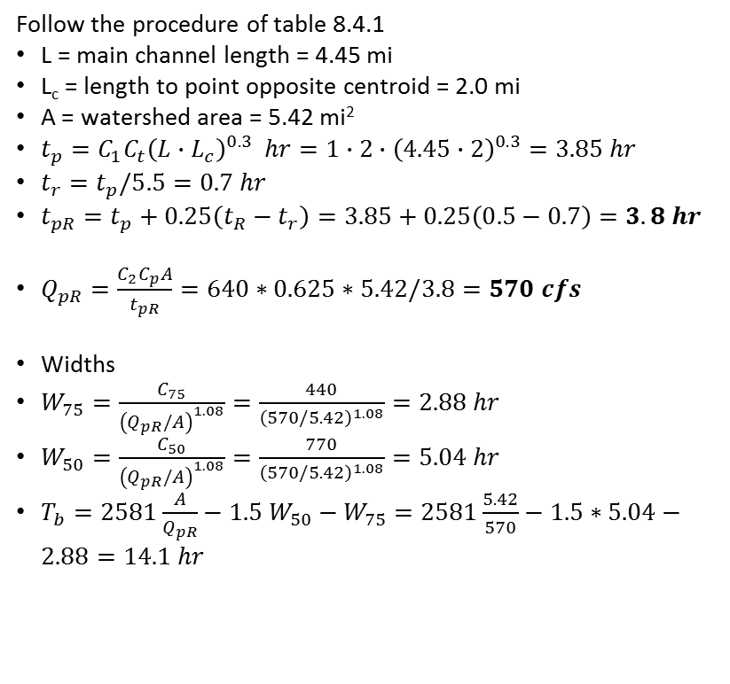
Example Snyder's Synthetic Unit Hydrograph
A watershed has a drainage area of 5.42 mi²; the length of the main stream is 4.45 mi, and the main channel length from the watershed outlet to the point opposite the center of gravity of the watershed is 2.0 mi. Using Ct = 2.0 and Cp = 0.625, determine the standard synthetic unit hydrograph for this basin. What is the standard duration? Use Snyder’s method to determine the 30- min unit hydrograph parameter.
Follow the procedure of table 8.4.1
L = main channel length = 4.45 mi
L_{c} = length to point opposite centroid = 2.0 mi
A = watershed area = 5.42 mi²
$t_{p}=C_{1}C_{t}{\left(L∙L_{c}\right)}^{0.3} hr=1∙2∙{\left(4.45∙2\right)}^{0.3}=3.85 hr$
$t_{r}=t_{p}/5.5=0.7 hr$
$t_{pR}=t_{p}+0.25\left(t_{R}−t_{r}\right)=3.85+0.25\left(0.5−0.7\right)=3.8 hr$
$Q_{pR}=\frac{C_{2}C_{p}A}{t_{pR}}=640∗0.625∗5.42/3.8=570 cfs$
Widths
$W_{75}=\frac{C_{75}}{{\left(Q_{pR}/A\right)}^{1.08}}=\frac{440}{{\left(570/5.42\right)}^{1.08}}=2.88 hr$
$W_{50}=\frac{C_{50}}{{\left(Q_{pR}/A\right)}^{1.08}}=\frac{770}{{\left(570/5.42\right)}^{1.08}}=5.04 hr$
$T_{b}=2581\frac{A}{Q_{pR}}−1.5 W_{50}−W_{75}=2581\frac{5.42}{570}−1.5∗5.04−2.88=14.1 hr$
(4.05,570)
(3.09,427.5)
(5.97,427.5)
(2.37,285)
W₇₅
(7.41,285)
W₅₀
1/3
2/3
(14.1,0)

Slide 21
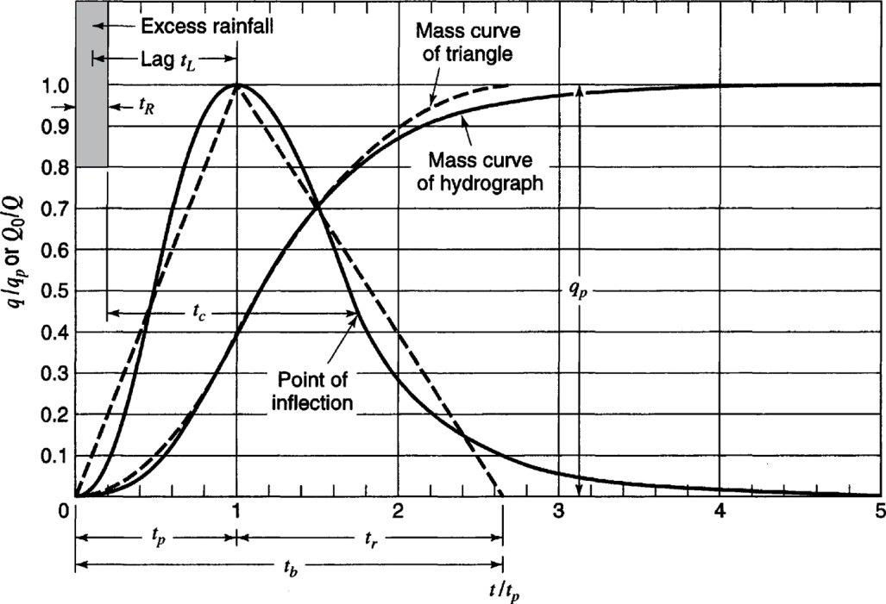
SCS Dimensionless Unit Hydrograph
From Mays, 2011, Ground and Surface Water Hydrology

Slide 22
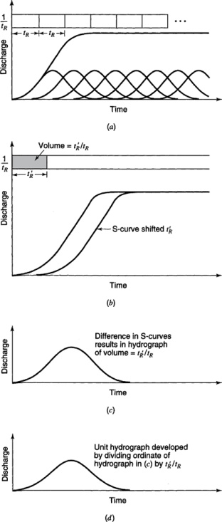
Unit Hydrographs of Different Durations - S Curves
From Mays, 2011, Ground and Surface Water Hydrology

Slide 23
Example
The 1- hr unit hydrograph for a watershed is given below. Determine the 2 hr unit hydrograph.
Time ( hr) | 1 | 2 | 3 | 4 | 5 | 6
Unit hydrograph ( cfs) | 10 | 100 | 200 | 150 | 100 | 50

Slide 24
S Curve to Develop 2 hr unit hydrograph

