Slide 1
Infiltration and unsaturated flow
Learning objective
Be able to calculate infiltration, infiltration capacity and runoff rates using the methods described in the Rainfall Runoff workbook chapter 5 and Dingman chapter 6.

Slide 2
Problem 1 as an example

Slide 3
Table 1. Clapp and Hornberger (1978) parameters for equation (27) based on analysis of 1845 soils. Values in parentheses are standard deviations
Soil Texture | Porosity | Ks (cm/hr) | psi_ae (cm) | b
Sand | 0.395 (0.056) | 63.36 | 12.1 (14.3) | 4.05 (1.78)
Loamy sand | 0.410 (0.068) | 56.16 | 9 (12.4) | 4.38 (1.47)
Sandy loam | 0.435 (0.086) | 12.49 | 21.8(31.0) | 4.9 (1.75)
Silt loam | 0.485 (0.059) | 2.59 | 78.6 (51.2) | 5.3 (1.96)
Loam | 0.451 (0.078) | 2.50 | 47.8 (51.2) | 5.39 (1.87)
Sandy clay loam | 0.420 (0.059) | 2.27 | 29.9 (37.8) | 7.12 (2.43)
Silty clay loam | 0.477 (0.057) | 0.612 | 35.6 (37.8) | 7.75 (2.77)
Clay loam | 0.476 (0.053) | 0.882 | 63 (51.0) | 8.52 (3.44)
Sandy clay | 0.426 (0.057) | 0.781 | 15.3 (17.3) | 10.4 (1.64)
Silty clay | 0.492 (0.064) | 0.371 | 49 (62.01) | 10.4 (4.45)
Clay | 0.482 (0.050) | 0.461 | 40.5 (39.7) | 11.4 (3.7)

Slide 4
The class of problem we need to solve
Consider a soil of given type (e.g. silty clay loam) and given an input rainfall hyetograph, calculate the infiltration and the runoff.
Rainfall rate 2 cm/hr, for 3 hours
Initial soil moisture content 0.3

Slide 5
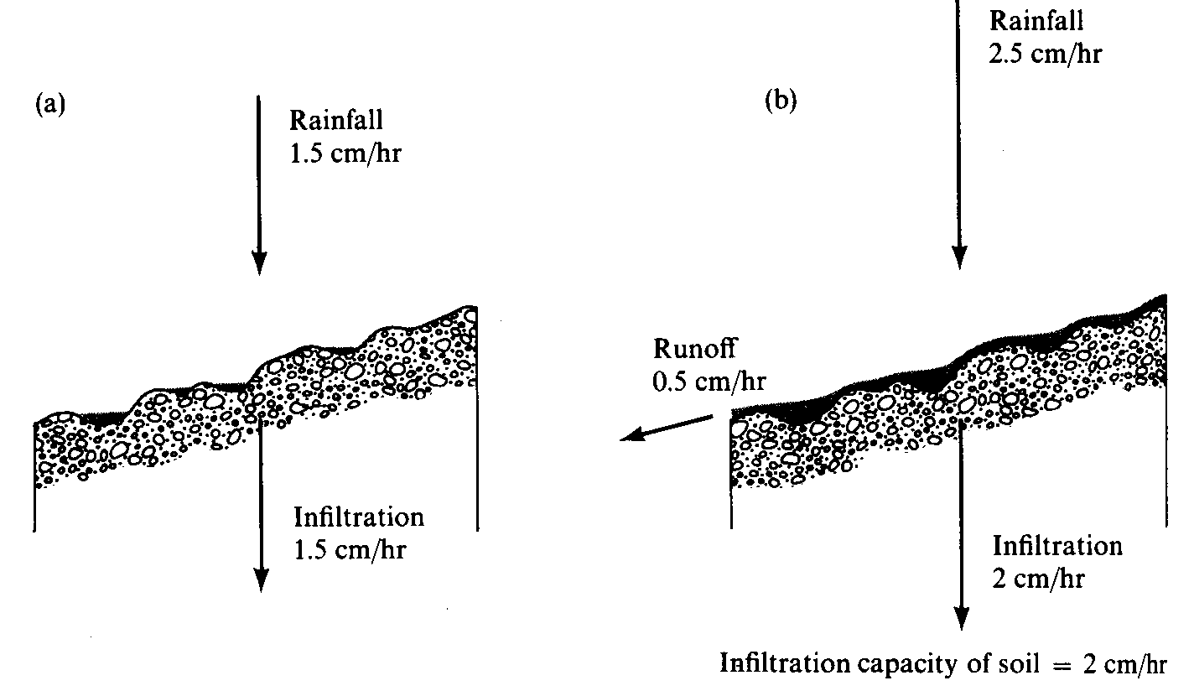
Surface Runoff occurs when surface water input exceeds infiltration capacity. (a) Infiltration rate = rainfall rate which is less than infiltration capacity. (b) Runoff rate = Rainfall intensity – Infiltration capacity. (from Dunne and Leopold, 1978)

Slide 6
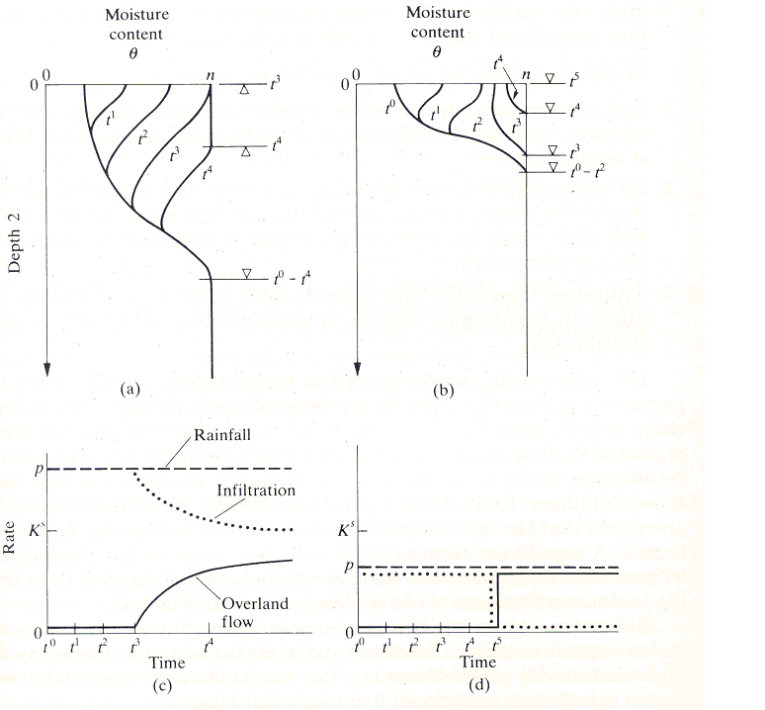
Saturation excess runoff generation mechanism
Water table near surface
Finite volume of water can infiltrate before soil completely saturated
No further infiltration
All further precipitation is runoff
Occurs in lowlands, zones of convergent topography
Partial contributing area concept
Dunne Mechanism
Saturation from Below
Notes:
Figure 38. Saturation excess runoff generation mechanism. (a) Moisture content versus depth profiles, and (b) Runoff generation time series. (from Bras, 1990)

Slide 7
Infiltration excess runoff generation mechanism
Initially dry soil
Suction large at surface
Total head gradient large
Large infiltration capacity
Penetration of moisture from rainfall
Suction reduces
Infiltration capacity reduces
Excess precipitation becomes runoff
(a)
Saturation from Above
Horton Mechanism
(b)
Notes:
Figure 37. Infiltration excess runoff generation mechanism. (a) Moisture content versus depth profiles and (b) Runoff generation time series. (from Bras, 1990)

Slide 8
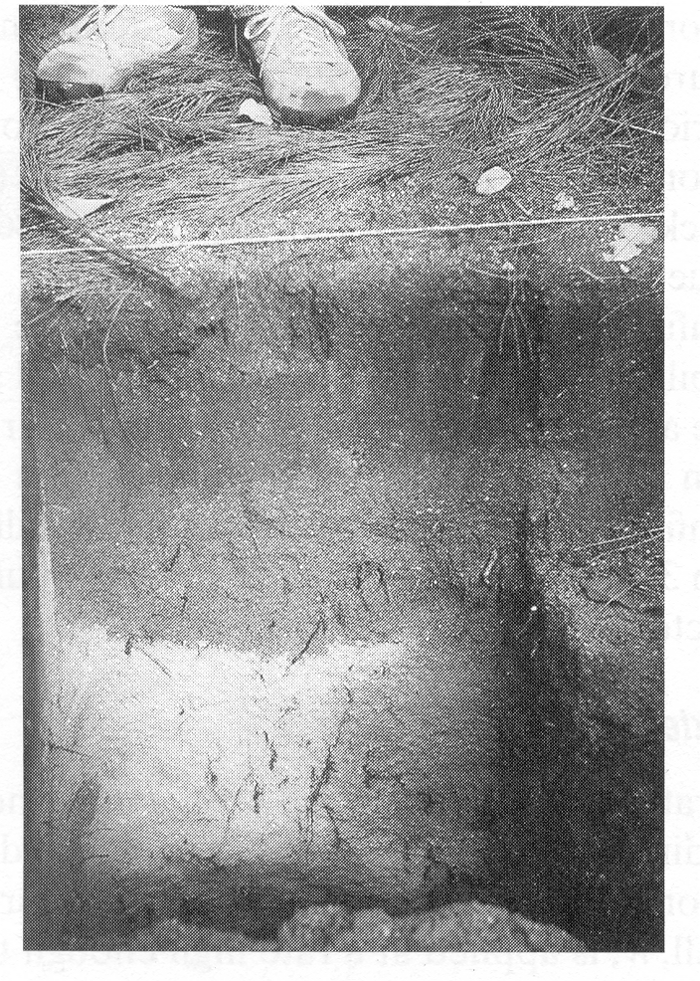
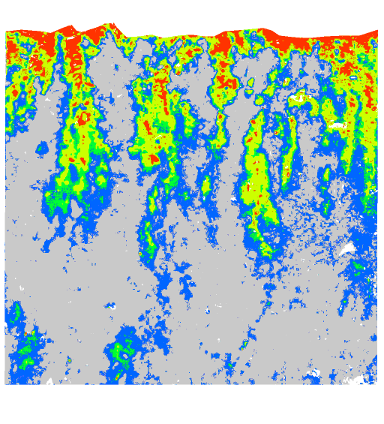
Need Equations to describe reduction in infiltration capacity as depth of water that has infiltrated increases (wetting front propagates downwards), recognizing that this may be a simplification
Wetting front in a sandy soil exposed after intense rain (from Dingman, 1994).
Preferential pathway infiltration (Markus Weiler, ETH Zurich)

Slide 9
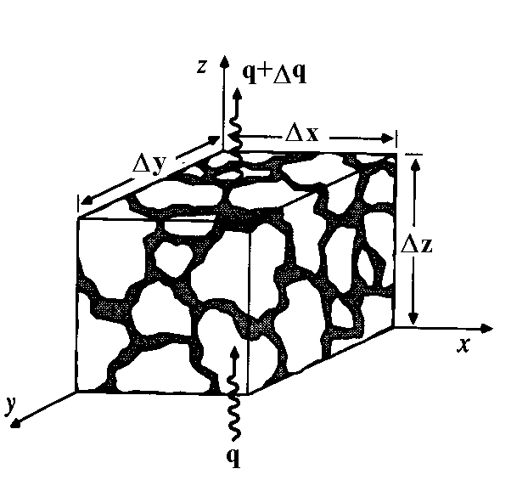
Continuity equation in an unsaturated porous medium.
Δθ Δx Δy Δz =
(q Δx Δy – (q+Δq) Δx Δy) Δt

Slide 10
3 dimensional continuity equation.
_{z z}
q_{y}
q_{x}
q_{x}+Δq_{x}
q_{y}+Δq_{y}
_{z}

Slide 11
Richard's Equation
Continuity
Darcy
Pressure and elevation head
h = ψ+z
Soil moisture characteristic
Pressure head as independent variable
Specific moisture capacity

Slide 12
Diffusion form of Richard's Equation
Soil water Diffusivity

Slide 13
Green-Ampt model idealization of wetting front penetration into a soil profile
Initial moisture content θ_{o}
Saturation moisture content θ_{s} equivalent to porosity, n
0.1
0.2
0.3
0.4
0.5
Moisture content, θ
t₁
t₂
L
10
t₃
20
t₄
Δθ
Depth, z, (cm)
30
40
Notes:
Figure 37. Green-Ampt model idealization of wetting front penetration into a soil profile.

Slide 14
Infiltration example problem
Consider a soil of given type (e.g. silty clay loam) and given an input rainfall hyetograph, calculate the infiltration and the runoff. Initial soil moisture content 0.3. Rainfall rate 2 cm/hr, for 3 hours.

Slide 15
Infiltrability – Depth Function

Slide 16
Key Ideas
Richard’s equation governs the movement of water in the unsaturated zone
The Green Ampt Model assumes a sharp wetting front and leads to the Infiltrability-Depth approximation
The state of the system in calculating infiltration is described by the depth of water that has infiltrated. This is the basis for the methods that follow.

Slide 17
Cumulative infiltration at ponding
Time to ponding
Infiltration under ponded conditions

Slide 18
Green – Ampt infiltration parameters for various soil classes (Rawls et al., 1983). The numbers in parentheses are one standard deviation around the parameter value given.
Soil Texture | Porosity n | Effective porosity θ_{e} | Wetting front soil suction head |ψ_{f}| (cm) | Hydraulic conductivity K_{sat} (cm/hr)
Sand | 0.437 (0.374-0.500) | 0.417 (0.354-0.480) | 4.95 (0.97-25.36) | 11.78
Loamy sand | 0.437 (0.363-0.506) | 0.401 (0.329-0.473) | 6.13 (1.35-27.94) | 2.99
Sandy loam | 0.453 (0.351-0.555) | 0.412 (0.283-0.541) | 11.01 (2.67-45.47) | 1.09
Loam | 0.463 (0.375-0.551) | 0.434 (0.334-0.534) | 8.89 (1.33-59.38) | 0.34
Silt loam | 0.501 (0.420-0.582) | 0.486 (0.394-0.578) | 16.68 (2.92-95.39) | 0.65
Sandy clay loam | 0.398 (0.332-0.464) | 0.330 (0.235-0.425) | 21.85 (4.42-108.0) | 0.15
Clay loam | 0.464 (0.409-0.519) | 0.309 (0.279-0.501) | 20.88 (4.79-91.10) | 0.1
Silty clay loam | 0.471 (0.418-0.524) | 0.432 (0.347-0.517) | 27.30 (5.67-131.50) | 0.1
Sandy clay | 0.430 (0.370-0.490) | 0.321 (0.207-0.435) | 23.90 (4.08-140.2) | 0.06
Silty clay | 0.479 (0.425-0.533) | 0.423 (0.334-0.512) | 29.22 (6.13-139.4) | 0.05
Clay | 0.475 (0.427-0.523) | 0.385 (0.269-0.501) | 31.63 (6.39-156.5) | 0.03

Slide 19
Philip Model

Slide 20
Cumulative infiltration at ponding
Time to ponding
Infiltration under ponded conditions

Slide 21
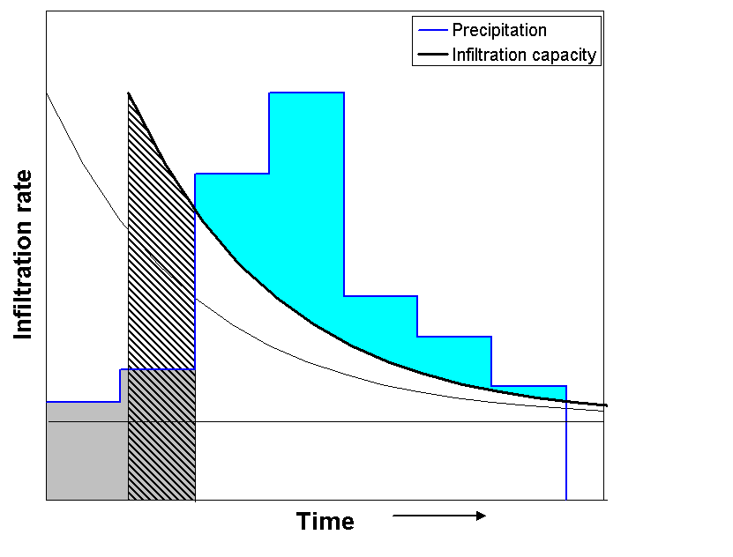
t₀
t_{o}
t₁
Time Compression Approximation
Notes:
Figure 40. Partition of surface water input into infiltration and runoff using the Horton infiltration equation. Ponding starts at t1. The cumulative depth of water that has infiltrated up to this time is the area F1 (shaded gray). This is less than the maximum possible infiltration up to t1 under the fc(t) curve. To accommodate this the fc(t) curve is shifted in time by an amount to so that the cumulative infiltration from to to t1 (hatched area) equals F1. Runoff is precipitation in excess of fc(t-to) (blue area).

Slide 22
Horton Infiltration Model

Slide 23
Cumulative infiltration at ponding
Time to ponding
Infiltration under ponded conditions
Given F_{s}, t_{s} solve for t_{o} implicitly then use 2nd equation

Slide 24
f₀
t₀
f₁
F₁
t_{o}
t₁
Notes:
Figure 40. Partition of surface water input into infiltration and runoff using the Horton infiltration equation. Ponding starts at t1. The cumulative depth of water that has infiltrated up to this time is the area F1 (shaded gray). This is less than the maximum possible infiltration up to t1 under the fc(t) curve. To accommodate this the fc(t) curve is shifted in time by an amount to so that the cumulative infiltration from to to t1 (hatched area) equals F1. Runoff is precipitation in excess of fc(t-to) (blue area).

Slide 25
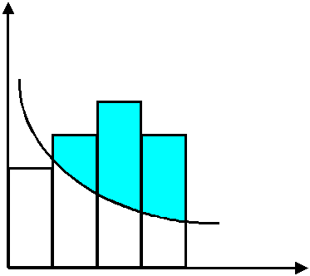
Surface Water Input
Infiltration Capacity
Runoff
Runoff
Time
Notes:
Figure 41. Pulse runoff hyetograph obtained from surface water input hyetograph and variable infiltration capacity.

Slide 26
A
Initialize: at t = 0, F_{t} = 0
Calculate infiltration capacity f_{c} from F_{t}, column 1 of table.
f_{c} ≤ w_{t}
f_{c}> w_{t}
Is f_{c} ≤ w_{t}
B
C
Ponding occurs throughout interval: F_{t+Δt} calculated using infiltration under ponded conditions equations with t_{s}=t and F_{s}= F_{t}.
Column 3.
No ponding at the beginning of the interval. Calculate tentative values
and column 1.
D
Ponding starts during the interval. Solve for F_{p} from w_{t}, column 2.
Δt' = (F_{p}-F_{t})/w_{t}
F_{t+Δt} calculated using infiltration under ponded conditions equations with t_{s}=t+Δt' and F_{s}= F_{p}. Column 3.
E
No ponding throughout interval
F
Infiltration is f_{t} = F_{t+Δt}-F_{t}
Runoff generated is r_{t}= w_{t}Δt - f_{t}
G
Increment time t=t+Δt
Notes:
Figure 42. Flow chart for determining infiltration and runoff generated under variable surface water input intensity.

Slide 27
Equations for variable surface water input intensity infiltration calculation.

Slide 28
0.303
0.146
0.159
0.178
0.00005
Notes:
Figure 43. Rainfall Hyetograph, Infiltration Capacity and Runoff Generated in Example 1. Numbers are infiltration in cm in each interval.

Slide 29
0.282
0.289
0.249
0.032
0.004
Notes:
Figure 44. Rainfall Hyetograph, Infiltration Capacity and Runoff Generated in Example 2. Numbers are infiltration in cm in each interval.

Slide 30
0.165
0.119
0.080
0.0003
Notes:
Figure 45. Rainfall Hyetograph, Infiltration Capacity and Runoff Generated in Example 3. Numbers are infiltration in cm in each interval.

Slide 31
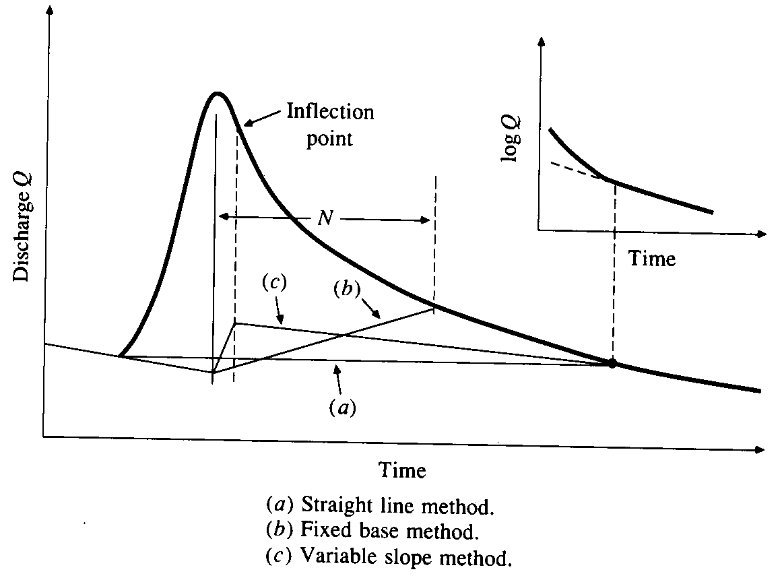
Baseflow Separation Techniques
From Chow, V. T., D. R. Maidment and L. W. Mays, (1988), Applied Hydrology, McGraw Hill, 572 p.

Slide 32
Phi (φ) - index

Slide 33
Determining the φ index and Excess Rainfall Hyetograph

Slide 34
Direct Runoff from the SCS Curve Number Equation

Slide 35
