Slide 1

Lecture 8 Datalogger Programming Using Arduino – Bringing it All Together
Jeffery S. Horsburgh
Hydroinformatics
Fall 2016
This work was funded by National Science Foundation Grants EPS 1135482 and EPS 1208732

Slide 2
Objectives
Develop a fully functional datalogger sketch for Arduino
Develop a plan for deploying it into an interesting environment to collect data

Slide 3
How do we turn an Arduino into a datalogger?
Some things we have to figure out:
Debugging
Timing
Interfacing with sensors and making measurements
Recording data to a file
Your task today – put all of these pieces together to develop a fully functional datalogger sketch

Slide 4
Assignment 2
Choose an environment in which to monitor temperature and relative humidity
What is an appropriate scan interval?
What is an appropriate recording interval?
Develop a fully functioning datalogger sketch
Deploy your sensor and datalogger to collect data – log data to a text file
Download the data, develop one or more visualizations, and describe the data you collected
Upload your Arduino sketch

Slide 5
Approach
Hints:
Might be easiest to start with the “Timing_Example2” example
Add the sensor measurements
Add the logging/writing data to the SD Card
Wire the sensor to the breadboard and jumper it to the Arduino so you can share the 5V port between the sensor and the MicroSD card reader

Slide 6
Power Options for Deployment
You’ve got options!!
USB Cable
Can use computer or a USB power supply
12 Volt power adapter plugged into the barrel jack
9 Volt Battery adapter plugged into the barrel jack

Slide 7
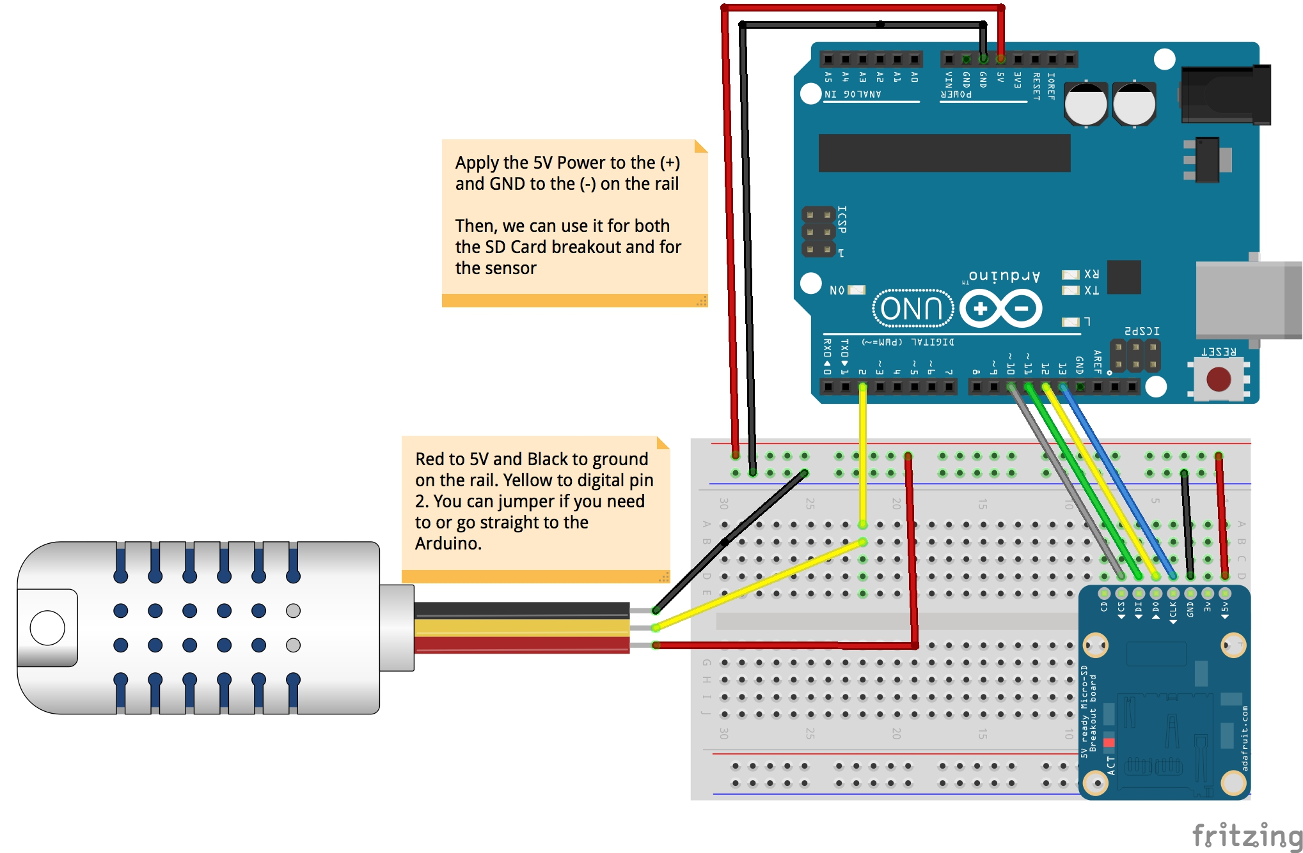
Full Wiring Example

