Slide 1

Using Structured Query Language (SQL) (continued)
Jeffery S. Horsburgh
Hydroinformatics
Fall 2016
This work was funded by National Science Foundation Grants EPS 1135482 and EPS 1208732

Slide 2
Objectives
Retrieve and use data from data models used in Hydrology such as the Observations Data Model (ODM)
Introduce the syntax of Structured Query Language (SQL) for common query types
Construct SQL queries to retrieve data

Slide 3
Quick Review
What we covered last time
Basic query structure – SELECT FROM WHERE
Ordering results – ORDER BY
Select distinct values – DISTINCT
Selecting from more than one table – JOIN

Slide 4
Aggregate Functions
Compute against a column of numeric data
MIN – Returns the smallest value in a given selection
MAX – Returns the largest value in a given selection
SUM – Returns the sum of numeric values in a given selection
AVG – Returns the average of numeric values in a given selection
COUNT – Returns the total number of values in a given selection
COUNT(*) – Returns the number of records in a table

Slide 5
Aggregate Function Example
ValueID | VariableName | DateTime | DataValue
1 | Temperature | 1/1/2013 10:30 | 8
2 | Temperature | 1/1/2013 11:30 | 9
3 | Temperature | 1/1/2013 12:30 | 7
4 | Temperature | 1/1/2013 1:30 | 8
5 | Temperature | 1/1/2013 2:30 | 10
6 | Temperature | 1/1/2013 3:30 | 12
7 | Temperature | 1/1/2013 4:30 | 13
8 | Temperature | 1/1/2013 5:30 | 16
9 | Temperature | 1/1/2013 6:30 | 13
10 | Temperature | 1/1/2013 7:30 | 10
VariableName | AverageValue
Temperature | 10.6
Calculate a single average value from a time series of values.

Slide 6
Aggregation Example
Example: “Give me the number of observations and the minimum, maximum, and average quality controlled (QualityControlLevelID = 1) median turbidity (VariableID = 66) value in the Logan River at Mendon Road (SiteID = 2).
First make sure you have the right set of DataValues:
SELECT *
FROM DataValues
WHERE SiteID = 2 AND VariableID = 66
AND QualityControlLevelID = 1;

Slide 7
Aggregation Example (cont.)
Example: “Give me the number of observations and the minimum, maximum, and average quality controlled (QualityControlLevelID = 1) median turbidity (VariableID = 66) value in the Logan River at Mendon Road (SiteID = 2).
Now modify the SELECT statement to add the aggregation functions:
SELECT COUNT(DataValue) AS Count, MIN(DataValue) AS
Minimum, MAX(DataValue) AS Maximum,
AVG(DataValue) AS Average
FROM DataValues
WHERE SiteID = 2 AND VariableID = 66
AND QualityControlLevelID = 1;
An alias is an alternative
name for a query output column

Slide 8
Aggregate Functions and NULL Values
All aggregation functions except COUNT(*) ignore NULL values in the input set
If the input set is empty, NULL is returned

Slide 9
GROUP BY Clause
Used with Aggregate functions
Groups records into sets for which the aggregate function should be evaluated
When using aggregate functions, every selected field must be part of either an aggregate function or a “GROUP BY” clause

Slide 10
Aggregation Example with GROUP BY
SELECT SiteID, VariableID, AVG(DataValue) AS AvgDataValue
FROM DataValues
GROUP BY SiteID, VariableID;
DataValues
ValueID | SiteID | VariableID | DateTime | DataValue
1 | 1 | 3 | 1/1/2012 | 8
2 | 1 | 3 | 1/2/2012 | 9
3 | 2 | 3 | 1/1/2012 | 10
4 | 2 | 3 | 1/2/2012 | 12
SiteID | VariableID | AvgDataValue
1 | 3 | 8.5
2 | 3 | 11
Result

Slide 11
Example GROUP BY Clause
“Give me the minimum, maximum, and average value of quality controlled (QualityControlLevelID=1) median turbidity (VariableID=66) for each Site.”
SELECT SiteID, MIN(DataValue) AS Minimum, MAX(DataValue)
AS Maximum, AVG(DataValue) AS Average
FROM DataValues
WHERE VariableID = 66 AND QualityControlLevelID = 1
GROUP BY SiteID;
The “GROUP BY” clause ensures that the query calculates values for each unique SiteID.

Slide 12
Challenge Query 1
“How many observations of quality controlled (QualityControlLevelID = 1) water temperature (VariableID = 57) are there in the Logan River at Mendon Road (SiteID = 2)?”
https://goo.gl/Cu62Jr

Slide 13
Arithmetic Functions
Computed attributes
Example: “Add a constant value to water level measurements to convert from gage height to water surface elevation.”
SELECT LocalDateTime, DataValue + 4380 AS Elevation
FROM DataValues WHERE SiteID = 2
AND VariableID = 73 AND QualityControlLevelID = 1
ORDER BY LocalDateTime ASC;

Slide 14
Mathematical Functions
ABS | DEGREES | RAND
ACOS | EXP | ROUND
ASIN | FLOOR | SIGN
ATAN | LOG | SIN
ATN2 | LOG10 | SQRT
CEILING | PI | SQUARE
COS | POWER | TAN
COT | RADIANS

Slide 15
Date/Time Functions
Example: “Give me the average water temperature (VariableID = 57) in the Logan River at Mendon Road (SiteID = 2) for each day of the year.”
Use the MONTH() and DAY() functions:
SELECT MONTH(LocalDateTime) AS theMonth,
DAY(LocalDateTime) AS theDay,
AVG(DataValue) AS AvgTemp
FROM DataValues
WHERE SiteID = 2 AND VariableID = 57 AND
QualityControlLevelID = 1 AND DataValue <> -9999
GROUP BY MONTH(LocalDateTime), DAY(LocalDateTime)
ORDER BY theMonth, theDay;

Slide 16
Challenge Query 2
“What are the maximum and minimum values of quality controlled (QualityControlLevelID = 1) water temperature (VariableID = 57) in the Logan River at Mendon Road (SiteID = 2) during the month of July?”
https://goo.gl/Cu62Jr

Slide 17
Sub-Queries
A sub-query is a SELECT FROM WHERE expression that is nested within another query
Sub-queries essentially create a virtual table from which you can select additional results

Slide 18
Sub-Queries in the WHERE Clause
Example: “Do we have any Variables in the database for which there are no DataValues?”
SELECT VariableID, VariableName
FROM Variables
WHERE VariableID NOT IN (SELECT
DISTINCT VariableID FROM DataValues);

Slide 19
Nested Sub-Queries
Example: “Give me all quality controlled (QualityControlLevelID = 1) water temperature (VariableID = 57) observations in the Logan River at Mendon Road (SiteID = 2) that are greater than the average temperature value.”
SELECT * FROM DataValues
WHERE SiteID = 2 AND VariableID = 57
AND QualityControlLevelID = 1 AND DataValue > (SELECT AVG(DataValue) FROM DataValues WHERE SiteID = 2 AND VariableID = 57 AND QualityControlLevelID = 1 AND DataValue <> -9999);

Slide 20
Subqueries in the FROM Clause
A name has to be given to the derived table in the subquery
Example: “What is the maximum water temperature at the site that has the highest maximum temperature.”
SELECT MAX(maxTemperature) AS OverallMax
FROM (SELECT SiteID, MAX(DataValue) AS maxTemperature
FROM DataValues WHERE VariableID = 57 AND QualityControlLevelID = 1
GROUP BY SiteID) AS MaxTempValues;

Slide 21
Assignment 4
Perform exploratory data analysis using the water temperature datasets in the Logan River ODM database
Compare water temperature data to the state of Utah water temperature numeric criterion value for streams designated as cold water fisheries
Perform analyses that may identify potential water temperature impairment

Slide 22
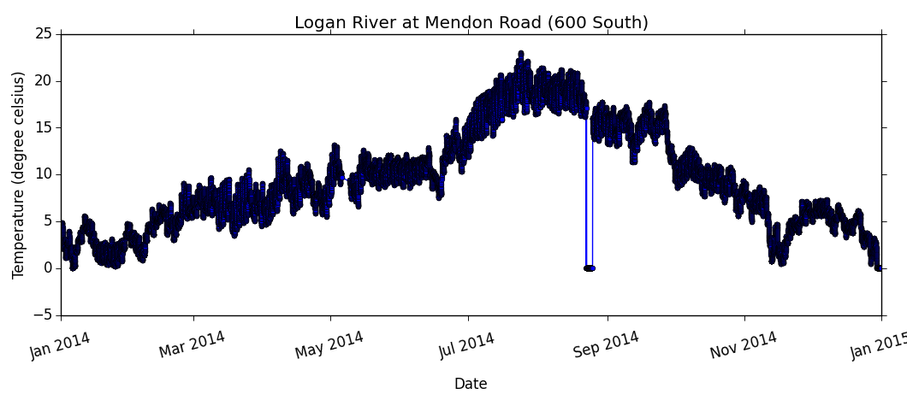
Water Temperature in the Logan River at Mendon Road

Slide 23
Assignment 4 Queries
A table listing the period of record for water temperature measurements (e.g., begin and end date), the number of observations, and the overall minimum, maximum, and average values for each site at which quality controlled (QualityControlLevelID = 1) water temperature (VariableID = 57) data have been collected.
A table listing the total number of temperature observations, the number of observations greater than the water quality criterion value (i.e., 20 degrees C), and the overall percent exceedence of the water quality criterion value for each site at which quality controlled water temperature data have been collected.

Slide 24
Assignment 4 Queries
A table for the Logan River at Mendon Road (SiteID = 1) listing the percent exceedence of the water quality standard for each month of the year.
A table listing the percent exceedence of the water quality standard for each site during the month of July, which is generally a critical period with low flows and elevated temperatures.

Slide 25
Summary
Aggregate functions provide a powerful way to summarize data
SQL supports a suite of mathematical, date/time manipulation, and other functions
Subqueries provide a convenient way to “materialize” a virtual table and then make selections from it

Slide 26
Advanced SQL Functionality

Slide 27
PIVOT
Convert data from a serial format to a cross-tabulated format
Uses a field’s values as column headers
Field 1 | Field 2 | Field 3
1 | A | 1
1 | B | 2
2 | A | 3
2 | C | 4
Cross tab
Field 1 | A | B | C
1 | 1 | 2
2 | 3 |  | 4

Slide 28
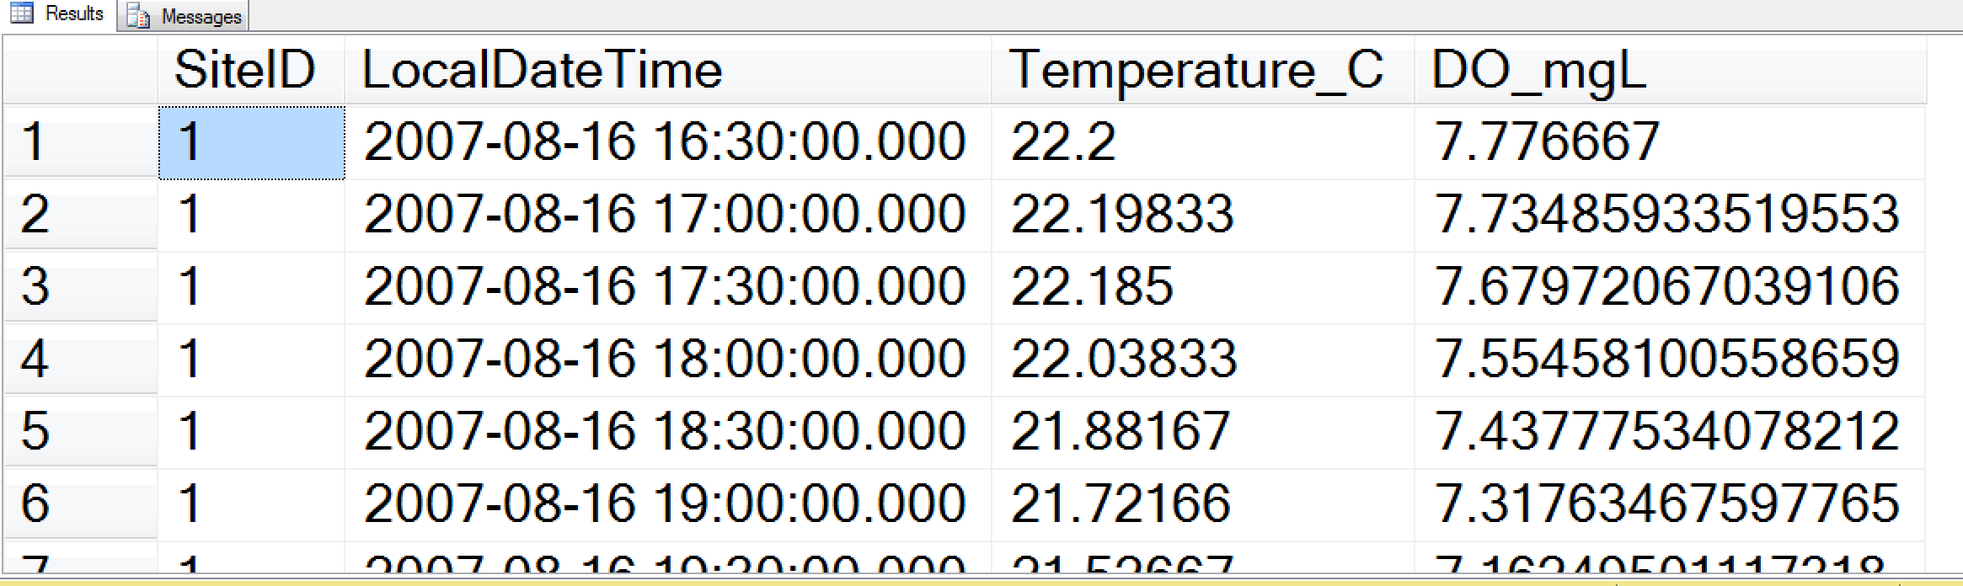
PIVOT
Example: “Give me a table with a single LocalDateTime column with time-matched temperature (VariableID = 57) and dissolved oxygen (VariableID = 60) values in additional columns for the Logan River at Mendon Road (SiteID = 2).”

Slide 29
PIVOT
SELECT SiteID, LocalDateTime, [57] AS Temperature_C, [60] AS DO_mgL
FROM
(SELECT SiteID, LocalDateTime, DataValue, VariableID
FROM DataValues
WHERE SiteID = 2 AND QualityControlLevelID = 1
AND VariableID IN (57,60)) dv
PIVOT(SUM(DataValue) FOR VariableID IN ([57],[60])) AS pvt
ORDER BY LocalDateTime

Slide 30
Steps in PIVOTing (1)
Write the base query
Only include columns needed in the final results
Assign an alias to the virtual table created by the base query
Columns in base query not pivoted or aggregated will cause extra grouping levels and unexpected results
SELECT SiteID, LocalDateTime, [57] AS Temperature_C, [60] AS DO_mgL
FROM
(SELECT SiteID, LocalDateTime, DataValue, VariableID
FROM DataValues
WHERE SiteID = 2 AND QualityControlLevelID = 1
AND VariableID IN (57,60)) dv
PIVOT(SUM(DataValue) FOR VariableID IN ([57],[60])) AS pvt
ORDER BY LocalDateTime

Slide 31
Steps in PIVOTing (2)
Create the PIVOT Expression
Select an aggregate function (SUM,MIN, MAX, AVG, etc.) for the column that will be used as values in the resulting table
Include the keyword FOR and the name of the pivoted column
Provide a list of values for column names
Provide an alias for the PIVOT expression
SELECT SiteID, LocalDateTime, [57] AS Temperature_C, [60] AS DO_mgL
FROM
(SELECT SiteID, LocalDateTime, DataValue, VariableID
FROM DataValues
WHERE SiteID = 2 AND QualityControlLevelID = 1
AND VariableID IN (57,60)) dv
PIVOT(SUM(DataValue) FOR VariableID IN ([57],[60])) AS pvt
ORDER BY LocalDateTime

Slide 32
Steps in PIVOTing (3)
Add column names to the SELECT list
Pivoted columns will display in the order listed in the SELECT clause
Do not list the aggregated column in the SELECT statement
SELECT SiteID, LocalDateTime, [57] AS Temperature_C, [60] AS DO_mgL
FROM
(SELECT SiteID, LocalDateTime, DataValue, VariableID
FROM DataValues
WHERE SiteID = 2 AND QualityControlLevelID = 1
AND VariableID IN (57,60)) dv
PIVOT(SUM(DataValue) FOR VariableID IN ([57],[60])) AS pvt
ORDER BY LocalDateTime

Slide 33
Other Things You can do with SQL
Create databases
Create tables
Insert data into tables
Update exiting records
Delete records, tables, databases
Create users and permissions
…

