Slide 1
Water in Soil
Learning objectives
Be able to quantify the properties of water held in and flowing through soil (porosity, moisture content, pressure, suction, hydraulic conductivity)
References
Rainfall-Runoff Processes workbook chapter 4
Dingman Chapter 6

Slide 2
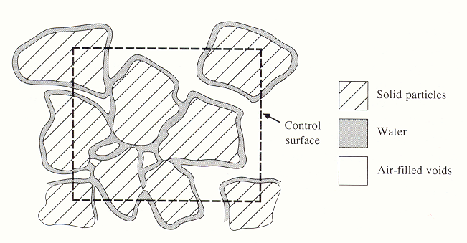
Notes:
Figure 21. Cross section through an unsaturated porous medium (from Chow et al. 1988)

Slide 3
Well graded silt, sand, gravel mixture
Uniformly graded sand
Figure 22. Illustrative grain-size distribution curves. The boundaries between size classes designated as clay, silt, sand and gravel are shown as vertical lines.

Slide 4
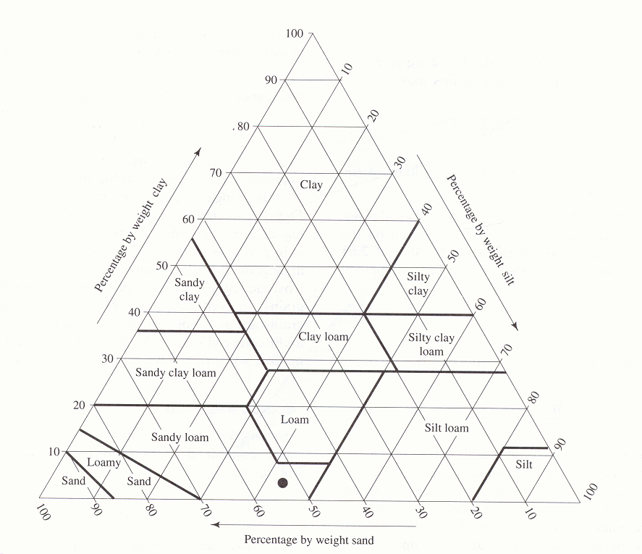
B
A
Soil texture triangle, showing the textural terms applied to soils with various fractions of sand, silt and clay. (from Dingman, 2002)

Slide 5
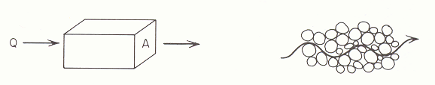
Macroscopic and microscopic concepts of porous medium flow. (from Freeze and Cherry, 1979)

Slide 6
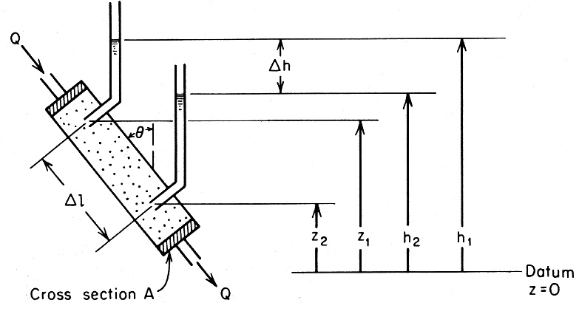
ψ₁
1
ψ₂
2
Experimental apparatus for the illustration of Darcy's equation. (From Freeze and Cherry)

Slide 7
Parallel conduit conceptual model for porous media flow.
v_{i}
A
A_{i}

Slide 8
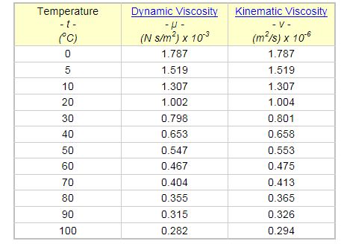
Water Viscosity at different temperatures
From http://www.engineeringtoolbox.com/water-dynamic-kinematic-viscosity-d_596.html

Slide 9
Group learning challenge 1
Figure out how much the flow rate through a porous media will change for a 5 °C change in temperature.
Does flow rate increase or decrease as temperature increases

Slide 10
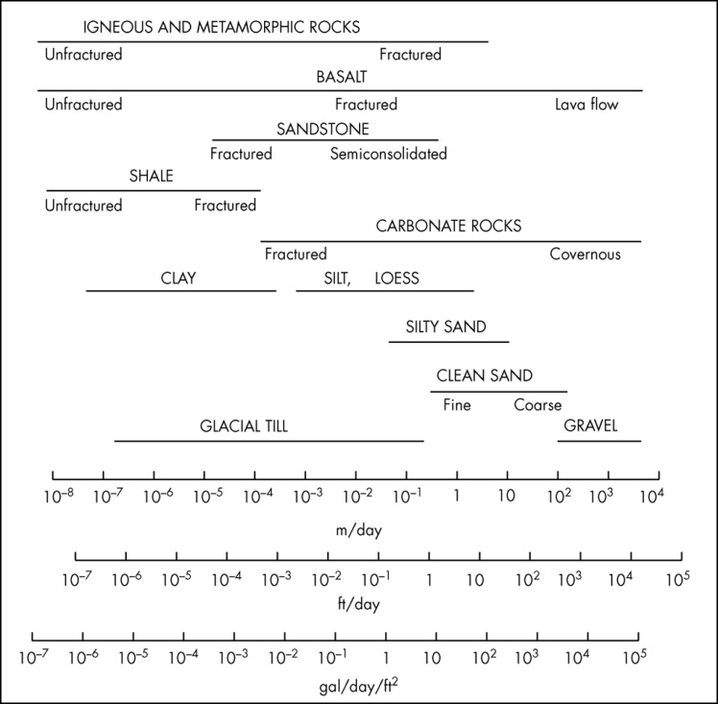
Range of values of Hydraulic Conductivity
From Mays, 2011, Ground and Surface Water Hydrology

Slide 11
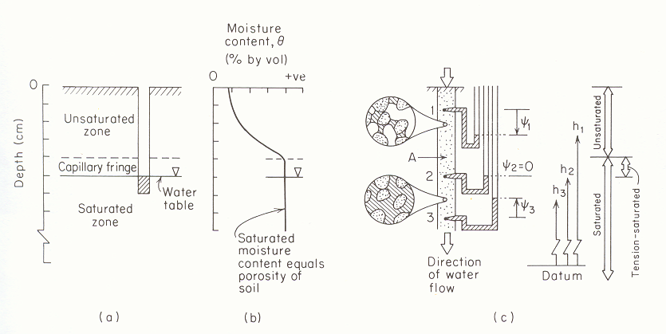
Negative Pressure Head. Suction vs Moisture content
(from Freeze and Cherry, 1979)

Slide 12
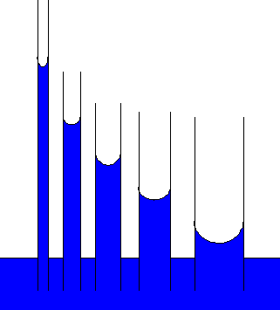
Suction head -|ψ|
Moisture Content θ
Illustration of capillary rise due to surface tension and relationship between pore size distribution and soil water retention curve.

Slide 13
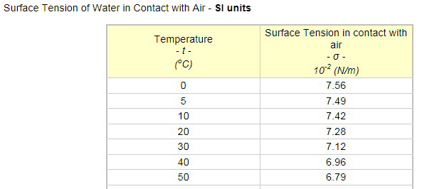
Surface Tension
From http://www.engineeringtoolbox.com/water-surface-tension-d_597.html

Slide 14
From Brutsaert, 2005

Slide 15
From Brutsaert, 2005

Slide 16
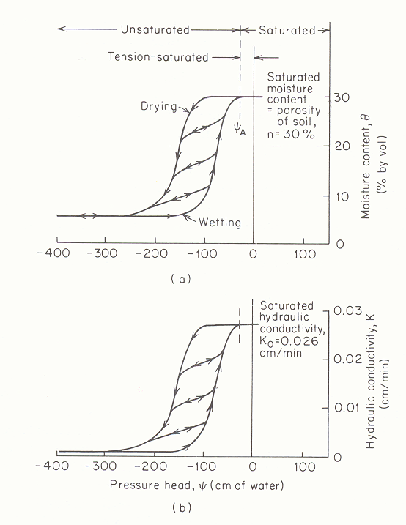
Residual moisture content θ_{r} =5%
Characteristic curve relating moisture content to pressure head (from Freeze and Cherry, 1979).

Slide 17
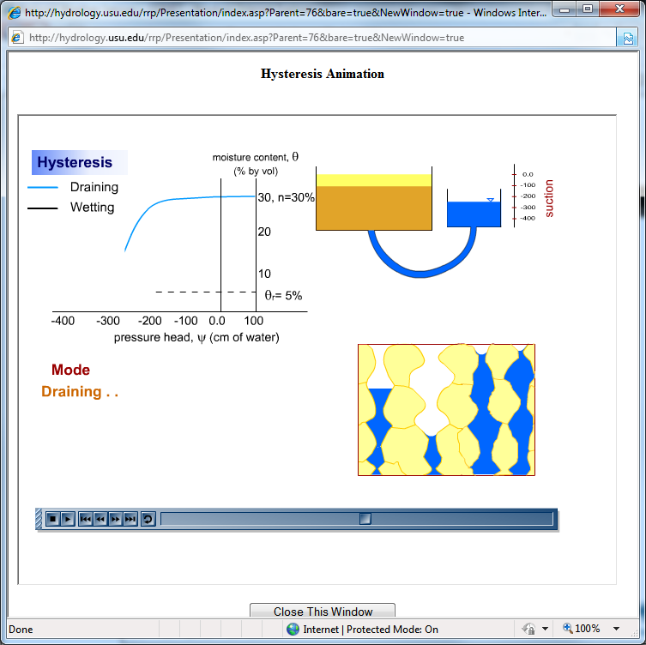
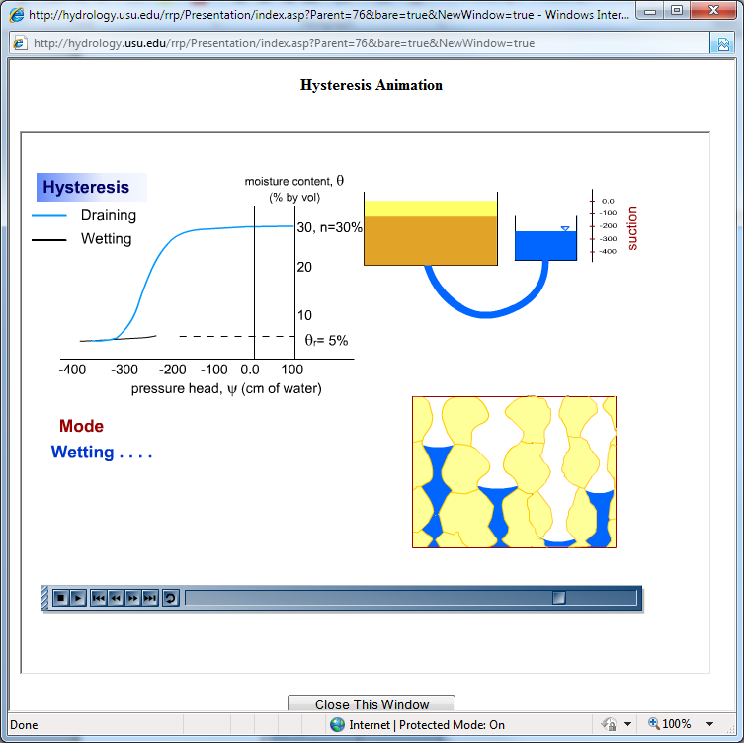
Basis for Hysteresis
See http://hydrology.usu.edu/rrp/ hysteresis animation

Slide 18
Characteristic curve relating Hydraulic Conductivity to pressure head (from Freeze and Cherry, 1979).

Slide 19
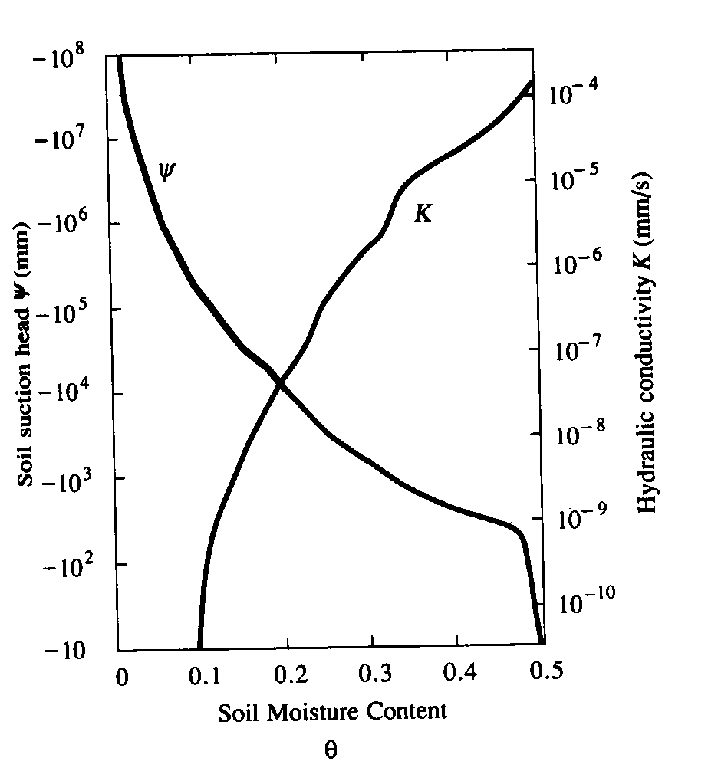
Variation of soil suction head, |ψ|, and hydraulic conductivity, K, with moisture content. (from Chow et al, 1988)

Slide 20
Equations to representing soil water characteristic functions
Brooks and Corey (1966)
Clapp and Hornberger (1978)
van Genuchten (1980)

Slide 21
Clapp and Hornberger (1978) parameters for Soil Moisture Characteristic functions based on analysis of 1845 soils. Values in parentheses are standard deviations.
Also see Rosetta model (Update to URL in Module)
http://ars.usda.gov/Services/docs.htm?docid=8953

Slide 22
Soil suction head, |ψ|, for different soil textures using the Clapp and Hornberger (1978) parameterization.

Slide 23
Hydraulic conductivity K(θ) for different soil textures using the Clapp and Hornberger (1978) parameterization.

Slide 24
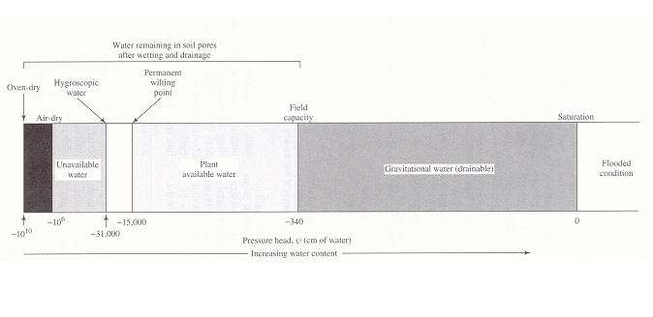
Soil-water status as a function of pressure (tension). Natural soils do not have tensions exceeding about -31000 cm; in this range water is absorbed from the air. [from Dingman, 1994]

Slide 25
Residual moisture content θ_{r} =5%
Characteristic curve relating moisture content to pressure head (from Freeze and Cherry, 1979).

Slide 26
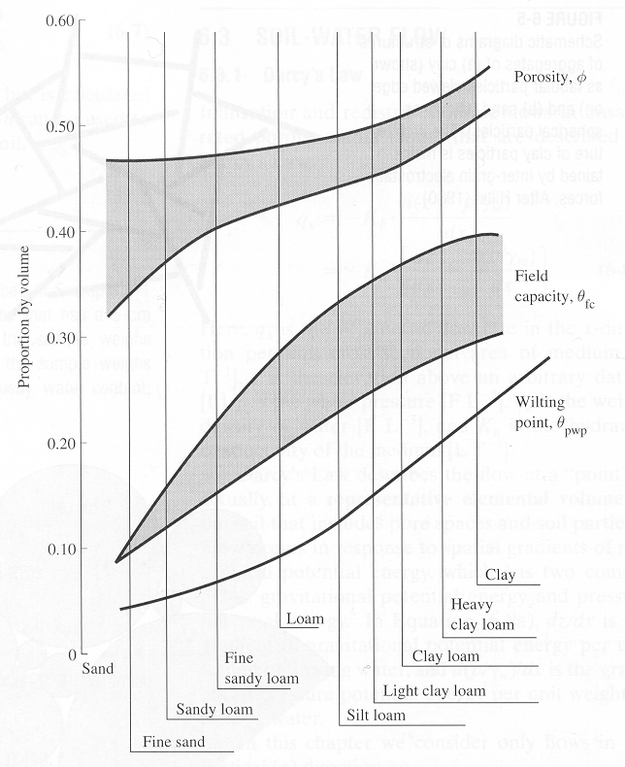
Ranges of porosities, field capacities, and permanent wilting points for soils of various textures. (from Dunne and Leopold, 1978)

Slide 27
Problem 17 example

Slide 28
Group learning challenge 2.
Figure out an approximate height of capillary rise (the height of the capillary fringe) in sand with average pore size approximated as 0.05 mm
Figure out an approximate height of capillary rise (the height of the capillary fringe) in silt with average pore size of 0.005 mm

