Slide 1
CEE Water and Environmental Seminar
Estimating design floods in a warming climate – gaps, challenges, and the way forward
Dr. Ashish Sharma, University of New South Wales, Sydney, Australia, Friday, September 9 @ 2:30 pm, ENGR 108
A lot has been said and written about climate change and how it may make floods more frequent and extreme. This talk will outline what needs to change in a warmer climate for design floods to increase or decrease, present data based (as opposed to model based) evidence for all the changes, and present a sensible way design flood estimation should be approached in this new climate we are in. These changes present the clearest evidence till date that design flood magnitudes for urban catchments across the world are increasing, a change that needs to be accepted and factored into our planning guidelines urgently given the implications this has to our existing stormwater infrastructure and society in general.

Slide 2
Temporal Variability of Hydrologic Data

Slide 3
Logan River Annual Aggregate Time Series
2500
mean cfs
7 day min cfs
2000
max cfs
1500
cfs
1000
500
0
1920
1930
1940
1950
1960
1970
1980
1990
2000

Slide 5

Random variables
Probability density
function
Cumulative distribution
function

Slide 6
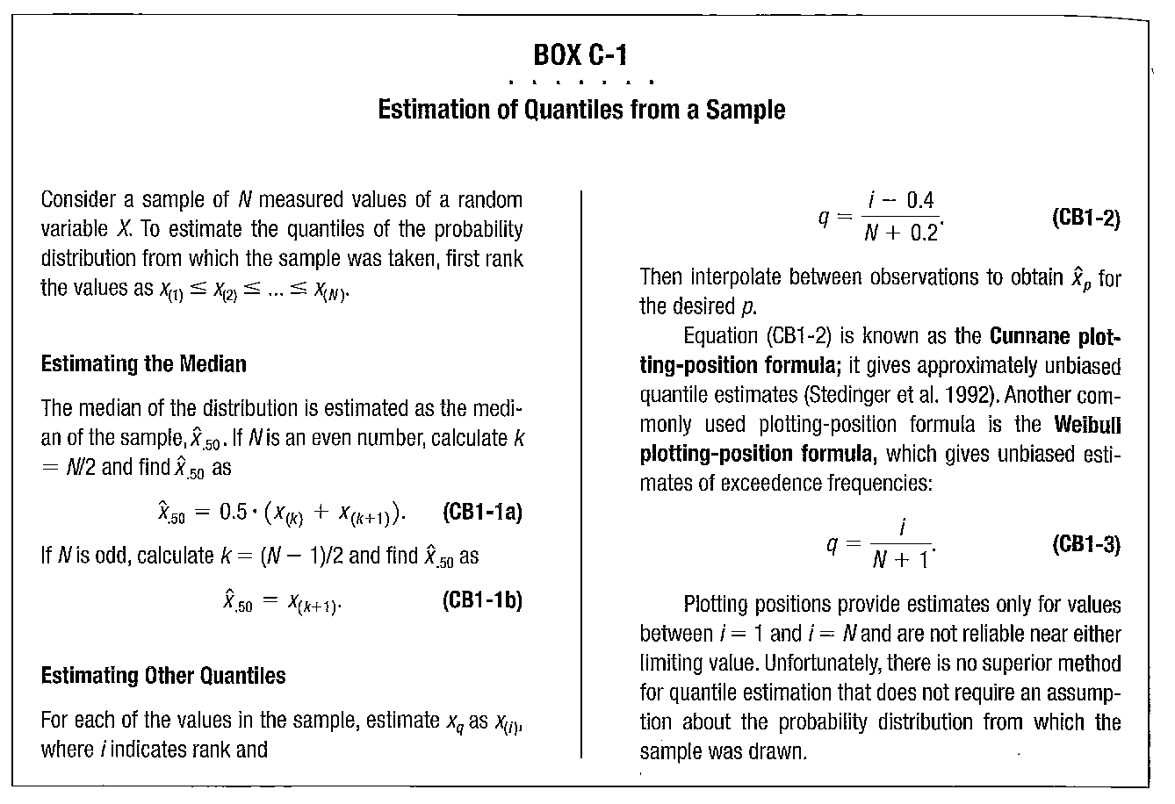
From Dingman, 2002

Slide 7
Mean of Monthly Streamflow. Alafia River

Slide 9
Storage-Yield Analysis
Used to size a reservoir given a streamflow time series.
An application of mass balance concepts

Slide 10
Storage-Yield Analysis
Sequent Peak Procedure
R_{t} = y
K_{t} = K_{t-1} + R_{t} – Q_{t}
If K_{t} < 0, K_{t}=0
S = Max(K_{t})

Slide 13
Reservoir Storage-Yield Analysis
R/Q

Slide 14
Box Plot
Outliers: beyond 1.5*IQR
Whiskers: 1.5*IQR or largest value
Box: 25th %tile to 75th %tile
Line: Median (50th %tile) - not the mean
Note: The range shown by the box is called the “Inter-Quartile Range” or IQR.
This is a robust measure of spread. It is insensitive to outliers since it is based purely on the rank of the values.

Slide 15
Reservoir Reliability Analysis

Slide 16
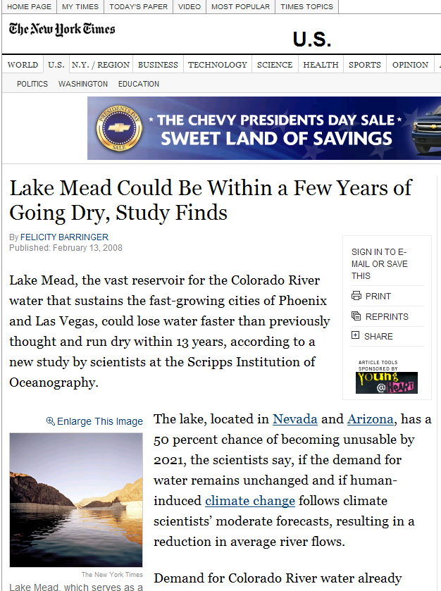
From http://www.nytimes.com/2008/02/13/us/13mead.html
Barnett, T. P., and D. W. Pierce (2008), When will Lake Mead go dry?, Water Resour. Res., doi:10.1029/2007WR006704, in press.

Slide 17
From NRC Colorado River Basin Management, 2007

Slide 18
From NRC Colorado River Basin Management, 2007

Slide 19
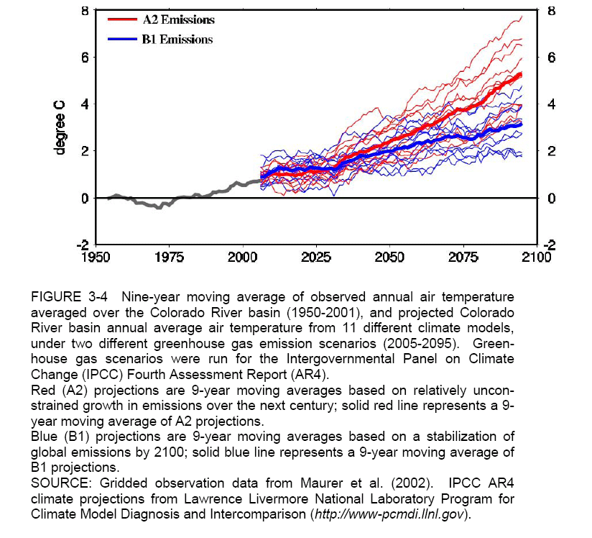
From NRC Colorado River Basin Management, 2007

Slide 20
From NRC Colorado River Basin Management, 2007

Slide 21
From NRC Colorado River Basin Management, 2007

Slide 23
Lake Powell Capacity 27 MAF

Slide 24
Reading
Loucks, D. P., E. van Beek, J. R. Stedinger, J. P. M. Dijkman and M. T. Villars, (2005), Water Resources Systems Planning and Management: An Introduction to Methods, Models and Applications, UNESCO, Paris, 676 p, http://hdl.handle.net/1813/2804.
Tarboton, D. G., (1994), "The Source Hydrology of Severe Sustained Drought in the Southwestern United States," Journal of Hydrology, 161: 31-69, http://dx.doi.org/10.1016/0022-1694(94)90120-1.
Barnett, T. P. and D. W. Pierce, (2008), "When will Lake Mead go dry?," Water Resour. Res., 44: W03201, http://dx.doi.org/10.1029/2007WR006704.
National Research Council Committee on the Scientific Bases of Colorado River Basin Water Management, (2007), Colorado River Basin Water Management: Evaluating and Adjusting to Hydroclimatic Variability, National Academy Press, Washington, DC, http://books.nap.edu/catalog.php?record_id=11857.

