Slide 1
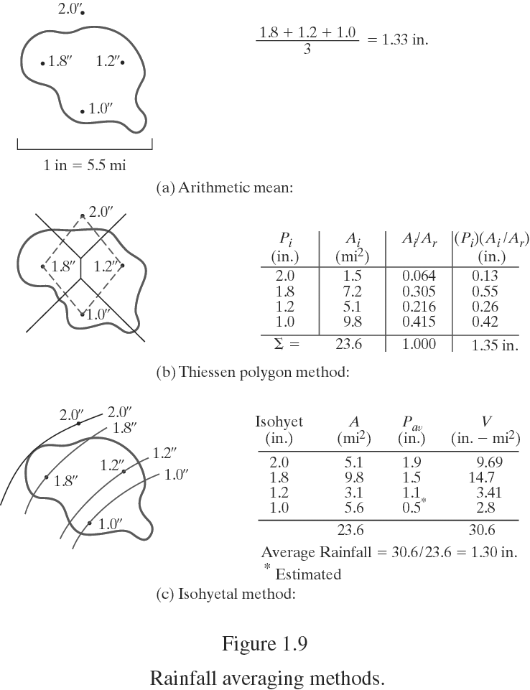
Rainfall Averaging Methods
From Bedient

Slide 2
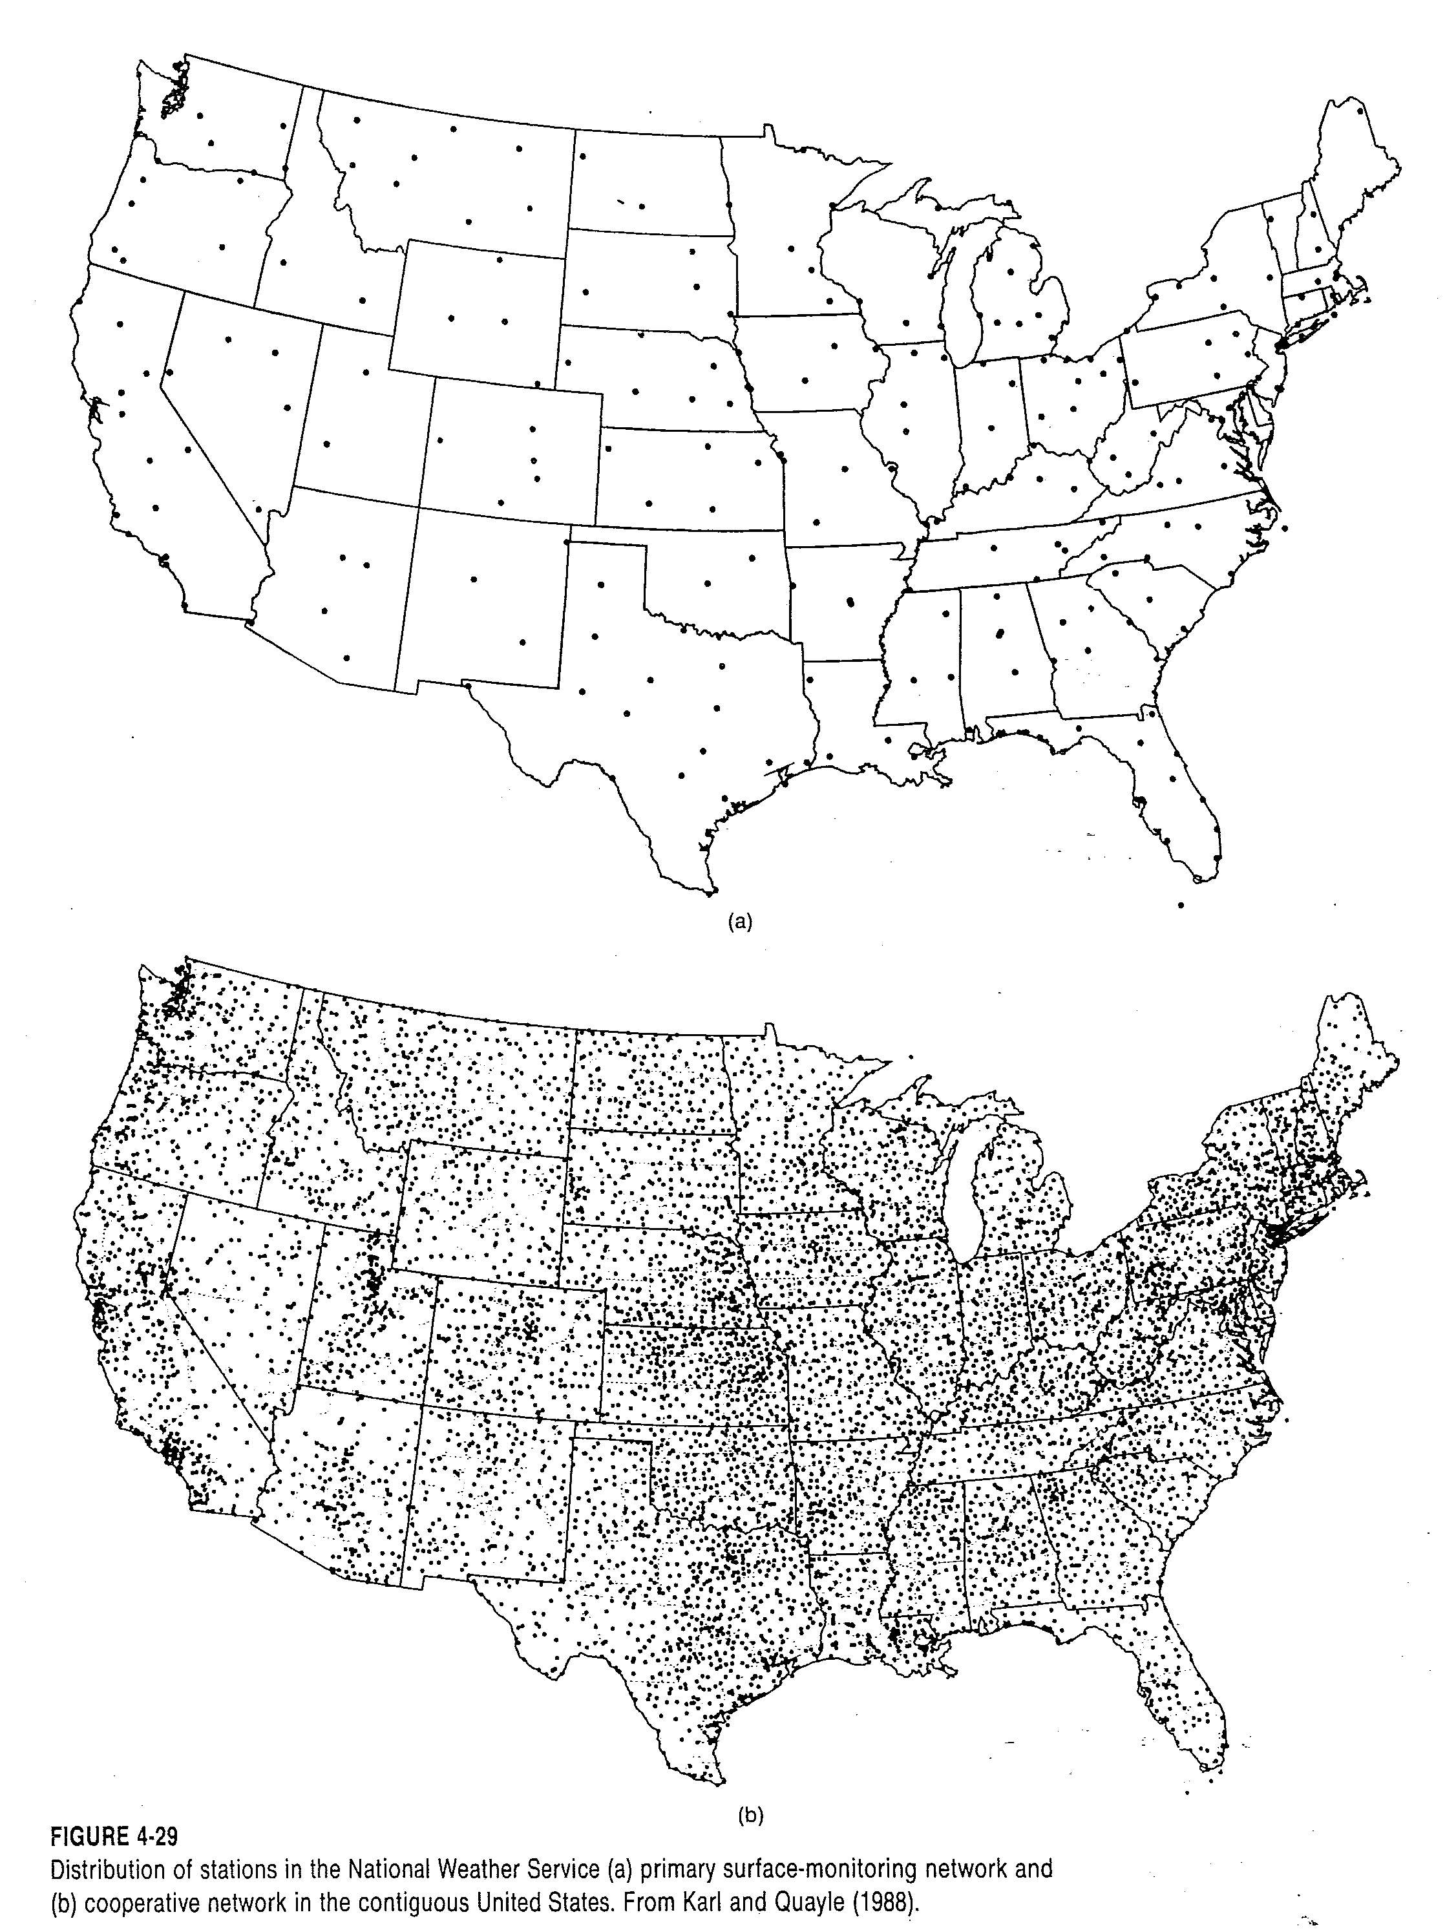
From Dingman, 1994

Slide 3
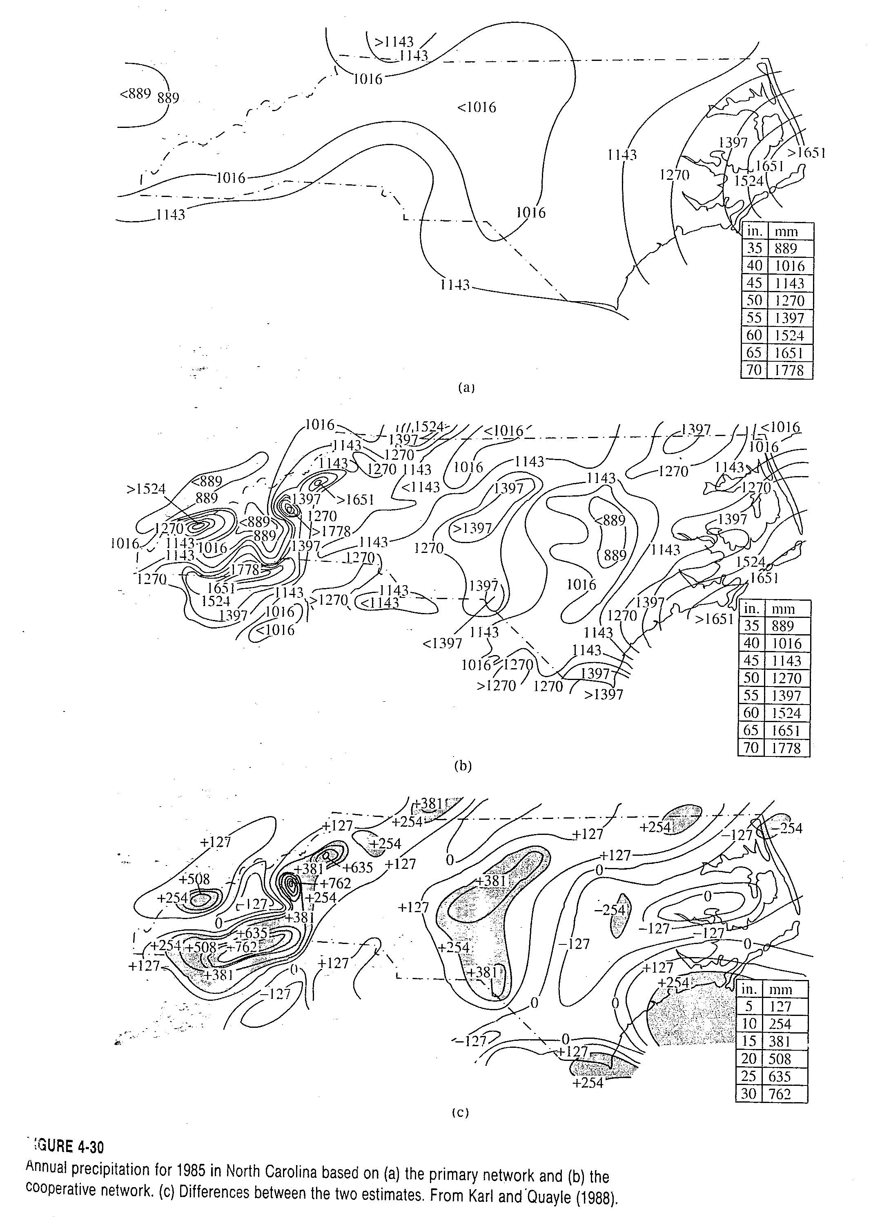
From Dingman, 1994

Slide 4
RADAR Rainfall Estimates
NEXRAD provides real-time data on a ~16 km² (6 mi²) grid
Each estimate represents an average rainfall amount over the entire 4 x 4 km² area
NEXRAD rainfall estimates compare well with point rain gage measurements (r² ~ 0.9)
From Bedient

Slide 5
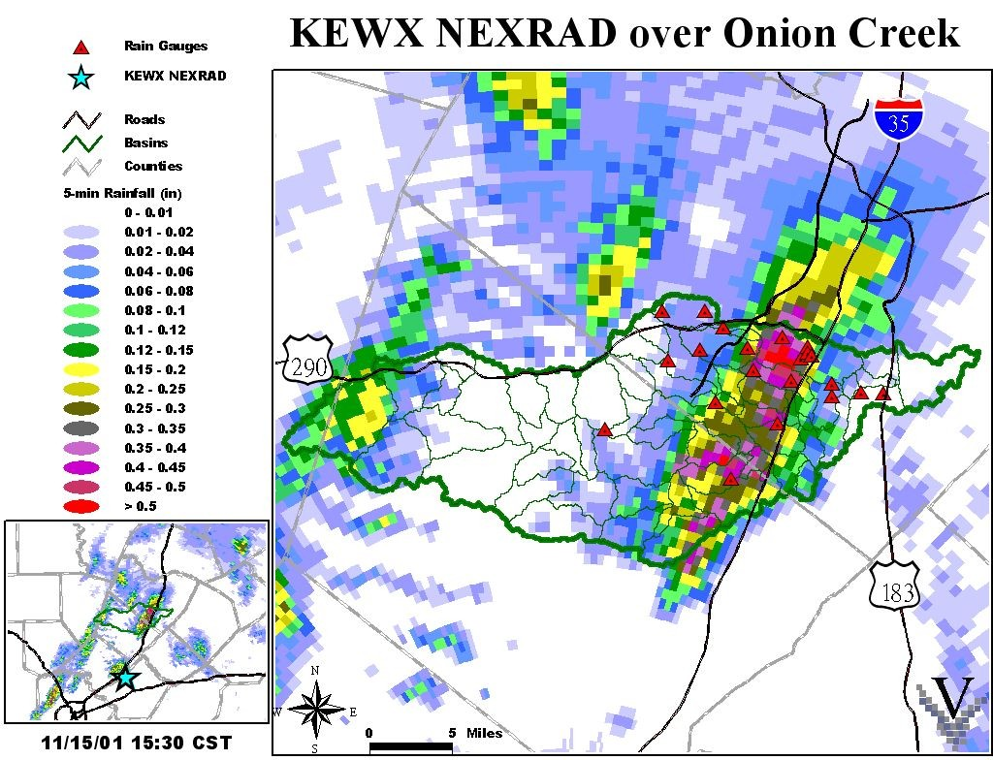

Slide 6
World Record Rainfall Amounts
From Dingman, 2002

Slide 7
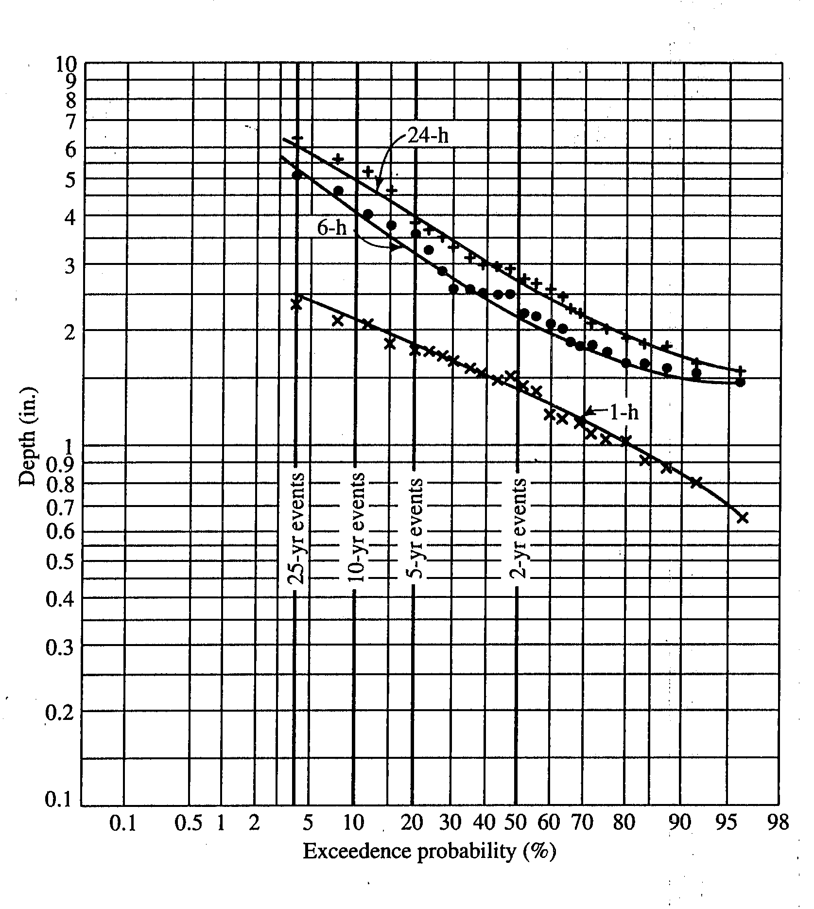
Logarithmic - probability plots of depths of 1-, 6-, and 24-hr rainfall data
From Dingman, 1994

Slide 8
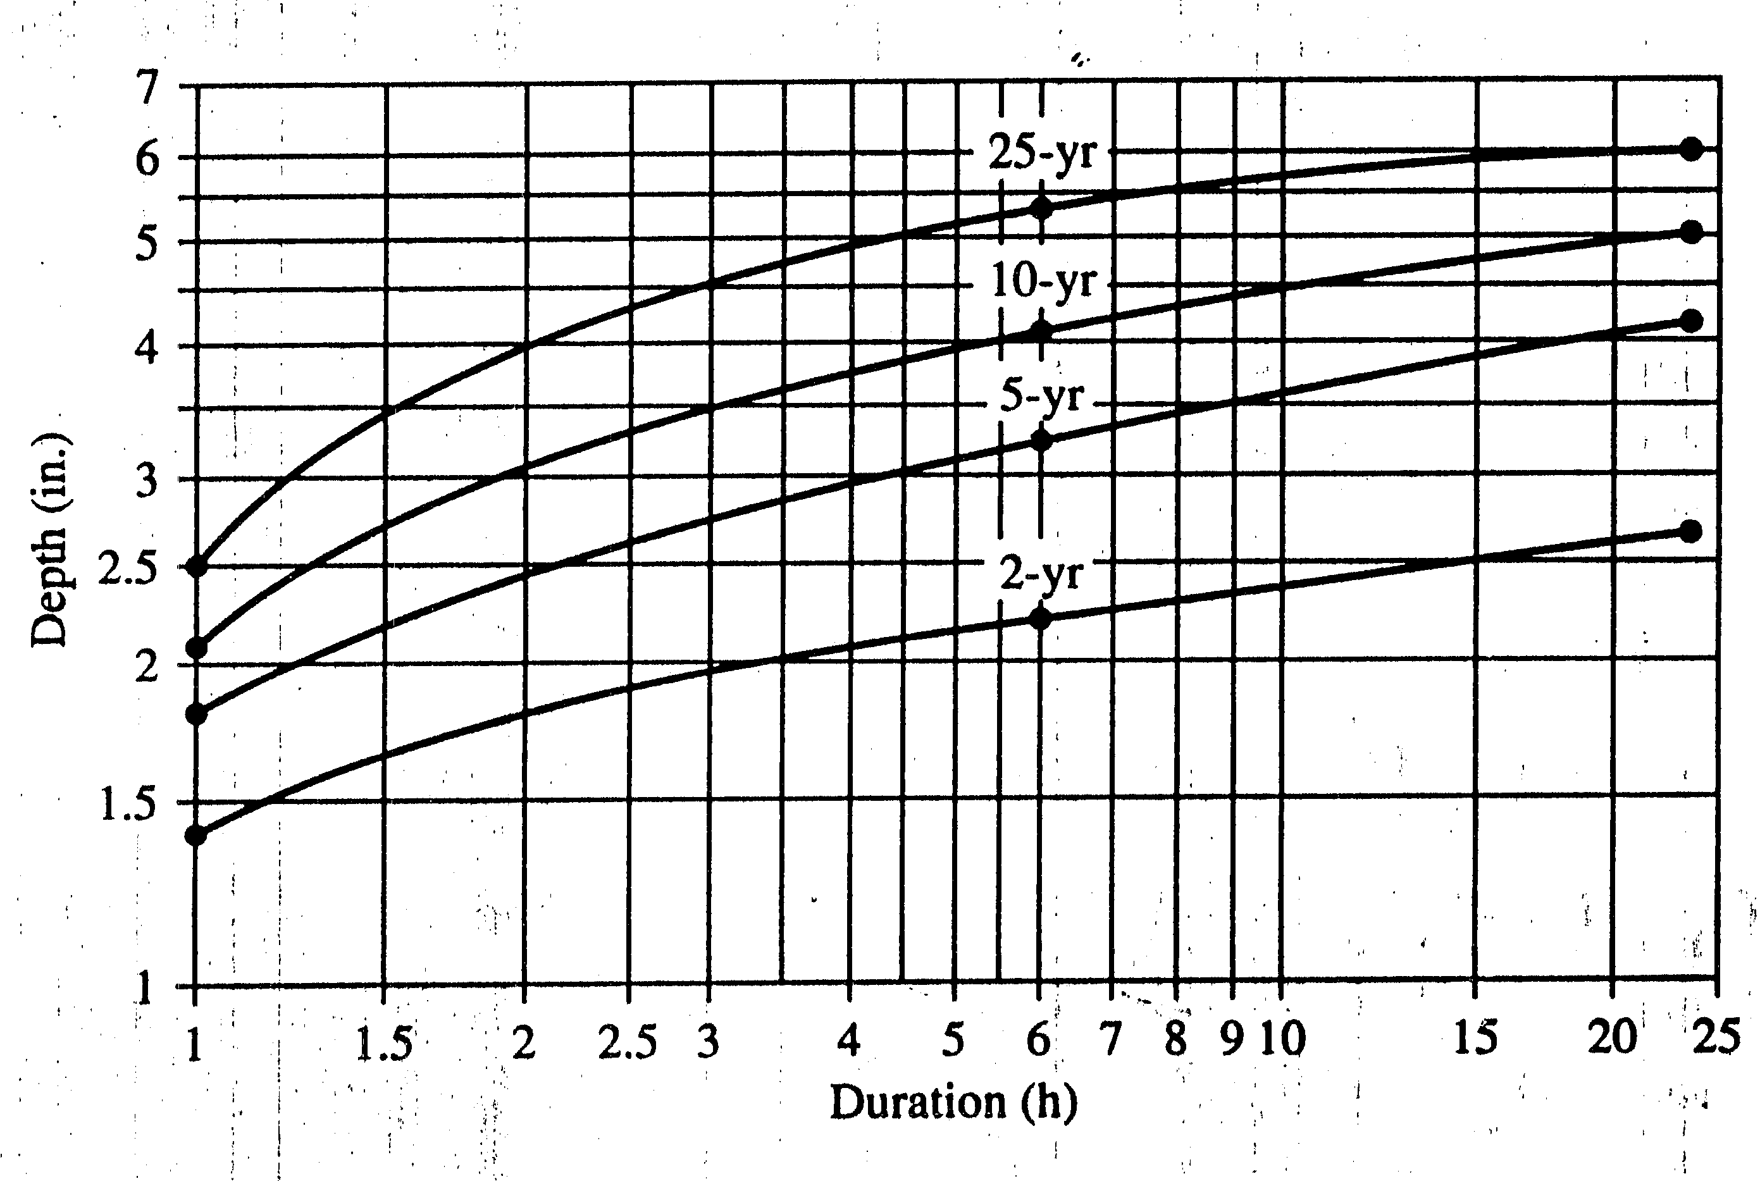
Depth – Duration – Frequency plot

Slide 9
From Brutsaert, 2005

Slide 10
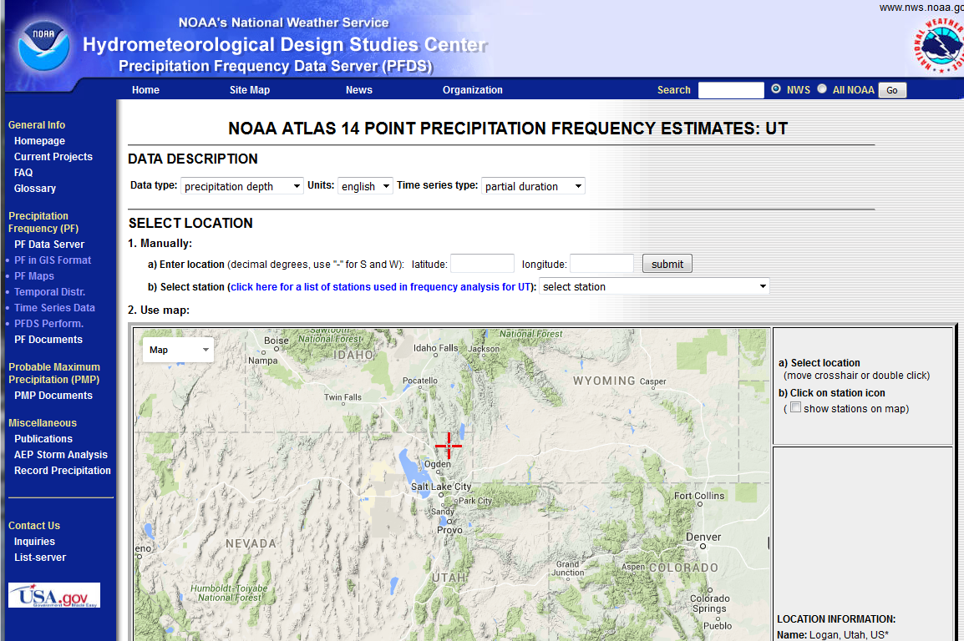
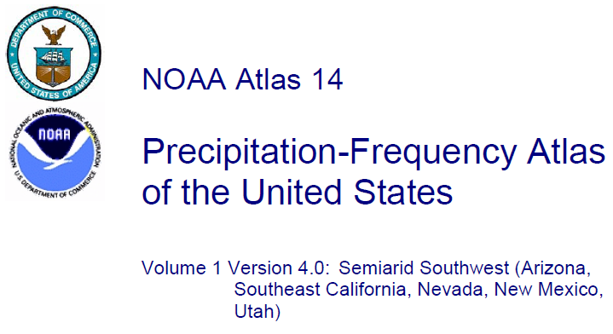
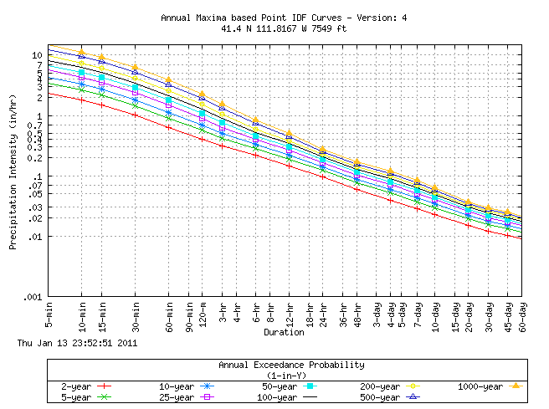
NOAA Hydrometeorological Design Studies Center Precipitation Frequency Data Server (PFDS)
http://hdsc.nws.noaa.gov/hdsc/pfds/
The standard source for design storm data

Slide 11
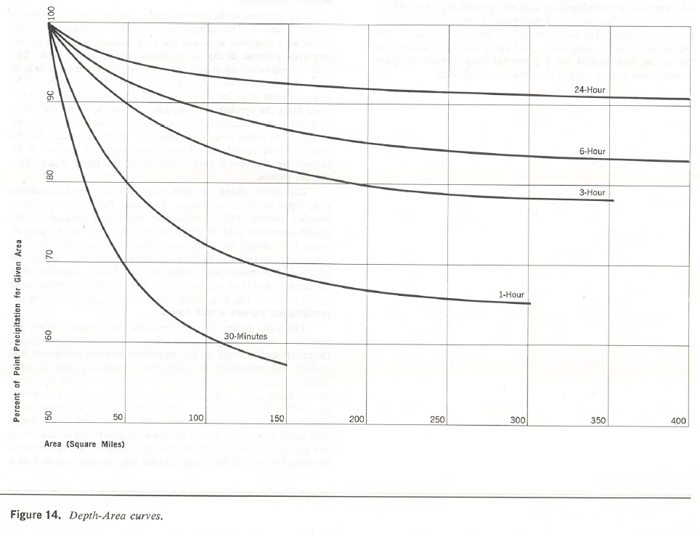
From NOAA Atlas 2 http://www.nws.noaa.gov/oh/hdsc/PF_documents/Atlas2_Volume5.pdf
Reduction of point rainfall for application to drainage area

