Slide 1
Midterm Review

Slide 2
Format
Closed book portion. Answer all questions. Please answer on this paper. Calculators are permitted. (20 min)
Open Book Portion. Answer all questions. Please answer on separate sheets of paper. You may refer to the textbook, notes, solutions to homeworks and any other written or printed reference material that you have brought with you. (60 min)
Calculator use. You may use a programmable calculator or equivalent calculating device (e.g. calculator functionality on a phone). You should limit the use of the calculating device to the performance of calculations. You may use programs that you have written to evaluate quantities commonly used in this class. You may not use your calculating device to retrieve stored reference material in any form. You may not send messages or access the internet or communicate in any way with anyone other than the instructor or moderator regarding solutions to these questions.

Slide 3
Learning Objectives
Hydrologic data, the hydrologic cycle and water balance (HW 1)
Work with hydrologic data, quantify uncertainty and variability, and apply conservation laws to the solution of hydrologic problems.
The Climate System and Global Hydrology (HW 2)
Analyze the global energy balance and sensitivity of surface temperature to factors involved, such as albedo and the greenhouse effect.
To quantify the water balance and its sensitivity to climate for a watershed of interest.

Slide 4
Learning Objectives 2
Precipitation (HW 3)
Estimate area average precipitation from point measurements using a variety of methods
Quantify the uncertainty in an areal precipitation estimate
Estimate design rainfall amounts and intensities
[Use ArcGIS for analysis of hydrologic data]

Slide 5
Learning Objectives 3
Runoff generation and water in soil (HW 4)
Use the terminology used in hydrology and the study of rainfall-runoff processes (Workbook chapter 1).
Describe the processes involved in runoff generation (Workbook chapter 2)
Distinguish between infiltration excess, saturation excess and subsurface stormflow runoff generation mechanisms and identify when and where each is more likely to occur (Workbook chapter 2)
Describe the physical factors resulting in the occurrence of runoff by the different mechanisms (Workbook chapter 3)
Quantify the properties of water held in and flowing through soil (Workbook chapter 4)

Slide 6
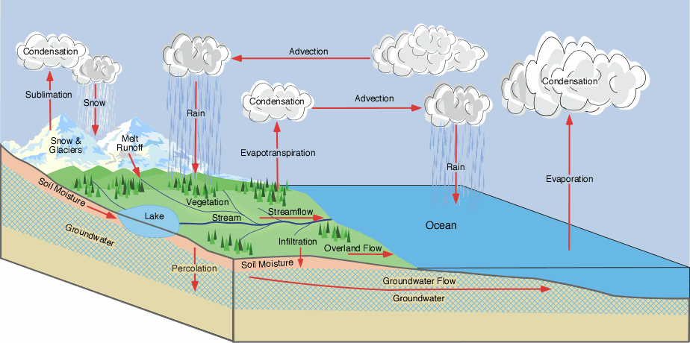
The Hydrologic Cycle
From Ross Woods

Slide 7
Water Balance
Atmospheric Water
Soil Water
Surface Water
Groundwater
Change of Storage
= Inflow - Outflow

Slide 8
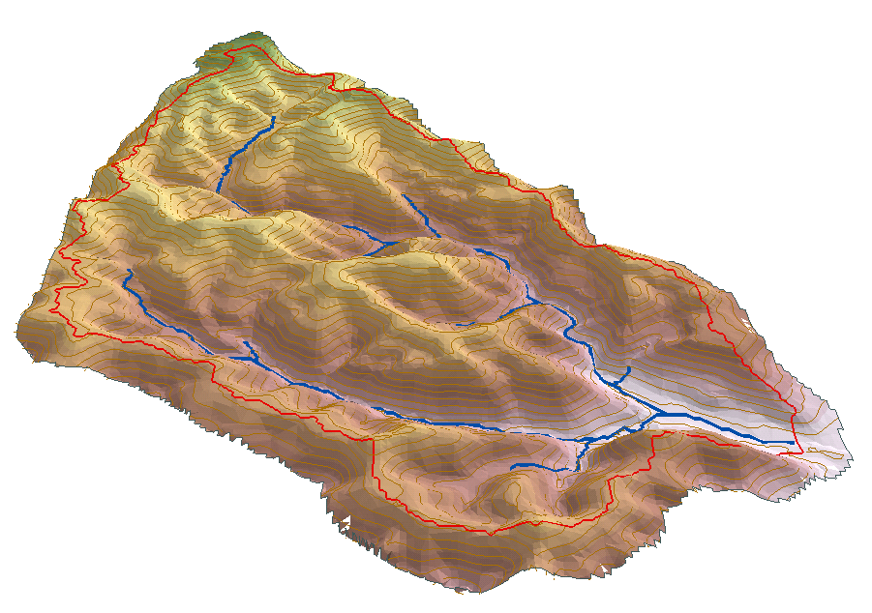
Watershed water balance
P
ET
G_{in}
Q
S
G_{out}
Notes:
DONE

Slide 9
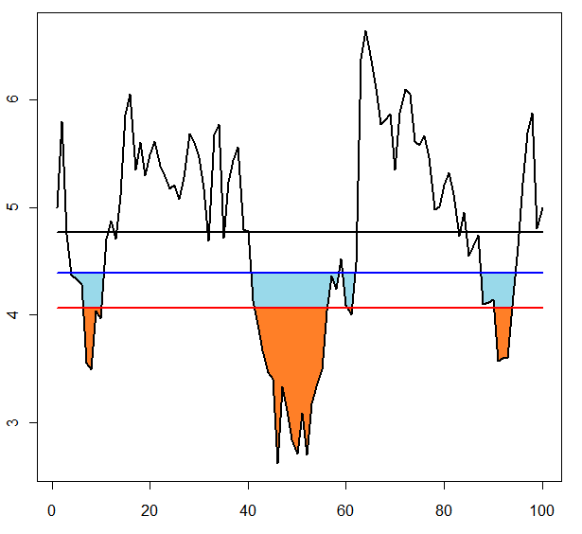
Storage-Yield Analysis
Used to size a reservoir given a streamflow time series.
Sequent Peak Procedure
R_{t} = y
K_{t} = K_{t-1} + R_{t} – Q_{t}
If K_{t} < 0, K_{t}=0
S = Max(K_{t})
Notes:
DONE

Slide 10
Notes:
DONE

Slide 11

The climate system and global hydrology
Perform simple analysis of the global energy balance and sensitivity of surface temperature to factors involved, such as albedo and the greenhouse effect
Notes:
DONE

Slide 12
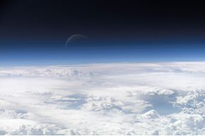
The Greenhouse Effect - Two layer atmosphere energy balance
W
Refer to Box 3-2 for definitions of quantities and numerical estimates of parameters
Notes:
DONE

Slide 13
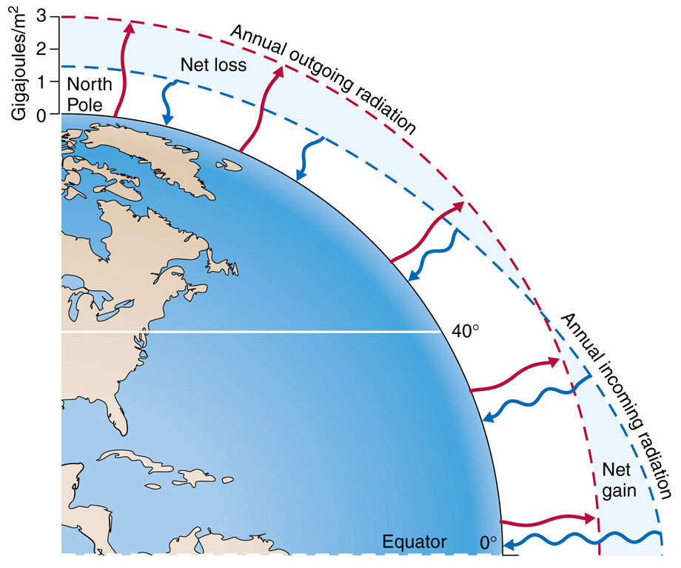
Notes:
DONES

Slide 14
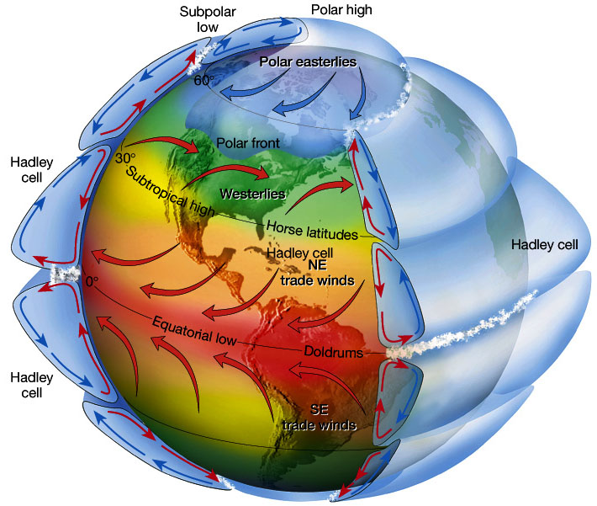
General Circulation of the Atmosphere
Slide from Simon Wang
Notes:
DOUBT:
What is the takeaway?
Why doldrums?
Why NE trade winds in NH, SE trade wins in the SH?
Why westerlies?
Why polar easterlies?

Slide 15
Water Balance (Budyko curve)
E/P
Soil Storage/ Retention or Residence time
E = R : energy limited upper bound
large
medium
small
1
E = P : water limited upper bound
Evapotranspiration fraction
Increasing variability in soil capacity or areas of imperviousness
Increasing variability in P – both seasonally and with storm events
Increasing Retention or Soil capacity
R/P
humid
arid
energy limited
water limited
Dryness (available energy /precip)
Notes:
DOUBT!

Slide 16
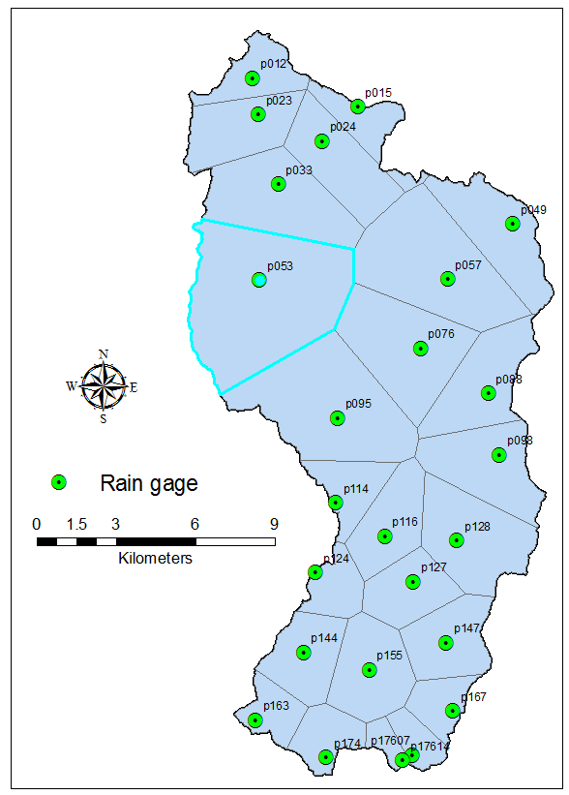
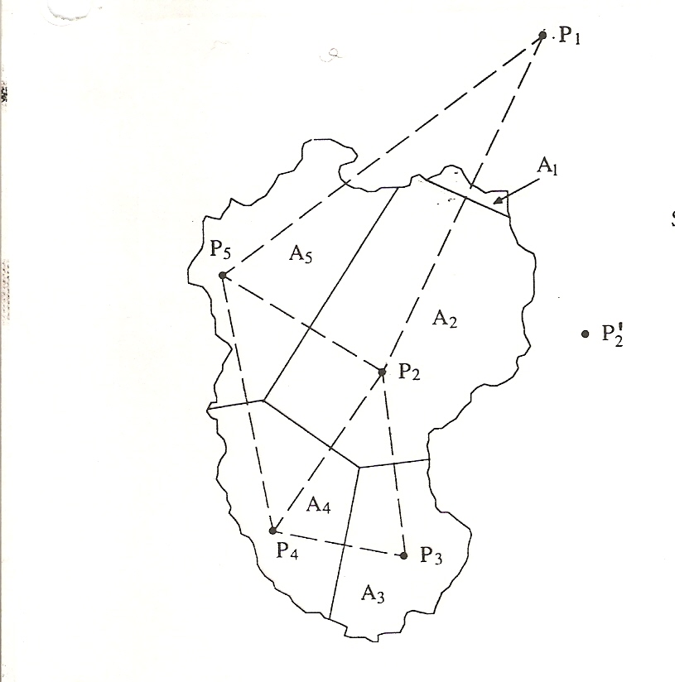
Precipitation
Area Averaging
Notes:
DONE

Slide 17
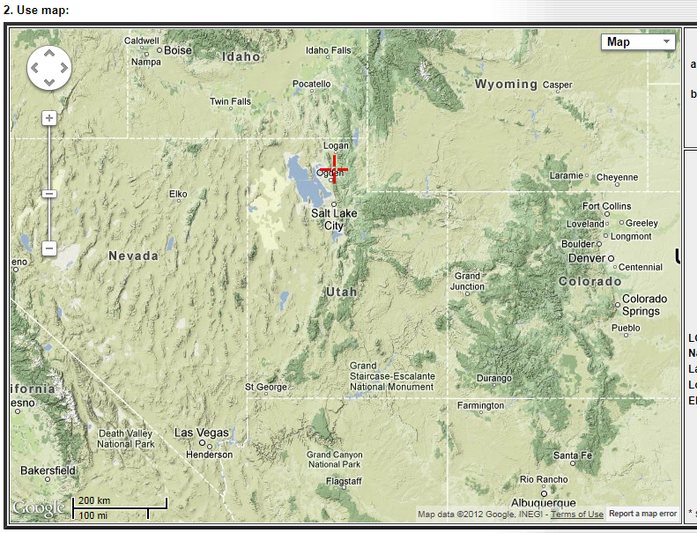
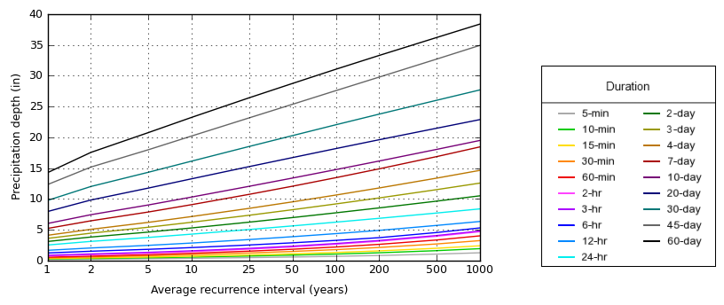
Climatology and statistical Variability http://dipper.nws.noaa.gov/hdsc/pfds/

Slide 18
Uncertainty in Areal precipitation
From Bras, 1990

Slide 19
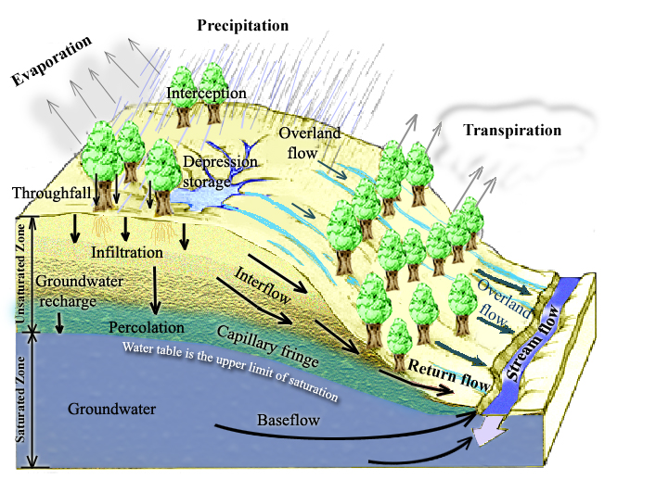
Physical Processes involved in Runoff Generation
Rainfall Runoff Processes
Notes:
Figure 1. Physical Processes involved in Runoff Generation.

Slide 20
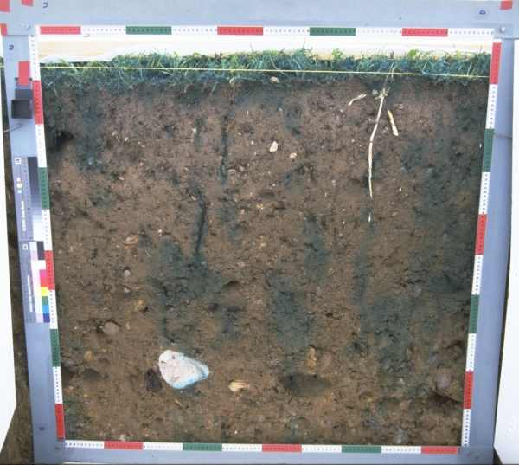
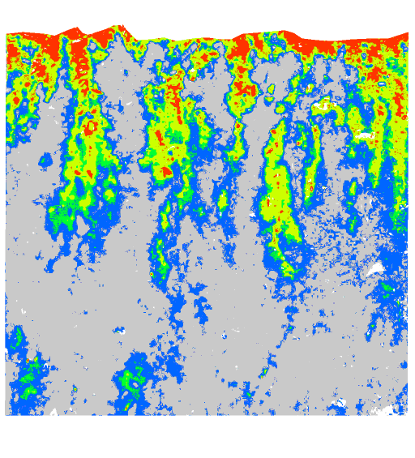
Infiltration follows preferential pathways
(a) Photograph of cross section through soil following dye tracing experiment. (b) Moisture content inferred from dye tracing experiment. (Courtesy of Markus Weiler)

Slide 21
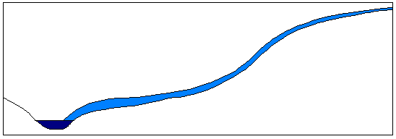
Runoff Generation Mechanisms
P
(a) Infiltration excess overland flow
(also called Horton overland flow)
f
P
P
q_{o}
f
(following Beven, 2001)
See infiltration excess runoff generation animation http://hydrology.neng.usu.edu/RRP/ (ch 2)

Slide 22
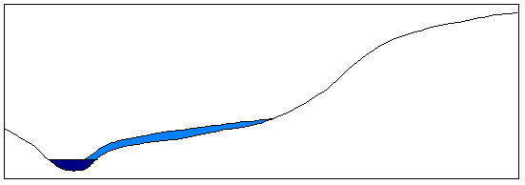
(b) Partial area infiltration excess overland flow
P
Fraction of area contributing to overland flow
q_{o}
P
P
f
(following Beven, 2001)

Slide 23
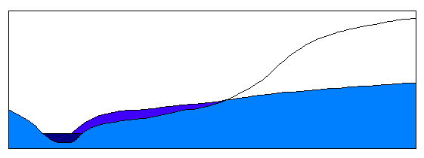
(c) Saturation excess overland flow
P
Variable source area
P
P
q_{o}
q_{r}
q_{s}
(following Beven, 2001)
See saturation excess runoff generation animation http://hydrology.neng.usu.edu/RRP/ (ch 2)

Slide 24
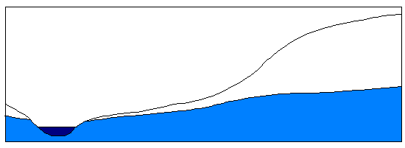
(d) Subsurface stormflow
P
P
P
q_{s}
(following Beven, 2001)
See subsurface runoff generation animation http://hydrology.neng.usu.edu/RRP/ (ch 2)

Slide 25
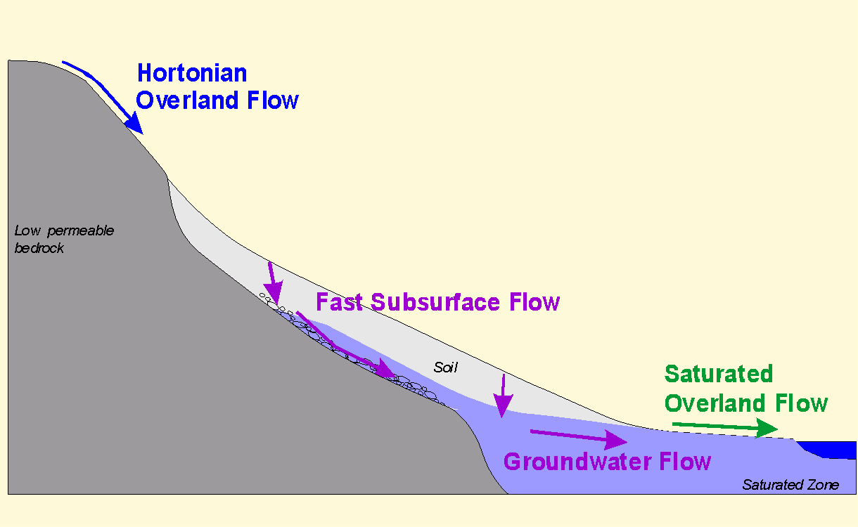
The particular runoff process that dominates is place and time dependent

Slide 26
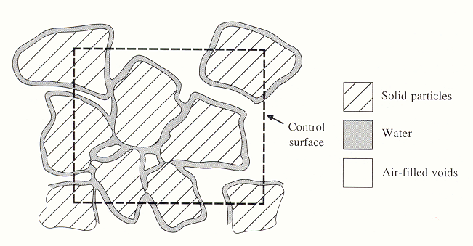
Water in Soil
Be able to quantify the properties of water held in and flowing through soil (porosity, moisture content, pressure, suction, hydraulic conductivity)

Slide 27
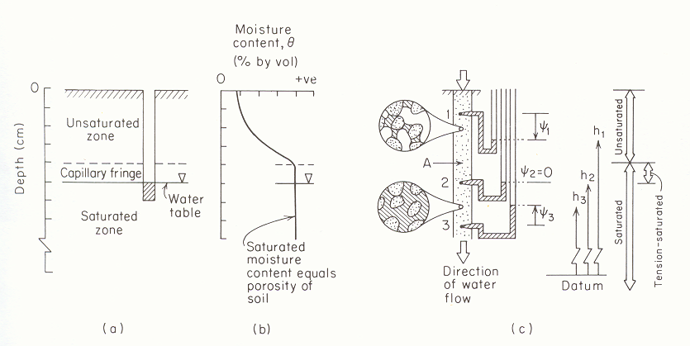
Negative Pressure Head. Suction vs Moisture content
(from Freeze and Cherry, 1979)

Slide 28
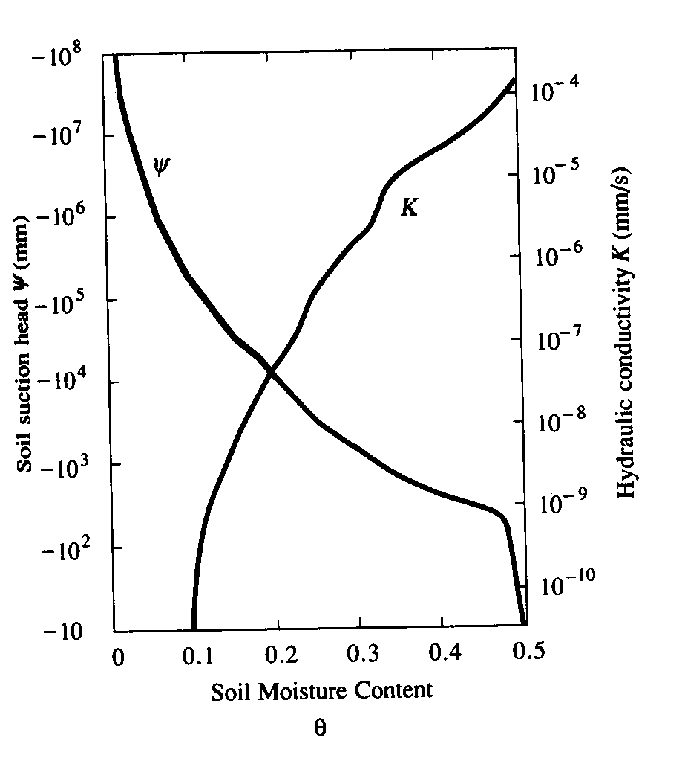
Variation of soil suction head, |ψ|, and hydraulic conductivity, K, with moisture content. (from Chow et al, 1988)

