Slide 1
Equation Unit Conversion

Slide 2
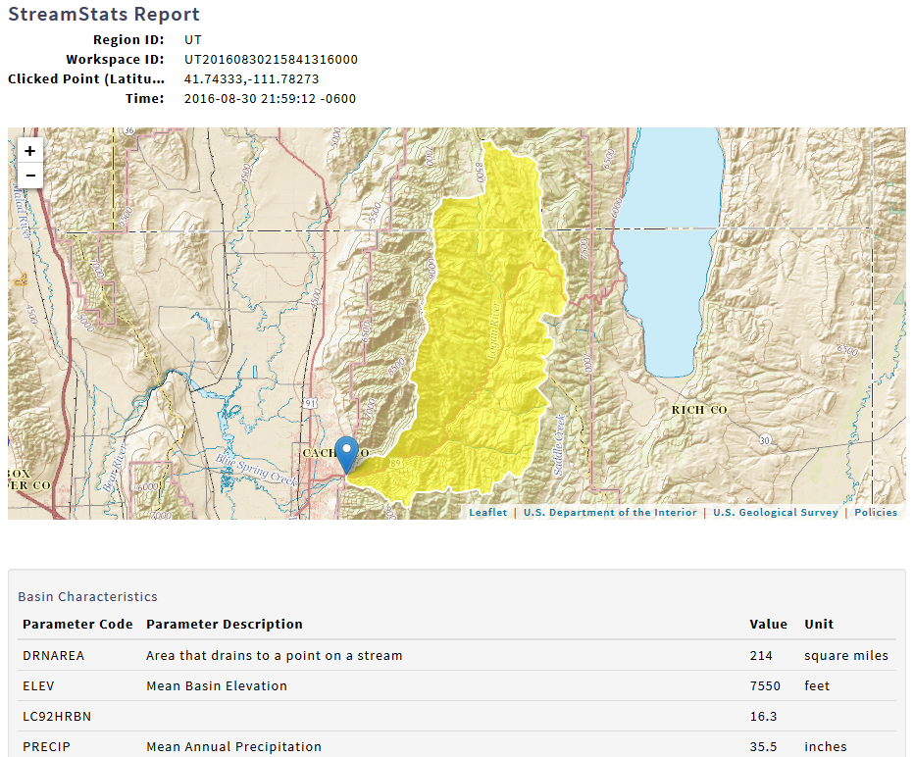

Slide 3
Hydrologic Data and Hydrologic Budget
USGS http://waterdata.usgs.gov
Logan River Mean Annual Flow 236.8 cfs
Streamstats http://water.usgs.gov/osw/streamstats/
Logan River Mean annual precipitation in inches 35.5
Area 214 mi²
What is the Evapotranspiration from the Logan River Catchment and what is its uncertainty?

Slide 4
R Work
R https://www.r-project.org/
R Studio https://www.rstudio.com/
R Bare Essentials R Bare Essentials.htm
USGS dataRetrieval https://github.com/USGS-R/dataRetrieval
Class R work (Rwork.r)

