Slide 1
Hydrology
A science dealing with the properties, distribution and circulation of water.
David Tarboton
http://hydrology.usu.edu/dtarb/
dtarb@usu.edu
CEE6400 Physical Hydrology

Slide 2
My Teaching
Physical Hydrology (CEE6400)
This course
GIS in Water Resources Online (CEE6440)
A linked classroom course presented in partnership with David Maidment at the University of Texas at Austin.
Engineering Hydrology (CEE3430)
Spring (sometimes)
Online Module - Rainfall Runoff Processes
http://www.engineering.usu.edu/dtarb/rrp.html

Slide 3
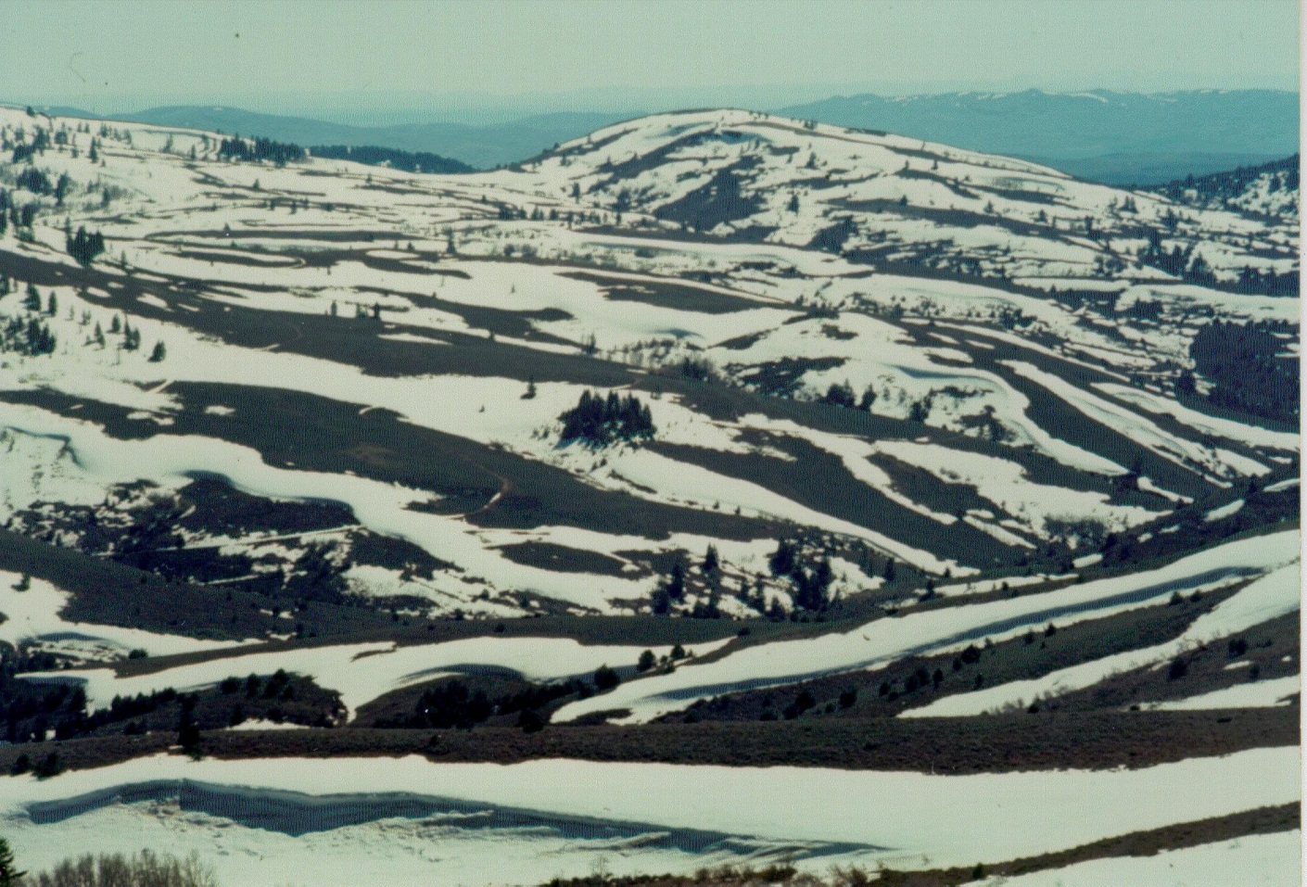
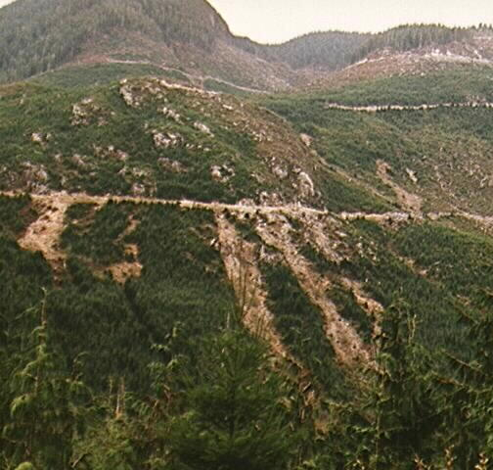
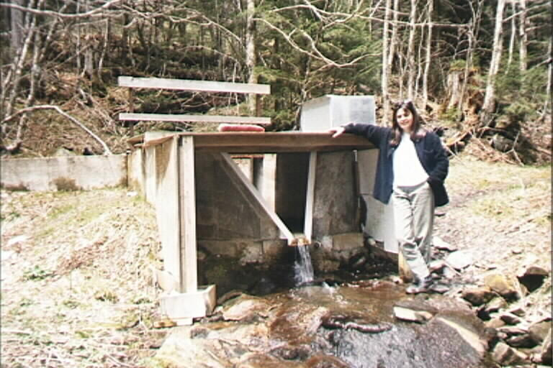
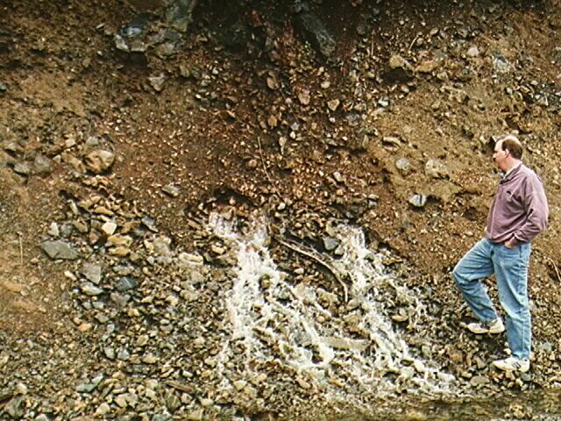
Research
Theme
To advance the capability for hydrologic prediction by developing models that take advantage of new information and process understanding enabled by new technology
Topics
Hydrologic information systems (includes GIS)
Terrain analysis using digital elevation models – Parallel computation for watershed delineation
Snow hydrology and glacier melt modeling
Hydrologic modeling
Hydrological Consequences of Global Climate Change for Stream Biodiversity
Notes:
My research has been pretty varied, but there are a few common themes. The statement "To advance the capability for hydrologic prediction by developing models that take advantage of new information and process understanding enabled by new technology" summarizes my overall goal. The general areas I have worked in are:
Hydrologic information systems (includes GIS)
Terrain analysis using digital elevation models (includes geomorphology)
Snow hydrology
Spatially distributed hydrologic modeling
Stochastic hydrology using nonparametric techniques
I will present some results from the first three of these today.

Slide 4
Hydrology and Water Resources
The availability of water to sustain life is perhaps the most recurrent constraint in human history and will remain so in the foreseeable future.

Slide 5
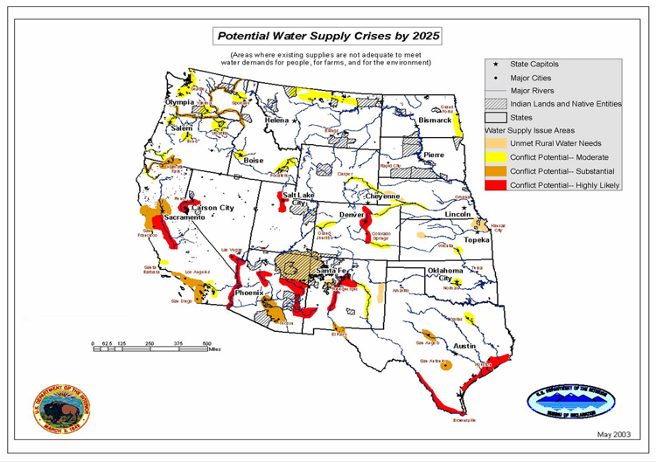
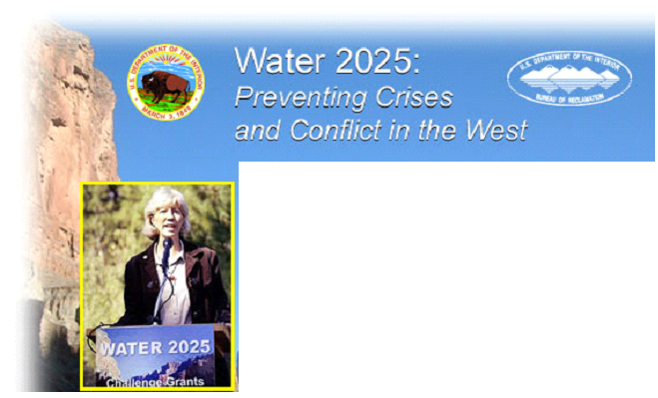
From http://www.doi.gov/water2025/index.html

Slide 6
Hydrologic Science in the hierarchy from basic sciences to water resources management
Basic Sciences
Mathematics
Statistics
Physics
Chemistry
Biology
Geosciences
Geology
Soil Science
Atmospheric Science
Ocean Science
Glaciology
Geochemistry
Economics
Law
Sociology
Political Science
Engineering Hydrology
Agriculture
Forestry
Fluid Mechanics
Hydraulic Engineering
Meteorology
Hydrologic Science
Water Resources Management
Modified From: National Research Council Committee on Opportunities in the Hydrologic Sciences (COHS), (1991), Opportunities in the Hydrologic Sciences, Editor, P. S. Eagleson, National Academy Press, Washington, D.C.

Slide 7
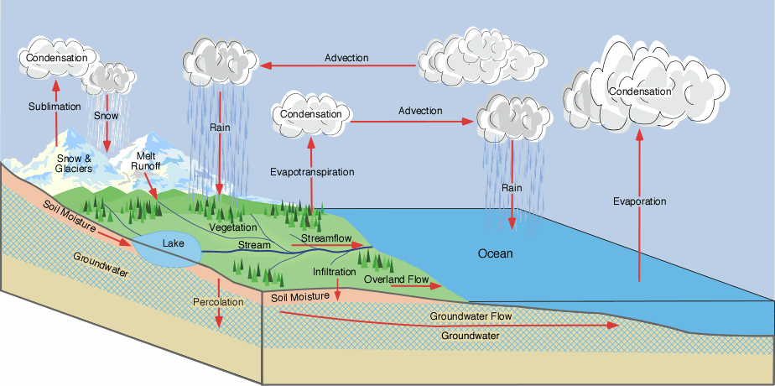
The Hydrologic Cycle
From Ross Woods

Slide 8
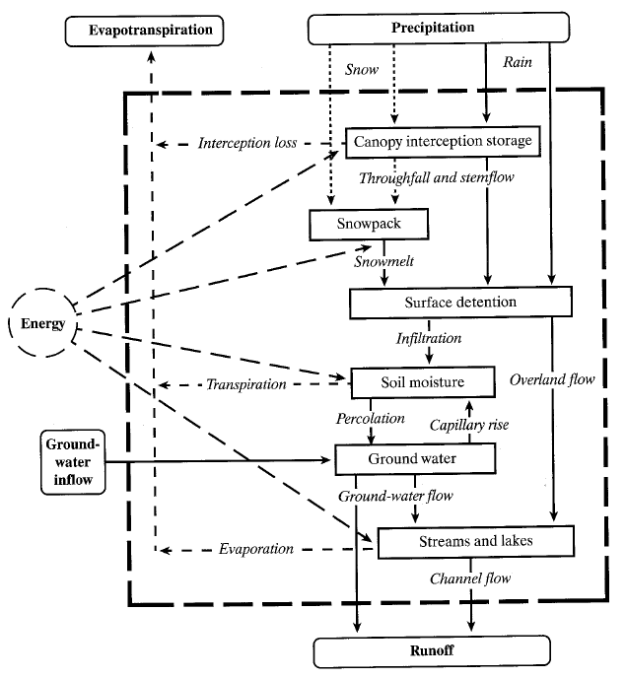
Land phase of the Hydrologic Cycle Dingman (2015)

Slide 9
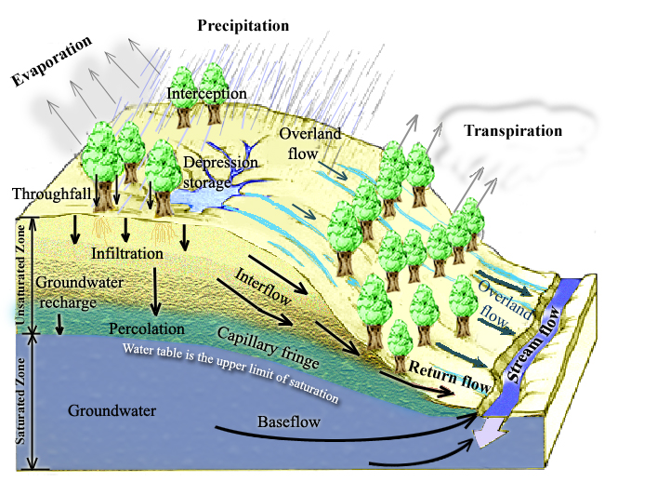
Physical Processes involved in Runoff Generation
Notes:
Figure 1. Physical Processes involved in Runoff Generation.

Slide 10
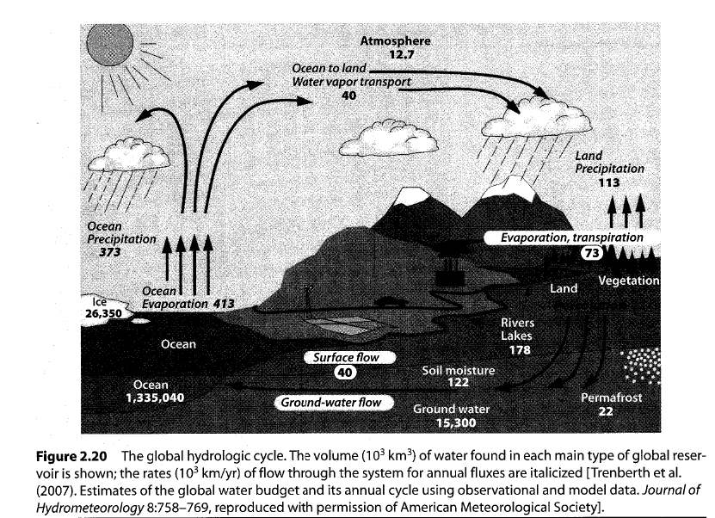
Quantifying the Hydrologic Cycle
Dingman, 2015

Slide 11
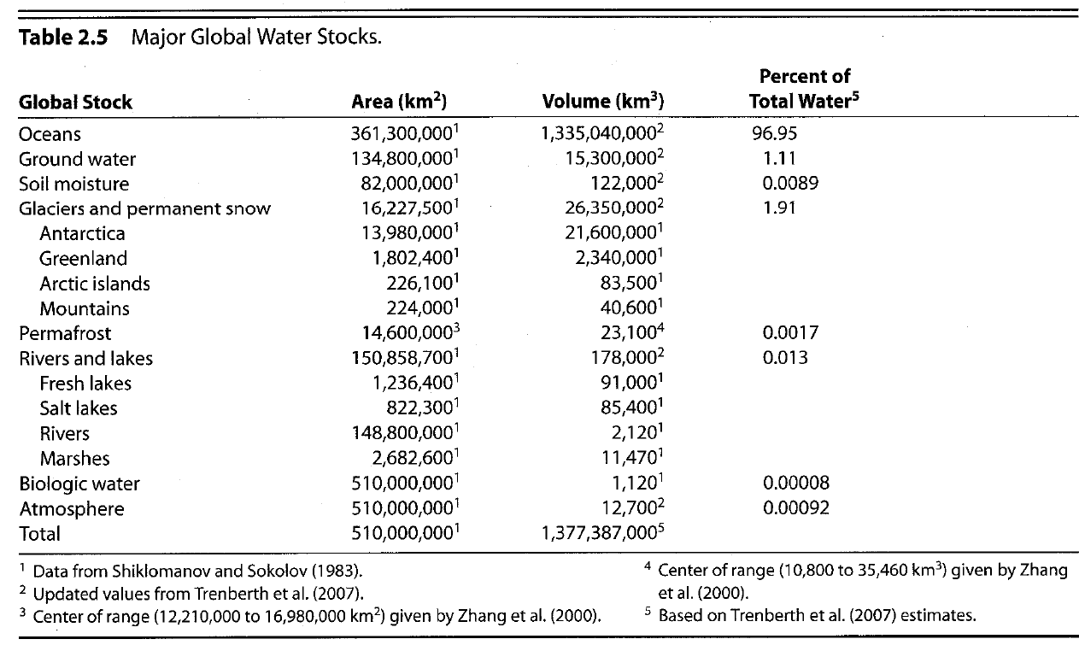
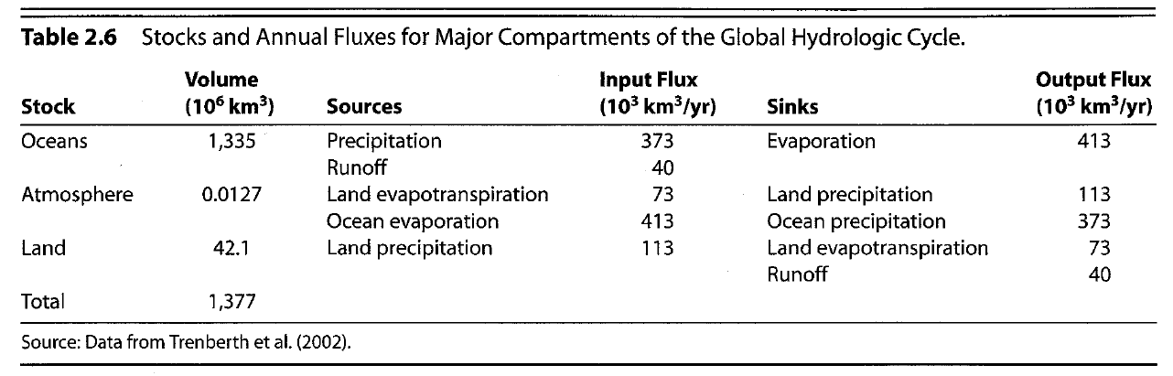
Global water balance fluxes and stores
From Dingman, 2015

Slide 12
Continental Water Balance m/yr
Europe
Asia
Africa
N America
Australia
0.73
0.73
0.69
0.67
0.74
0.41
0.44
0.55
0.38
0.51
0.32
0.29
0.14
0.29
0.23
Data from Brutsaert, 2005, Table 1.2
From Chow et al., 1988

Slide 13
World Water Balance
From Brutsaert, 2005

Slide 14
Water Balance
Atmospheric Water
Soil Water
Surface Water
Groundwater
Change of Storage
= Inflow - Outflow

Slide 15
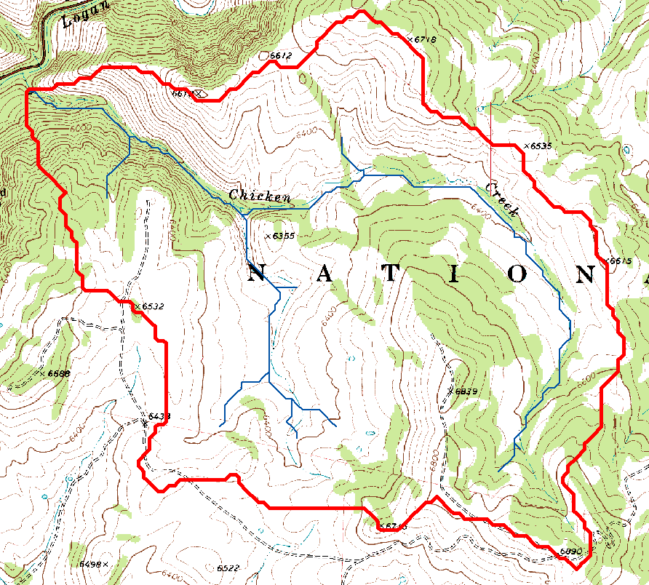
Watershed delineated on a topographic map

Slide 16
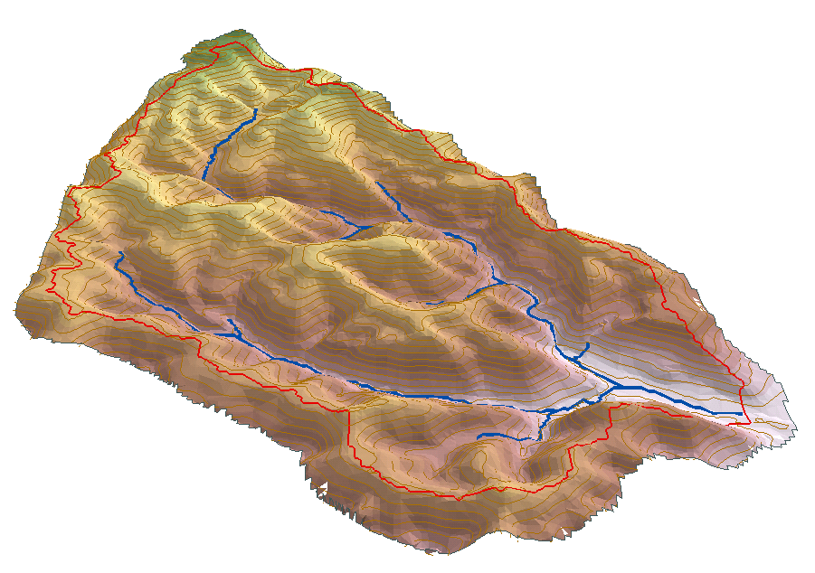
Watershed water balance
P
ET
G_{in}
Q
S
G_{out}

