Slide 1
Market Dynamics:
Flipkart protein
E-Commerce insights & strategic Analysis
Presented by
P. Karunya Chowdary

Slide 2
Protein Market Analysis
Overview of the global and Indian protein market
  Focus on dietary and sports nutrition proteins
  Growing demand driven by health awareness

Slide 3
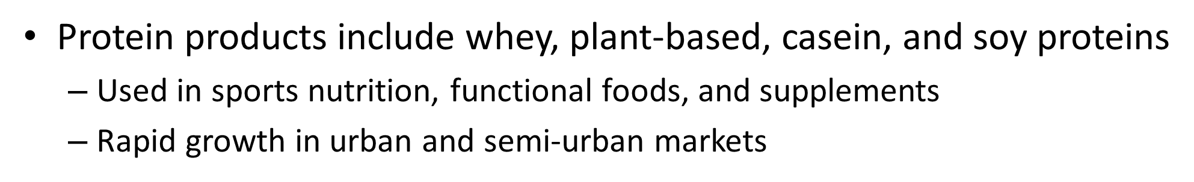
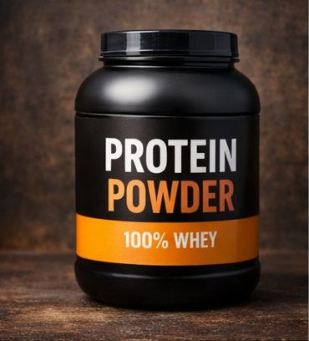
Market Overview
.

Slide 4
Market Segmentation
By Source: Animal-based and Plant-based proteins
  By Application: Sports nutrition, dietary supplements, food & beverages
  By Distribution: Online platforms and offline retail

Slide 5
Key Market Drivers
Increasing health and fitness awareness
  Rising gym and sports culture
  Growth of e-commerce and online supplement sales

Slide 6
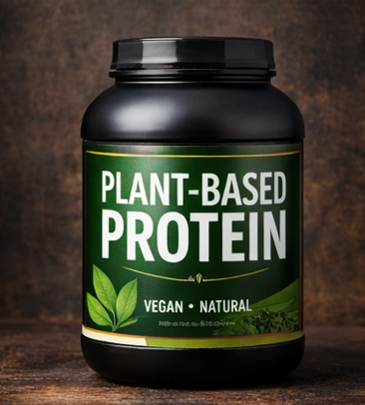
Market Challenges
High product prices and affordability issues.
  Concerns about product authenticity.
  Lack of awareness in rural areas.

Slide 7
Competitive Landscape
Presence of global and domestic protein brands
  Strong competition based on quality and pricing
  Brand trust and certifications play a key role

Slide 8
Market Trends
Rising demand for plant-based proteins
Clean-label and organic protein proRising demand for plant-based proteins
  Clean-label and organic protein products
  Personalized nutrition solutions

Slide 9
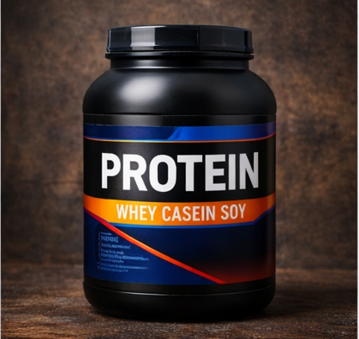
Conclusion
Protein market shows strong growth potential
  Innovation and affordability will drive future
  expansion
  Online channels will remain a key growth
  factor

Slide 10
Thank You
I appreciate your time &consideration for further inquiries , please contact:
P. Karunya Chowdary

