Slide 1

AI-Powered NCAA Assistant: Scouting Teams, Matching Recruits and Tracking Player Growth

Slide 2
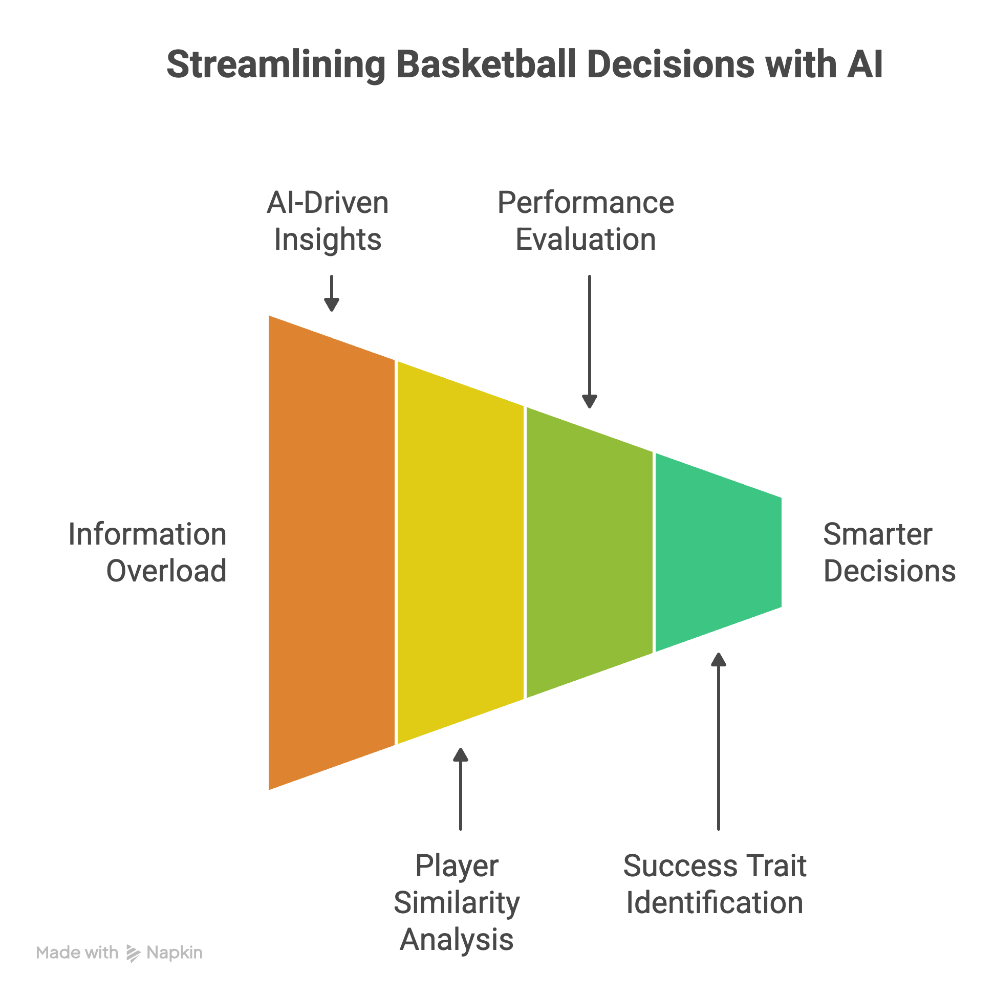
What Problem Am I Solving?
NCAA basketball generates massive data across players, teams, and seasons — but coaches and recruiters often face information overload. Manually scanning stats, comparing players, and evaluating team performance is inefficient.
My Solution:
I built an AI-powered Basketball Assistant that streamlines scouting and decision-making through:
Player Similarity Matching: Find recruits similar to star players using embeddings & cosine similarity.
Success Trait Analysis: Identify attributes that correlate with top performers.
Performance Breakdown: Evaluate year-over-year team strengths in offense, defense, and efficiency.
Chatbot Insights: Ask season-specific questions and get answers based on historical scouting data.

Slide 3
What Data I Used and How I Sourced It
Player Stats (Merged & Enriched)
Scraped player-level stats such as points, rebounds, assists, and efficiency metrics from Sports-Reference. Processed using custom scripts: scrape_player_stats.py and enrich_player_stats.py.
Player Links
Extracted from Sports-Reference Player Index to dynamically scrape data for each athlete. Stored in player_links.json for automation.
Team Scouting Data Scraped team summaries from Sports-Reference Team Pages using convert_team_scouting_to_json.py. Embedded for use in the AI chatbot.
March Madness Player Stats
Downloaded from Kaggle: 2024 March Madness Statistical Analysis Dataset. Tournament-focused stats to support player similarity and success pattern modeling.

Slide 4
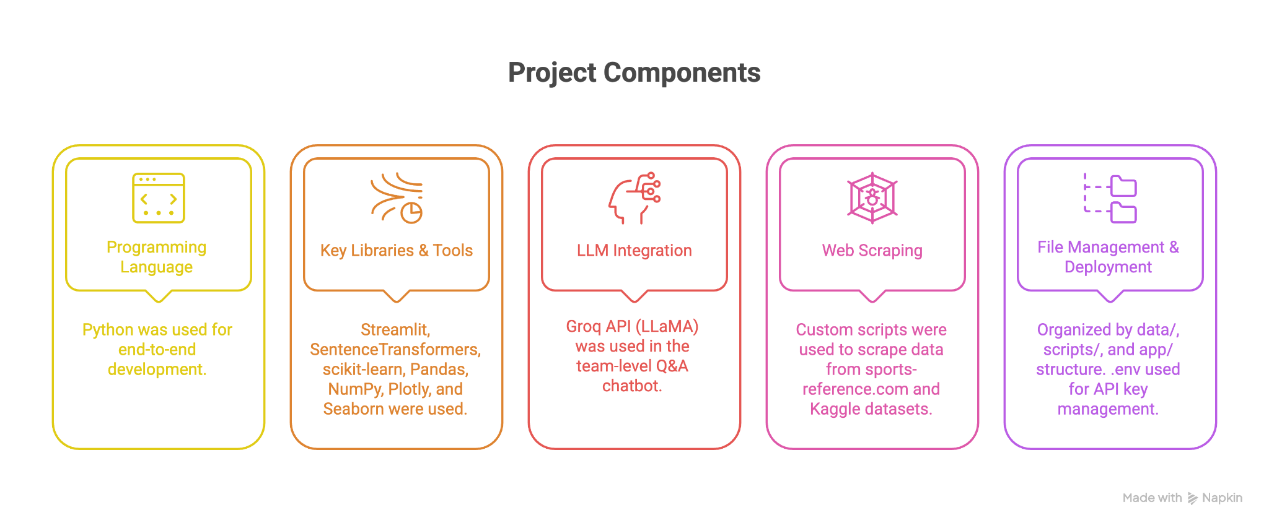
How I Built the Solution

Slide 5
How I Built the Solution

Slide 6
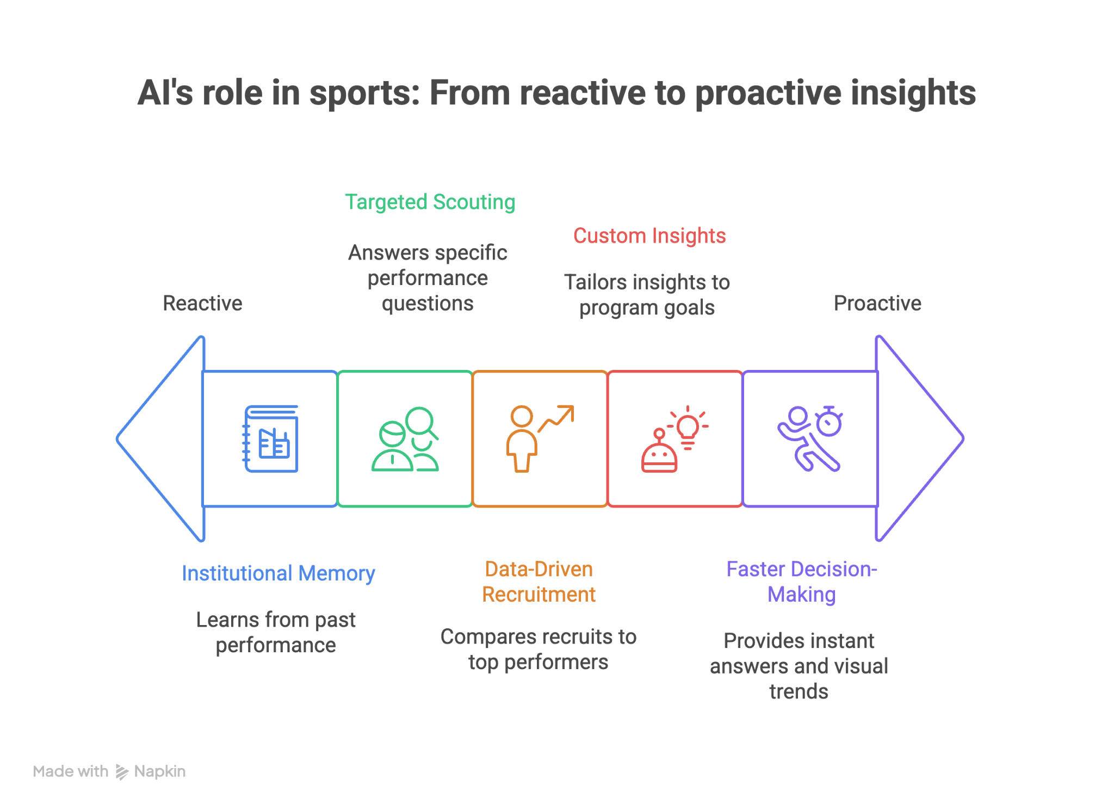
Why it’s useful to a General Manager or Coaching Staff
Data-Driven Recruitment: Quickly find high-potential recruits by comparing player stats and traits to past top performers using the Recruiting Similarity module.
Targeted Scouting: Ask specific questions like “How was Purdue’s rebounding in 2023?” and instantly get contextual insights from team-level summaries.
Faster Decision-Making: Instead of digging through spreadsheets or game footage, staff can rely on AI-powered answers and visual trends.
Institutional Memory: Access historical performance across 2008–2025 seasons to guide long-term planning and season-to-season adjustments.
Custom Insights: Supports smarter roster building, player development planning, and game strategy — all tailored to the program’s style and goals.

Slide 7
A link or file to the final product
Github link : https://github.com/karunyaMunagala12/ncaa-basketball-assistant
Demo link : https://entrevitainc-my.sharepoint.com/:v:/g/personal/karunyam_entrevita_ai/ERk-w-cwvypDrwuoOrRoINkBFS9UW3bc8YbgNoMacU2knQ?e=R62gHS
Commands to run :
1. Go to Downloads folder: cd ~/Downloads
2. Clone your GitHub repo (optional if already cloned):
3. Go into the project directory:cd ncaa-basketball-assistant
4. Create and activate a virtual environment: python3 -m venv venv , source venv/bin/activate
5. Install all dependencies from requirements.txt : pip install -r requirements.txt
6. Create a .env file with your API keys : nano .env
7. Run the Streamlite app : python -m streamlit run app/chatbot.py

Slide 8
THANKYOU
KARUNYA MUNAGALA

