Slide 1
AGILE CAPSTONE | P_022
Retail Inventory Management System
Real-time, multi-location inventory for 500+ stores and multiple warehouses
Karunya Singh Kanyal | Roll No: 2400320100580
Project Mentor: Sajin Kamaraj
PRG_RIMS_001 | Client: XYZ Retail Corporation | PM: Manmeet Jalota
Spring Boot | React | MySQL | Docker | Kubernetes

Slide 2
The problem and our targets
Why XYZ Retail needs RIMS
Inaccurate manual stock data
Inefficient order fulfilment
No real-time view across stores and warehouses
Slow response to changing demand
98%
-25%
Inventory accuracy in 6 months
Stockouts in year 1
-20%
95%
Overstock in year 1
Order fulfilment rate
Vision: a leading provider of innovative, efficient inventory management for retailers.
99.9%
9 months
System uptime
Delivery timeline
RIMS | P_022 | HCL Agile Capstone

Slide 3
Agile delivery: 8 epics, 15 sprints
Two-week sprints from 02-Nov-26, prioritised with WSJF
Product Catalog
2 sprints
Inventory Tracking
3 sprints
Order Management
2 sprints
Supplier Management
1
Barcode and RFID
2 sprints
Reporting and Analytics
2 sprints
User Mgmt and Access
1
ERP Integration
2 sprints
Team of 19: PM 1, Scrum Master 1, BA 2, Front-end 4, Back-end 4, DBA 2, DevOps 2, QA 3
Prioritisation: WSJF = (Business Value + Time Criticality + Risk Reduction) / Job Size
RIMS | P_022 | HCL Agile Capstone

Slide 4
System architecture
Layered REST design, secured and containerised
React + Vite
SPA, Axios, Recharts
Spring Boot 3
REST, Security, Validation
Spring Data JPA
14 entities, Hibernate
MySQL 8 / H2
Production / dev and tests
>
>
>
Security
Core modules
Delivery
HTTP Basic + BCrypt
4 roles: Admin, Manager, Staff, Viewer
Audit log on every write
Catalog, Inventory, Transfers
Orders, Suppliers and POs
Reports, ERP, Barcode / RFID
Docker and docker-compose
Kubernetes manifests, Jenkinsfile
Swagger / OpenAPI docs
RIMS | P_022 | HCL Agile Capstone

Slide 5
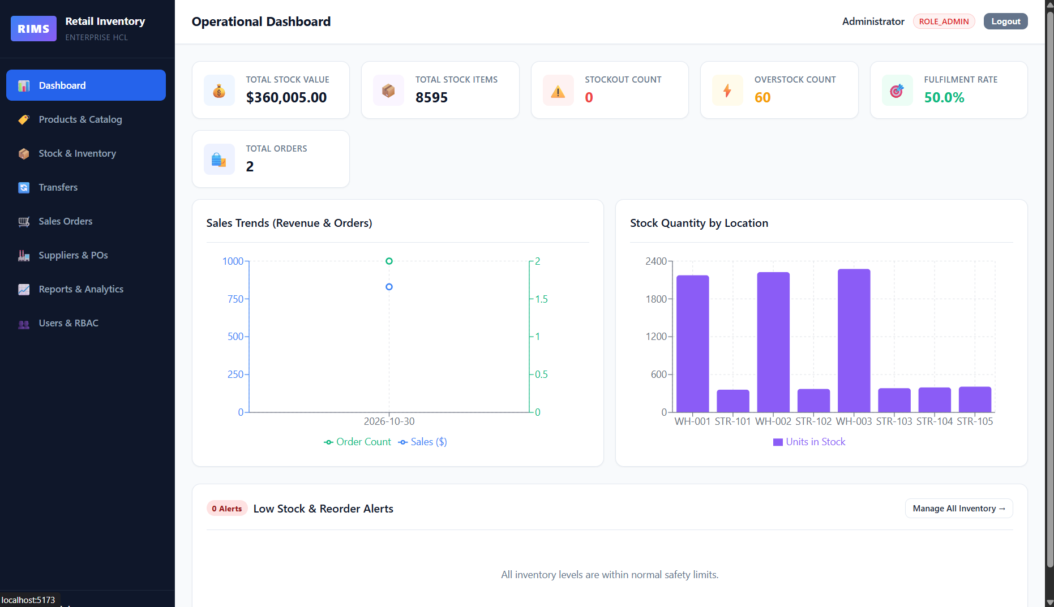
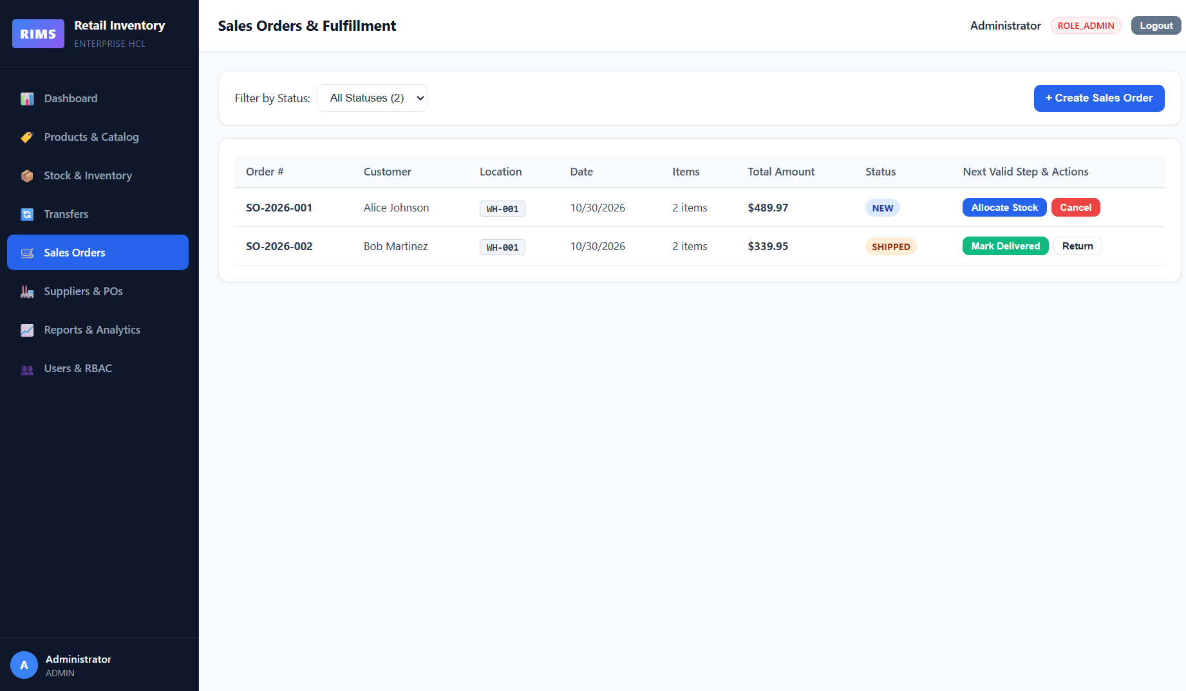
The working system
Live data from the running application
Executive dashboard: KPIs, sales trend, stock by location, low-stock alerts
Order lifecycle: allocate, pick, pack, ship, deliver, return
Also built: product catalog with barcode / RFID scan, stock transfers, suppliers and purchase orders, reports with CSV export, user and role management.
RIMS | P_022 | HCL Agile Capstone

Slide 6
Quality, security and DevOps
Built to be tested, auditable and deployable
18 / 18
14
4
8
Automated tests passing
JPA entities modelled
Role-based access levels
Epics delivered as modules
Testing and quality
Deployment readiness
JUnit 5 and MockMvc integration tests
Auth, CRUD, transfers, allocation, PO receipt, low-stock alerts
Validation and consistent JSON error handling
Multi-stage Dockerfiles and docker-compose
Kubernetes manifests and Jenkins pipeline
Configured for deployment; not yet run in containers
RIMS | P_022 | HCL Agile Capstone

Slide 7
Outcomes and roadmap
Where RIMS goes next
What RIMS delivers
Future roadmap
One real-time view of stock across all locations
Automatic low-stock alerts at reorder points
Controlled order flow with stock allocation
Audited, role-based access to every change
JWT authentication, SSO and MFA
Demand forecasting and auto-replenishment
Live barcode / RFID hardware integration
Live ERP and accounting connectors
Thank you
github.com/karunyakanyal/retail-inventory-management-system
RIMS | P_022 | HCL Agile Capstone

