Slide 1

Sign Language to Text Converter
By Karunya Sharma

Slide 2
Introduction
• Millions of people use sign language to communicate.
• Barrier exists for non-signers to understand sign language.
• Objective: Convert sign language gestures into readable text in real-time using webcam and AI.

Slide 3
How It Works
1. Capture: Webcam captures hand signs.
2. Preprocessing: Image processing to isolate hand gestures.
3. Recognition: Machine learning model classifies hand signs.
4. Translation: Recognized signs converted into corresponding text.
5. Display: Text output displayed to user.

Slide 4
Key Technologies Used
• Used colab for running the code
• Deep Learning: teachable machine for gesture recognition.
• Programming: Python, TensorFlow, Keras.
• Hardware: Webcam or built-in camera.

Slide 5
Applications
• Aid for deaf and mute individuals.
• Education tools.
• Real-time communication in public services.
• Integration into virtual assistants.

Slide 6
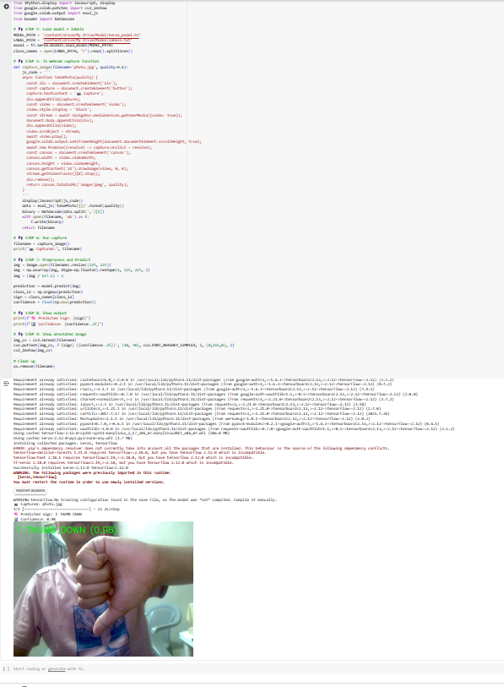

Slide 7
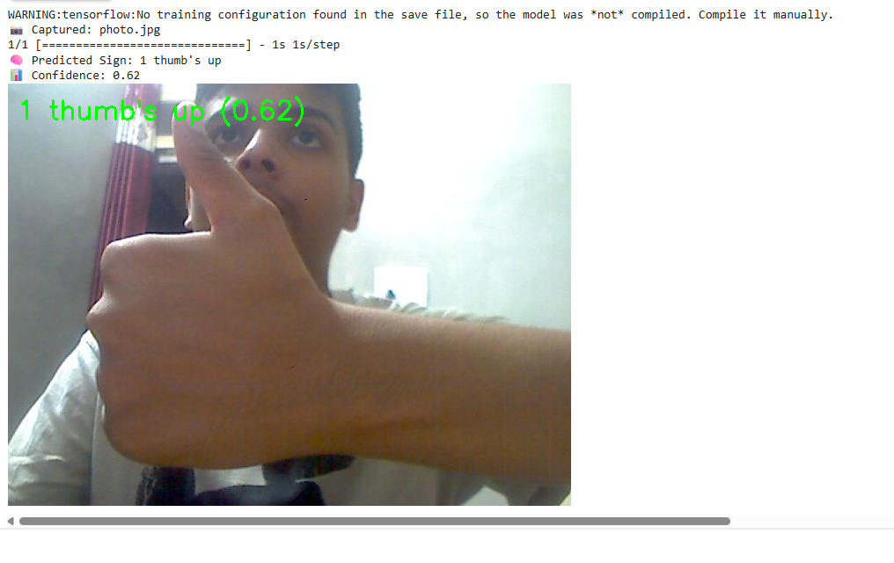

Slide 8
