Slide 1
ShopEZ: E-commerce Application
KARUNYA M (au211521205062)
JAYAVIDHYA S R (au211521205057)
KRISHNAVENI K (au211521205070)
LAKSHITHA A D (au211521205072)

Slide 2
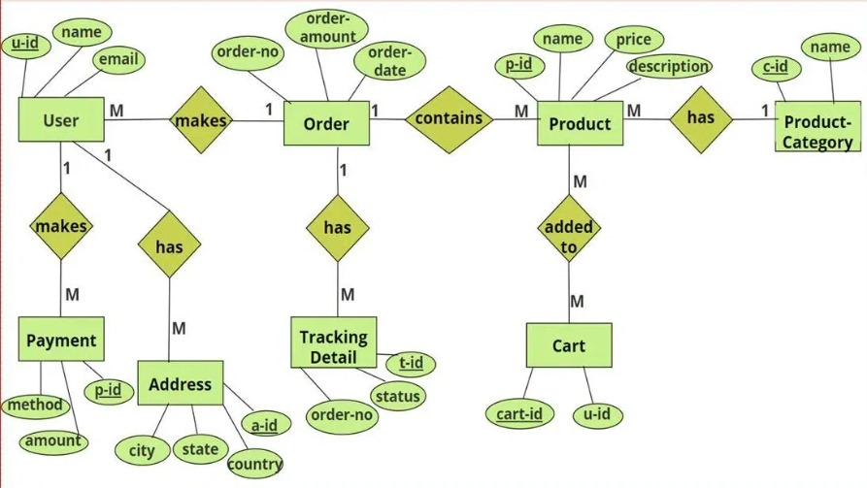
ER DIAGRAM

Slide 3
PRE-REQUISITES
1. Technical Setup:
Technology Stack: Frontend (React, Vue.js), backend (Node.js, Django), and database (MySQL, MongoDB) with cloud hosting (AWS, Azure).
Payment Gateway: Integration with Stripe, PayPal, or Razorpay.
Security: SSL, encryption, and PCI-DSS compliance for payment safety.
2. Business Features:
Product Catalog: Organize product data, pricing, and inventory.
User Authentication: Secure login using OAuth or JWT.
Order Management: Handle orders, returns, and invoices.
3. Other Features:
Search & Filter: Efficient search algorithms.
Responsive Design: Mobile-friendly user interface.
SEO Optimization: Ensure discoverability with clean URLs and metadata.

Slide 4
APPLICATION FLOW:
1. User Onboarding:
Home Page:The user lands on the homepage, which showcases featured products, categories, and ongoing deals.
Sign Up/Login: Users can create an account or log in via email, social media (OAuth), or as a guest. Secure authentication (JWT, OAuth) is used.
2. Product Browsing:
Category/Product Listing: Users can browse products by category or use the search function with filtering options (price, ratings, etc.).
Product Detail Page: Clicking on a product displays details such as images, descriptions, price, availability, and reviews.
3. Shopping Cart:
Add to Cart: Users can add items to the shopping cart from the product page. The cart displays real-time updates (quantity, total price).
Apply Discounts: Users can apply discount codes or use available rewards points.

Slide 5
4. Checkout Process:
Billing & Shipping Information: Users input their billing and shipping details or select saved addresses.
Payment Gateway: Users choose a payment method (credit card, PayPal, Stripe) and complete the transaction via a secure gateway.
5. Order Confirmation & Tracking:
Order Summary:** Upon successful payment, an order summary is displayed, and a confirmation email is sent.
Order Tracking:** Users can track their order status (processing, shipped, delivered) through their account or via a tracking link.
6. Post-Purchase:
Review & Feedback: After receiving the product, users can leave reviews and rate their experience.
Returns/Refunds: Users can request returns or refunds from the order history page if applicable.
7. Admin Dashboard (Back-end Flow):
Product Management: Admins can add, update, or delete products, manage inventory, and apply discounts.
Order Management: Admins can view, update, and fulfill orders and manage returns.
User & Role Management: Admins control user access, roles (admin, vendor), and permissions.

Slide 6
PROJECT STRUCTURE:
1. Directory:
/client: Contains frontend files.
/server: Backend files for managing business logic, APIs, and database interactions.
/config: Configuration files for environment settings, database connections, and credentials.
/scripts: Helper scripts for tasks such as seeding the database or deploying the app.
/public: Static assets like images, CSS, and JavaScript used globally.
2. Client (Frontend):
/components: Reusable UI components (e.g., ProductCard, CartItem, Navbar).
/pages: React components representing different routes/pages (e.g., HomePage, ProductPage, CheckoutPage).
/services: Handles API requests and interacts with the backend.
/context: Manages global state (e.g., user authentication, cart data) using React Context or Redux.
.

Slide 7
/styles: Contains global and component-specific CSS files or SCSS modules.
/assets: Static assets like logos, icons, and product images.
App.js: Main component handling route management.
index.js: Application entry point.
3. Server (Backend):
/models: Database schemas and models (e.g., User, Product, Order).
/controllers: Business logic handling various API requests (e.g., user authentication, product retrieval, order management).
/routes: Defines API routes (e.g., `/auth`, `/products`, `/cart`, `/orders`).
/middleware: Middleware for authentication (e.g., JWT), error handling, and request validation.
/config: Configuration files for database, server settings, and environment variables.
/services: External services (e.g., payment gateways, email notifications) or business logic not directly tied to routes.
server.js: The main server file that starts the Express server.
4. Database (if separate):
/migrations: Database migration files to version control the database schema.
/seeders: Seed files to populate the database with initial data (e.g., sample users, products).
/queries: SQL queries (if using raw SQL) or ORM queries (e.g., Sequelize, Mongoose).

Slide 8
5. Config and Environment Files:
.env: Contains environment variables such as API keys, database credentials, and JWT secrets.
db.js: Database configuration settings.
app.js: Application-level configurations.
6. Test Files:
/tests: Contains unit tests for both frontend and backend components.
/client/tests: Frontend-specific tests (e.g., React component tests using Jest).
/server/tests: Backend tests (e.g., API endpoint tests using Mocha, Chai, or Jest).
7. Miscellaneous Files:
package.json: Manages project dependencies and scripts for both client and server.
README.md: Project documentation.
Dockerfile / docker-compose.yml: Defines the Docker configuration for containerization (if using Docker).

Slide 9
PROJECT FLOW:
1. Project Setup and Configuration:
Set up the development environment (Node.js, Git).
Create the initial project structure and configuration files, including environment variables.
2. Backend Development:
Select a backend framework (e.g., Express.js).
Develop RESTful APIs for user authentication, product management, and order processing.
Implement authentication (JWT/OAuth) and write unit tests for APIs.
3. Database Development:
Choose a database (e.g., MySQL, MongoDB).
Design the schema for users, products, and orders.
Implement data access models and seed the database with initial data.

Slide 10
4. Frontend Development:
Choose a frontend framework (e.g., React).
Build reusable components and implement routing and state management.
Connect frontend components to backend APIs for data interaction.
5. Project Implementation and Execution:
Deploy the backend and frontend on cloud platforms (e.g., AWS, Netlify).
Set up CI/CD pipelines for automated testing and deployment.
Monitor application performance and collect user feedback for improvements.

Slide 11

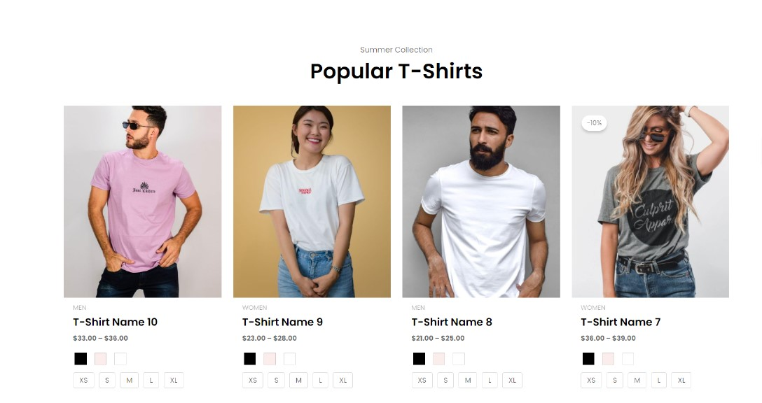
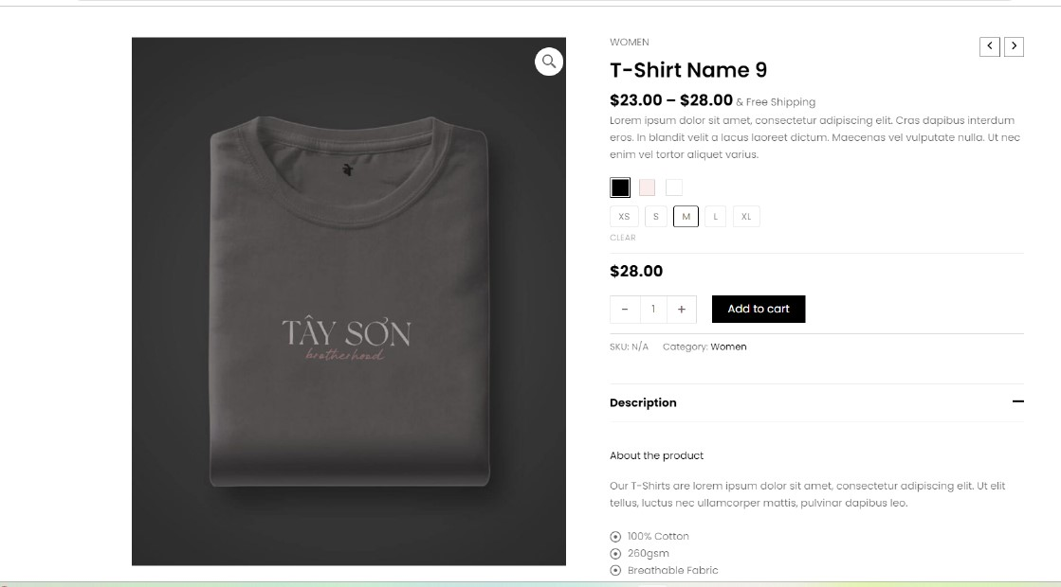
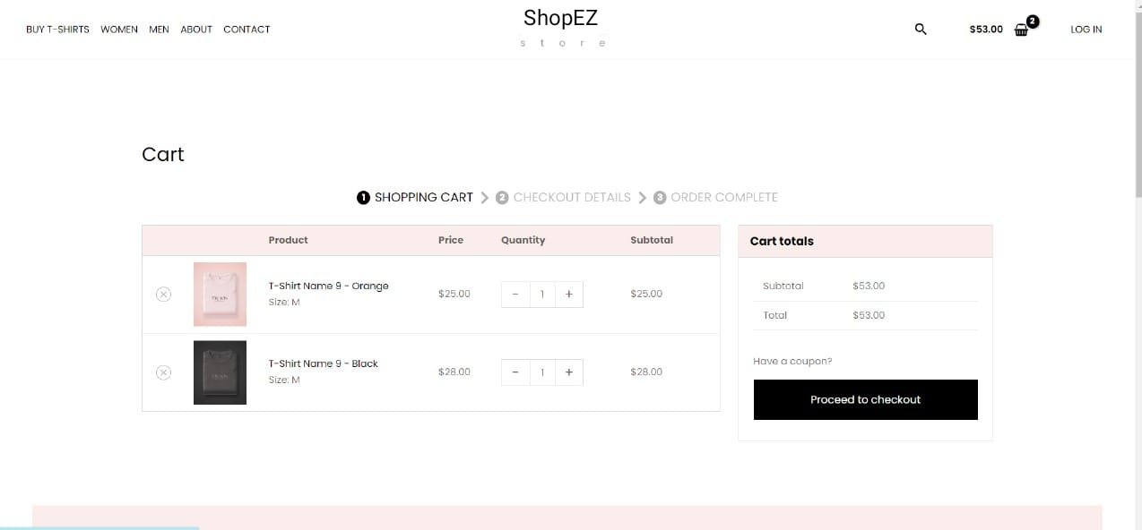
Sample Model

Slide 12
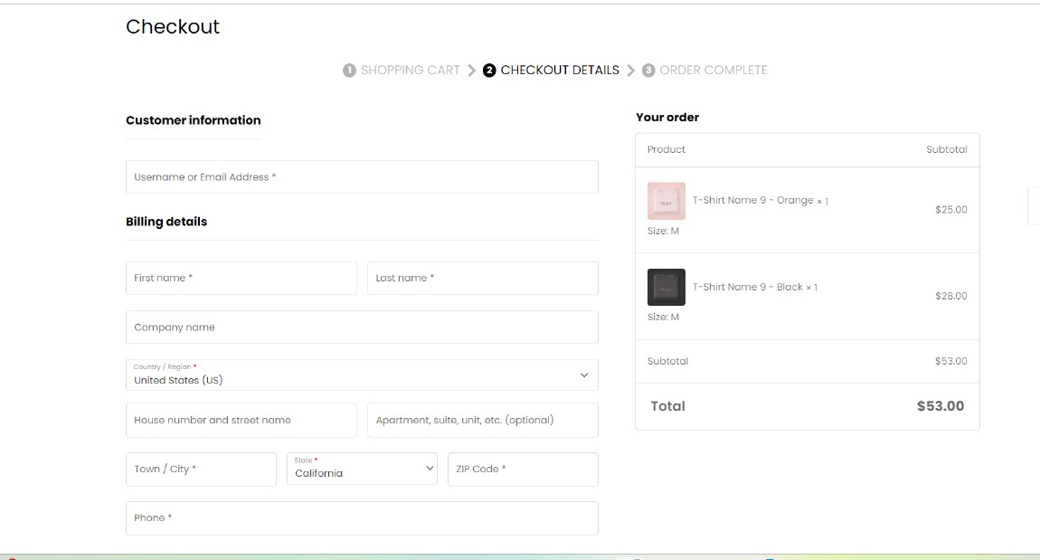
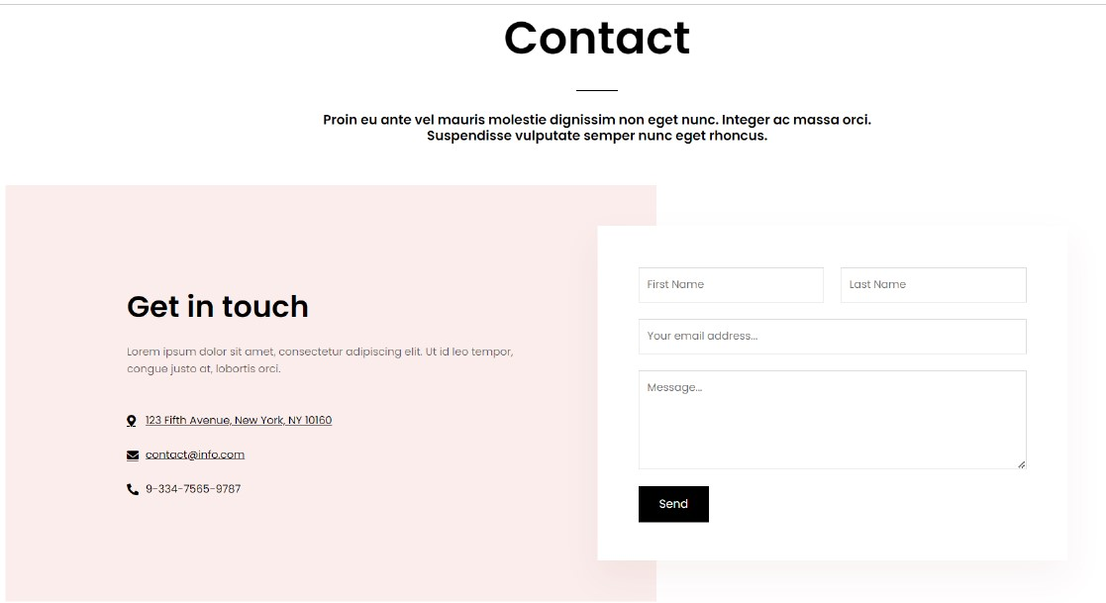

Slide 13
THANK YOU

