Slide 1
EFFICIENT MACHINE LEARNING ALGORITHM FOR FUTURE PRICE PREDICTION
Presented by
N Aameer Mohamed (910322104001)
M Ajith (910322104004)
A Karuppaiah (910322104024)
M Suthakar (910322104056)

Slide 2
ABSTRACT
Gold Is A Core Safe-haven Asset. This Study Presents An Efficient Machine Learning Pipeline To Forecast Future Gold Prices In India.
We Compare Classic Regression Methods With Tree-based Models And LSTM To Capture Both Short-term Dynamics And Long-range Temporal Patterns.
Key Steps: Data Collection, Cleaning, Feature Selection, Model Training, And Evaluation.

Slide 3
OVERVIEW
Develop an efficient ML model to accurately predict future gold prices in India
Analyze historical data and identify principal drivers: currency, inflation, global trends
Implement and compare algorithms (Regression, Random Forest, Gradient Boosting, LSTM)
Deliver a robust, adaptive forecasting system for investors and policymakers

Slide 4
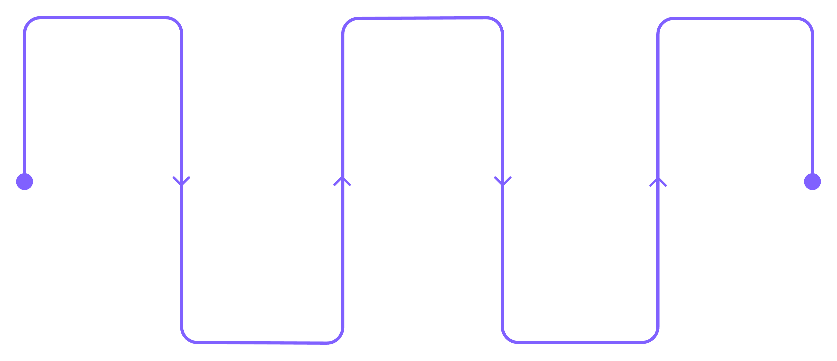
MODULE DESCRIPTION
Data Collection
Feature Selection
Evaluation
Acquire reliable data
Choose relevant features
Validate with holdout tests
Preprocessing
Model Training
Clean and normalize
Train candidate models

Slide 5
EXISTING SYSTEM — LIMITATIONS
Poor Adaptability To Sudden Economic Shocks And Multi-factor Influences
Limited Real-time Performance And Lower Accuracy For Short-term Forecasting
Poor Adaptability To Sudden Economic Shocks And Multi-factor Influences
Limited Real-time Performance And Lower Accuracy For Short-term Forecasting

Slide 6
PROPOSED SYSTEM — OVERVIEW
We propose an ML-driven framework combining feature-rich inputs with advanced models: Random Forest, Gradient Boosting (XGBoost/LightGBM), and LSTM.
Key enhancements: multivariate inputs (FX rates, inflation, indices), robust preprocessing, automated feature selection, and hyperparameter tuning for real-time, adaptive forecasts.

Slide 7
MODULE LIST
Data Collection Module
Data Preprocessing Module
Feature Selection Module
Model Training Module
Prediction Module
Evaluation Module
Visualization Module

Slide 8
MODULE DESCRIPTIONS — DATA & PREPROCESSING
Data Collection
Aggregate historical gold prices, INR–USD exchange rates, interest rates, CPI, global indices, and commodity signals from trusted APIs and financial databases.
Data Preprocessing
Handle missing values, remove outliers, apply smoothing where appropriate, engineer lagged features and rolling statistics, and normalize or scale numeric inputs for model compatibility.

Slide 9
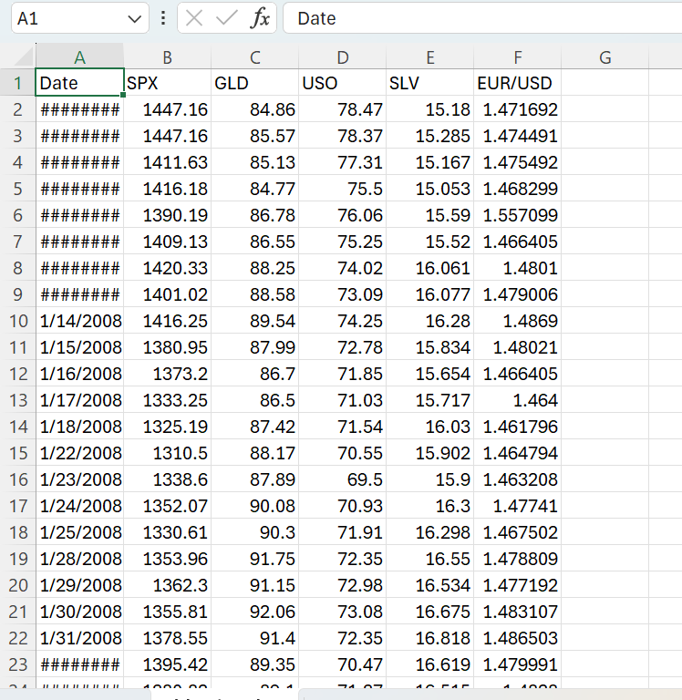
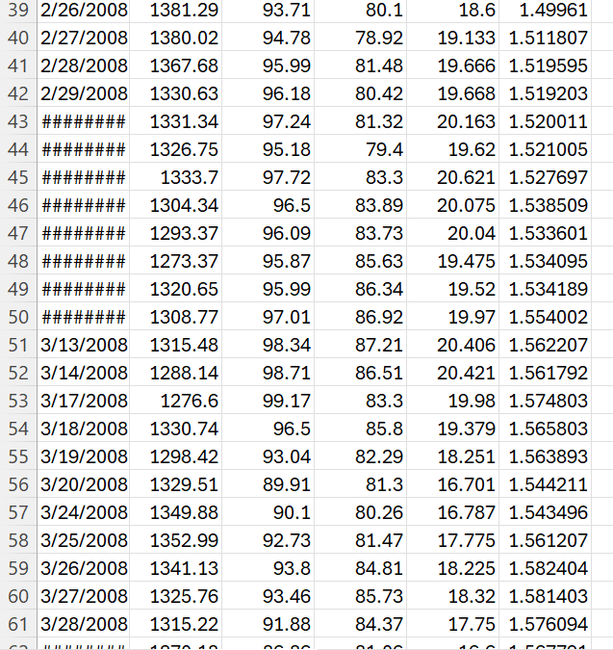
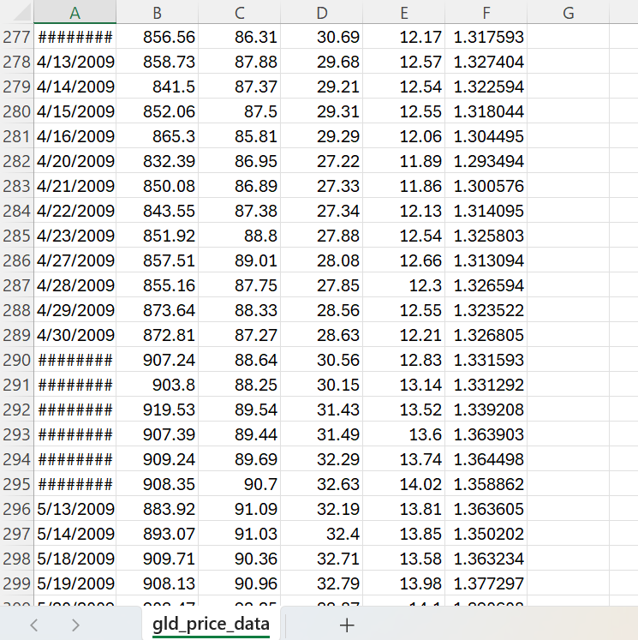
DATA COLLECTION

Slide 10
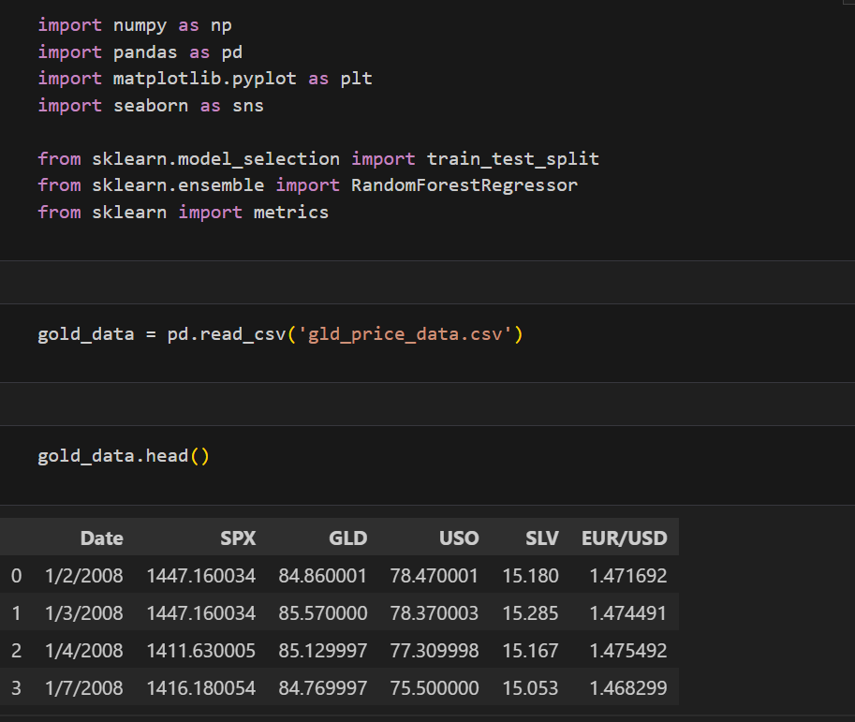
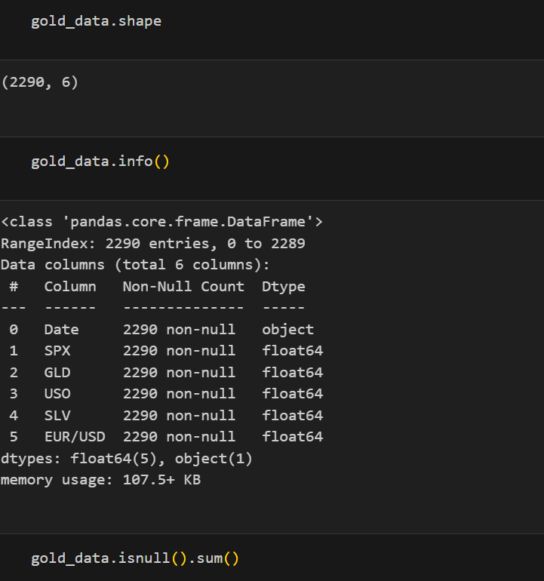
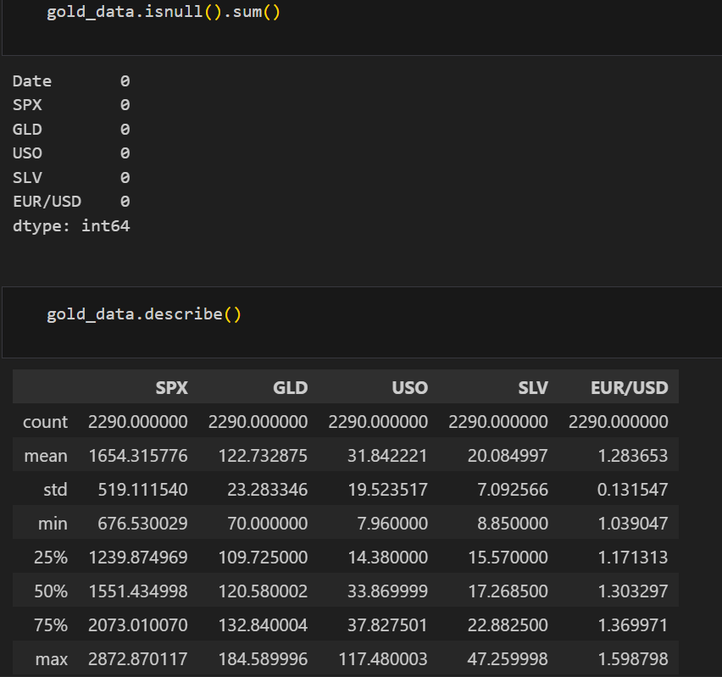
DATA PREPROCESSING

Slide 11
FEATURE SELECTION & MODEL TRAINING
Feature Selection: correlation analysis, SHAP, mutual information, recursive feature elimination
Models Trained: linear regression baseline, Random Forest, Gradient Boosting (XGBoost/LightGBM), and LSTM for sequence modeling
Training Strategy: time-series-aware cross-validation, walk-forward validation, and grid/Bayesian hyperparameter search

Slide 12
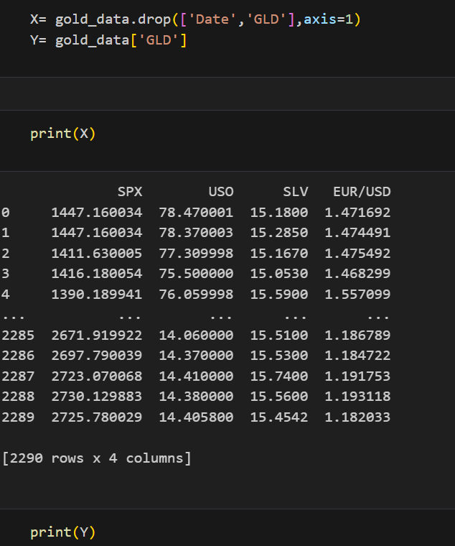
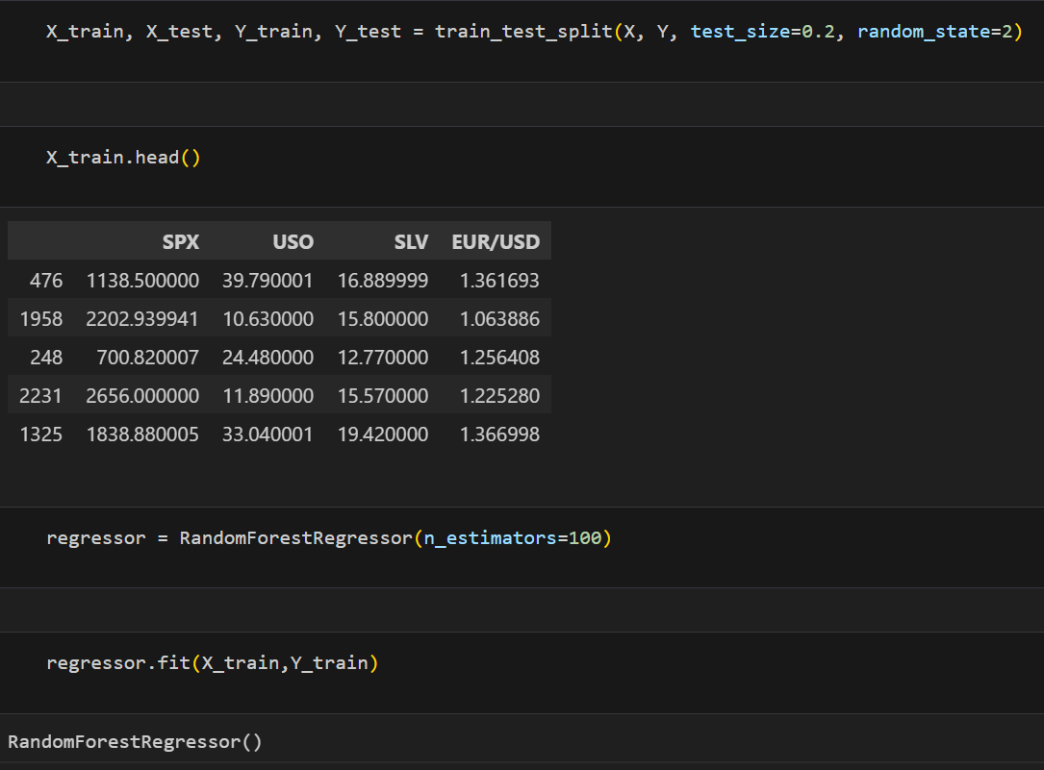
MODEL TRAINING

Slide 13
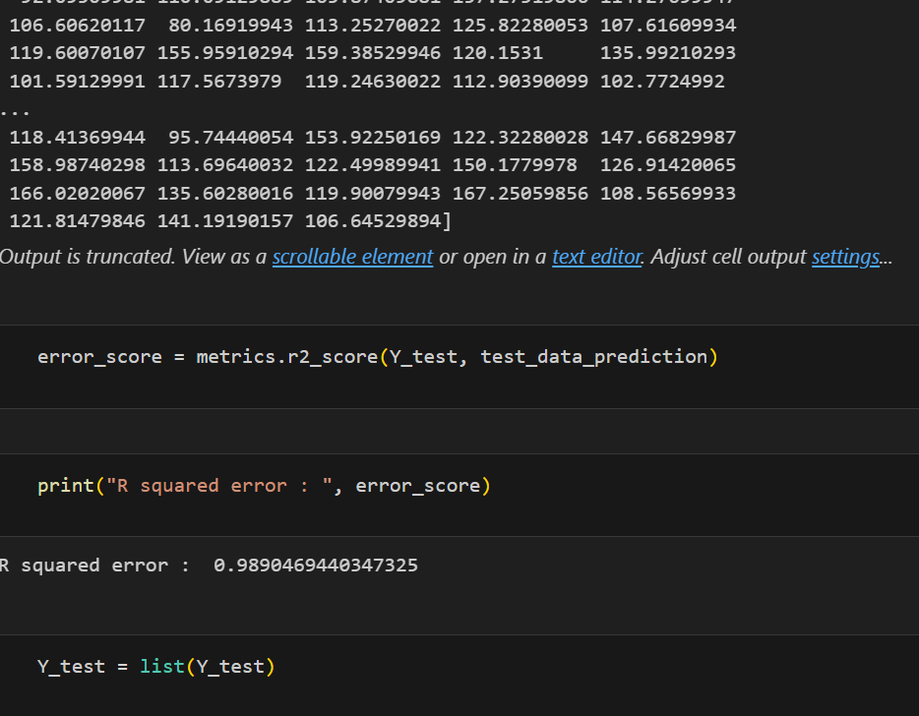
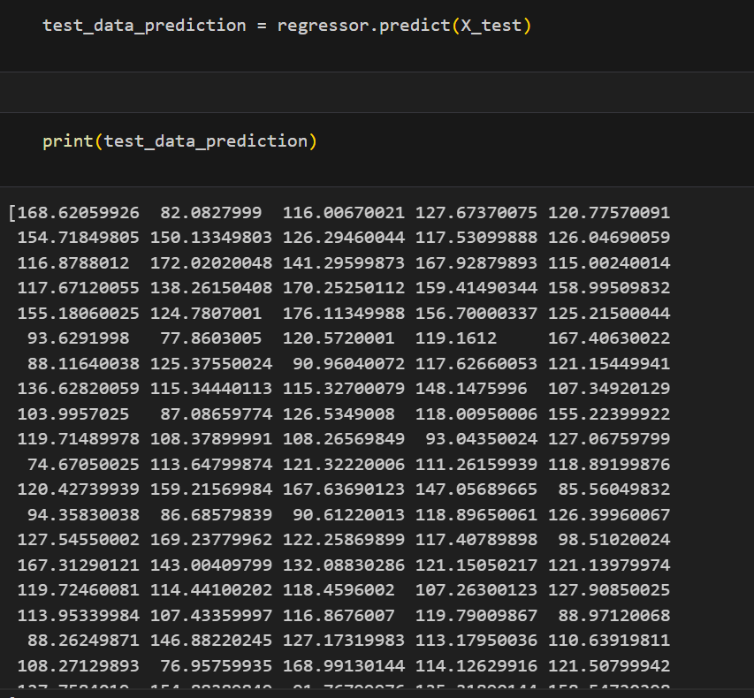
MODEL TRAINING

Slide 14
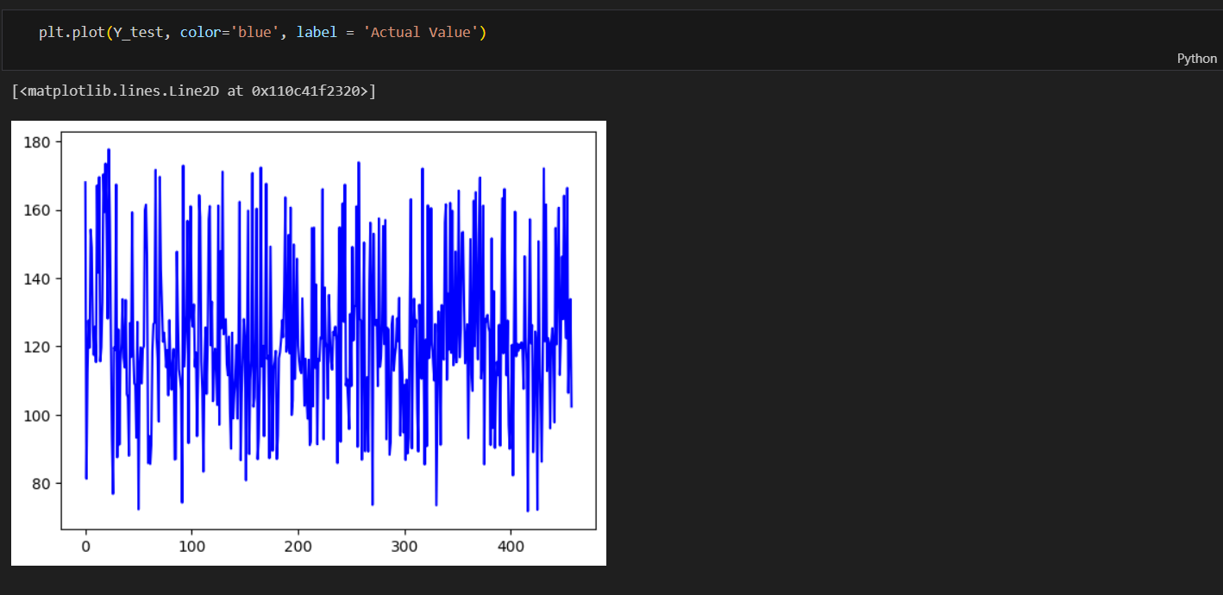
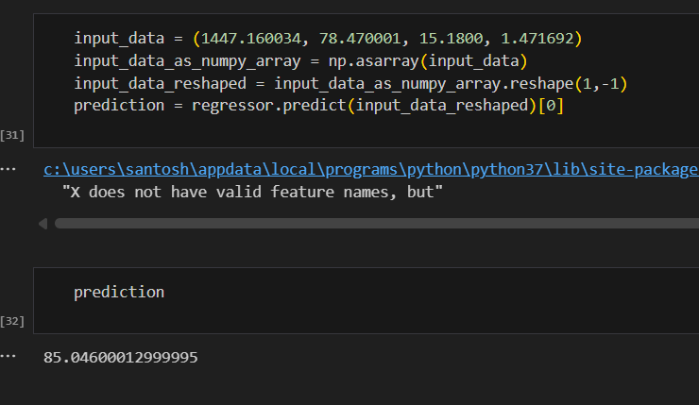
PREDICTION, EVALUATION & NEXT STEPS

Slide 15
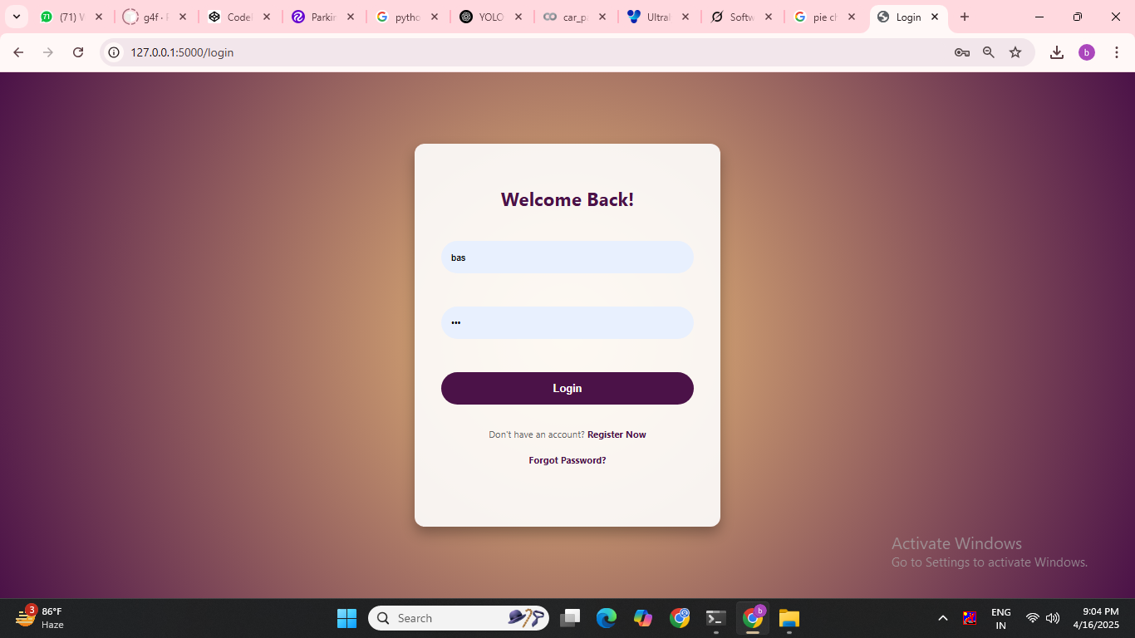
FINAL OUTPUT

Slide 16

LOGIN PAGE

Slide 17
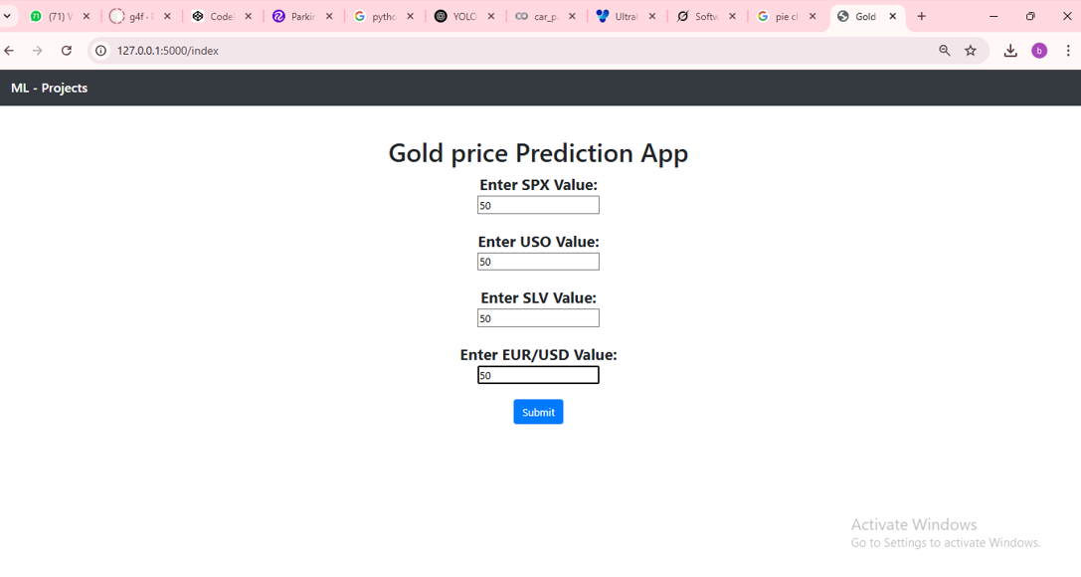
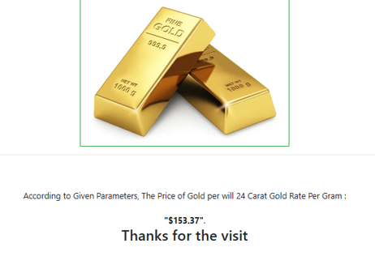
PREDICTION PAGE

Slide 18
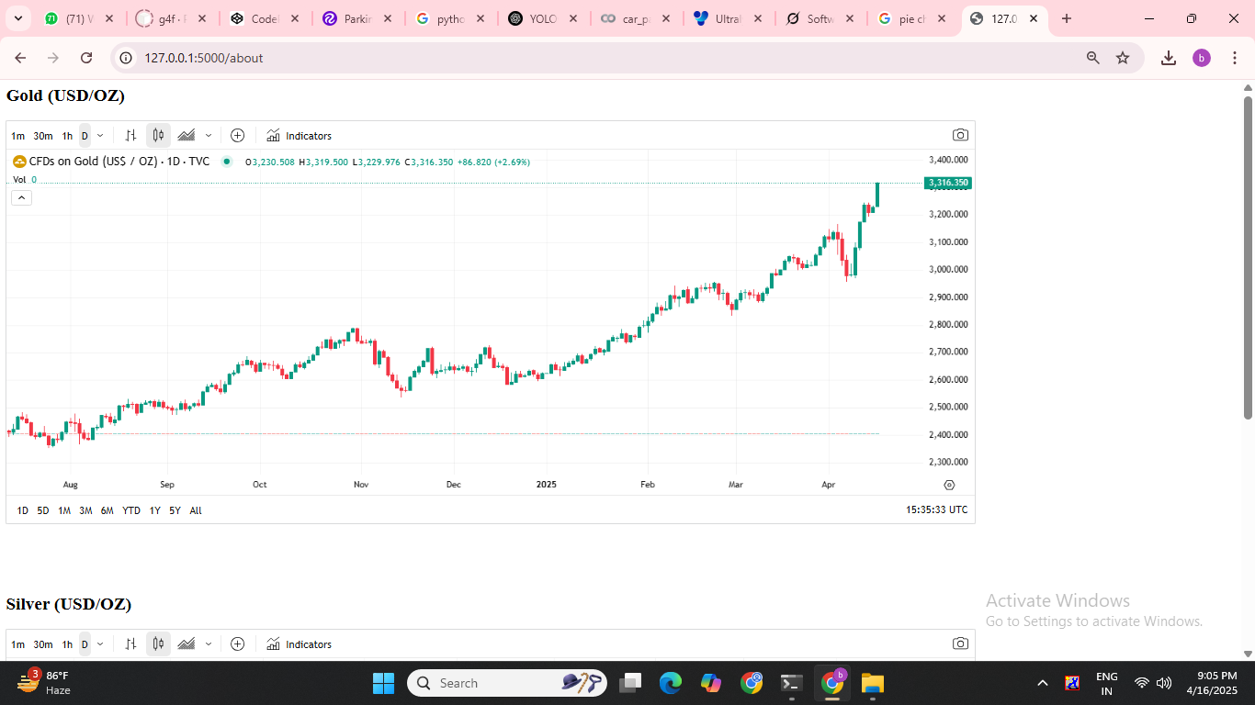
GOLD PREDICTION RATE

Slide 19
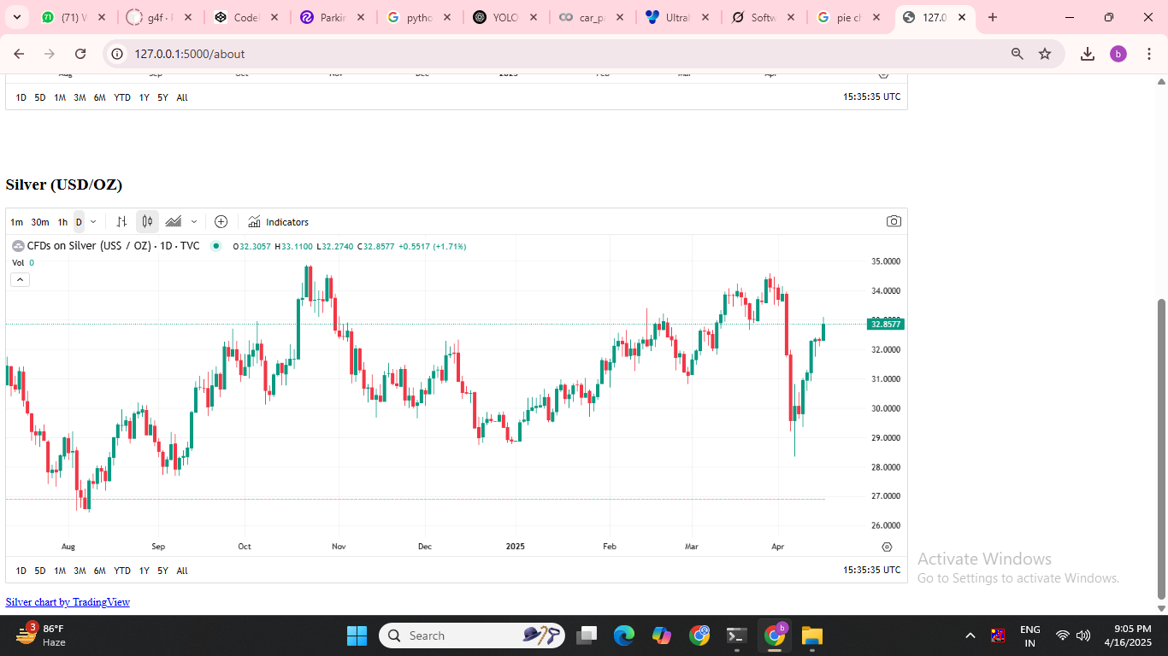
SILVER PREDICTION RATE

Slide 20
THANK YOU

