Slide 1


PARK COLLEGE OF ENGINEERING AND TECHNOLOGY
Department of Information Technology
ONLINE CANTEEN SYSTEM
Presented by
ISHWARYA.R - 712220205018
KARUPPAIYA.M - 712220205021
MOHAMMED AMJID.S - 712220205028
NANDEESH.N - 712220205030
Internal Guide
Ms.ANUPRIYA.,AP/IT

Slide 2
OUTLINE
1. Introduction
Project Objectives
Abstract
Literature Review
Existing System
Problem Statement
Proposed System
Technical Implementation
Flowchart
Conclusion
11. Integration with Payment Systems

Slide 3
INTRODUCTION
The online canteen system contains the e-menu cards that contains the details of the food. The user initially has to create an account for the utilization of the service. The customer can select the desired item and can pay the amount through online payment gateway system. Immediately after booking the order, the canteen people will get the information of the order and they prepare the order.The data can be stored in the database. The food will be ready in advance and the customers need not to wait near the delivery place. The digitalisation of the canteen system will be helpful in providing the better service to the users and the time consumption will be reduced. The user can select can select particular item like in the different slots where there are admins for all the slots. The updation and deletion of any item can be done. The online system will help be helpful for the food makers to prepare the food as early as possible. As a result there will be quick serving to the customers. No queues can be formed for waiting of the food. The updation of the data to the database will be monitored by the admin.

Slide 4
PROJECT OBJECTIVES
The Online Canteen System aims to revolutionize the campus dining experience with key objectives. It strives to streamline the food ordering process, minimizing queues and enhancing user convenience. The system prioritizes a user-centric approach, providing a seamless and stress-free experience from menu exploration to order confirmation. Introducing flexibility, the system supports both Cash on Delivery (COD) and online payment options. Operational efficiency is improved through automated order processing, reducing errors and wait times. Additionally, the implementation of a unique COD rating system ensures accountability and encourages responsible usage. The Online Canteen System is designed to optimize and elevate the overall campus dining experience through innovation and efficiency.

Slide 5
ABSTRACT
The Online Canteen System is a web-based application designed to streamline and enhance the canteen ordering process for educational institutions, offices, and other establishments. It leverages modern technologies to facilitate convenient, efficient, and user-friendly online ordering and management of food items.This system offers a seamless experience to users, allowing them to browse through a comprehensive menu of food items, place orders, and make payments electronically,as well as direct payments. By eliminating the need for manual order taking, the Online Canteen System significantly reduces waiting times and enhances overall operational efficiency.The Online Canteen System brings numerous benefits to both canteen administrators and customers. For administrators, it automates order processing, reduces paperwork, and provides valuable insights through comprehensive sales and inventory reports. Additionally, it enables efficient menu planning and customization based on user preferences and feedback.Customers, on the other hand, benefit from a convenient and time-saving ordering process. They can browse the menu at their own pace, place orders remotely, and avoid long queues at the canteen.Overall, the Online Canteen System revolutionizes the traditional canteen experience by leveraging technology to streamline operations and enhance customer satisfaction. By providing a user-friendly platform for online ordering, secure payments, and efficient management, it offers a seamless and modern solution for the food service industry.

Slide 6
LITERATURE REVIEW
S. No | Year | Author | Title of the paper | Description
1 | 2020 | Sharma, S., Bansal, N. | Design and implementation of an online canteen system using web services. | The study highlights the benefits of implementing the online canteen system using web services. It discusses how web services enable seamless integration with various components such as inventory management, payment gateways, and order tracking systems. This integration improves efficiency, accuracy, and customer satisfaction by automating processes and ensuring real-time updates.
2 | 2019 | Kumar, A., Verma, D. | Design and implementation of an online food ordering system for educational institutions | The study highlights the benefits of implementing such a system in educational institutions. It discusses how the online food ordering system improves efficiency by reducing queues and wait times, enhances accuracy in order processing, and provides a convenient solution for the busy schedules of students and staff members.

Slide 7
EXISTING SYSTEM
The existing Online Canteen System is a web-based platform facilitating food ordering and delivery within a college campus. It allows users to browse menus, place orders, and make payments online. The system includes features for user registration, menu management, order tracking, and payment processing. Users can choose from various food items, customize orders, and select delivery options. The system integrates with existing college databases for user authentication and access control. It aims to streamline the food ordering process, improve efficiency, and enhance user experience for students, faculty, and staff within the college community.

Slide 8
PROBLEM STATEMENT
The existing campus canteen faces challenges with the Cash on Delivery (COD) system, leading to inefficiencies and a lack of accountability. Users often abuse the COD option, resulting in order cancellations and operational disruptions. The absence of a robust rating system for COD orders further compounds this issue. Our project recognizes the need for a solution to address these challenges, implementing a unique COD rating system that encourages responsible usage. By restricting COD access based on user ratings and introducing accountability measures, the Online Canteen System aims to overcome the current problems associated with the Cash on Delivery mechanism.

Slide 9
PROPOSED SYSTEM
The proposed Online Canteen System introduces an innovative approach to user accountability through a unique star rating system. Users initially receive a 3-star rating for Cash on Delivery (COD) transactions. With each order cancellation, one star is deducted. Once a user exhausts their stars, the COD option becomes unavailable, promoting responsible usage. However, for every five successful online payments, users earn an additional star. This system encourages reliability in online transactions and responsible behavior, fostering a balanced and accountable approach to payment options within the Online Canteen System.The transaction history data is going to be stored in blockchain.

Slide 10
TECHNICAL IMPLEMENTATIONS
The frontend is build using the HTML,CSS and Javascript. The Backend is build using the Python Django.My Sql is used for the database. We are going to use Blockchain for the storage of all the transactions data. We use web3.js or ethers.js libraries to interact with Ethereum smart contracts from the frontend, enabling users to make payments and interact with blockchain-based features.
In this Online Canteen Project Implementing backend integration for Ethereum involves setting up a server-side component of our application to communicate with the Ethereum blockchain. This backend component is responsible for handling interactions with Ethereum nodes, such as sending transactions. In this we are going to use the managed node services provided by Infura which is one of the Ethereum infrastructure providers for convenience.

Slide 11
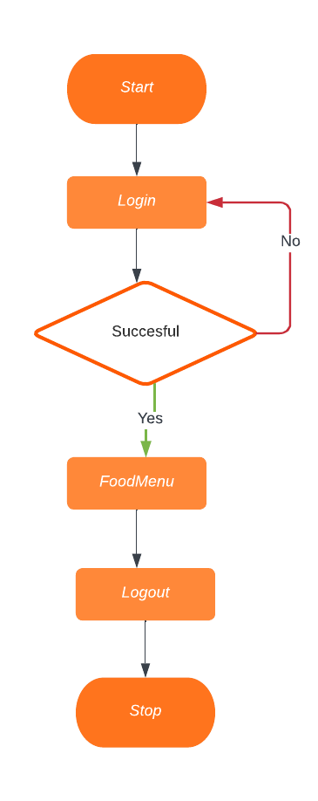
FLOWCHART FOR ADMIN

Slide 12
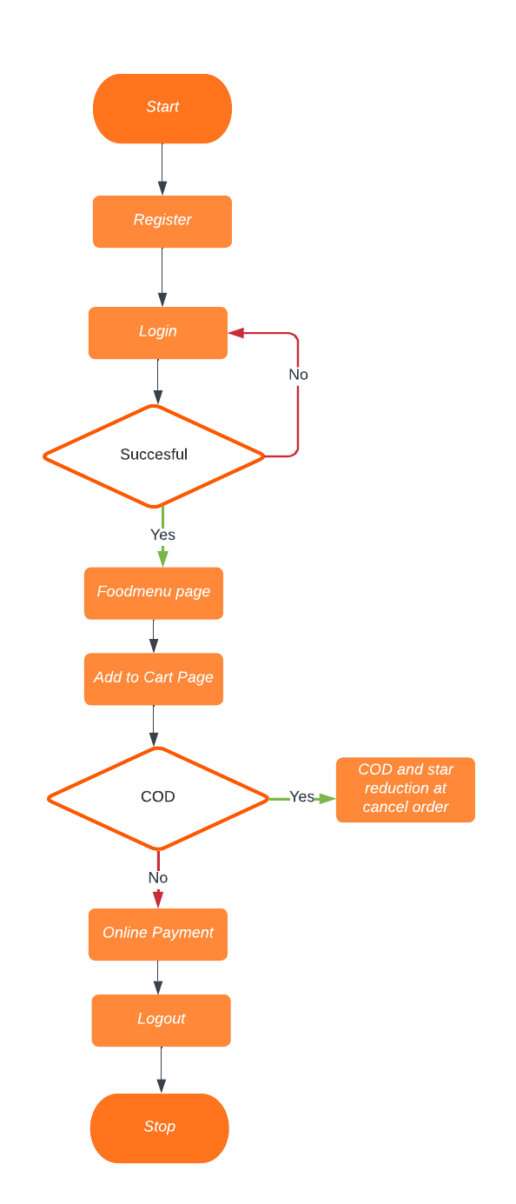
FLOWCHART FOR USER

Slide 13
MODULES
User Management Module
Menu Management Module
Order Management Module
Payment Module
Food tracking Module
COD restrictions and retrieval module
Blockchain Integration Module

Slide 14
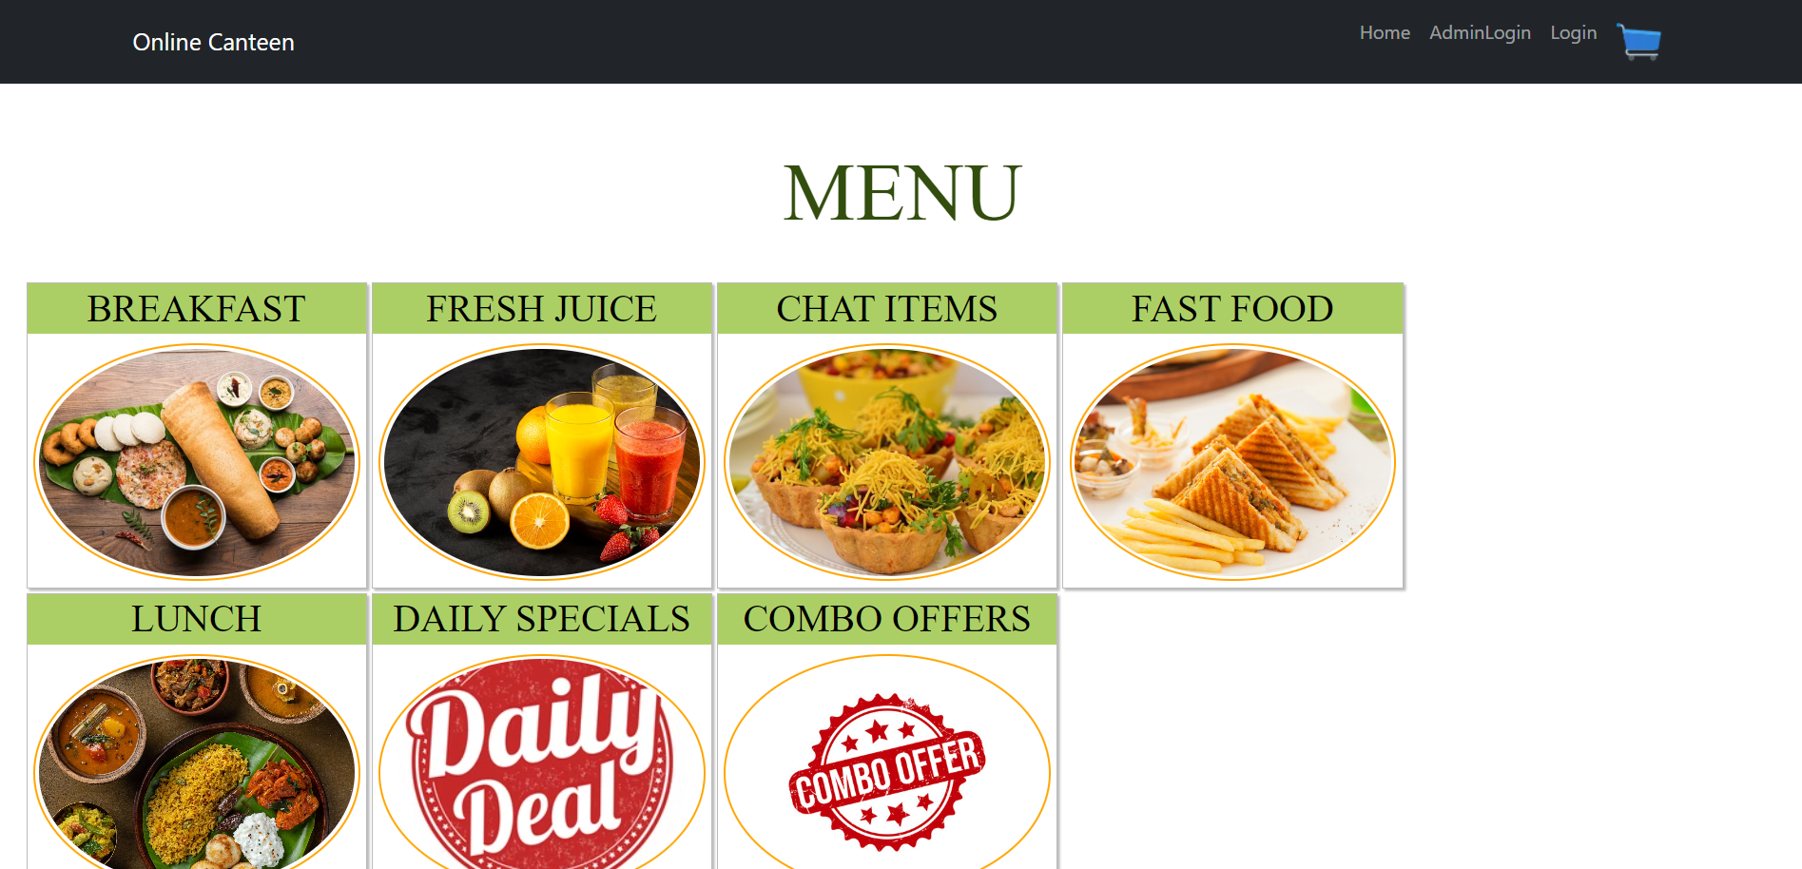
Home page

Slide 15
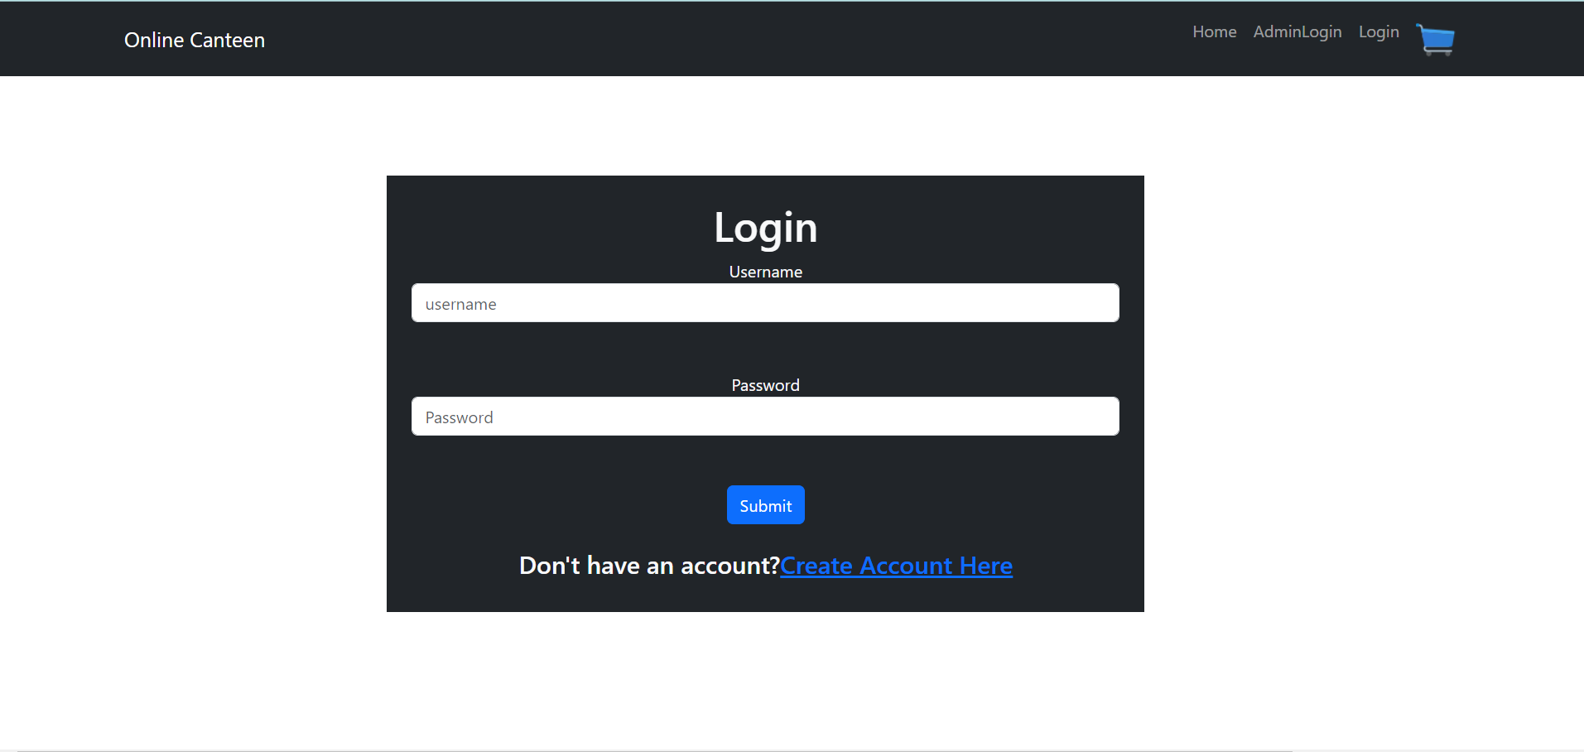
The one who have already registered can use login page.

Slide 16
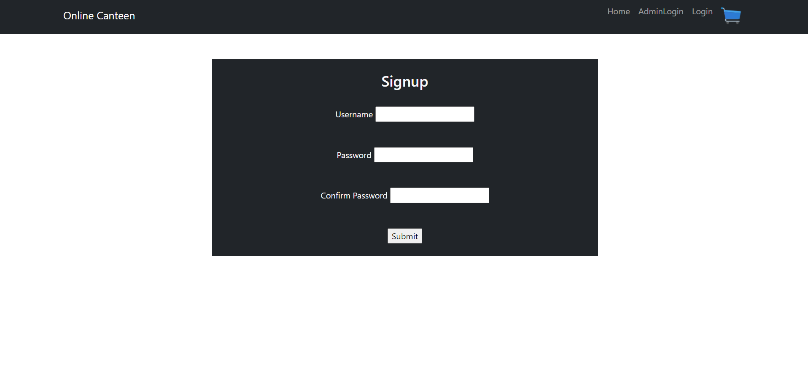
The new customer needs to initially register using this signup page

Slide 17
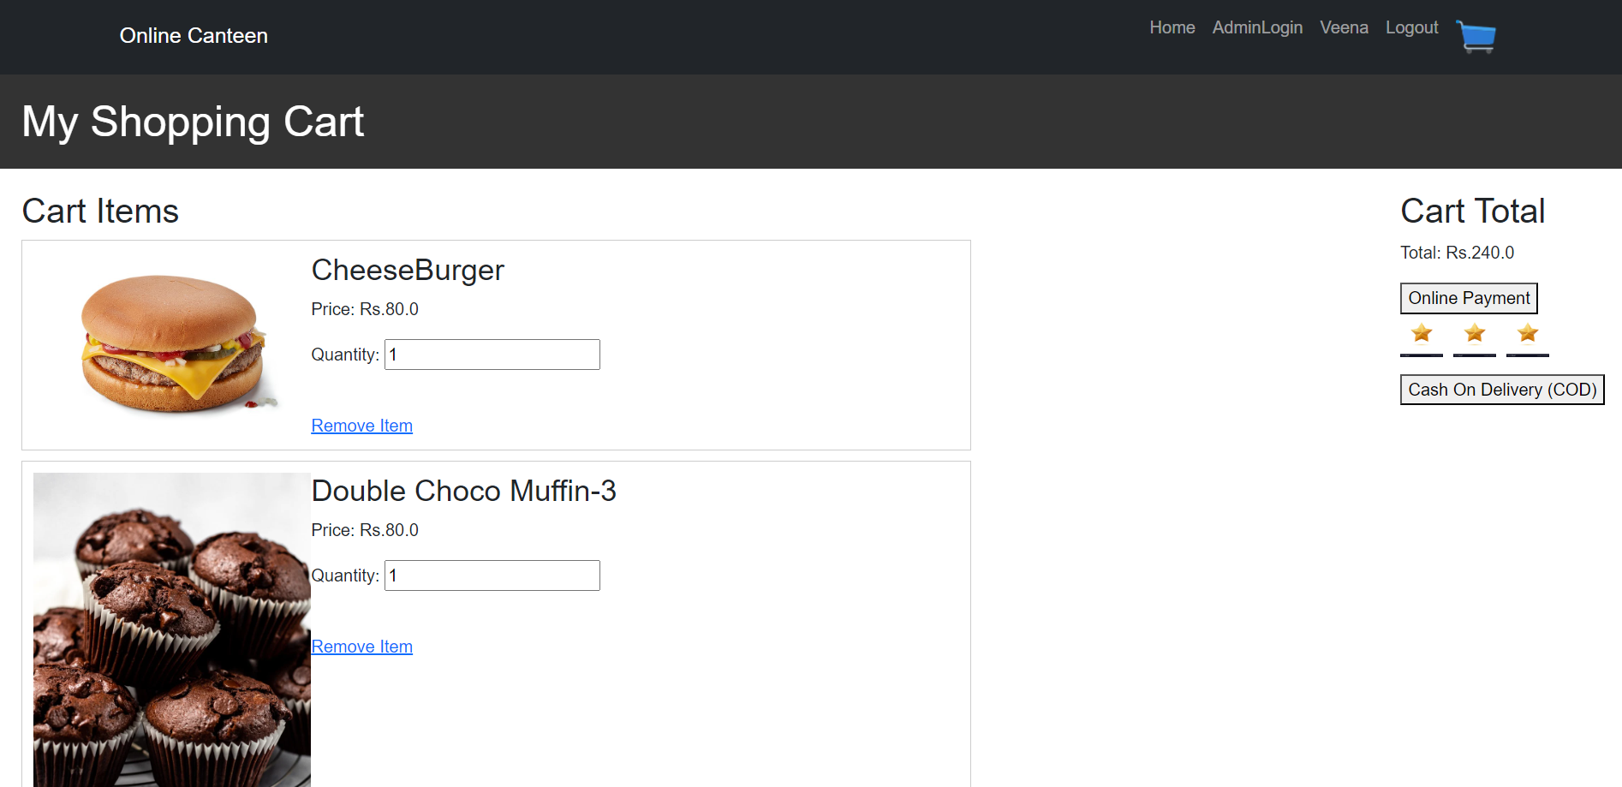
Here we can initially note that the user has got login.So that they are able to proceed with add to cart option.The user then either proceeds with Online Payment or Cash On Delivery option.So the user is provided with 3 stars in default.

Slide 18
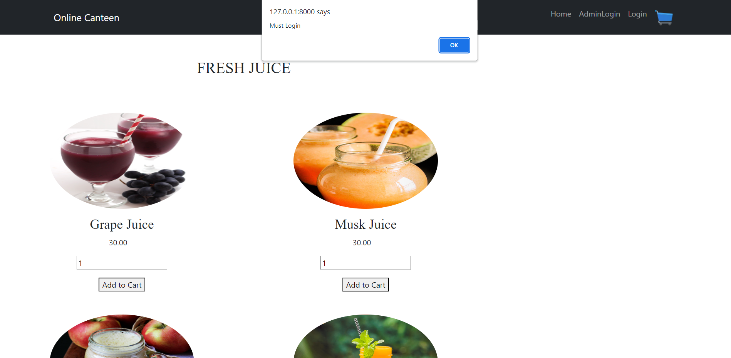
The User must login to proceed with Add to Cart option,If suppose an user clicks the add to cart button without login,the error message will appear.

Slide 19
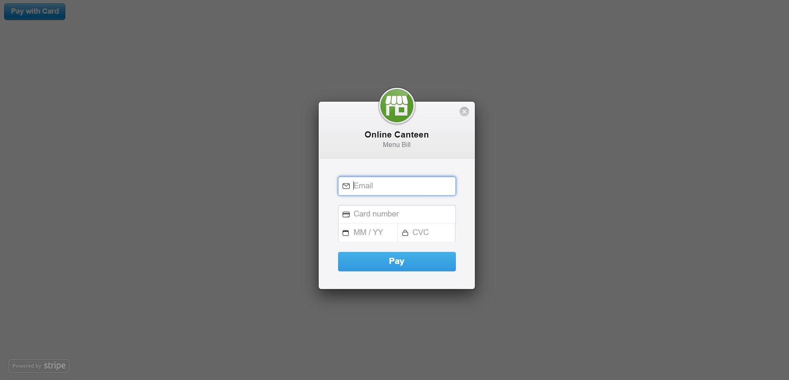
This shows that the user proceeds with online payment.

Slide 20
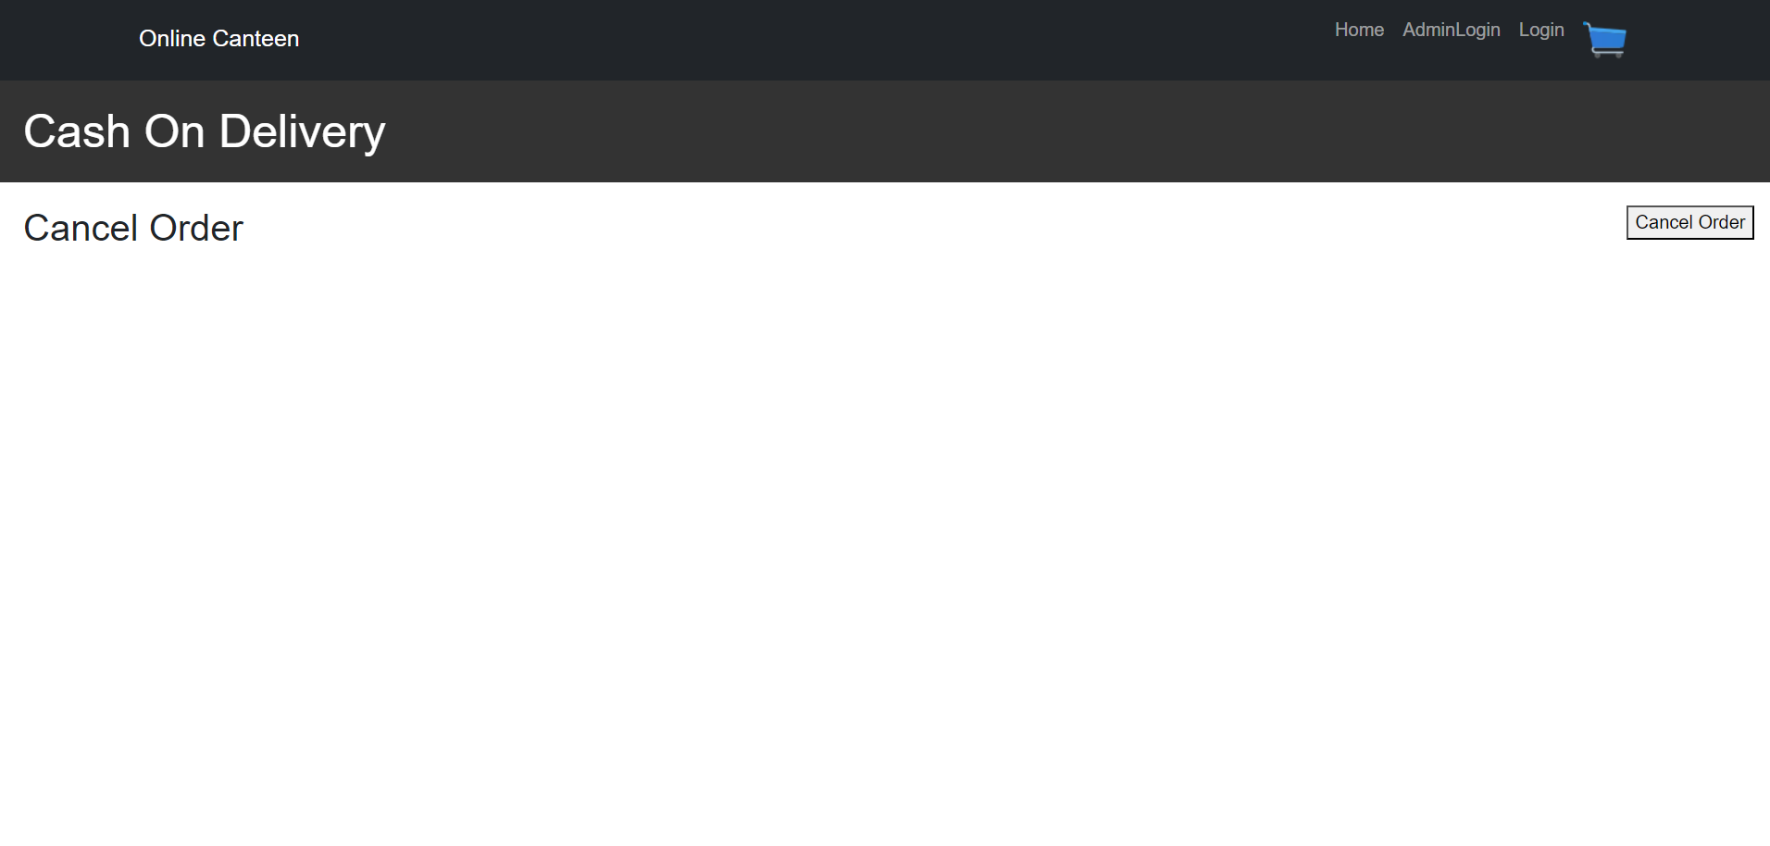
This shows the Cash On Delivery option.So once if the COD is clicked it directly proceeds with making of orders,and they can even cancel their orders.So each time when they cancel their orders their star ratings will be reduced.

Slide 21
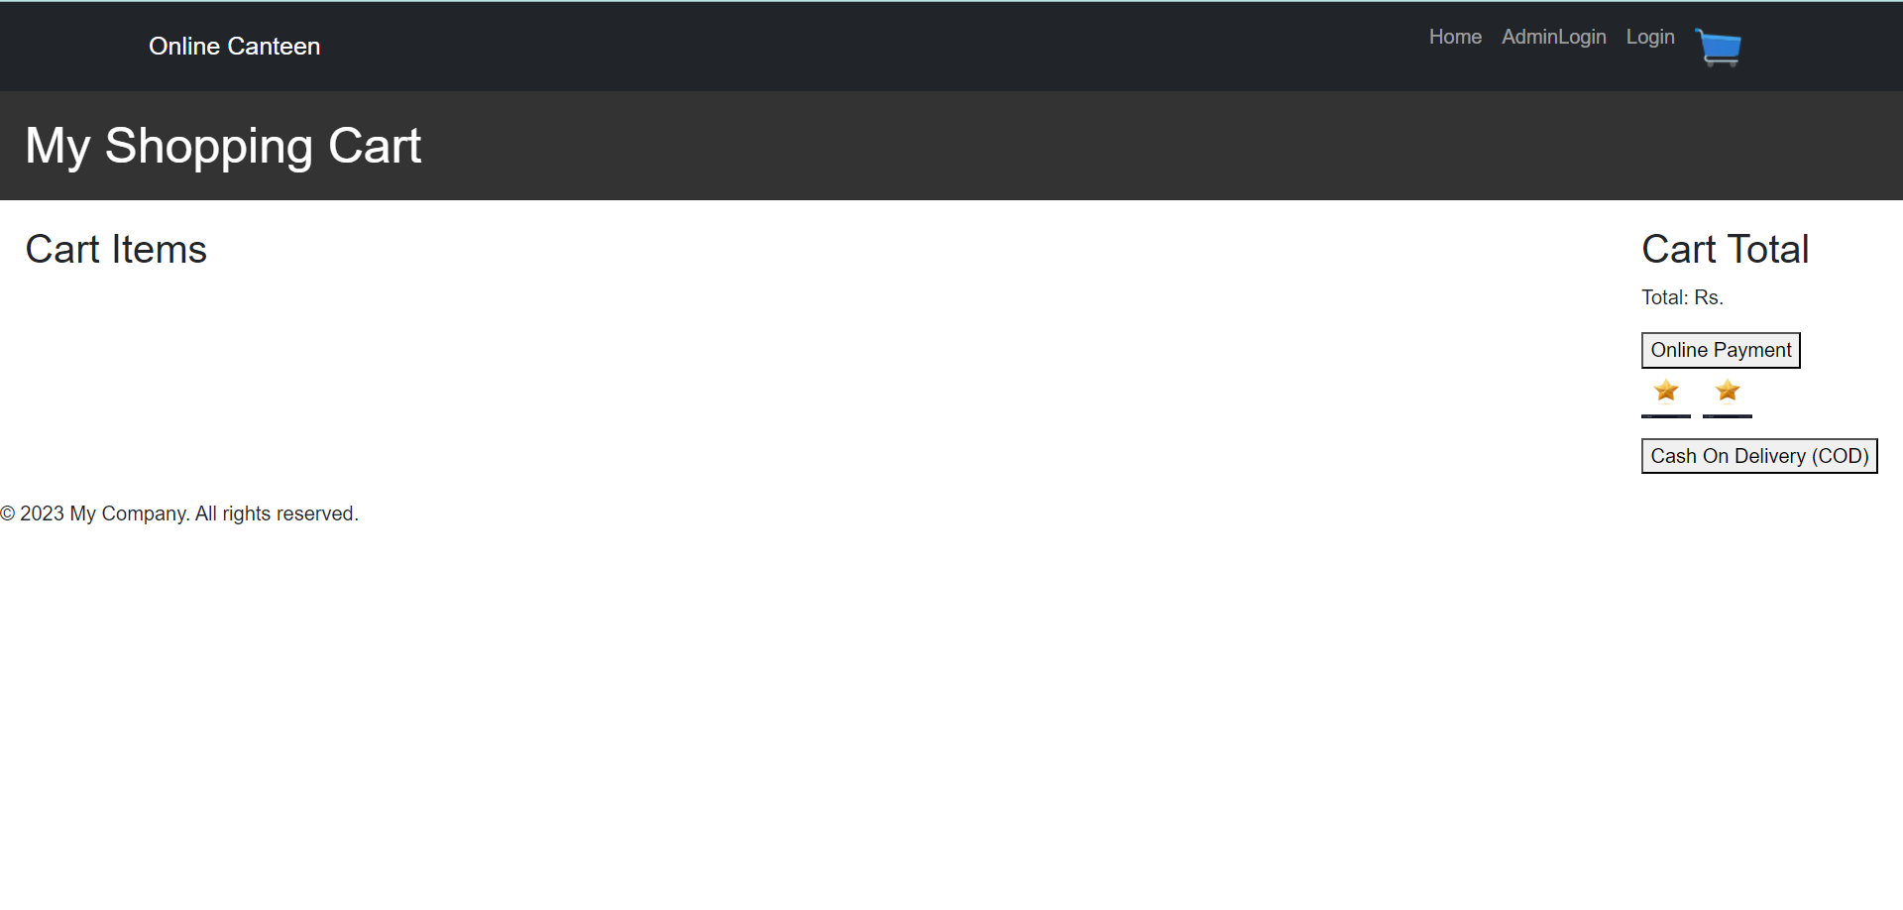
The star is reduced by 1 from 3 so it indicates that the user cancelled the order for the 1st time.

Slide 22
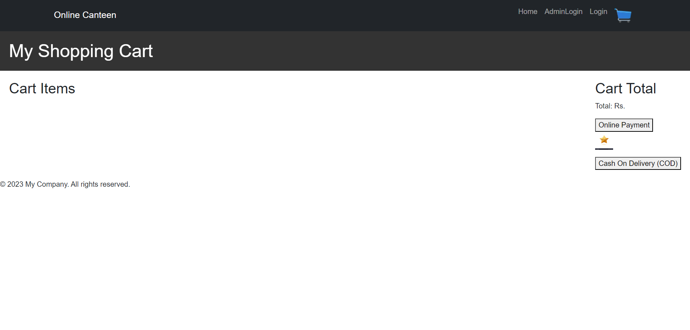
It shows that the particular customer had again cancelled the order,so the star is reduced to 1.And there is only one star left.

Slide 23
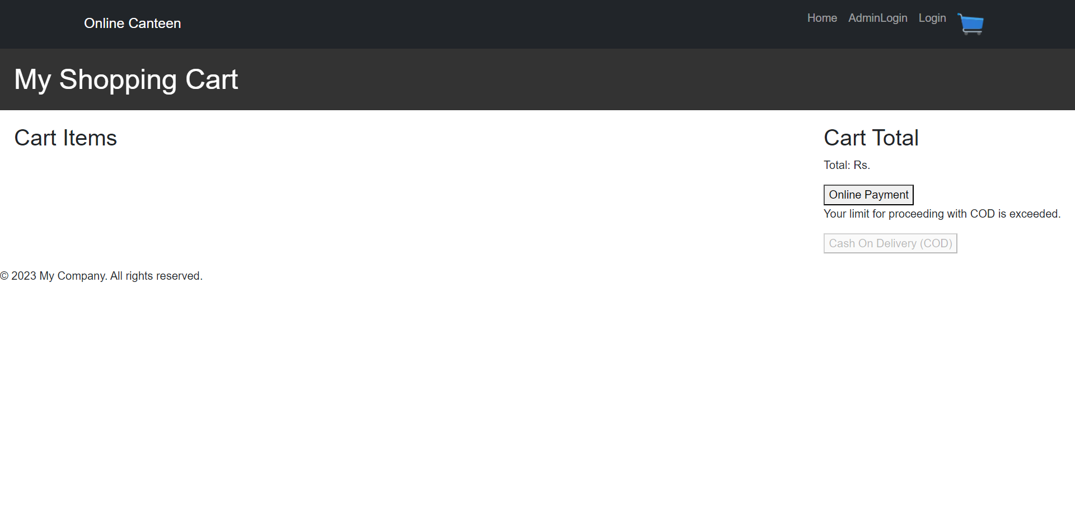
Now the complete 3 stars got reduced so the particular customer got disabled their COD.Hereafter the customer can’t proceed with COD they can only use Online Payment.

Slide 24
CONCLUSION
The project aims to develop an online canteen system that provides a convenient and efficient platform for users to order food from a variety of menus. The system incorporates features such as user registration, menu management, order placement, payment processing, and a star rating system to enhance user experience and promote accountability.The implementation of the project is based on the Django web framework, utilizing HTML, CSS, and JavaScript for frontend development. Django's robust backend capabilities and its integration with SQLite as the database management system ensure a reliable and scalable system.The system's core functionality includes user management, where users can register, log in, and update their profiles. The menu management module enables canteen administrators to add, edit, and delete menu items, while the order management module allows users to place orders, track their status, and maintain an order history. The payment module ensures secure online transactions by integrating with third-party payment gateways.A notable feature of the system is the star rating module, which assigns an initial star rating of 3 to each user and reduces it with each order cancellation. Once the star rating reaches 0, the user's Cash on Delivery (COD) option is disabled. This feature promotes user accountability and encourages responsible ordering behavior.

Slide 25
.
THANK YOU

