Slide 1




Introduction to Flipkart's Mobile Sales
Flipkart is India's leading e-commerce platform and a major player in the mobile sales market. It offers a wide range of smartphones from various brands at competitive prices.
by Karuppasamy S

Slide 2

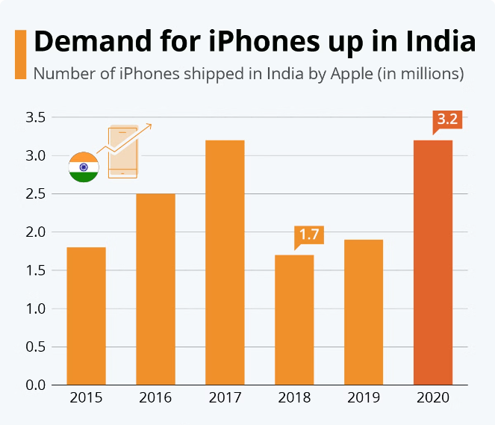
Market Trends in the Indian Smartphone Industry
1
Growth in Smartphone Adoption
The Indian smartphone market is rapidly growing, with increasing smartphone penetration and demand for affordable devices.
2
Focus on Value-for-Money
Consumers prioritize affordable smartphones with good features and performance, driving competition in the budget segment.
3
Rise of Online Sales
E-commerce platforms like Flipkart have gained immense popularity, contributing to the shift from offline retail to online sales.
4
Emerging Technologies
The market is witnessing the adoption of new technologies like 5G, AI, and foldable screens, further driving innovation and demand.

Slide 3
Flipkart's Smartphone Portfolio
Budget Smartphones
Mid-Range Smartphones
Premium Smartphones
Flipkart offers a wide range of affordable smartphones from brands like Redmi, Realme and poco.
The portfolio includes popular mid-range options from brands like OnePlus, Vivo, and Oppo.
Flipkart caters to the premium segment with flagship devices from brands like Apple, Samsung, and Google.

Slide 4
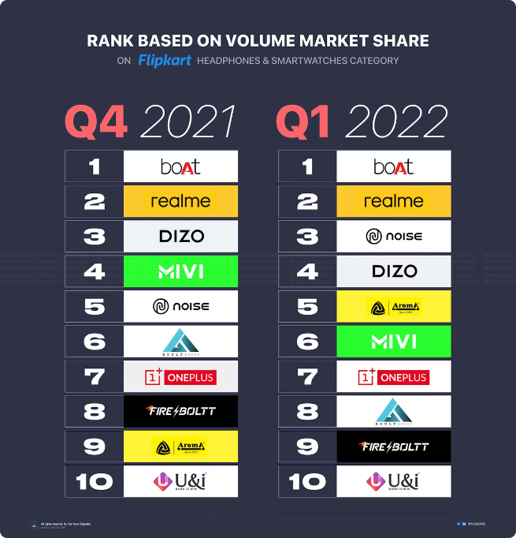

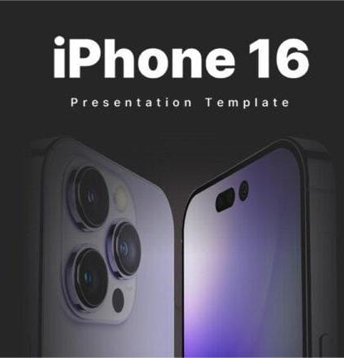
Flipkart's Exclusive Mobile Brands
1
Realme
Flipkart has partnered with Realme to offer exclusive models and deals on its smartphones.
2
Samsang
Flipkart is a key partner for Samsang in India, selling its latest smartphones and feature phones.
3
Xiomi
Xiomi launched its exclusive upgraded smartphone in India through Flipkart, establishing a strong partnership with the platform.
4
Mi
Flipkart has a strategic partnership with Xiaomi's Mi brand, offering exclusive deals and early access to new launches.

Slide 5






Flipkart's Mobile Sales Strategies
Price Competitiveness
Flipkart aggressively prices its smartphones to attract budget-conscious consumers.
Exclusive Launches
It partners with brands to offer exclusive launches and early access to new models.
Flash Sales
Flipkart conducts flash sales for popular models, generating excitement and driving sales.
Festival Promotions
During major festivals, Flipkart offers significant discounts and offers on mobile phones.
Exchange Offers
Customers can trade in their old smartphones for discounts on new purchases.
No-Cost EMI
Flipkart provides easy financing options through no-cost EMI schemes, making smartphones more accessible.

Slide 6

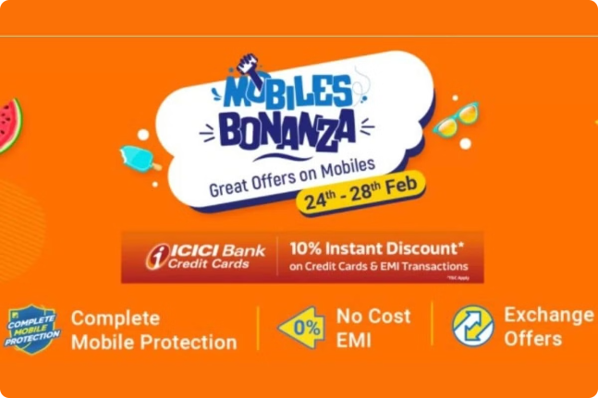
Flipkart's Mobile Sales Initiatives
Flipkart Mobile Bonanza
Flipkart hosts annual mobile bonanza events, offering deep discounts and exclusive deals on smartphones.
Flipkart Mobile Exchange Program
Customers can trade in their old smartphones for discounts on new purchases, encouraging device upgrades.
Flipkart Mobile Protection Plan
Flipkart offers mobile protection plans that provide coverage for accidental damage, liquid damage, and other issues.

Slide 7


Conclusion
Flipkart is a dominant player in India's mobile sales market, leveraging various strategies to drive sales and achieve market leadership.

