Slide 1
DATAPILOT AGENT OS
Governed AI Data Engineering Workspace
End-to-End Product Demo & Spec Completion Review
Live walkthrough — Analysis · SQL Generation · Multi-Agent Orchestration · Tool Registry · Governance · Analytics
August 2026 | Screenshots captured live against a running local stack

Slide 2
AGENDA
What we'll cover
01
What is DataPilot
Purpose, personas, and where it sits in the data stack
02
Architecture
Services, data plane, agent orchestration, model providers
03
Live demo walkthrough
18 workflows captured end-to-end against a running stack
04
Issues found & fixed this pass
Two blocking bugs reproduced live; one fixed in-app, one root-caused
05
Spec completion status
Done / partial / not-built, from the code-verified tracker
06
Recommended next steps
Priority order for demo readiness and enterprise readiness
DataPilot Agent OS | End-to-End Demo
2

Slide 3
OVERVIEW
What is DataPilot Agent OS
A local-first, governed AI workspace where analysts and engineers ask questions in plain English, generate and run SQL against real catalogued data, and let bounded multi-agent workflows stage pipelines, check quality, and publish analytics — with every risky step gated behind human approval.
1
2
3
4
Ask, don't query
Governed by design
Multi-agent orchestration
Two audiences for tools
Business questions become grounded, dialect-aware, read-only SQL — validated against the real catalog before it ever runs.
Every catalog asset carries an owner, sensitivity, and freshness SLA. High-risk actions require explicit approval.
Temporal-backed Planner → Specialist agents (SQL, Pipeline, Quality, Policy) execute bounded, explainable tool calls.
Internal agents call vetted internal tools; external systems call published, rate-limited tools over REST/MCP.
DataPilot Agent OS | End-to-End Demo
3

Slide 4
ARCHITECTURE
How the pieces fit together
Next.js Web App
External Agents / Systems
Superset (embedded)
Single-page workspace — Admin, Analyst, Engineer, Viewer views
REST + MCP clients calling published governed tools
Short-lived guest tokens — no separate login
FastAPI API — Auth · Catalog · SQL Generation · Conversations · Tools · Gateway · Admin
Temporal Workers
Tool Runtime
Model Providers
Planner → Metadata → SQL Analyst / Analytics / Pipeline / Quality / Policy agents, bounded tool calls
Internal tools (sql.generate, schedule.run, pipeline.stage) + governed query-tool gateway
Gemini · OpenAI-compatible · Claude · Local deterministic mock — per-project default
PostgreSQL
Qdrant
Redis
SQL Server / Postgres demo
MCP Toolbox
Control plane + local workspace staging schema
Vector search — catalog + glossary embeddings
Caching + gateway rate limiting
Governed external connectors
MCP-mode metadata scanning
Cross-cutting: RBAC (project-scoped roles) · PII detection & masking · audit events · approval gating on risky actions
Deployment: Docker Compose locally (api, worker, web, postgres, redis, qdrant, temporal, superset); Kubernetes/OpenShift manifests with non-root containers, securityContext, HPAs, and a worker PodDisruptionBudget for production.
DataPilot Agent OS | End-to-End Demo
4

Slide 5
OVERVIEW
Five capability pillars
Catalog & Governance
Grounded SQL Generation
Multi-Agent Orchestration
Tool Registry & Gateway
Embedded Analytics
Connectors, schema scanning, PII masking, owner/sensitivity/freshness metadata, lineage graph
Catalog-grounded, dialect-aware, read-only-enforced SQL with validation and execution preview
Temporal-backed Planner + specialist agents, bounded tool calls, human approval gates
Internal agent tools plus a rate-limited external REST/MCP gateway for governed query tools
Semantic layer, quality rules, and Superset dashboards published straight from a query result
DataPilot Agent OS | End-to-End Demo
5

Slide 6
LIVE DEMO
What the walkthrough covers
18 workflows captured end-to-end against a running Docker Compose stack, organized around the scenario categories that matter for this review:
Analysis
Conversational Q&A over the catalog — ask a business question, get grounded results
Slide 11
SQL generation pipeline
Grounded prompt → generated SQL → validation checks → execution preview
Slide 12–13
Agent orchestration
Multi-agent job run trace, approvals gate on risky steps
Slide 14–15
Data quality & pipelines
Rule checks, pipeline staging, lineage
Slide 16–17
Tool registry
Internal agent tools and the external REST/MCP gateway agents call
Slide 21–22
Governance & admin
Connectors, model providers, RBAC, auth, projects
Slide 26
Embedded analytics
Superset dashboards published from a query result
Slide 25
DataPilot Agent OS | End-to-End Demo
6

Slide 7
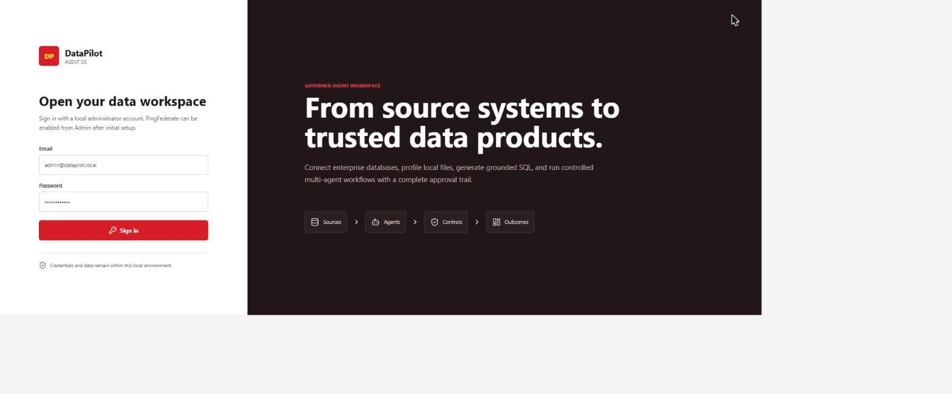
DEMO · ACCESS
Login & Authentication
Seeded local credentials authenticate against the FastAPI /auth endpoints. Role (Admin / Analyst / Engineer / Viewer) drives the landing view and every downstream permission check via require_permission().
DataPilot Agent OS | End-to-End Demo
7

Slide 8
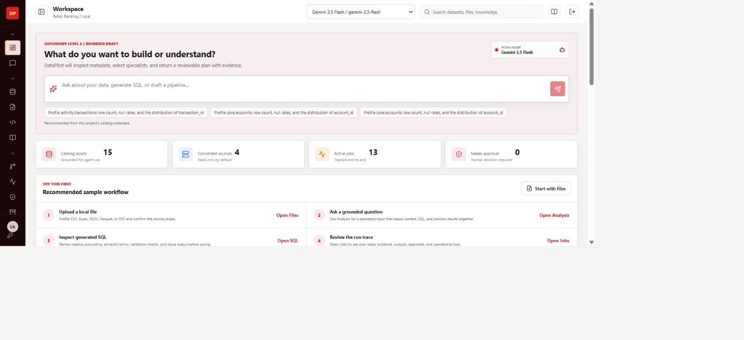
DEMO · ACCESS
Workspace Hub
Single-page workspace — no separate URL routes. Grouped, collapsible navigation gives each role a relevant landing area: Files, Catalog, Analysis, SQL, Jobs, Approvals, Quality, Pipelines, Artifacts, Notebooks, Semantic, Tools, Agents, Evaluations, Analytics, Admin.
DataPilot Agent OS | End-to-End Demo
8

Slide 9
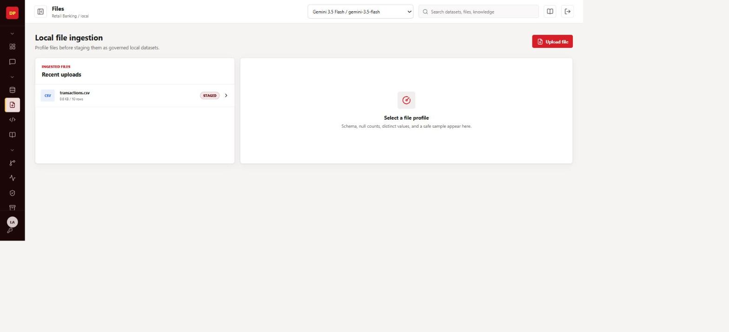
DEMO · INGESTION
Data Ingestion & Files
Real files are staged into the local Postgres workspace (staging schema) — demo data mode is reserved for automated tests, not this walkthrough. Staged tables immediately become catalog assets available to SQL generation.
DataPilot Agent OS | End-to-End Demo
9

Slide 10
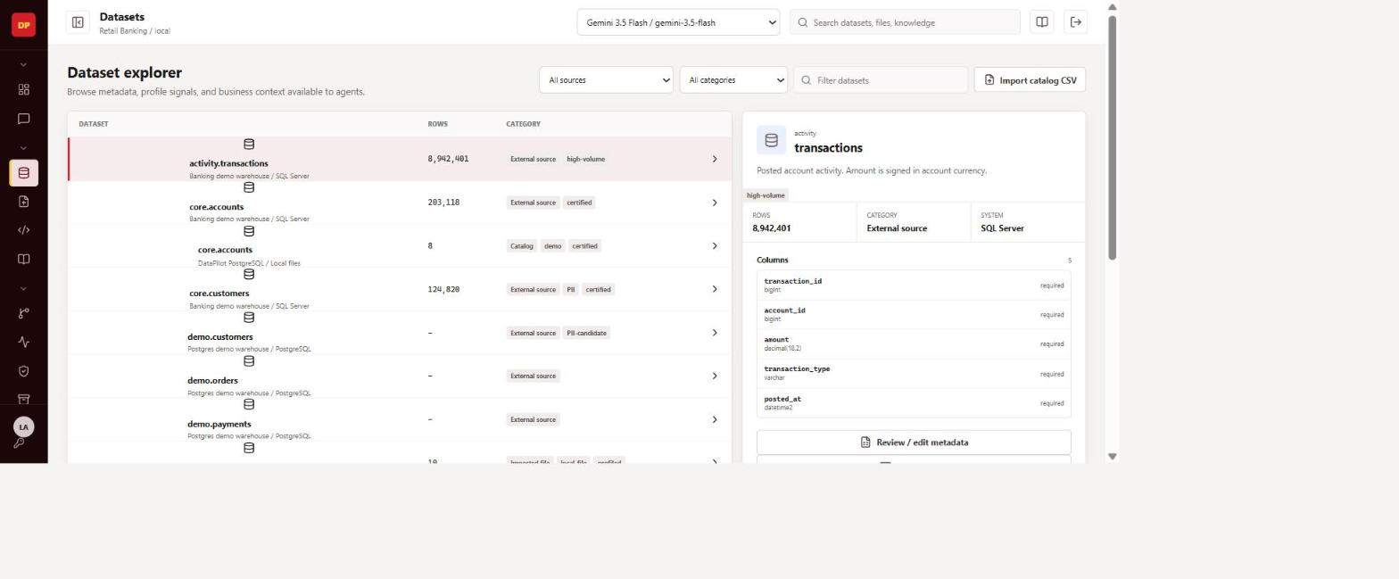
DEMO · GOVERNANCE
Catalog & Datasets
Every asset carries owner, sensitivity, freshness SLA, certification status, and business-level column names/descriptions — the metadata that grounds SQL generation and drives PII masking downstream.
DataPilot Agent OS | End-to-End Demo
10

Slide 11
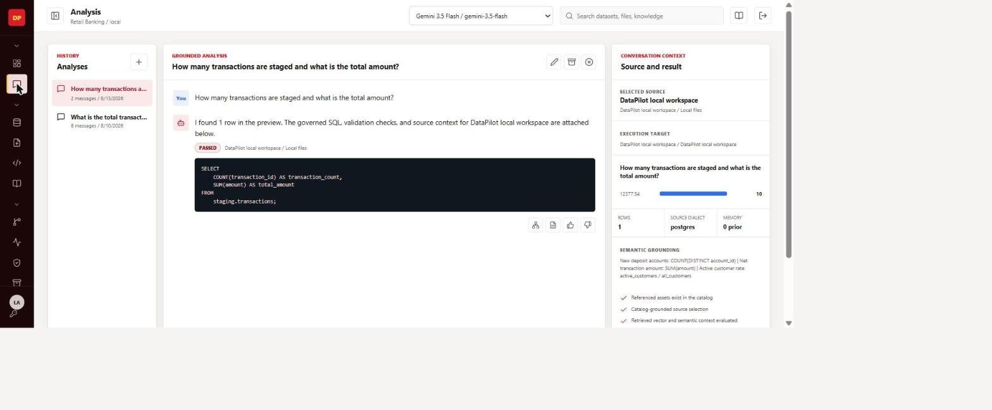
DEMO · ANALYSIS
BUG FIXED
Ask a Business Question
A fresh, single-connector conversation asks a real question against the local workspace and returns grounded results (10 rows, $12,377.54 total) via COUNT/SUM over staging.transactions. See the "Issues Found" section for the cross-connector bug this avoids.
DataPilot Agent OS | End-to-End Demo
11

Slide 12
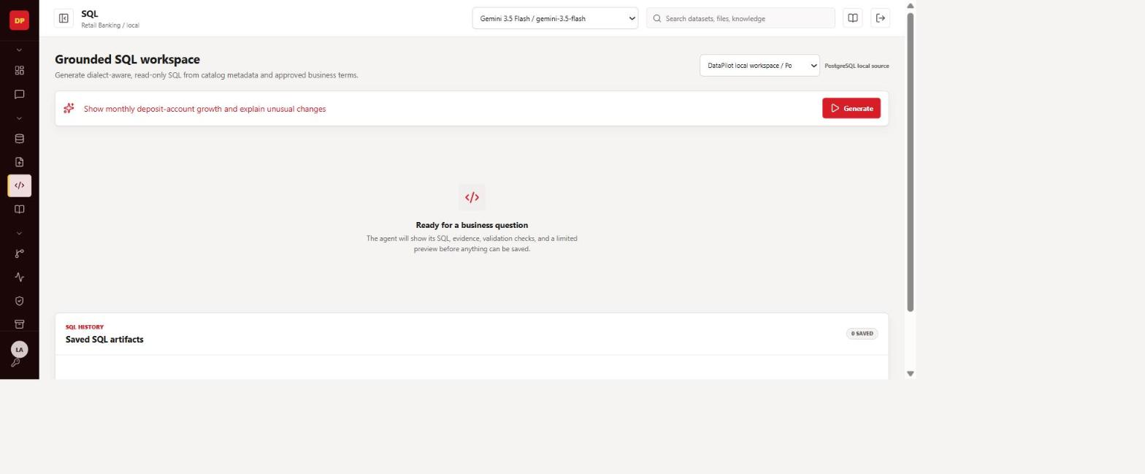
DEMO · SQL GENERATION PIPELINE
SQL Workspace — Ready State
Catalog-grounded SQL workspace: pick a source, describe the question in plain English, and the pipeline builds a prompt from the live catalog_text and grounding_prompt_text() before ever calling a model.
DataPilot Agent OS | End-to-End Demo
12

Slide 13
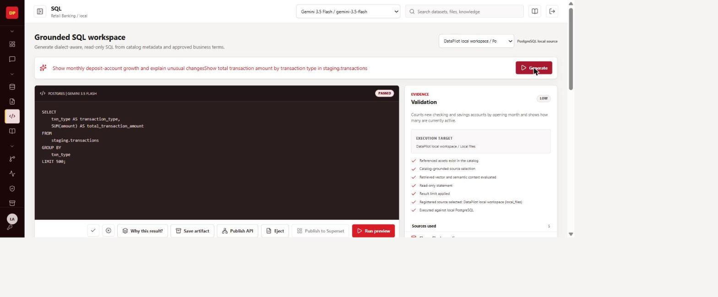
DEMO · SQL GENERATION PIPELINE
BUG FIXED
Generated, Validated, Executed
End-to-end pass after switching the default model provider to a healthy one: SQL generated, safety-validated as read-only, executed as a preview, and 10 real rows returned. See "Issues Found" for the root cause and the fix.
DataPilot Agent OS | End-to-End Demo
13

Slide 14
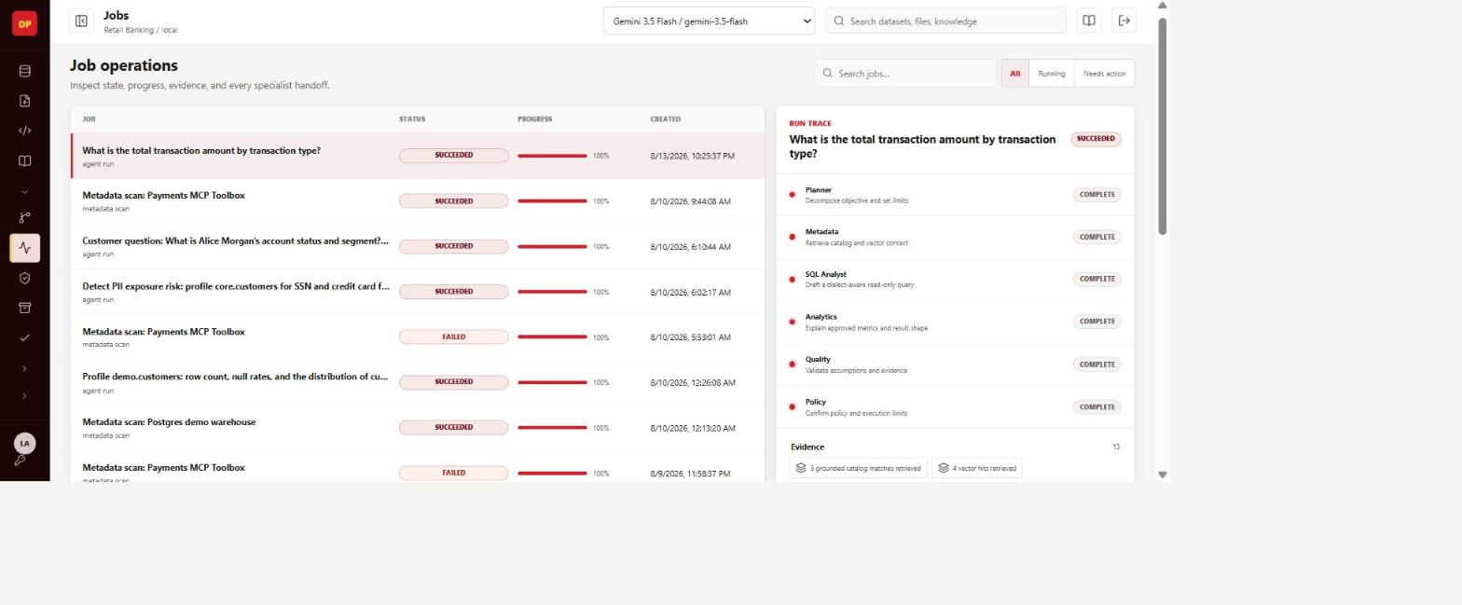
DEMO · AGENT ORCHESTRATION
Agent Jobs & Run Trace
A Temporal-backed multi-agent run: Planner drafts 3–6 steps from the enabled agent set, each bounded tool call is logged with its evidence and parameter source (heuristic vs. model-filled), and the trace stays fully explainable after the fact.
DataPilot Agent OS | End-to-End Demo
14

Slide 15
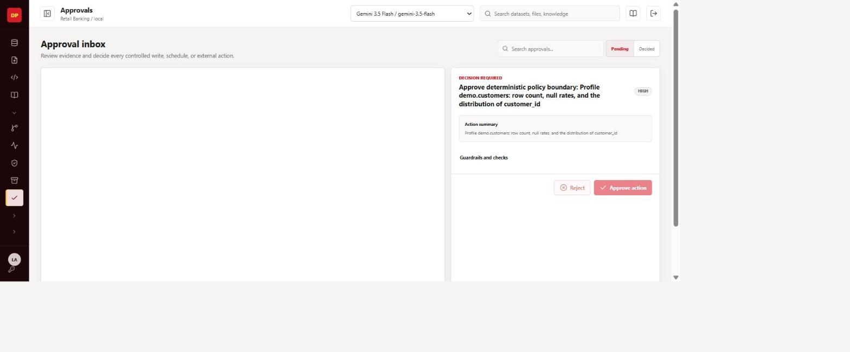
DEMO · GOVERNANCE
Approvals Inbox
Deterministic policy — not the model — decides what needs a human. Any plan step crossing a risk/write boundary pauses here before bound tools execute; reviewers see live evidence, not a placeholder count.
DataPilot Agent OS | End-to-End Demo
15

Slide 16
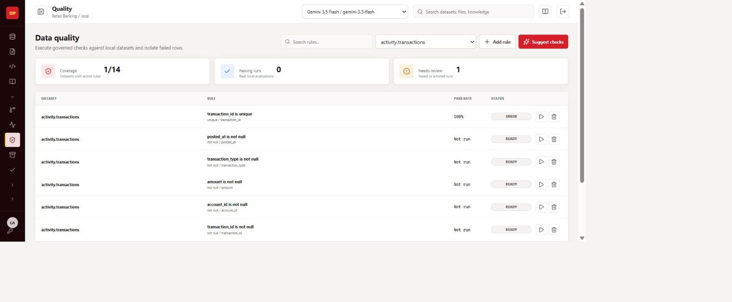
DEMO · QUALITY
Data Quality Rules
Rule-based checks run against catalogued assets; results feed both the quality dashboard and grounding context for the Quality specialist agent.
DataPilot Agent OS | End-to-End Demo
16

Slide 17
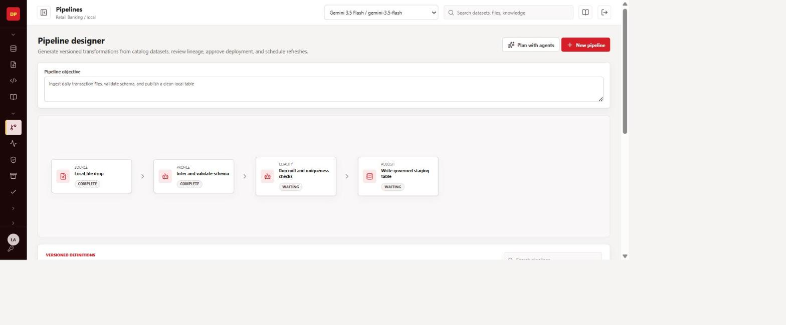
DEMO · PIPELINES
Pipelines Designer & Lineage
Objective- and source-asset-driven pipeline generation (not free-text SQL) stages transformations; the lineage graph traces upstream/downstream dependencies across catalog assets.
DataPilot Agent OS | End-to-End Demo
17

Slide 18
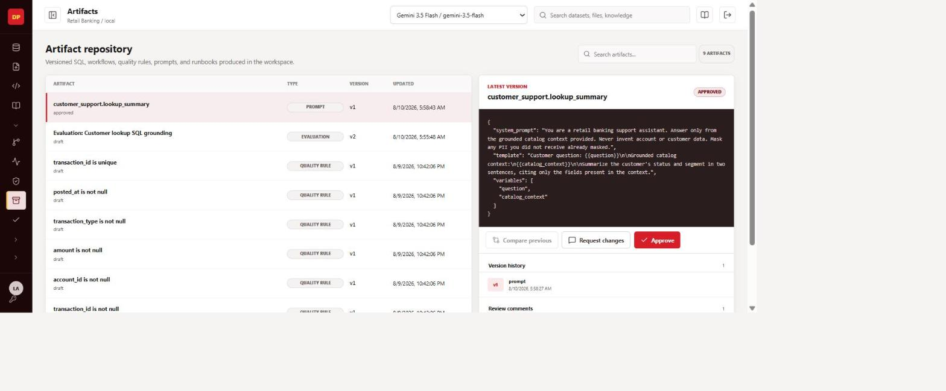
DEMO · ARTIFACTS
Artifacts Repository
Generated SQL, published query tools, and pipeline outputs are tracked as reviewable artifacts, with the same approval-decision path used across the platform.
DataPilot Agent OS | End-to-End Demo
18

Slide 19
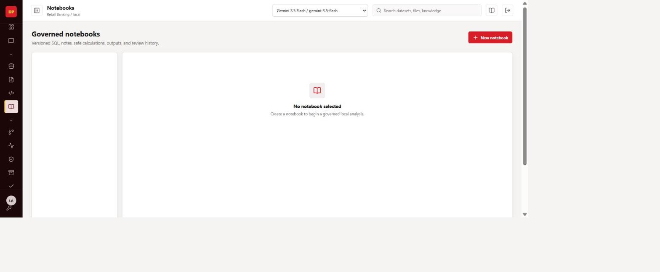
DEMO · NOTEBOOKS
Notebooks
Analysis results can be ejected straight into a notebook for further exploration, keeping the generated SQL and its grounding context attached.
DataPilot Agent OS | End-to-End Demo
19

Slide 20
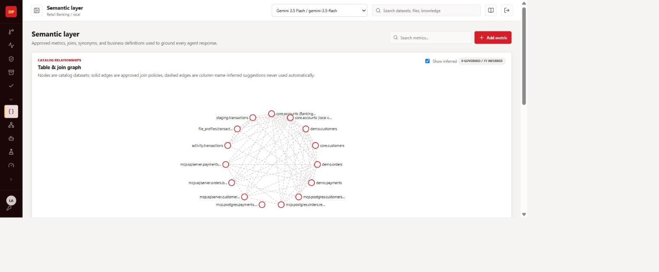
DEMO · SEMANTIC LAYER
Catalog Relationship Graph
A hand-rolled node-link diagram over GET /semantic/graph: governed joins render solid, column-name-inferred suggestions render dashed, with a toggle and hover highlighting.
DataPilot Agent OS | End-to-End Demo
20

Slide 21
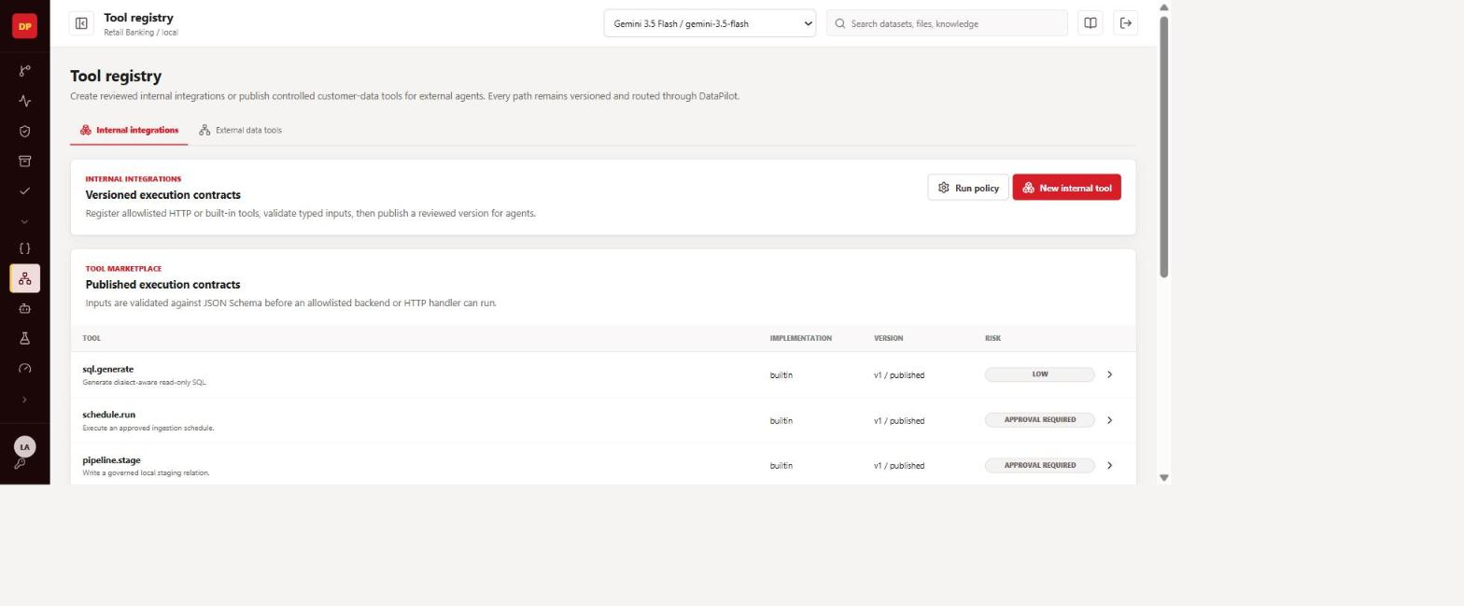
DEMO · TOOL REGISTRY
Internal Agent Tools
The internal ToolDefinition registry agents call directly — sql.generate, file.profile, quality.run, pipeline.stage, schedule.run and more, each with a published contract, risk level, and approval requirement.
DataPilot Agent OS | End-to-End Demo
21

Slide 22
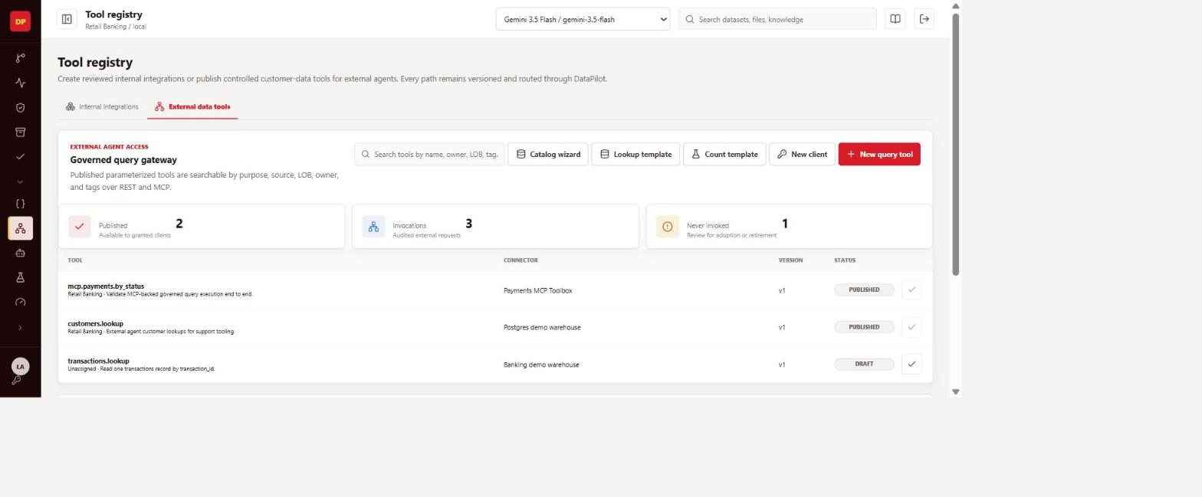
DEMO · TOOL REGISTRY
External Gateway — Agent Call Tools
Published, parameterized QueryTools exposed over REST + MCP for external agents/systems — rate-limited per client, PII-masked, and scoped to a project. This is the surface other agent systems call into DataPilot through.
DataPilot Agent OS | End-to-End Demo
22

Slide 23
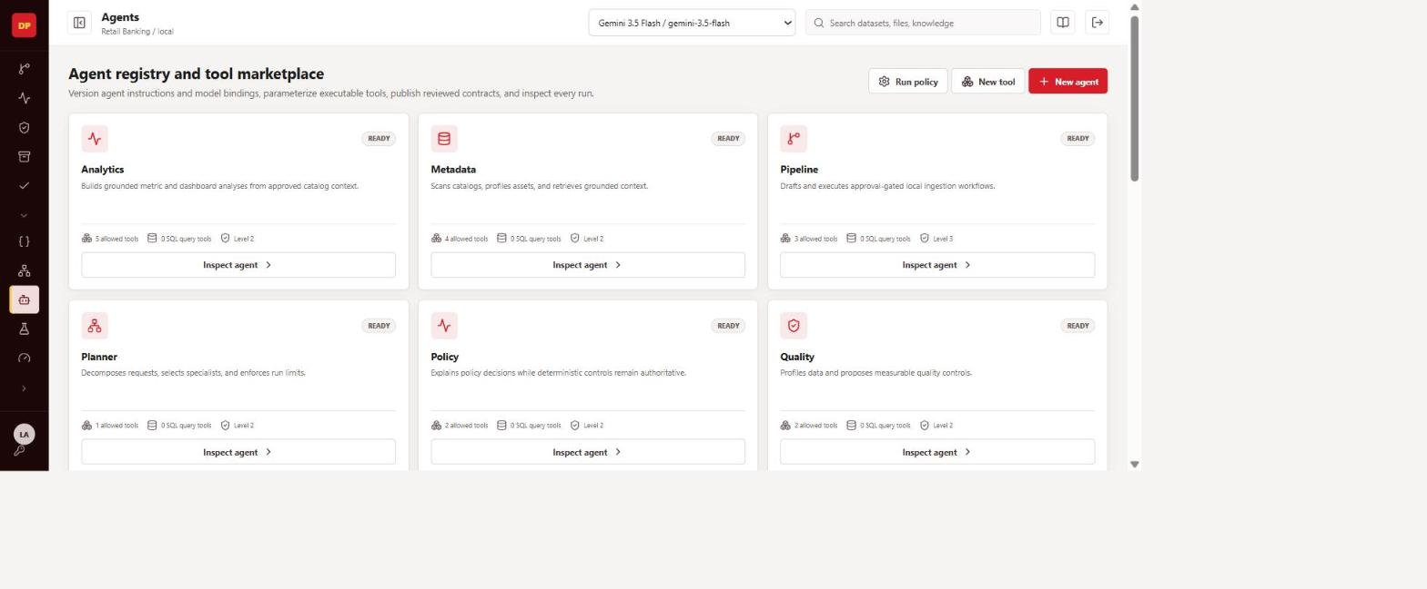
DEMO · AGENTS
Agents Registry
Versioned, publishable agent definitions — Planner, Metadata, SQL Analyst, Analytics, Pipeline, Quality, Policy, Troubleshooter — each bindable to internal tools or governed query tools.
DataPilot Agent OS | End-to-End Demo
23

Slide 24
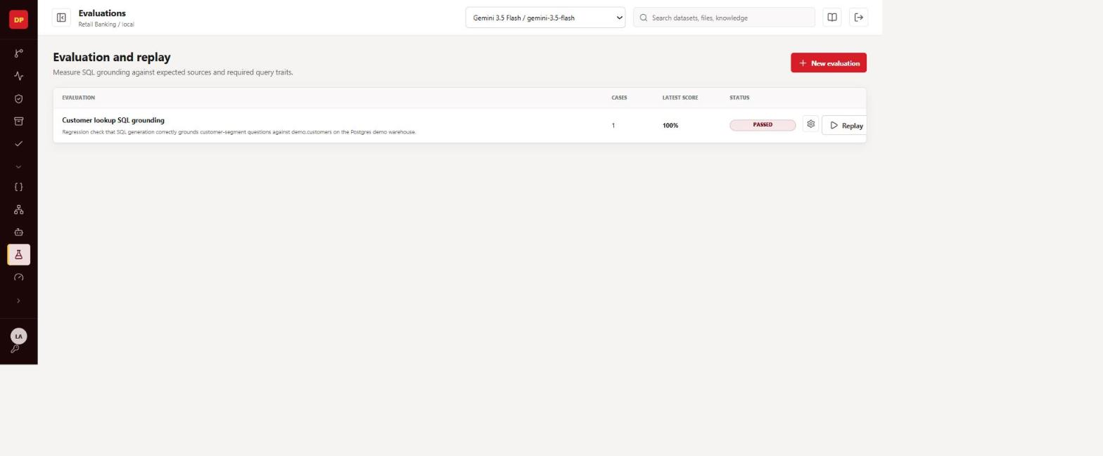
DEMO · EVALUATIONS
Evaluations
Evaluation suites score agents against defined scenarios; results feed each agent's scorecard, distinct from live-run quality (a documented, still-open gap — see Spec Status).
DataPilot Agent OS | End-to-End Demo
24

Slide 25
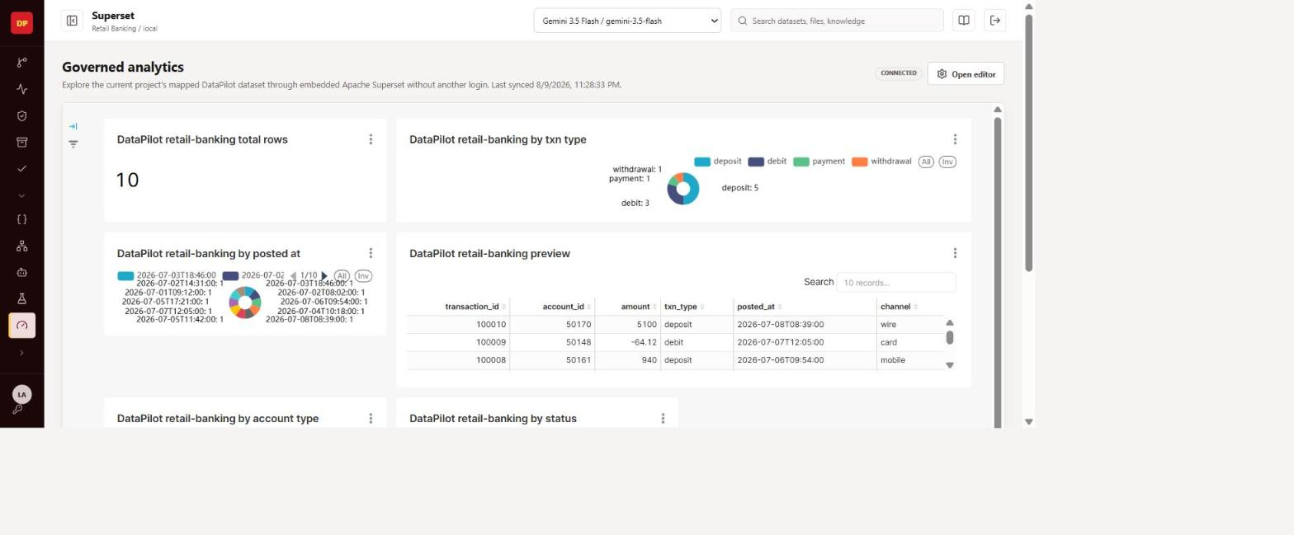
DEMO · ANALYTICS
Embedded Analytics (Superset)
A published query result opens straight into its own Superset dashboard via a short-lived guest token — no separate login, and no collision with the project's primary dashboard (a real bug fixed this session, per the code-verified status tracker).
DataPilot Agent OS | End-to-End Demo
25

Slide 26
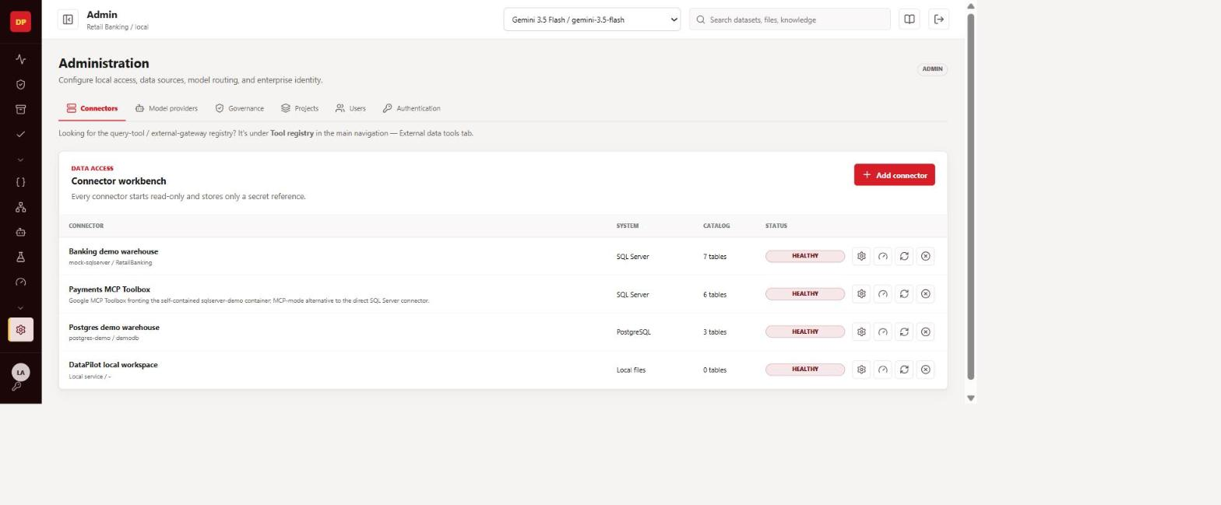
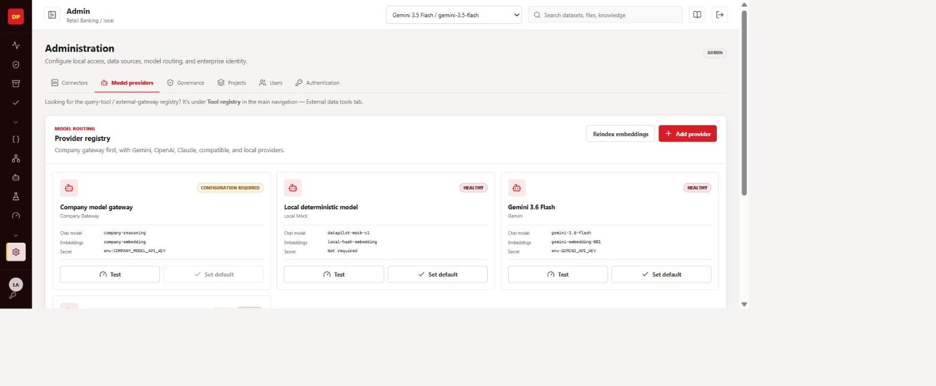
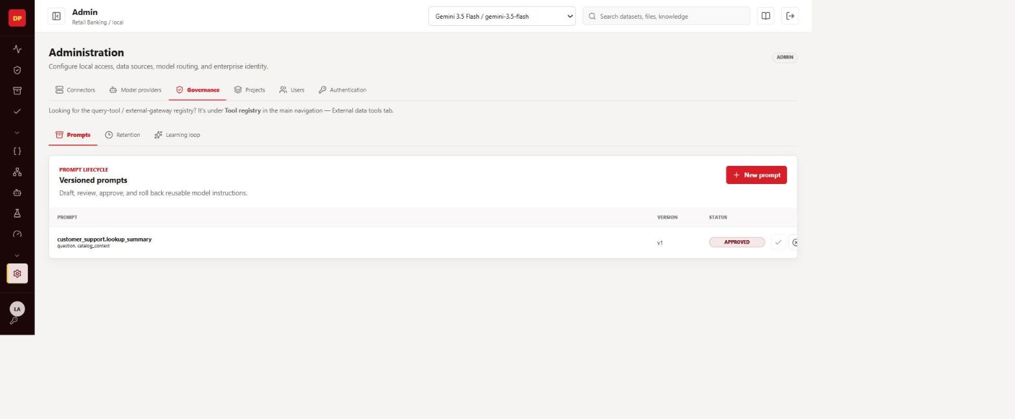
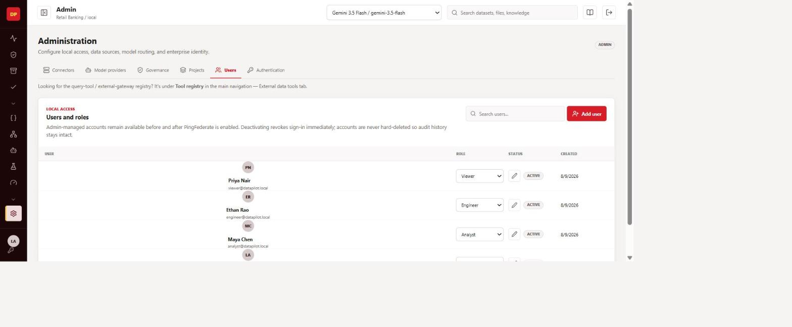
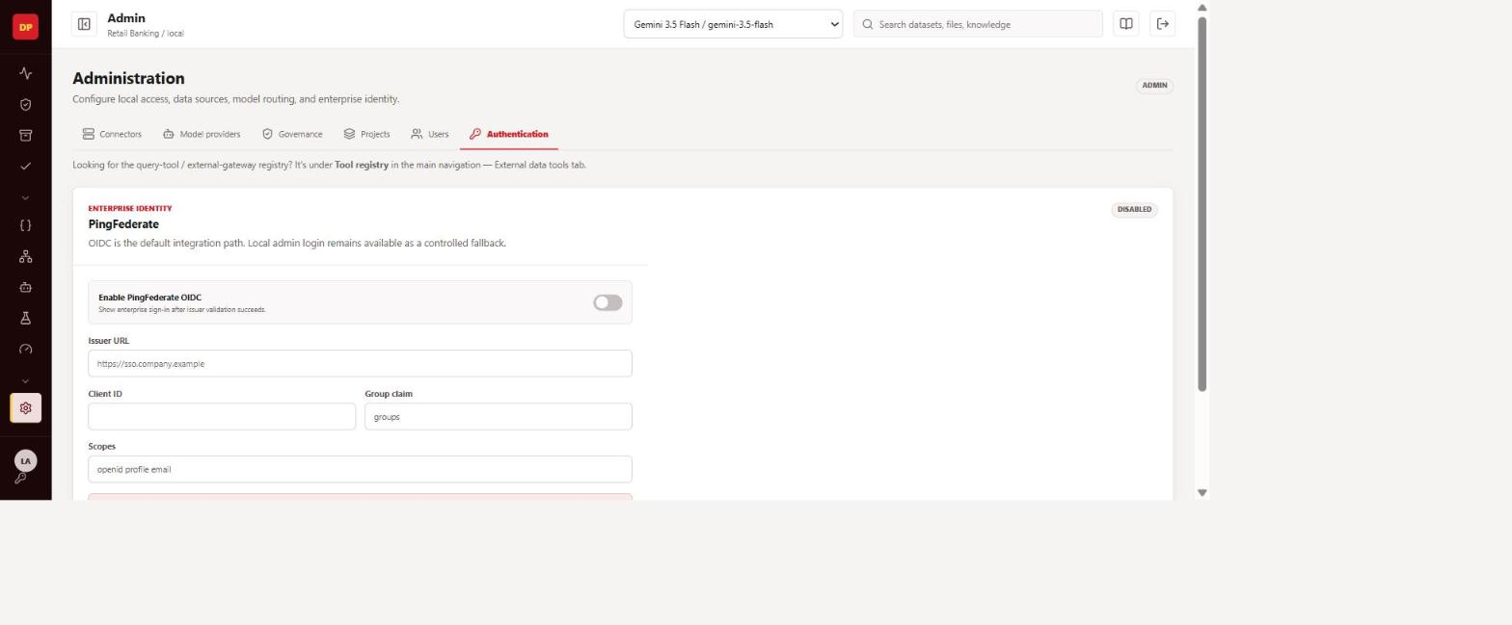
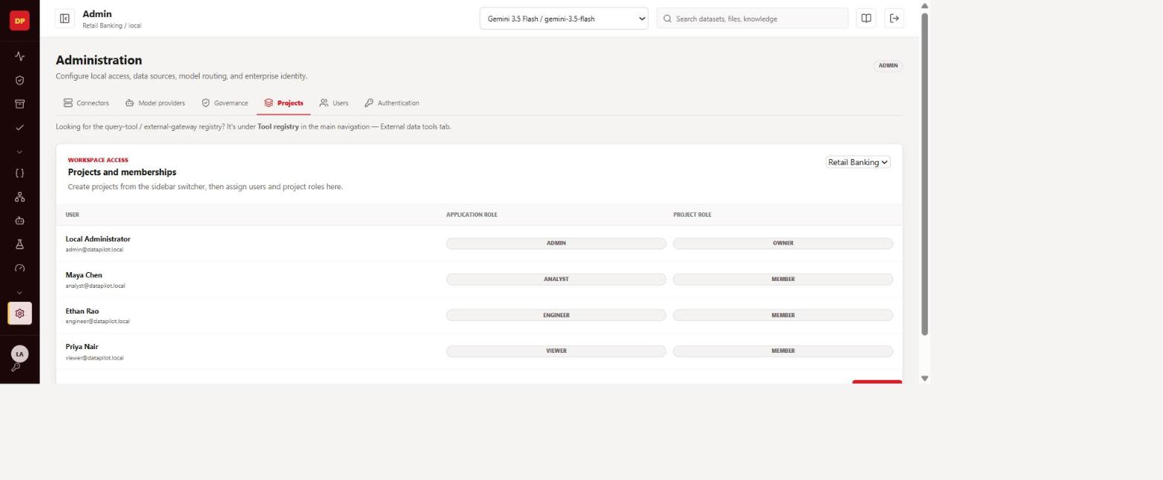
DEMO · ADMINISTRATION
Admin Console — Governance Surface
Connectors
Model Providers
Governance
Users & Personas
Authentication
Projects & Memberships
DataPilot Agent OS | End-to-End Demo
26

Slide 27
ISSUES FOUND THIS PASS
Two blocking bugs, reproduced live before recapturing
Per the review instruction to fix before recapturing: both bugs below were reproduced against the running stack (not assumed from docs), then addressed with real sample data before any "after" screenshot was taken.
SQL generation — 400 Bad Request
FIXED
Analysis — "relation activity.transactions does not exist"
ROOT-CAUSED
SYMPTOM
SYMPTOM
Generating SQL failed outright: "Client error '400 Bad Request' for url '.../models/gemini-3.6-flash:generateContent'", surfaced as a 422 from /sql/generate.
A follow-up analysis question failed at execution, referencing a table (activity.transactions) that was never part of the local workspace's catalog.
ROOT CAUSE
ROOT CAUSE
The project's default model provider, "Gemini 3.6 Flash", pointed at a model id Google's API rejects. GEMINI_API_KEY was valid — confirmed by the fact that "Gemini 3.5 Flash" (same key) worked.
activity.transactions is a synthetic catalog fixture seeded for the "Banking demo warehouse" connector (seed.py), not the local workspace. Theorized mechanism: prior-turn conversation_history text is passed verbatim into the SQL-generation prompt, and the model reused a stale table name from an earlier connector without re-validating it against the current turn's catalog.
FIX / STATUS
FIX / STATUS
Switched the project's default provider to "Gemini 3.5 Flash" via Admin → Model Providers (in-app config, no code change). Re-verified end-to-end: SQL generated, validated read-only, executed — 10 real rows returned.
Worked around for this demo with a fresh, single-connector conversation — verified clean end-to-end. The underlying cross-connector history-bleed is a real gap: prompt construction in sql.py / conversations.py needs to strip or scope conversation_history to the active connector. Logged for engineering follow-up, not yet code-patched.
DataPilot Agent OS | End-to-End Demo
27

Slide 28
SPEC STATUS
Core Product Workflows — Mostly Done
From docs/IMPLEMENTATION_STATUS_MATRIX.md — verified against the actual code, not the commit messages describing it.
DONE
Catalog, connectors, PII masking, lineage
Multi-hop lineage traversal and PII detection/masking both re-verified against real code this pass
DONE
Grounded SQL generation + validation
Catalog-grounded prompt, read-only safety check, local execution pre-validation, response caching
DONE
Multi-agent orchestration (Temporal)
Planner + specialist agents, bounded tool calls, deterministic policy authority over generated plans
DONE
Agent ↔ governed SQL tool binding
Internal agents can now call published QueryTools, not just the internal tool registry
DONE
Real semantic embeddings
ModelProvider.embedding_model now actually drives Gemini/OpenAI embeddings, with dimension-safe reindexing
DONE
External gateway rate limiting + concurrency guard
Redis-backed limiter; per-connector BoundedSemaphore protects source databases from connection storms
DONE
Superset dashboard-per-query isolation
Fixed a real collision where publishing a query overwrote the project's main dashboard
PARTIAL
SQL-generation catalog relevance (large projects)
Fixed for >40-table catalogs this session — grounding-prioritized ordering now feeds the prompt
DataPilot Agent OS | End-to-End Demo
28

Slide 29
SPEC STATUS
Partial — Real but Incomplete
Fine-grained RBAC enforcement
Real via require_permission(), but one router (artifacts.py approval endpoint) still used a raw role check — closed this pass
PARTIAL
Kubernetes / OpenShift production hardening
Non-root containers, securityContext, HPAs, PDB shipped; NetworkPolicy, secrets-manager, backup/restore/DR drills still open
PARTIAL
Async/Temporal scan for large sources
Present in code — not yet confirmed exercised against a genuinely large schema
PARTIAL
Test coverage for newer endpoints
New test file added, but has a real isolation bug: passes only by import-order accident, needs its own DATABASE_URL setup
PARTIAL
Registry marketplace UI
No internal search/filter by tag / line-of-business / owner in the admin tool registry yet
PARTIAL
Agent failure handling
A failed tool call logs and moves on — no reflection/replan step that retries with adjusted parameters
PARTIAL
Scalability
Architecturally sound, but no load test has been run against the documented Postgres connection-pool math
PARTIAL
DataPilot Agent OS | End-to-End Demo
29

Slide 30
SPEC STATUS
Open Gaps — Not Yet Built
GAP
Demo video
docs/videos/ still contains only a placeholder — not recorded
GAP
Screenshot verification
Flagged as unconfirmed-on-disk before this session — this session's captures directly close that gap
GAP
Live SQL Server / Oracle / Teradata / BigQuery certification
SQL Server unblocked via a self-contained Docker demo container; the other three remain fully open
GAP
SSO / PingFederate end-to-end
Admin config contract exists; the full OIDC flow is not wired
GAP
Security review (threat model, pen test, dependency scan)
Not performed
GAP
Cross-connector conversation-history bleed
Root-caused this session (see Issues Found) — not yet code-patched
GAP
First-class "multiple data models per project" grouping
Confirmed not to exist — flat catalog + free-text tags only, by design so far
GAP
Automated live-run quality judging
Evaluations score suite pass rate, not an LLM-as-judge score of a completed live run
DataPilot Agent OS | End-to-End Demo
30

Slide 31
ROADMAP
Recommended Priority Order
P0 — Demo readiness
P0 — Enterprise credibility
P1 — Correctness & trust
P1 — Scale & usability
• Record the actual demo video (still a placeholder)
• Complete SSO / PingFederate end-to-end
• Patch the cross-connector conversation-history bleed
• Load-test the documented Postgres connection-pool math
• Screenshots now verified on disk — this deck closes that gap
• Certify live connectors beyond SQL Server Express
• Migrate the last raw-role-check router (done this pass)
• Add search/filter to the tool registry admin UI
• Run one live SQL Server scan end-to-end against the demo container
• Run a real security review / penetration test
• Fix the new test file's DB-isolation bug
• Consider a Temporal-queue-depth autoscaling metric
• Add a NetworkPolicy and a backup/restore drill
• Add automated tests for PII masking specifically
DataPilot Agent OS | End-to-End Demo
31

Slide 32
Thank you
Screenshots in this deck are a first pass captured live against a running stack — please verify and refresh them as fixes land, especially the two flagged bugs.
DataPilot Agent OS · Governed AI Data Engineering Workspace

