Slide 1
DATAPILOT AGENT OS
Solution Architecture Review
Architecture, sequence flows, and enterprise-grade design — for architects and principal engineers
6 presenters · 45 minutes · live demo · open technical Q&A

Slide 2
RUN OF SHOW
45 Minutes, End to End
0:00 – 0:30
6 speakers, 5 min each
Positioning → Architecture → Workflows → Agents & governance → Integrations → Enterprise-grade design
0:30 – 0:35
Live demo
One continuous walkthrough of the flows shown in the sequence diagrams
0:35 – 0:45
Technical Q&A
Open floor — questions routed to the presenter who owns that architecture area
01

Slide 3
WHO'S TALKING
Six Speakers, Six Architecture Views
1
SPEAKER 1 · 5 MIN
2
SPEAKER 2 · 5 MIN
3
SPEAKER 3 · 5 MIN
Business Case & Positioning
Solution Architecture
Core Workflows
The problem, the personas, what this deliberately is not
System diagram, component boundaries, technology decisions
Sequence diagrams — data engineer and analyst journeys
4
SPEAKER 4 · 5 MIN
5
SPEAKER 5 · 5 MIN
6
SPEAKER 6 · 5 MIN
Agents & Governance
Integration Architecture
Enterprise-Grade Design
Bounded orchestration, agent roles, enforcement architecture
External gateway, MCP, model providers, resilience patterns
Deployment topology, security, scalability, reliability
02

Slide 4
01
SPEAKER 1 · 5 MIN
Business Case & Positioning
Why this exists, who it serves, and what it deliberately does not do

Slide 5
THE PROBLEM
Five Problems, Five Governed Responses
Analysts don't know the right tables, metrics, or SQL dialect.
Catalog + semantic metrics + hybrid search ground every answer.
Engineers rebuild the same ingestion/transform work repeatedly.
Reusable file mapping, quality rules, pipelines, lineage, schedules.
AI output can be unsafe or unauditable.
Read-only SQL, typed tools, risk levels, approvals, immutable versions.
External AI clients need data but not raw credentials.
Published, scoped query tools over REST / OpenAPI / MCP.
Long-running work disappears in a chat thread.
Temporal jobs retain plan, evidence, retries, and incidents.
03

Slide 6
WHO USES IT
Five Personas, One Control Plane
Data Analyst
Data Engineer
Administrator
Governance Reviewer
External AI Developer
Outcome
Outcome
Outcome
Outcome
Outcome
Trusted answers, SQL preview, charts, reports
Profiled files, mappings, pipelines, lineage, schedules
Project isolation, roles, model/connector config
Approval queue, versions, audit, job evidence
Typed, searchable, least-privilege query tools
Guardrail
Guardrail
Guardrail
Guardrail
Guardrail
SQL is catalog-grounded and read-only
Deployments & recurring runs need approval
Secrets never reach the browser
Telemetry vendors never become the approver
No raw SQL, identifiers, or credentials
04

Slide 7
POSITIONING
Deliberately Scoped, Not Accidentally Limited
WHAT IT IS
WHAT IT DELIBERATELY IS NOT
• A control plane for models, tools, approvals, artifacts, and execution history
• Not a cloud data warehouse replacement
• Enterprise database + file context, unified under one catalog
• Not an unrestricted coding agent — no arbitrary code execution
• Bounded multi-agent operation with durable evidence
• Not a BI platform — Superset stays the analytics surface
• A discoverable, governed surface for external AI clients
• Not autonomous — every improvement requires a human click
05

Slide 8
02
SPEAKER 2 · 5 MIN
Solution Architecture
System design, component boundaries, and the technology decisions behind them

Slide 9
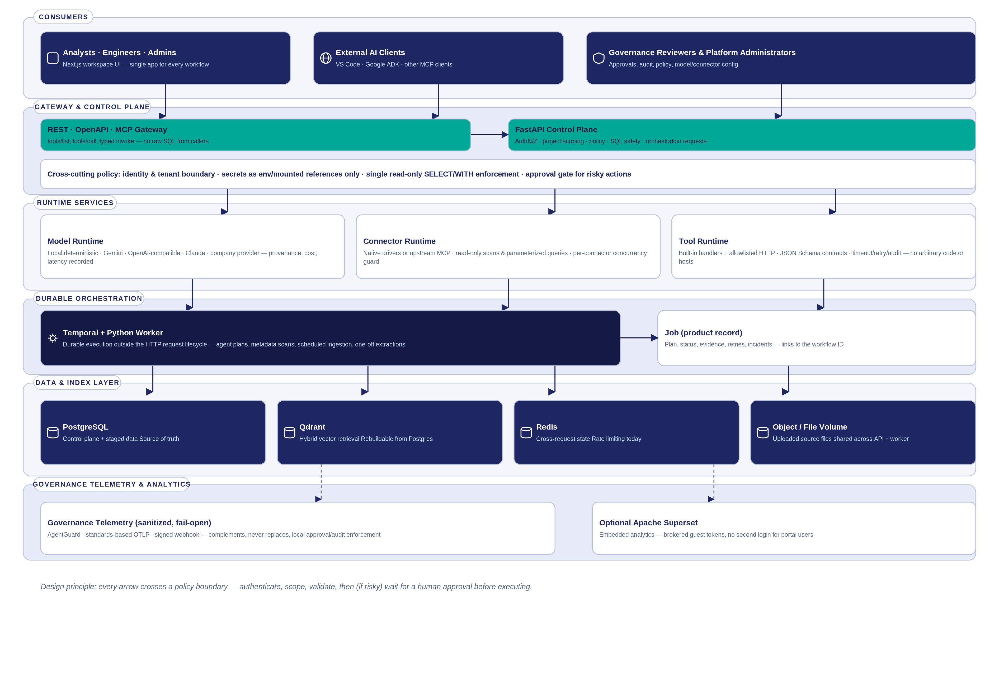
SYSTEM ARCHITECTURE
Layered Solution Architecture
Every arrow crosses a policy boundary — authenticate, scope, validate, then (if risky) wait for a human approval before executing.
06

Slide 10
SYSTEM ARCHITECTURE
Every Component Has an Explicit Boundary
Next.js web app
Single workspace UI for every workflow
Never receives connector/provider secrets
FastAPI control plane
AuthN/Z, project scope, policy, SQL safety, orchestration
PostgreSQL is authoritative; the API enforces policy, not the UI
PostgreSQL
Users, catalog, staged data, jobs, approvals, audit
Source of truth — Qdrant is fully rebuildable from it
Temporal + worker
Durable execution outside the HTTP request lifecycle
Job stays the product-facing record; workflow ID just links to it
Connector / Tool runtime
Read-only scans, parameterized queries, typed tool calls
No arbitrary SQL, no arbitrary outbound hosts, no raw code exec
07

Slide 11
TECHNOLOGY DECISION RECORD
Chosen Deliberately, Documented Honestly
Decision
Choice
Why
Alternative considered
Lineage & join storage
PostgreSQL edge-list + recursive CTEs
Today's queries are 0–1 hop; a second store would duplicate the source of truth
Neo4j / graph DB — revisit if interactive multi-hop traversal becomes real
Durable execution engine
Temporal
Retries, history, visibility built in — the right fit for bounded agent plans & scheduled ingestion
Kafka + custom consumers — a log isn't a workflow engine
Cross-request state
Redis
Already provisioned; now backs rate limiting; a good fit for caching/session revocation next
A new broker — not justified by any current fan-out need
Vector retrieval
Qdrant, derived from PostgreSQL
Vector search has no relational equivalent; fully rebuildable, holds no credentials
Embed vectors in PostgreSQL — revisit only at very large scale
Source connection ceiling
Per-connector BoundedSemaphore
Occasional governed reads, not OLTP — a pool would be the wrong shape
A full connection pooler — pair with it if a source becomes constrained
08

Slide 12
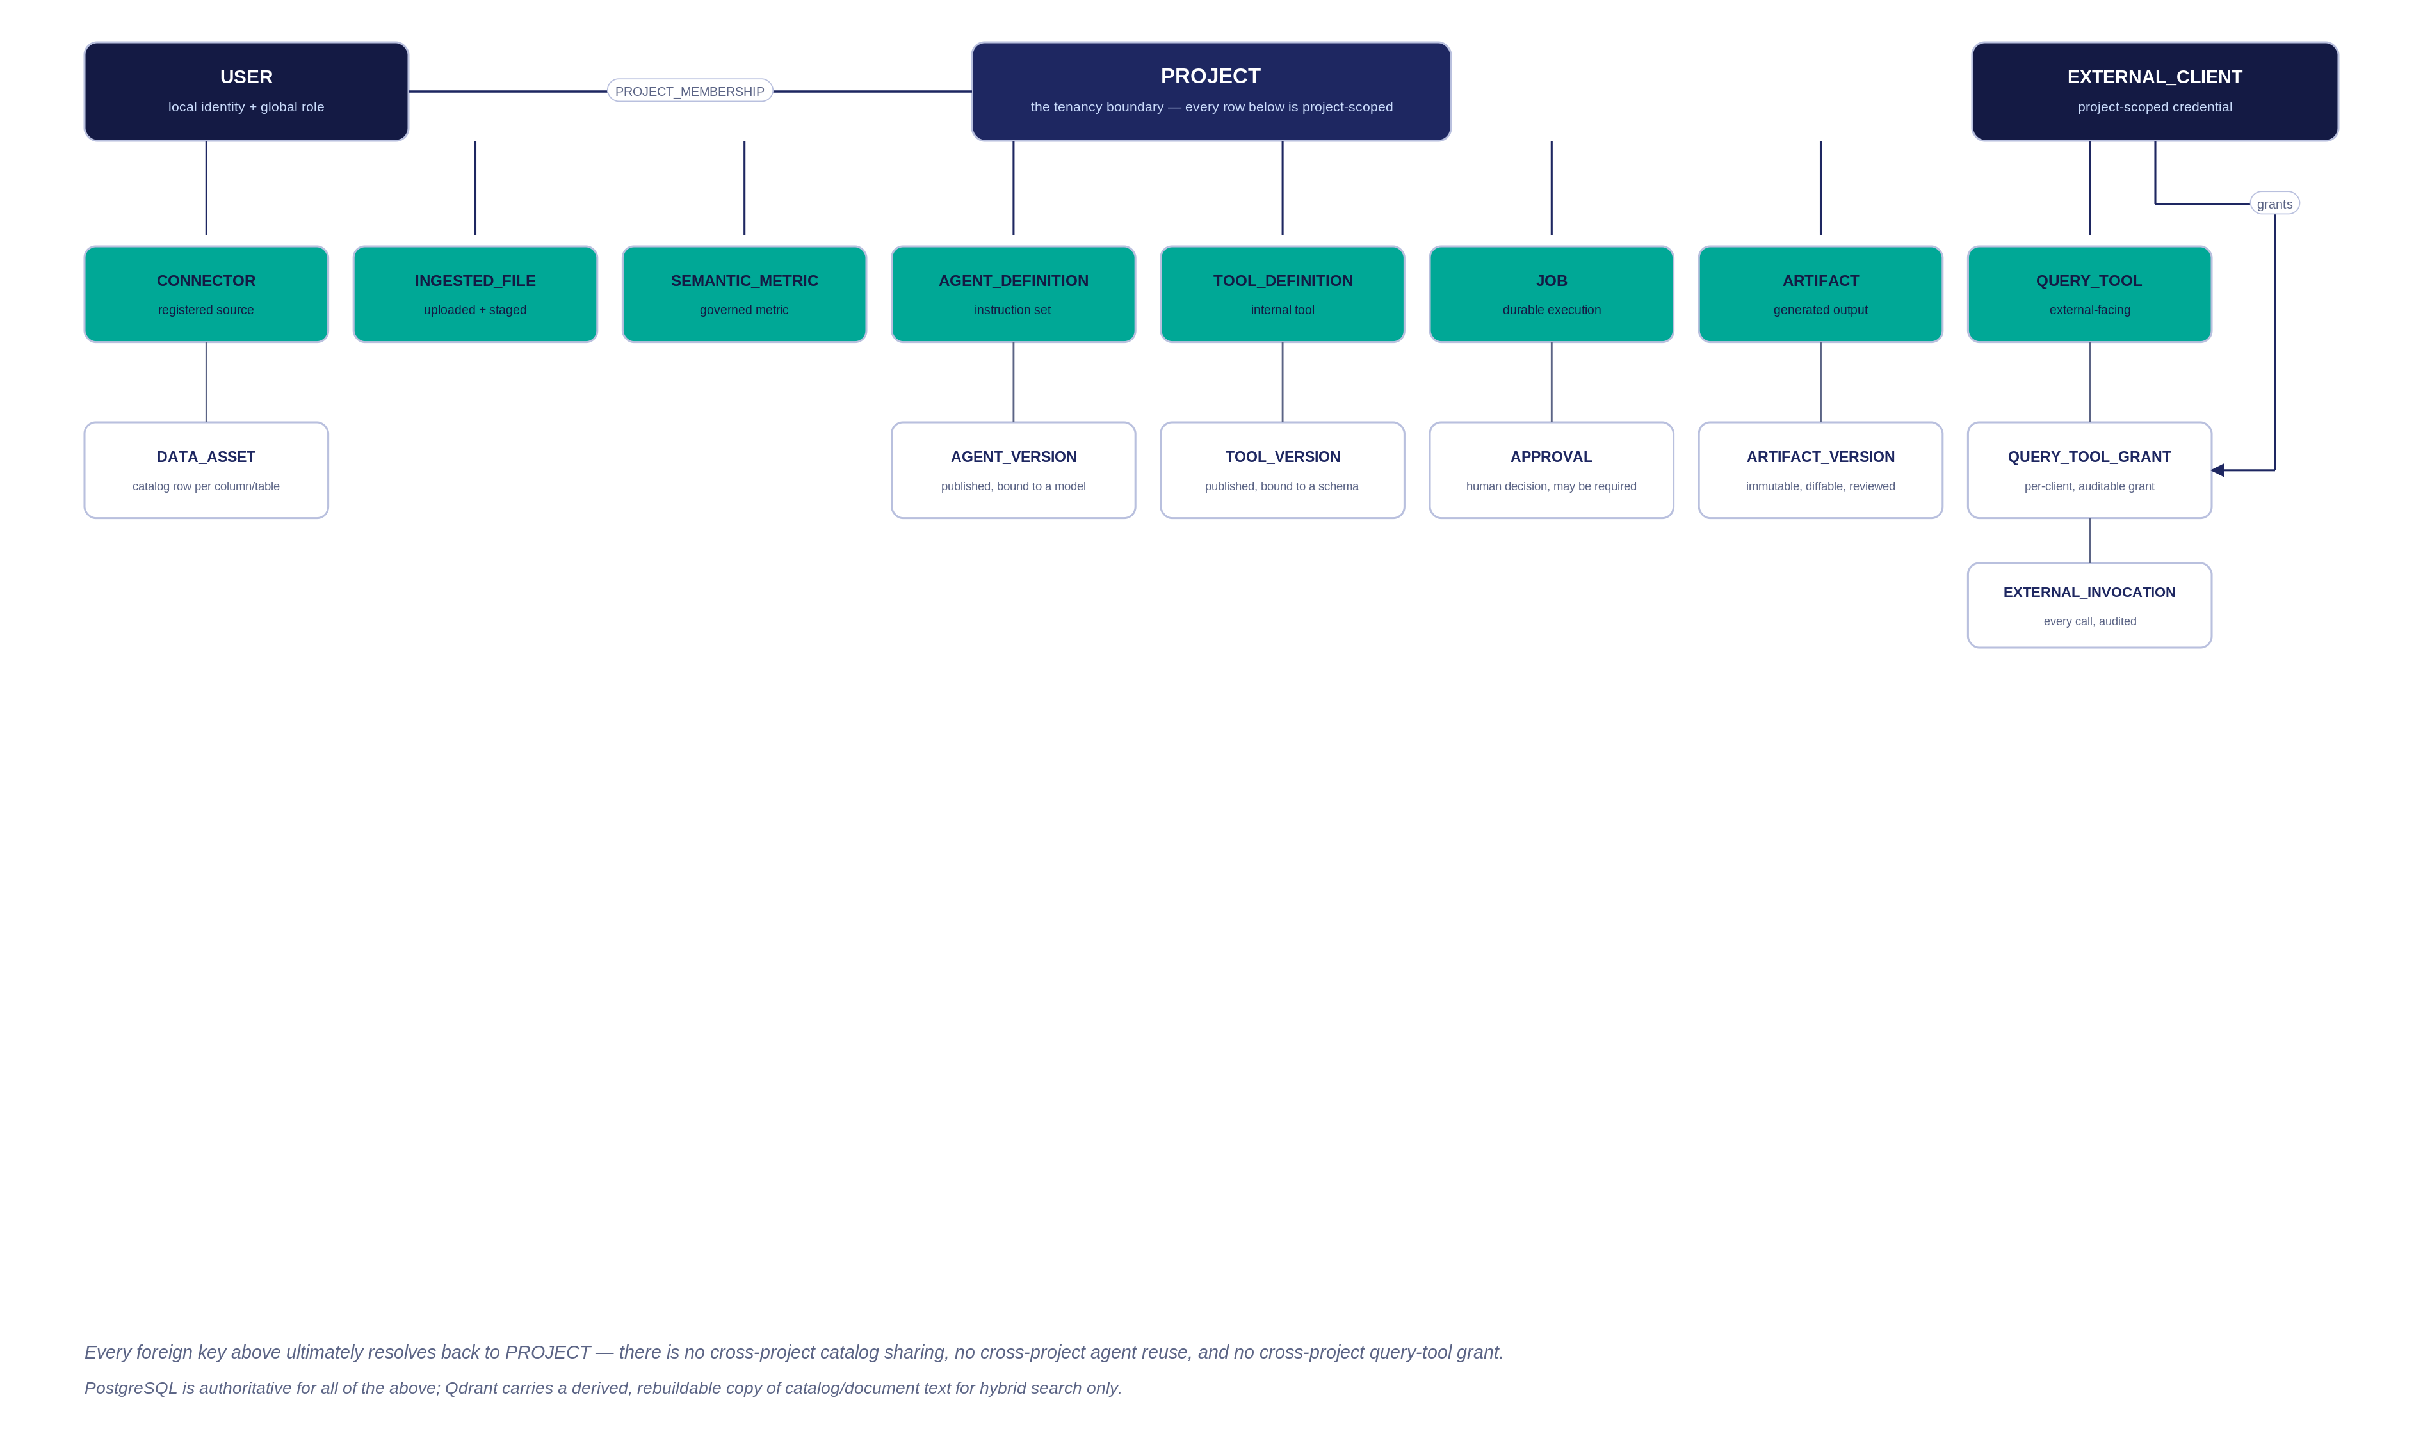
SYSTEM ARCHITECTURE
Domain Model — Everything Is Project-Scoped
Every foreign key resolves back to PROJECT — no cross-project catalog sharing, agent reuse, or query-tool grant.
09

Slide 13
03
SPEAKER 3 · 5 MIN
Core Workflows
The two everyday journeys, traced end to end as sequence diagrams

Slide 14
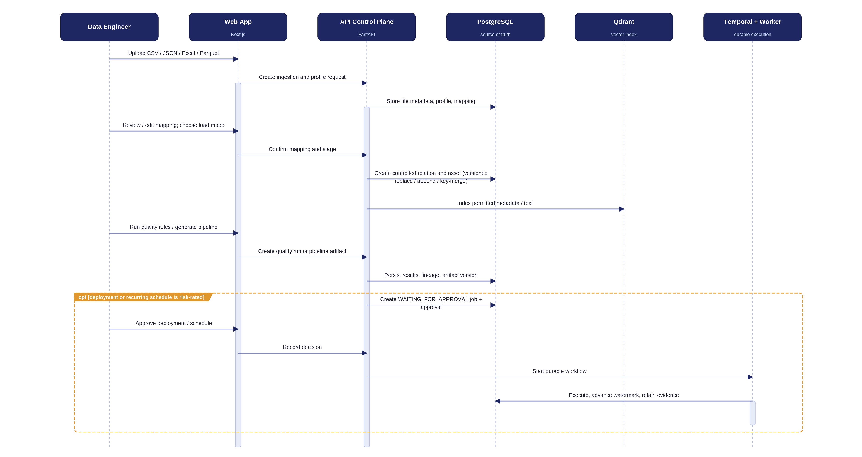
SEQUENCE · DATA ENGINEER
Ingest → Quality → Governed Deployment
The opt block is the load-bearing detail: risky deployments and recurring schedules stop and wait for a recorded human decision.
10

Slide 15
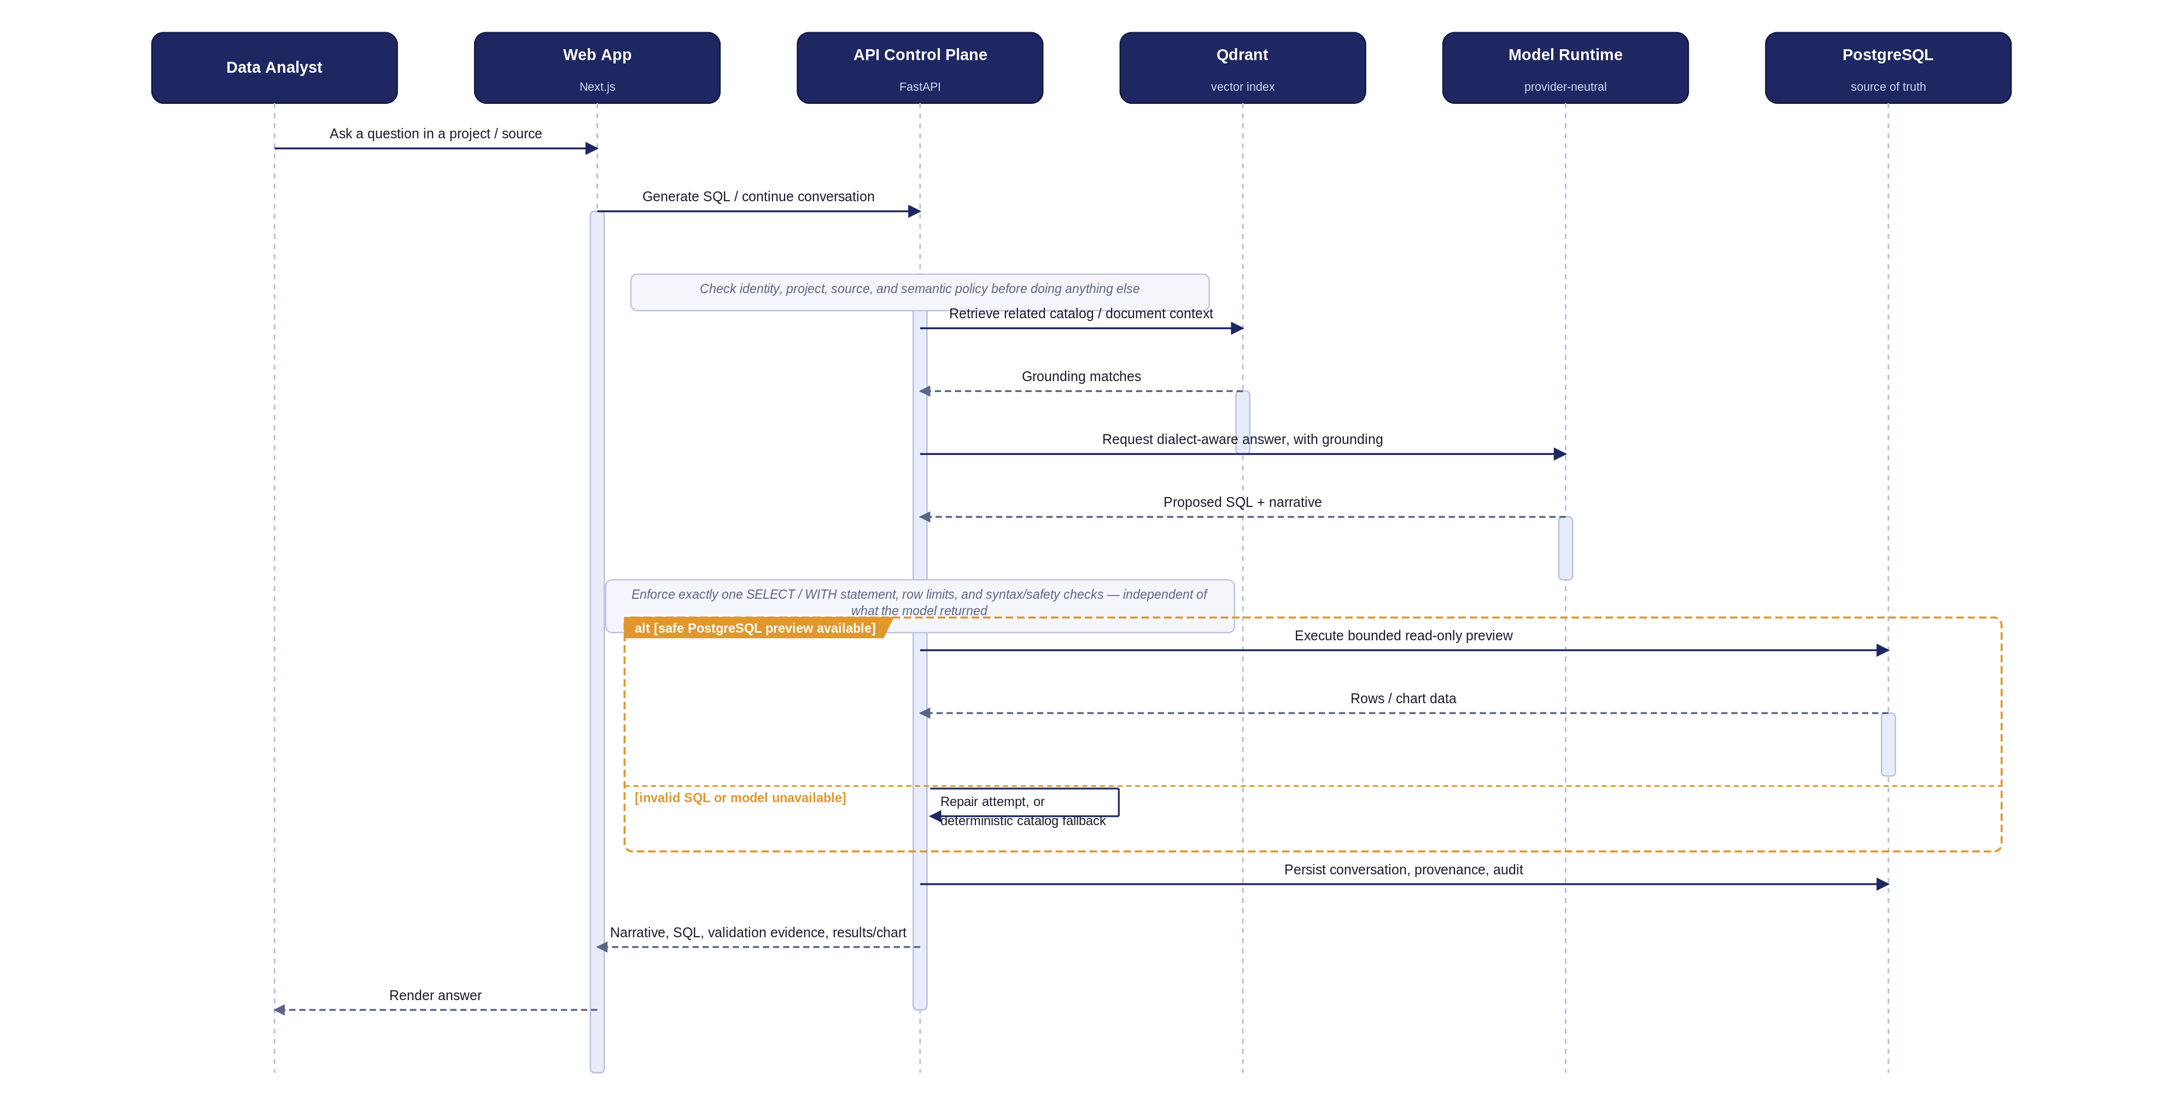
SEQUENCE · DATA ANALYST
A Grounded Analytical Question
The alt block is the safety net: an invalid or unavailable model still resolves to a repair pass or a deterministic catalog fallback — never a hang.
11

Slide 16
04
SPEAKER 4 · 5 MIN
Agents & Governance
Bounded orchestration, specialist agent roles, and the enforcement architecture behind them

Slide 17
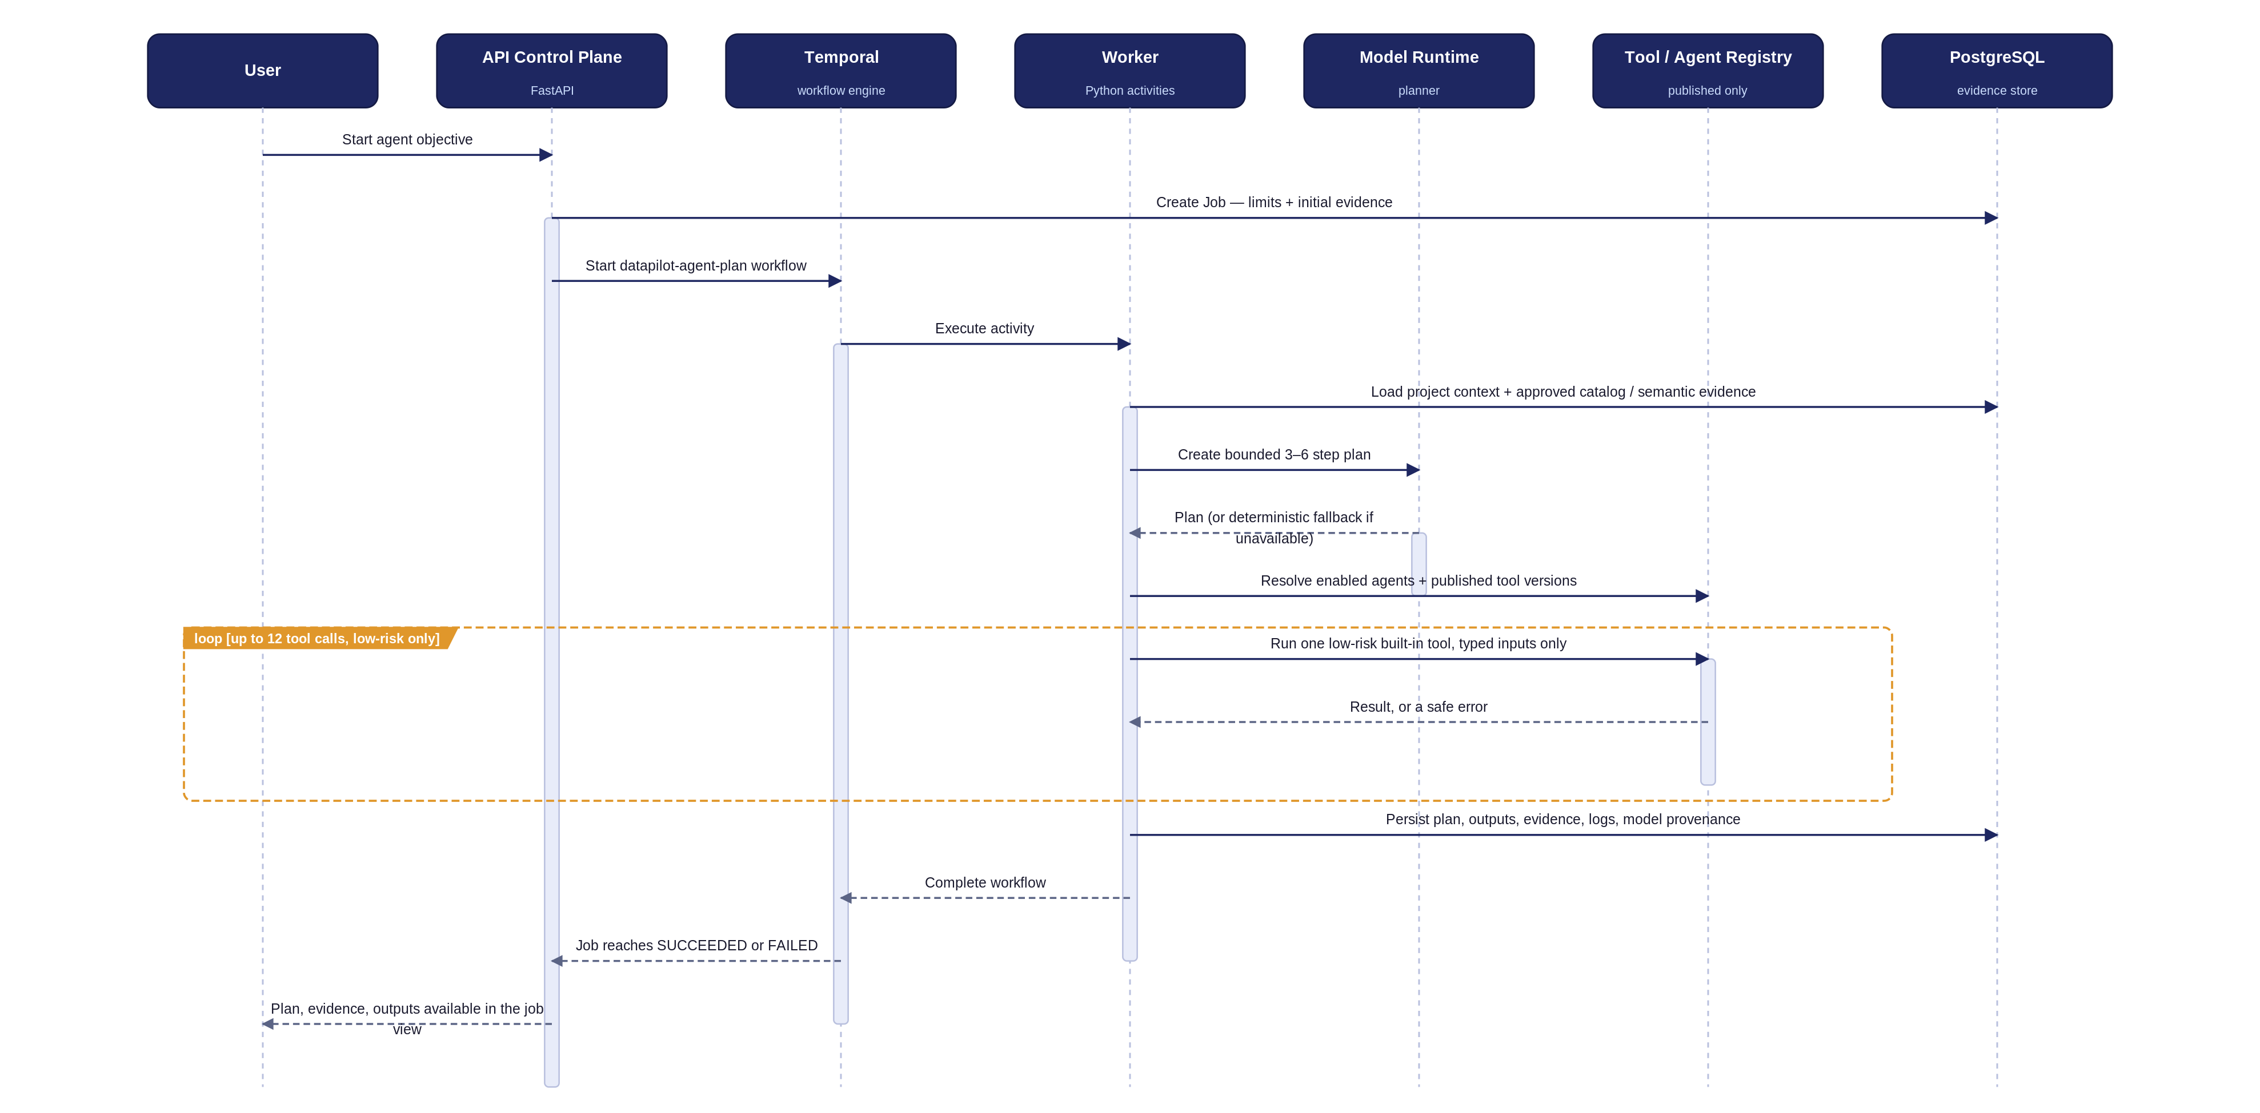
SEQUENCE · AI AGENT
Bounded Multi-Agent Orchestration
The loop is hard-capped at 12 calls, low-risk built-ins only — every plan, output, and model call is persisted as evidence.
12

Slide 18
SPECIALIST AGENTS
Seven Roles, Each With a Declared Authority
Role
Purpose
Execution authority
Planner
Decompose an objective into 3–6 bounded steps
Draft only
Metadata
Retrieve catalog assets, documents, metrics, approved joins
Read-only retrieval
SQL Analyst
Draft, explain, validate, revise dialect-aware read-only SQL
Bounded preview only when permitted
Pipeline
Produce a local pipeline/view package and lineage draft
Deployment requires approval
Quality
Profile data, propose or run governed checks
Remediation requires approval when configured
Troubleshooter
Interpret job evidence, propose safe retry/remediation
Does not perform arbitrary remediation
Policy
Check project scope, risk, and approval requirements
Enforces limits; not a model-only opinion
13

Slide 19
ENFORCEMENT ARCHITECTURE
One Path, Five Checks, Before Anything Executes
1
2
3
4
5
6
Authenticate identity / client
Check project scope & role/grant
Validate contract: schema, SQL, relation, limits
Risk decision — approval if required
Controlled execution
Persist job / artifact / audit evidence
→
→
→
→
→
Governance telemetry (AgentGuard / OTLP / signed webhook) observes this path in sanitized form — it complements local enforcement and is never the system of record for the approval itself.
14

Slide 20
05
SPEAKER 5 · 5 MIN
Integration Architecture
How other systems, other AI agents, and other models plug in safely

Slide 21
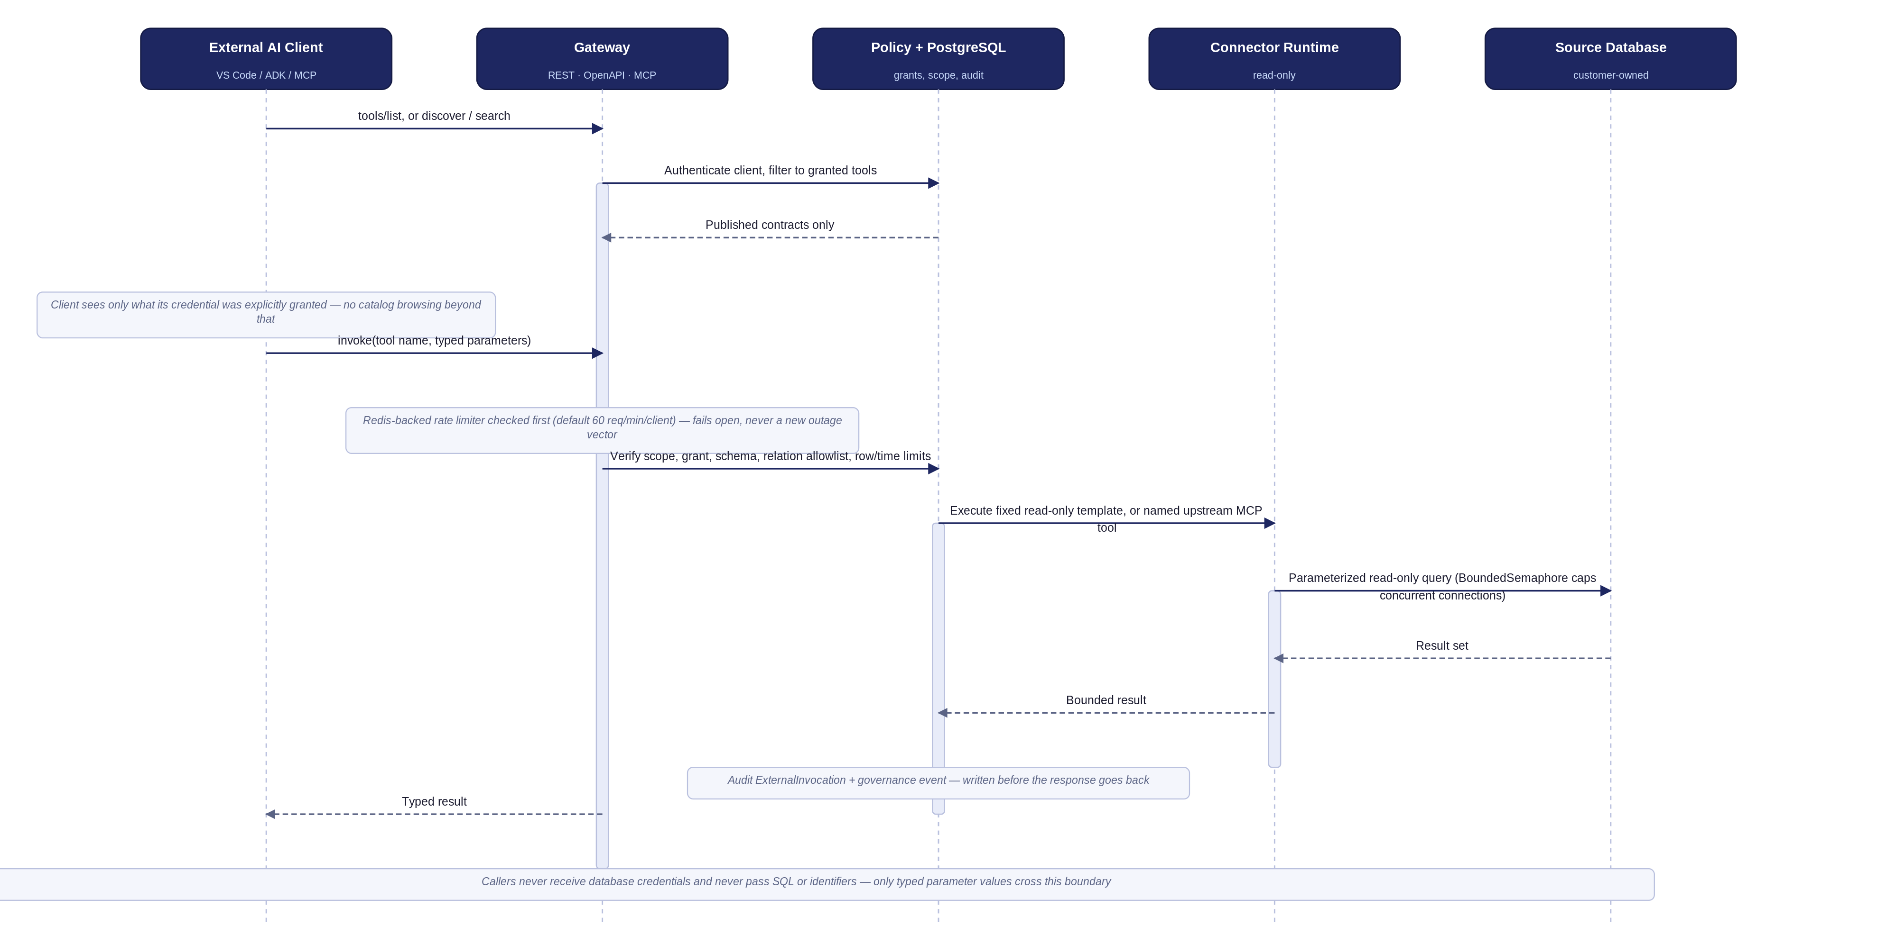
SEQUENCE · EXTERNAL AI DEVELOPER
Query-Tool Gateway Invocation
Callers never receive database credentials and never pass SQL or identifiers — only typed parameter values cross the boundary.
15

Slide 22
TWO REGISTRIES, TWO PURPOSES
Internal Tools vs. the External Gateway
INTERNAL TOOL REGISTRY
EXTERNAL QUERY-TOOL GATEWAY
• Used by agents inside a bounded plan
• Used by external AI clients over REST / OpenAPI / MCP
• Built-in handlers + allowlisted HTTP only
• Fixed, admin-authored SQL template — typed value params only
• Declared JSON Schema, timeout, retry policy
• Per-client grants, publication lifecycle, full audit history
• Host must be in TOOL_HTTP_ALLOWLIST
• Native driver or named upstream MCP tool underneath
16

Slide 23
RESILIENCE PATTERNS
Engineered Not to Become the Next Outage
Rate limiting — fails open
Per-connector concurrency guard
Durable one-off extraction
Redis-backed fixed window, 60 req/min/client default. If Redis is unreachable, the gateway stays available rather than becoming a new outage vector.
A BoundedSemaphore caps simultaneous physical connections per connector (default 8) — callers wait briefly, then get a clear 503, instead of the source silently absorbing unbounded connections.
The on-demand “extract now” path now runs through Temporal like every other ingestion path — a crash mid-extraction retries instead of silently losing the run.
17

Slide 24
MODELS & ANALYTICS
Provider Choice, Embedded BI
MODEL PROVIDERS
EMBEDDED ANALYTICS
•
Local deterministic (works offline)
•
Apache Superset embeds directly inside DataPilot
•
Gemini 3.6 / 3.5 Flash — default for SQL & planning
•
Short-lived, dashboard-scoped guest tokens; no second login
•
OpenAI-compatible
•
Admin “Open editor” performs a short-lived handoff
•
Claude
•
Bootstrap creates datasets, charts, dashboard, embed domains
•
Company / internal provider
Every call records provenance, cost, and latency. Secrets are env/mounted references only — never stored in the database.
18

Slide 25
06
SPEAKER 6 · 5 MIN
Enterprise-Grade Design
Deployment topology, security posture, and how the platform scales and stays reliable

Slide 26
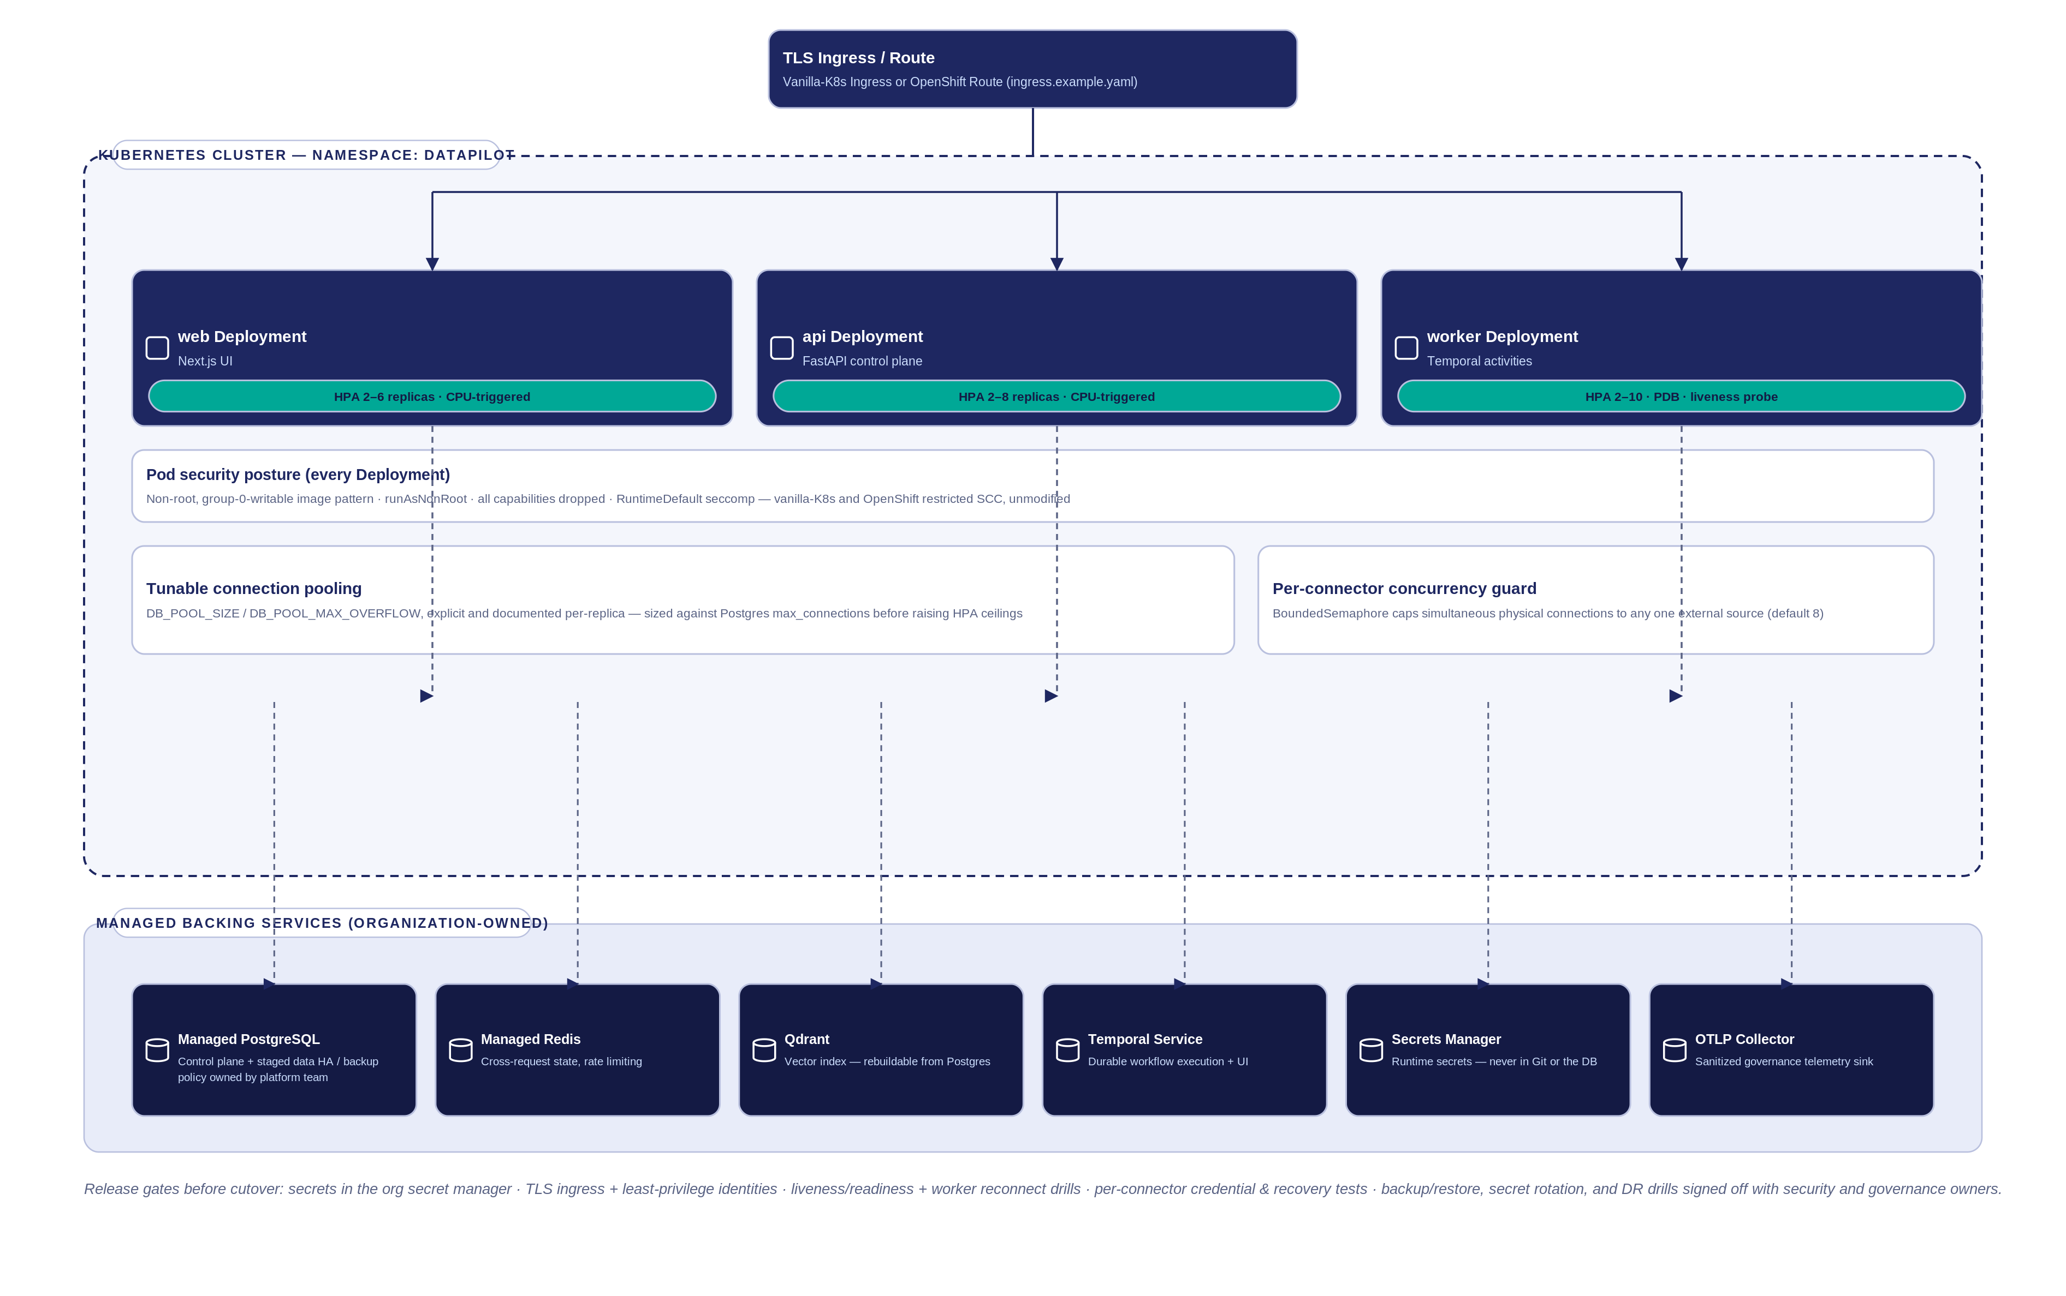
DEPLOYMENT ARCHITECTURE
Kubernetes Topology
Non-root, least-privilege pods on both vanilla Kubernetes and OpenShift's restricted SCC, unmodified.
19

Slide 27
SECURITY & GOVERNANCE CONTROLS
Built In, Not Bolted On
Identity & tenant boundary
Local auth, roles, project membership, project-scoped queries, distinct external client grants
Secrets
env:/mounted references only — never stored in the UI or source control
SQL safety
One SELECT/WITH statement only; DDL, DML, multi-statement, malformed content all rejected
Tool safety
JSON Schema validation, built-in or allowlisted HTTP only, timeout/retry, audit evidence
Approval boundary
Writes, DDL, deployment, schedules, retention cleanup, high-risk tools all route through approval
Evidence
Model provenance, job logs, versions, reviews, lineage, invocations, decisions — all durable
Notebook safety
Markdown / read-only SQL / restricted Python only — no imports, no file or network access
20

Slide 28
SCALABILITY & RELIABILITY
Engineered to Scale Horizontally
2–8 / 2–6 / 2–10
Independent
Tunable
API / web / worker replicas
Worker scaling
Connection pool sizing
Independent HorizontalPodAutoscalers, CPU-triggered — stateless pods, standard container-native scaling
The Temporal worker pool scales separately from the API, so ingestion/agent bursts never starve interactive traffic
DB_POOL_SIZE / DB_POOL_MAX_OVERFLOW explicit and documented — sized deliberately against Postgres max_connections
Bounded
Durable
Non-root everywhere
Per-connector concurrency
Every ingestion path
Pod security posture
A semaphore ceiling protects every external source from an unbounded burst of simultaneous connections
Scans, schedules, and one-off extractions all execute through Temporal — retry-on-crash, full history, no silent loss
runAsNonRoot, all capabilities dropped, RuntimeDefault seccomp — vanilla-K8s and OpenShift SCC, unmodified
21

Slide 29
CLOSING THE CASE
Why This Design Holds Up
Governed by design
Every AI action is a typed, approved, audited tool call — not a raw model with credentials
Durable by design
Temporal, not the request thread, owns every long-running plan, scan, and schedule
Scoped by design
Every row resolves back to PROJECT — no cross-tenant catalog, agent, or grant leakage
Human-in-the-loop by design
Agents learn from evaluation, not from themselves — a human click is always the last step
Derived, not duplicated, state
Qdrant is rebuildable from PostgreSQL; no second source of truth to keep consistent
22

Slide 30
LIVE DEMO · 5 MIN
The Sequence Diagrams, Live
Upload → catalog & search → ask a question (SQL preview) → agent run → approval → quality / pipeline
Full click-by-click steps: “Demo Storyboard.docx”

Slide 31
TECHNICAL Q&A · 10 MIN
Ask Us Anything
Business case, positioning, personas
Speaker 1
Architecture, tech decisions, data model
Speaker 2
Workflows, sequence flows
Speaker 3
Agents, governance, enforcement
Speaker 4
Integrations, gateway, resilience
Speaker 5
Deployment, security, scale, reliability
Speaker 6
Full anticipated Q&A with prepared answers: “Anticipated Q&A.docx”

Slide 32
THANK YOU
DataPilot Agent OS
Governed AI for real data engineering work

