Slide 1



Company Performance Report
View in Power BI
Last data refresh:
2/15/2022 6:07:33 PM UTC
Downloaded at:
3/11/2022 5:46:43 AM UTC

Slide 2
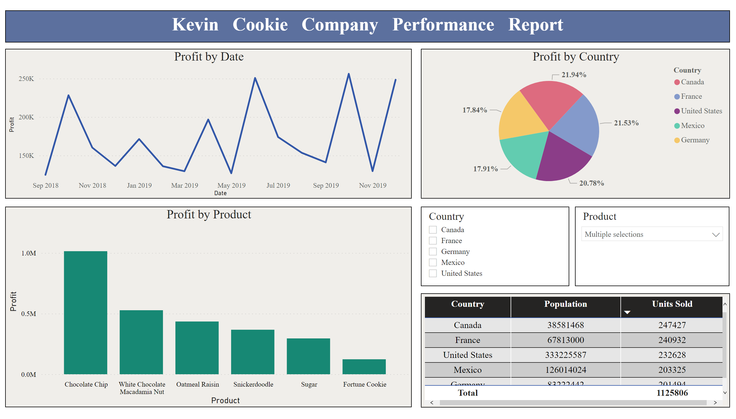
Performance Dashboard
Notes:
textbox
No alt text provided
lineChart
No alt text provided
tableEx
No alt text provided
clusteredColumnChart
No alt text provided
slicer
No alt text provided
slicer
No alt text provided
pieChart
No alt text provided

