Slide 1



Covid Analysis
View in Power BI
Last data refresh:
2/17/2022 3:21:27 PM UTC
Downloaded at:
2/17/2022 3:26:32 PM UTC

Slide 2
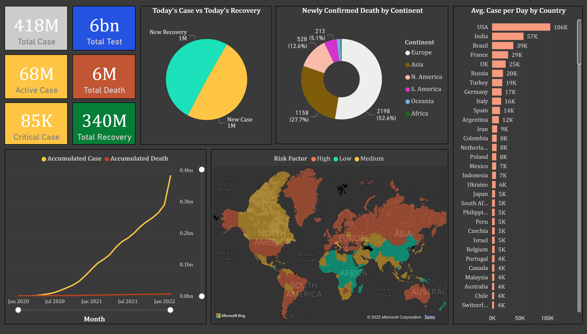
Covid Dashboard
Notes:
card
No alt text provided
filledMap
No alt text provided
card
No alt text provided
card
No alt text provided
Today's Case vs Today's Recovery
No alt text provided
card
No alt text provided
card
No alt text provided
card
No alt text provided
Newly Confirmed Death by Continent
No alt text provided
lineChart
No alt text provided
Avg. Case per Day by Country
No alt text provided

