Slide 1

On Cooperation in Multi-Agent Reinforcement Learning
Karush Suri
University of Toronto
Department of Electrical and Computer Engineering
ECE1657 Game Theory and Evolutionary Games
Fall 2020

Slide 2
Overview
The Multi-Agent Paradigm
Stochastic Markov Games
Q-Learning
Multi-Agent Reinforcement Learning
Independent Q-Learning (IQL)
Value Decomposition Network (VDN)
QMIX
Surprise Minimization
Results
Discussion
Future Work

Slide 3




The Multi-Agent Paradigm
More than one agent interacts with the environment to optimize strategies
Agents may perform as a team or in selfish interests

Slide 4
The Multi-Agent Paradigm
Cooperation gives rise to centralized updates with decentralized control
Improved scalability to complex tasks which may not be not achievable for a single agent

Slide 5
The Multi-Agent Paradigm
But how can multiple agents learn to collaborate at the same time?

Slide 6






Stochastic Markov Games
Setup of Stochastic Markov Games-
- State space
- State transition probability distribution
- Action space of agent-n
- Reward function of agent-n
- Reward function of agent-n
- Discount factor
- Set of all players in the game

Slide 7
Stochastic Markov Games
Also known as General Markov Games (GMGs).
- State space
- State transition probability distribution
- Action space of agent-n
- Reward function of agent-n
- Reward function of agent-n
- Discount factor
- Set of all players in the game

Slide 8



Stochastic Markov Games
Collaboration is focussed in Team Markov Games (TMGs).
- State space
- State transition probability distribution
- Action space of all agent
- Reward function of all agents
- Discount factor
- Set of all players in the game
Lucian Bus¸oniu, Robert Babuˇska, and Bart De Schutter. Multi-agent reinforcement learning: An overview.. 2010.

Slide 9


Stochastic Markov Games
Team Markov Games-
Combined strategy space for all agents.
All agents observe the same reward.

Slide 10

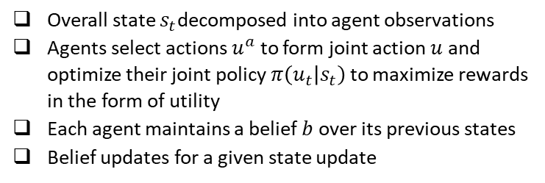
Stochastic Markov Games
Partial Observability in Team Markov Games-
Overall state $s_{t}$decomposed into agent observations
Agents select actions $u^{a}$ to form joint action $u$ and optimize their joint policy $π\left(u_{t} | s_{t}\right)$to maximize rewards in the form of utility
Each agent maintains a belief $b$ over its previous states
Belief updates for a given state update

Slide 11
Stochastic Markov Games
But how do agents update their policies to maximize payoffs?

Slide 12

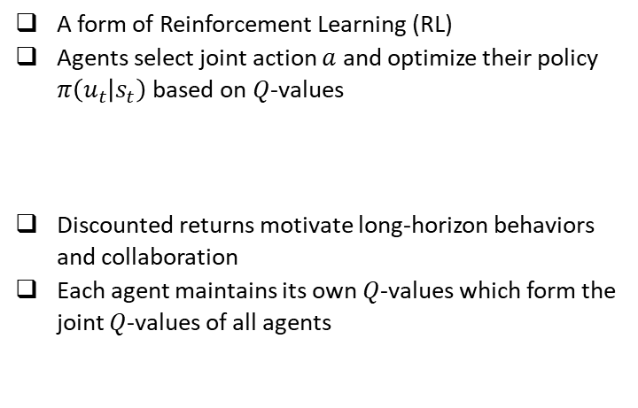
Q-Learning
A form of Reinforcement Learning (RL)
Agents select joint action $a$ and optimize their policy $π\left(u_{t} | s_{t}\right)$based on $Q$-values
Discounted returns motivate long-horizon behaviors and collaboration
Each agent maintains its own $Q$-values which form the joint $Q$-values of all agents
Richard S. Sutton and Andrew G. Barto. Reinforcement Learning: An Introduction. 2018.

Slide 13

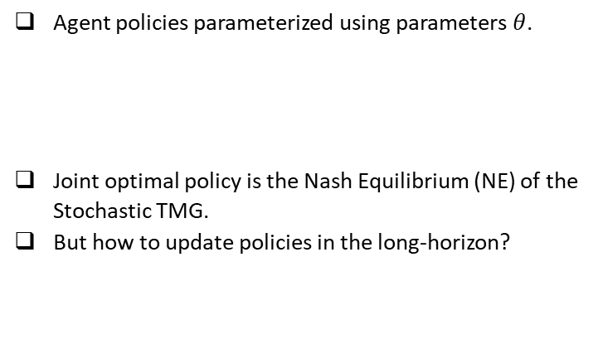
Q-Learning
Agent policies parameterized using parameters $θ$.
Joint optimal policy is the Nash Equilibrium (NE) of the Stochastic TMG.
But how to update policies in the long-horizon?
Richard S. Sutton and Andrew G. Barto. Reinforcement Learning: An Introduction. 2018.

Slide 14


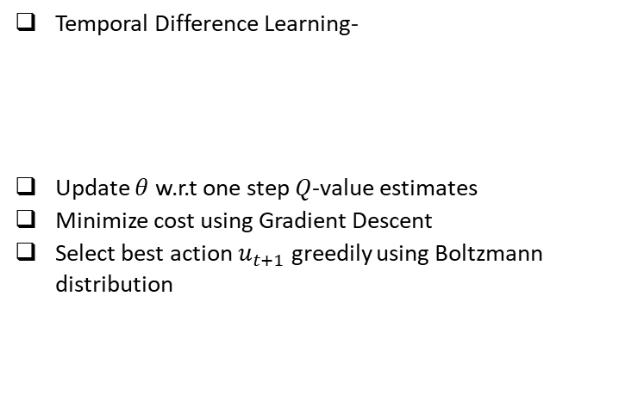
Q-Learning
Temporal Difference Learning-
Update $θ$ w.r.t one step $Q$-value estimates
Minimize cost using Gradient Descent
Select best action $u_{t+1}$ greedily using Boltzmann distribution
Richard S. Sutton and Andrew G. Barto. Reinforcement Learning: An Introduction. 2018.

Slide 15
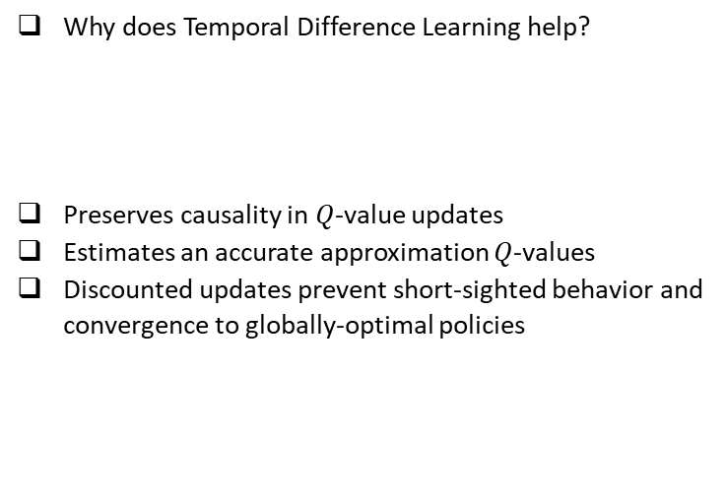
Q-Learning
Why does Temporal Difference Learning help?
Preserves causality in $Q$-value updates
Estimates an accurate approximation $Q$-values
Discounted updates prevent short-sighted behavior and convergence to globally-optimal policies
Richard S. Sutton and Andrew G. Barto. Reinforcement Learning: An Introduction. 2018.

Slide 16
Q-Learning
When does Temporal Difference Learning hurt?
Hinders credit assignment corresponding to each action
Overoptimistic estimates in the case of large action spaces
Absence of learning in the case of sparse rewards
Richard S. Sutton and Andrew G. Barto. Reinforcement Learning: An Introduction. 2018.

Slide 17
Q-Learning
How to make use of Temporal Difference Learning in Multi-Agent settings?

Slide 18
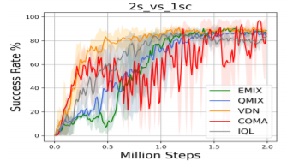
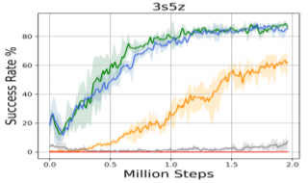
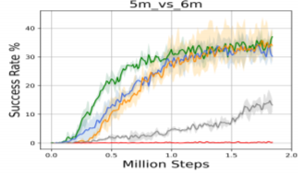
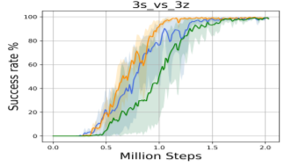
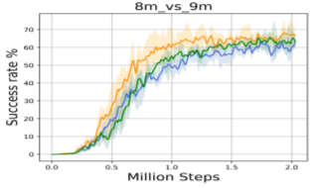
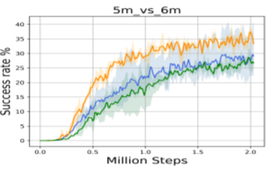
Performance
Stability with Temperature

Slide 19
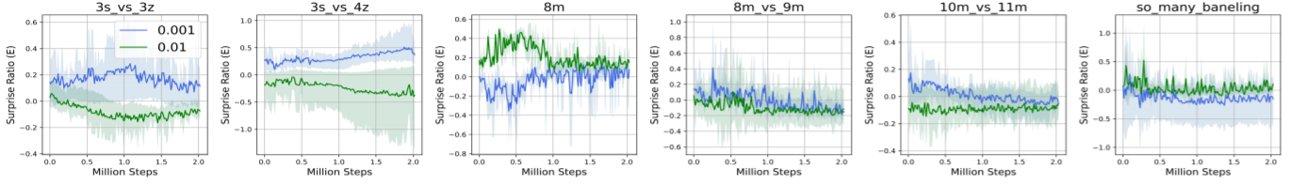
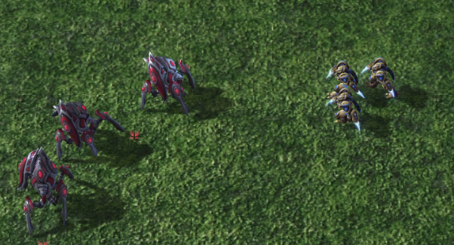
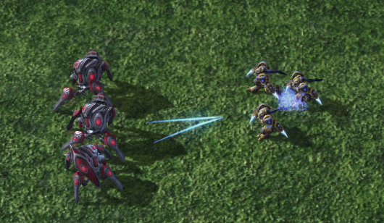
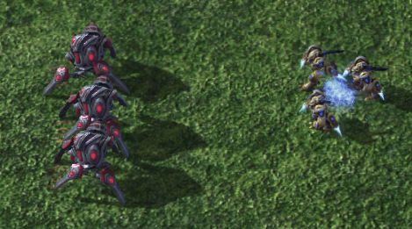
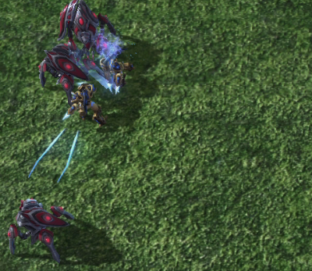
Surprise Minimization
Dependence of surprise-based behaviors on temperature parameter
Surprise-robust behavior during collaboration

Slide 20
Find Out More!
Blog Post, Code, Videos, Paper:
karush17.github.io/emix-web

