Slide 1
Netdog
Things done so far...

Slide 2
Release highlights
Automated deployer tool
Access control for web interface
Rewritten encryption system
Selecting target nodes from web interface
Large files can now be broadcasted

Slide 3
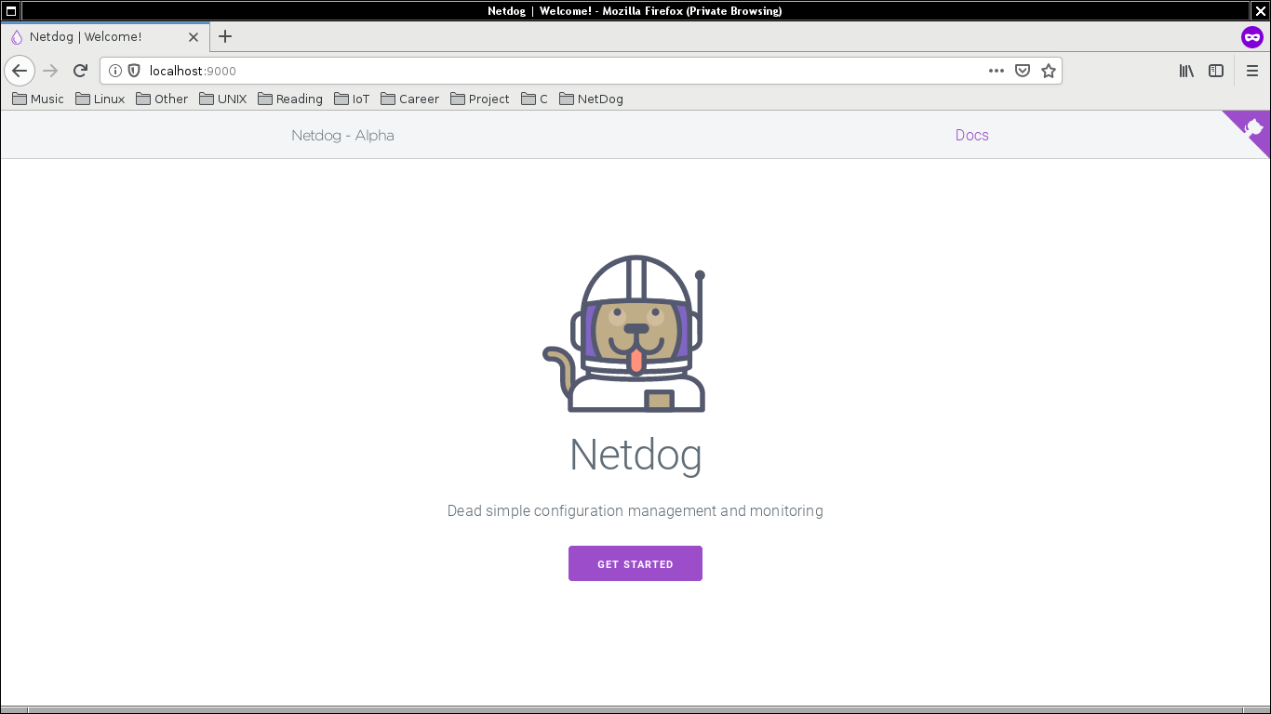
First time run page

Slide 4
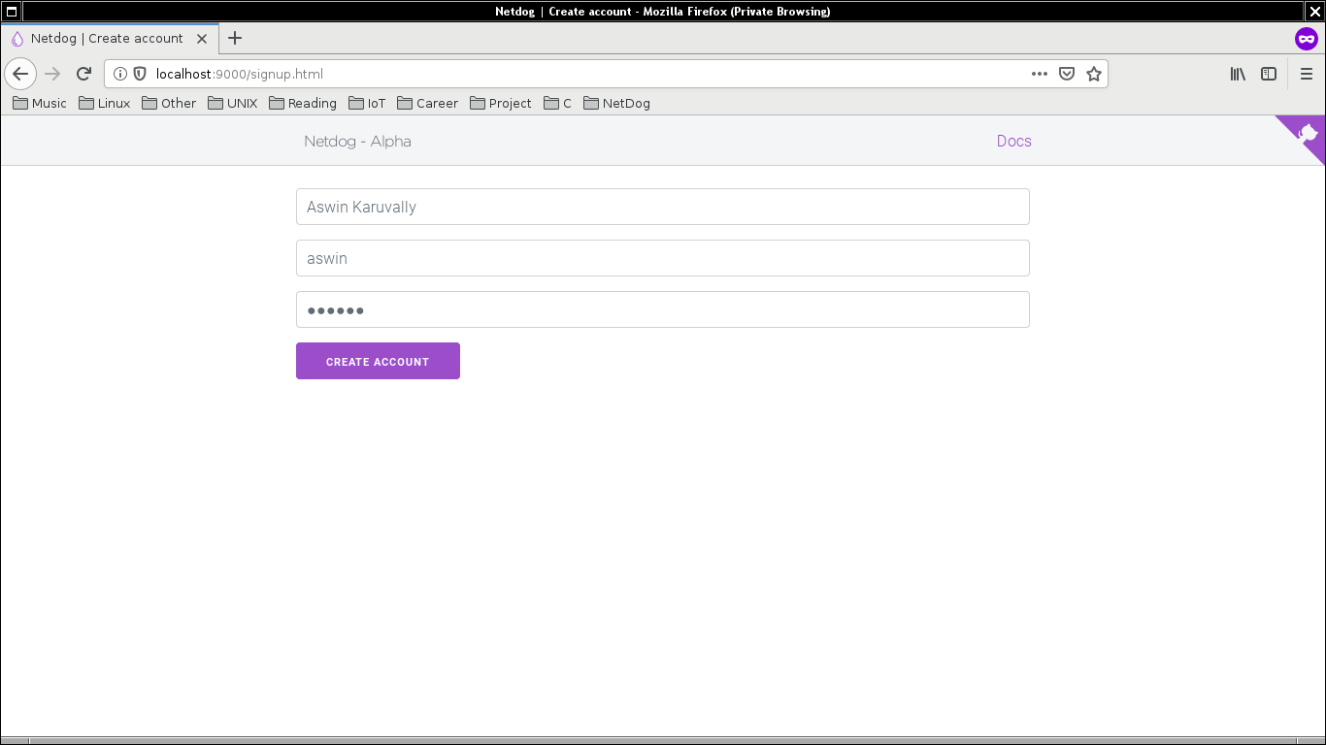
Account creation

Slide 5
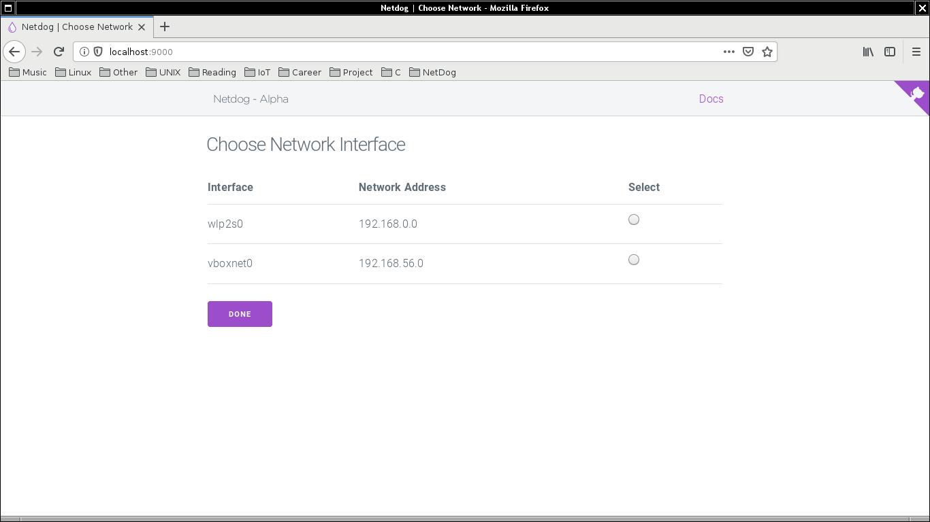
Choosing interface

Slide 6
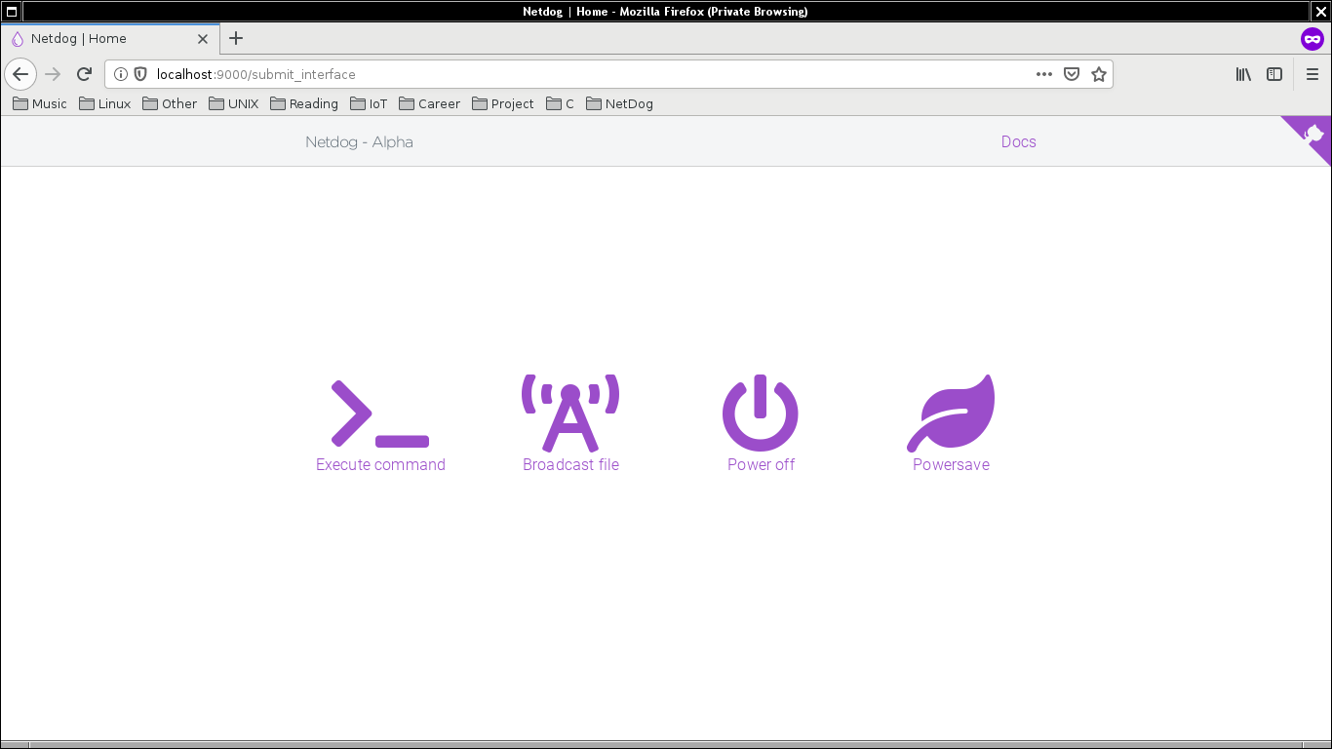
Homepage

Slide 7
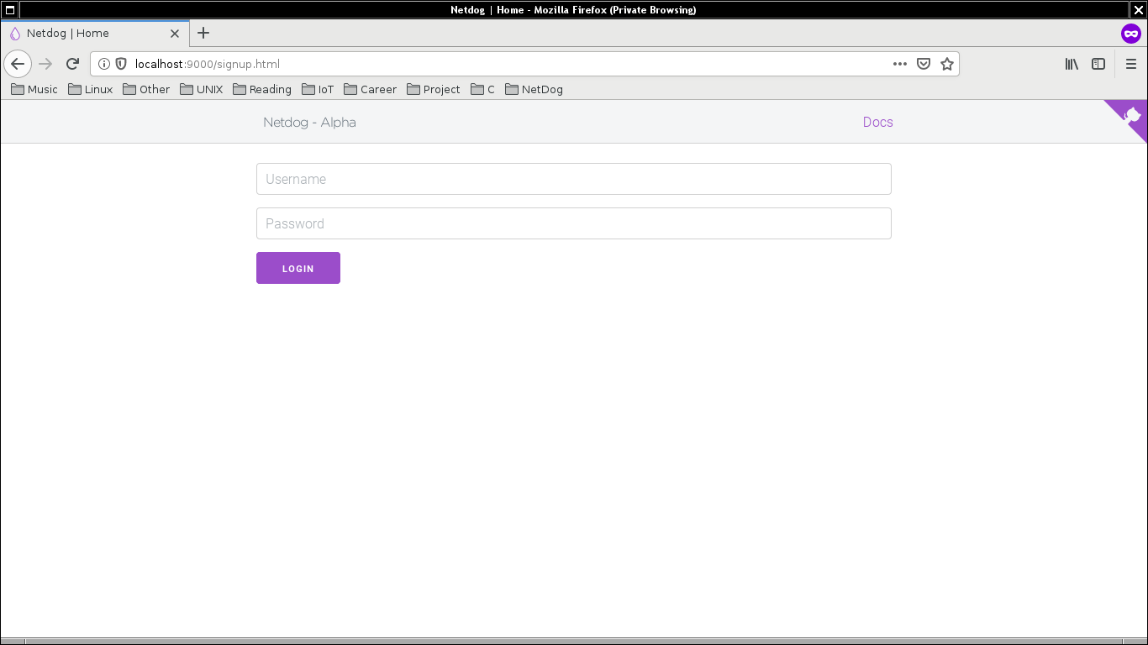
Login

Slide 8
github.com/karuvally/project_green

