Slide 1
Enhancing Performance and Reliability of
Network File System
Aswin Babu Karuvally

Slide 2
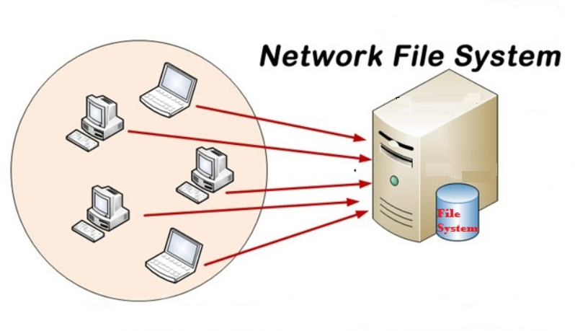

Slide 3


Slide 4
hard
nfsvers
rsize
timeo
no-root-squash
udp
wsize
async
Parameters
squashroot
vers
wsize
syn
retrans
subtree-check
intr
rw
rsize

Slide 5
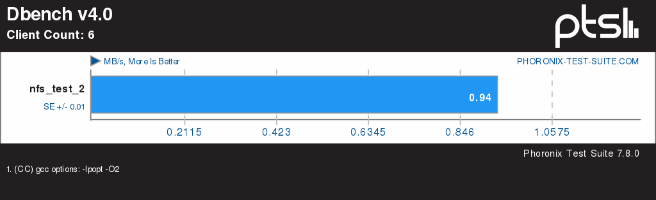
Performance – default config

Slide 6
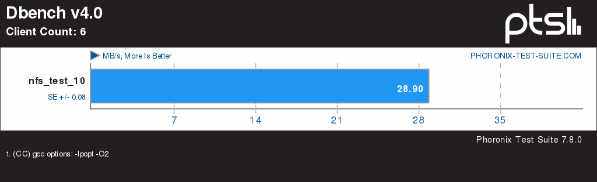
Performance – ASYNC on

Slide 7
What is ASYNC?

Slide 8
Why not just leave it ON?

Slide 9
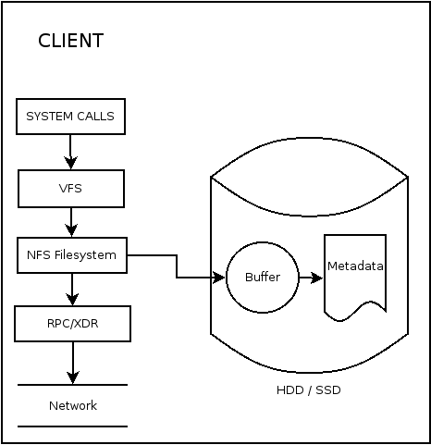

Slide 10
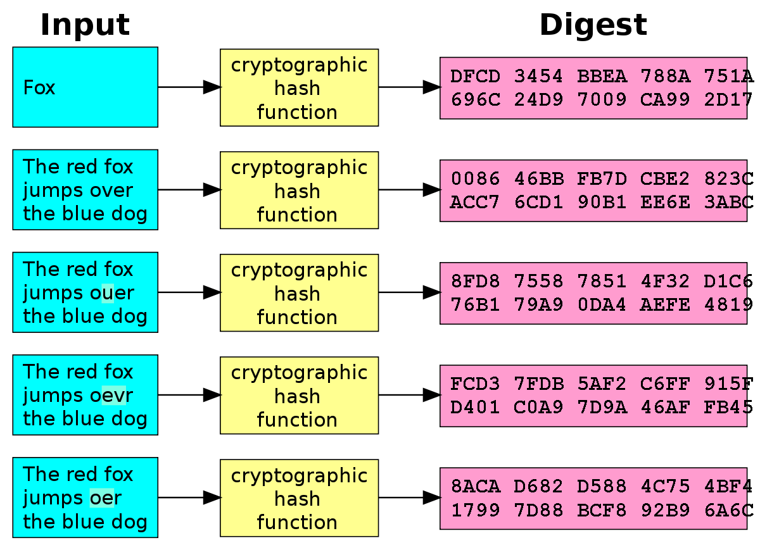

Slide 11
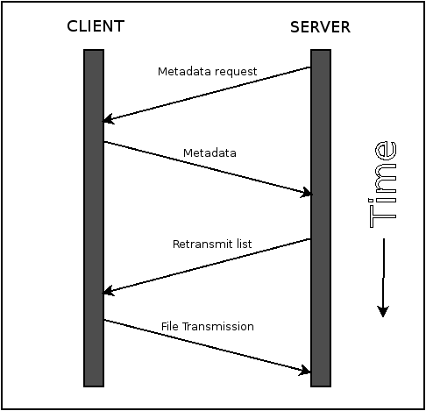
File recovery

Slide 12
Advantages of the proposed system

Slide 13
Client side ASYNC

Slide 14
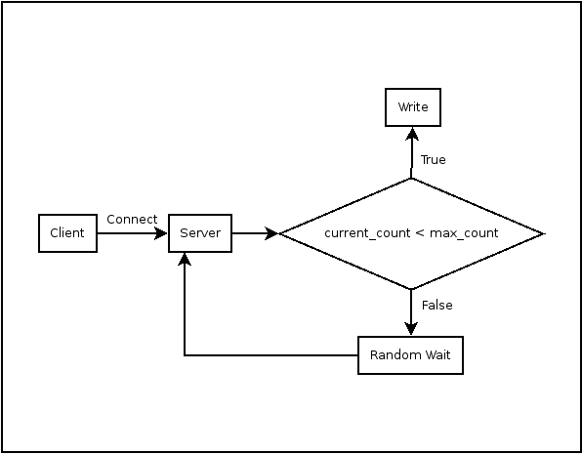

Slide 15
Advantages of the proposed system

Slide 16
Thank You

