Slide 1


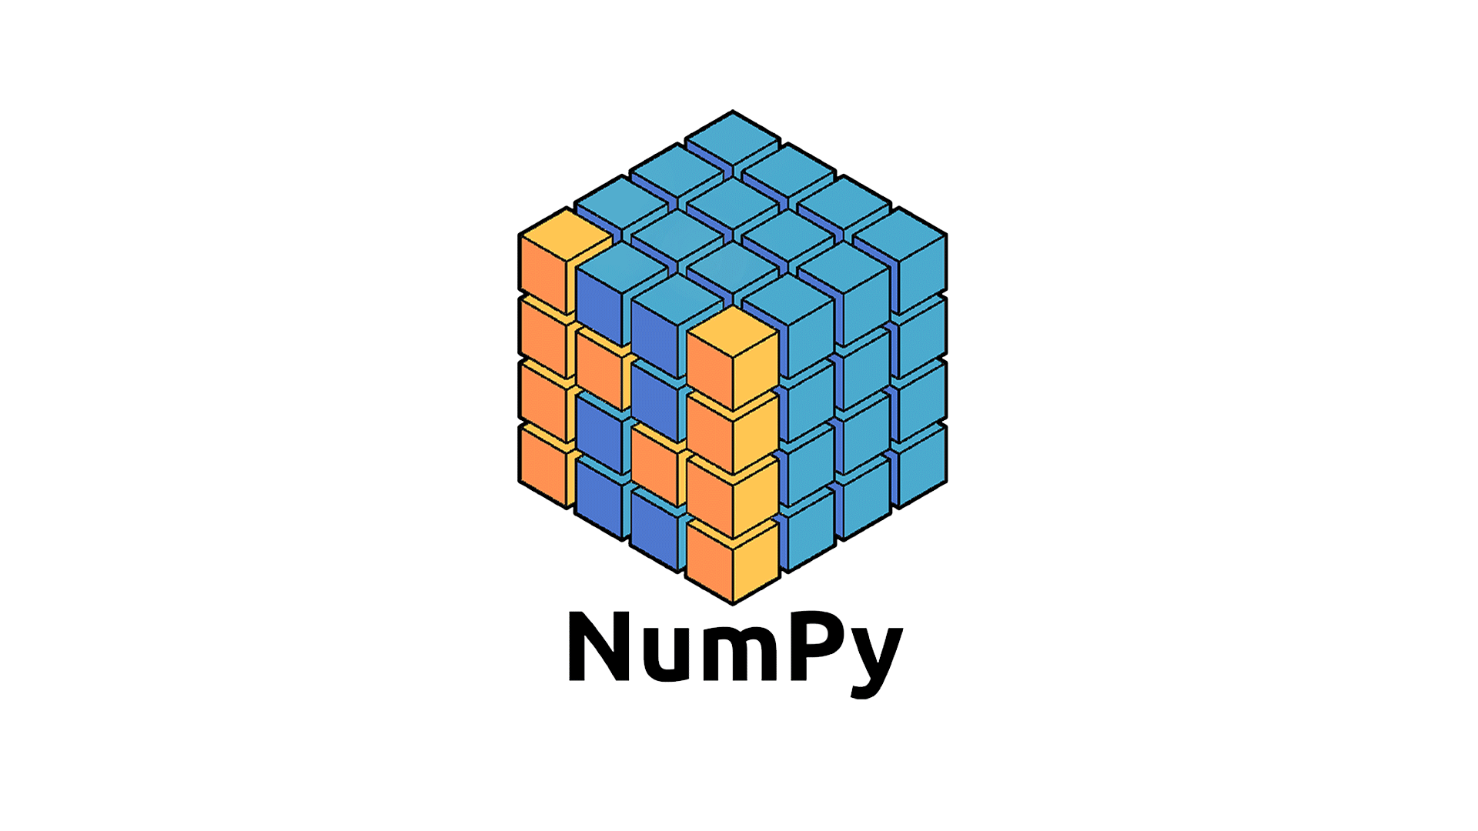
Numpy
Arvind Kharwal
http://www.kharwal.com

Slide 2

Infographic Style
Numpy

Slide 3
Numpy

Slide 4
Numpy is the core library for scientific computing in Python. It provides a high performance multi dimensional array object and tool for working with these arrays.

Slide 5
Numpy
Arvind Kharwal
www.Kharwal.com

Slide 6
Introduction

Slide 7
Numpy is a Python package, which stands for Numerical Python.
Numpy was created by Travis Oliphant.
The elements in a Numpy array are all required to be of the same data type, and thus will be the same size in memory.
NumPy is licensed under the BSD license, enabling reuse with few restrictions.

Slide 8
Advantages of Numpy

Slide 9
It is very fast and efficient as its engine is built using C code.
It supports multi-dimensional arrays using ndarray object.
It has built-in functions to perform various mathematical operations and computations for arrays.
All array based operations can be done very efficiently.

Slide 10
It supports array operations like reading and writing data from disk, files and data repos.
It supports C/C++ based APIs for extended Python for Numpy’s data structures and computations.
All the following mathematical operations are supported – random number generation, Fourier transforms, linear algebra and matrix operations.

Slide 11
How to Import Numpy?

Slide 12
Import numpy as np

Slide 13
while loop with else

Slide 14
Thank You

