Slide 1
numpy.arange() Function:
The numpy.arange() is an inbuilt numpy function that returns an array with evenly spaced elements as per the interval.

Slide 2
Syntax:
numpy.arange(start, stop, step, dtype)

Slide 3
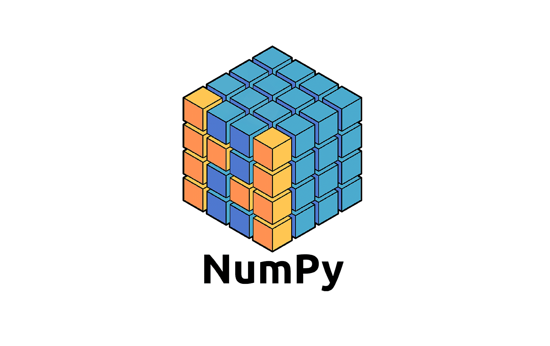
Numpy
Part 19
Arvind Kharwal
www.Kharwal.com

Slide 4
Arange Function

Slide 5
Data Types of np.arange():
When working with arange(), you can specify the type of elements with the parameter dtype.
It is an optional parameter. It depends on the types of start, stop, and step, as you can see in the following example:
>>> x = np.arange(5)
>>> x
array([0, 1, 2, 3, 4])

Slide 6
>>> x.dtype
dtype('int64')
Here, there is one argument (5) that defines the range of values. Its type is int. That’s why the dtype of the array x will be one of the integer types provided by NumPy.

Slide 7
But when you pass a decimal or float argument instead of integer, the dtype will be floating-point type.
>>> y = np.arange(5.0)
>>> y
array([0., 1., 2., 3., 4.])
>>> y.dtype
dtype('float64')

Slide 8
When we want floating point elements in an array then we need to provide at least one floating-point argument to arange(), even when other arguments are integers:
A = np.arange(1, 5.1)
array([1., 2., 3., 4., 5.])
A.dtype
dtype('float64')

Slide 9
B = np.arange(0, 9, 1.5)
array([0. , 1.5, 3. , 4.5, 6. , 7.5])
B.dtype
dtype('float64')

Slide 10
If you specify dtype, then arange() will create an array with the elements of the provided data type:
>>> y = np.arange(5, dtype=float)
>>> y
array([0., 1., 2., 3., 4.])
>>> y.dtype
dtype('float64')

Slide 11
Comparison of range and np.arange():
Python has a built-in class range, similar to NumPy arange() to some extent. range and np.arange() have important distinctions related to application and performance. You’ll see their differences and similarities.
The main difference between the two is that range is a built-in Python class, while arange() is a function that belongs to a third-party library (NumPy).

Slide 12
In addition, their purposes are different! Generally, range is more suitable when you need to iterate using the Python for loop. If you want to create a NumPy array, and apply fast loops under the hood, then arange() is a much better solution.

Slide 13
Parameters and Outputs:
Both range and arange() have the same parameters that define the ranges of the obtained numbers:
start
stop
Step
You apply these parameters similarly, even in the cases when start and stop are equal.

Slide 14
However, when working with range:
You have to provide integer arguments. Otherwise, you’ll get a TypeError. You can’t specify the type of the yielded numbers. It’s always int.
The range() and arange() also differ in their return types:

Slide 15
The range() creates an instance of this class that has the same features as other sequences (like list and tuple), such as membership, concatenation, repetition, slicing, comparison, length check, and more.
The arange() returns an instance of NumPy ndarray.

Slide 16
Creating Sequences:
You can apply range() to create an instance of list or tuple with evenly spaced numbers within a predefined range. You might find comprehensions particularly suitable for this purpose.
However, creating and manipulating NumPy arrays is often faster and more elegant than working with lists or tuples.

Slide 17
Let’s compare the performance of creating a list using the comprehension against an equivalent NumPy ndarray with arange():
>>> import timeit
>>> n = 1
>>> timeit.timeit(f'x = [i**2 for i in range({n})]')
>>> timeit.timeit(f'x = np.arange({n})**2', setup='import numpy as np')

Slide 18
Repeating this code for varying values of n yielded the following results on my machine:
Size: n Time Per Loop: range Time Per Loop: arange() Ratio
1 497 ns 1.14 µs 0.41
10 2.24 µs 1.28 µs 1.74
100 20.0 µs 1.37 µs 14.6
1,000 211 µs 2.92 µs 72.3

Slide 19
These results might vary, but clearly you can create a NumPy array much faster than a list, except for sequences of very small lengths. (The application often brings additional performance benefits!)
This is because NumPy performs many operations, including looping, on the C-level. In addition, NumPy is optimized for working with vectors and avoids some Python-related overhead.

Slide 20
Quick Summary
To use NumPy arange(), you need to import numpy first:
>>> import numpy as np
Here’s a table with a few examples that summarize how to use NumPy arange(). It could be helpful to memorize various uses:

Slide 21
Example Result
np.arange(start=1, stop=10, step=3) array([1, 4, 7])
np.arange(1, 10, 3) array([1, 4, 7])
np.arange(1, 10, 3, dtype=float) array([1., 4., 7.])
np.arange(1.0, 10, 3) array([1., 4., 7.])
np.arange(0, 1.1, 0.5) array([0. , 0.5, 1. ])
np.arange(2, 6) array([2, 3, 4, 5])
np.arange(5) array([0, 1, 2, 3, 4])
np.arange(-8, -2, 2) array([-8, -6, -4])
np.arange(7, 0, -3) array([7, 4, 1])
np.arange(8, 2) array([])

Slide 22
Don’t forget that you can also influence the memory used for your arrays by specifying NumPy dtypes with the parameter dtype.

Slide 23
Conclusion
You now know how to use NumPy arange(). The function np.arange() is one of the fundamental NumPy routines often used to create instances of NumPy ndarray. It has four arguments:

Slide 24
start: the first value of the array
stop: where the array ends
step: the increment or decrement
dtype: the type of the elements of the array
You also learned how NumPy arange() compares with the Python built-in class range when you’re creating sequences and generating values to iterate over.

Slide 25
You saw that there are other NumPy array creation routines based on numerical ranges, such as linspace(), logspace(), meshgrid(), and so on.

Slide 31
Thank You

