Slide 1
Language processing: introduction to compiler construction
Andy D. Pimentel
Computer Systems Architecture group
andy@science.uva.nl
http://www.science.uva.nl/~andy/taalverwerking.html

Slide 2
About this course
This part will address compilers for programming languages
Depth-first approach
  Instead of covering all compiler aspects very briefly, we focus on particular compiler stages
  Focus: optimization and compiler back issues
This course is complementary to the compiler course at the VU
Grading: (heavy) practical assignment and one or two take-home assignments

Slide 3
About this course (cont’d)
Book
  Recommended, not compulsory: Seti, Aho and Ullman,”Compilers Principles, Techniques and Tools” (the Dragon book)
  Old book, but still more than sufficient
  Copies of relevant chapters can be found in the library
Sheets are available at the website
Idem for practical/take-home assignments, deadlines, etc.

Slide 4
Topics
Compiler introduction
  General organization
Scanning & parsing
  From a practical viewpoint: LEX and YACC
Intermediate formats
Optimization: techniques and algorithms
  Local/peephole optimizations
  Global and loop optimizations
  Recognizing loops
  Dataflow analysis
  Alias analysis

Slide 5
Topics (cont’d)
Code generation
  Instruction selection
  Register allocation
  Instruction scheduling: improving ILP
Source-level optimizations
  Optimizations for cache behavior

Slide 6
Compilers: general organization

Slide 7
Compilers: organization
Source
Frontend
Optimizer
Backend
Machine
code
IR
IR
Frontend
  Dependent on source language
  Lexical analysis
  Parsing
  Semantic analysis (e.g., type checking)

Slide 8
Compilers: organization (cont’d)
Source
Frontend
Optimizer
Backend
Machine
code
IR
IR
Optimizer
  Independent part of compiler
  Different optimizations possible
  IR to IR translation
  Can be very computational intensive part

Slide 9
Compilers: organization (cont’d)
Source
Frontend
Optimizer
Backend
Machine
code
IR
IR
Backend
  Dependent on target processor
  Code selection
  Code scheduling
  Register allocation
  Peephole optimization

Slide 10
Frontend
Introduction to parsing using LEX and YACC

Slide 11
Overview
Writing a compiler is difficult requiring lots of time and effort
Construction of the scanner and parser is routine enough that the process may be automated
Lexical Rules
Scanner
---------
Parser
---------
Code
generator
Compiler
Compiler
Grammar
Semantics

Slide 12
YACC
What is YACC ?
  Tool which will produce a parser for a given grammar.
  YACC (Yet Another Compiler Compiler) is a program designed to compile a LALR(1) grammar and to produce the source code of the syntactic analyzer of the language produced by this grammar
  Input is a grammar (rules) and actions to take upon recognizing a rule
  Output is a C program and optionally a header file of tokens

Slide 13
LEX
Lex is a scanner generator
  Input is description of patterns and actions
  Output is a C program which contains a function yylex() which, when called, matches patterns and performs actions per input
  Typically, the generated scanner performs lexical analysis and produces tokens for the (YACC-generated) parser

Slide 14
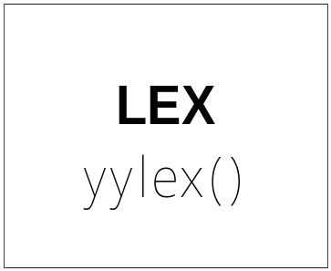
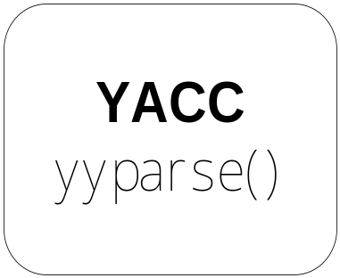
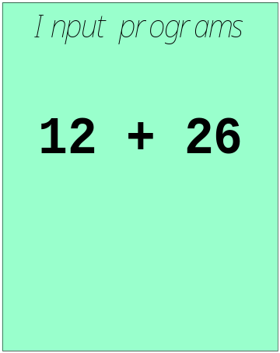
LEX and YACC: a team
How to work ?

Slide 15
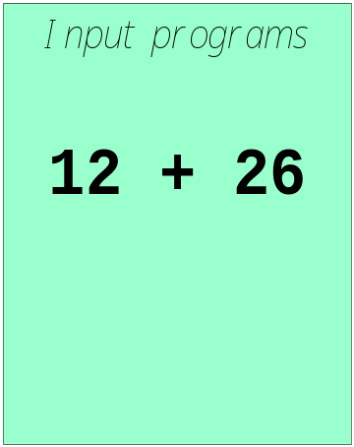
LEX and YACC: a team
call yylex()
[0-9]+
next token is NUM
NUM ‘+’ NUM

Slide 16
Availability
lex, yacc on most UNIX systems
bison: a yacc replacement from GNU
flex: fast lexical analyzer
BSD yacc
Windows/MS-DOS versions exist

Slide 17
YACC
Basic Operational Sequence
gram.y
File containing desired
grammar in YACC format
yacc
YACC program
y.tab.c
C source program created by YACC
cc
or gcc
C compiler
a.out
Executable program that will parse
grammar given in gram.y

Slide 18
YACC File Format
Definitions
%%
Rules
%%
Supplementary Code
The identical LEX format was
actually taken from this...

Slide 19
Rules Section
Is a grammar
Example
expr : expr '+' term | term;
term : term '*' factor | factor;
factor : '(' expr ')' | ID | NUM;

Slide 20
Rules Section
Normally written like this
Example:
expr : expr '+' term
| term
;
term : term '*' factor
| factor
;
factor : '(' expr ')'
| ID
| NUM
;

Slide 21
Definitions Section
Example
%{
#include <stdio.h>
#include <stdlib.h>
%}
%token ID NUM
%start expr
This is called a terminal
The start symbol
(non-terminal)

Slide 22
Sidebar
LEX produces a function called yylex()
YACC produces a function called yyparse()
yyparse() expects to be able to call yylex()
How to get yylex()?
Write your own!
If you don't want to write your own: Use LEX!!!

Slide 23
Sidebar
int yylex()
{
if(it's a num)
return NUM;
else if(it's an id)
return ID;
else if(parsing is done)
return 0;
else if(it's an error)
return -1;
}

Slide 24
Semantic actions
expr : expr '+' term { $$ = $1 + $3; }
| term { $$ = $1; }
;
term : term '*' factor { $$ = $1 * $3; }
| factor { $$ = $1; }
;
factor : '(' expr ')' { $$ = $2; }
| ID
| NUM
;

Slide 25
Semantic actions (cont’d)
$1
expr : expr '+' term { $$ = $1 + $3; }
| term { $$ = $1; }
;
term : term '*' factor { $$ = $1 * $3; }
| factor { $$ = $1; }
;
factor : '(' expr ')' { $$ = $2; }
| ID
| NUM
;

Slide 26
Semantic actions (cont’d)
expr : expr '+' term { $$ = $1 + $3; }
| term { $$ = $1; }
;
term : term '*' factor { $$ = $1 * $3; }
| factor { $$ = $1; }
;
factor : '(' expr ')' { $$ = $2; }
| ID
| NUM
;
$2

Slide 27
Semantic actions (cont’d)
expr : expr '+' term { $$ = $1 + $3; }
| term { $$ = $1; }
;
term : term '*' factor { $$ = $1 * $3; }
| factor { $$ = $1; }
;
factor : '(' expr ')' { $$ = $2; }
| ID
| NUM
;
$3
Default: $$ = $1;

Slide 28
Bored, lonely? Try this!
yacc -d gram.y
Will produce:
y.tab.h
Look at this and you'll
never be unhappy again!
yacc -v gram.y
Will produce:
y.output
Shows "State Machine"®

Slide 29
Example: LEX
scanner.l
%{
#include <stdio.h>
#include "y.tab.h"
%}
id [_a-zA-Z][_a-zA-Z0-9]*
wspc [ \t\n]+
semi [;]
comma [,]
%%
int { return INT; }
char { return CHAR; }
float { return FLOAT; }
{comma} { return COMMA; } /* Necessary? */
{semi} { return SEMI; }
{id} { return ID;}
{wspc} {;}

Slide 30
Example: Definitions
decl.y
%{
#include <stdio.h>
#include <stdlib.h>
%}
%start line
%token CHAR, COMMA, FLOAT, ID, INT, SEMI
%%

Slide 31
Example: Rules
decl.y
/* This production is not part of the "official"
* grammar. It's primary purpose is to recover from
* parser errors, so it's probably best if you leave
* it here. */
line : /* lambda */
| line decl
| line error {
printf("Failure :-(\n");
yyerrok;
yyclearin;
}
;

Slide 32
Example: Rules
decl.y
decl : type ID list { printf("Success!\n"); } ;
list : COMMA ID list
| SEMI
;
type : INT | CHAR | FLOAT
;
%%

Slide 33
Example: Supplementary Code
decl.y
extern FILE *yyin;
main()
{
do {
yyparse();
} while(!feof(yyin));
}
yyerror(char *s)
{
/* Don't have to do anything! */
}

Slide 34
Bored, lonely? Try this!
yacc -d decl.y
Produced
y.tab.h
# define CHAR 257
# define COMMA 258
# define FLOAT 259
# define ID 260
# define INT 261
# define SEMI 262

Slide 35
Symbol attributes
Back to attribute grammars...
Every symbol can have a value
  Might be a numeric quantity in case of a number (42)
  Might be a pointer to a string ("Hello, World!")
  Might be a pointer to a symbol table entry in case of a variable
When using LEX we put the value into yylval
  In complex situations yylval is a union
Typical LEX code:
[0-9]+ {yylval = atoi(yytext); return NUM}

Slide 36
Symbol attributes (cont’d)
YACC allows symbols to have multiple types of value symbols
%union {
double dval;
int vblno;
char* strval;
}

Slide 37
Symbol attributes (cont’d)
%union {
double dval;
int vblno;
char* strval;
}
yacc -d
y.tab.h
…
extern YYSTYPE yylval;
[0-9]+ { yylval.vblno = atoi(yytext);
return NUM;}
[A-z]+ { yylval.strval = strdup(yytext);
return STRING;}
LEX file
include “y.tab.h”

Slide 38
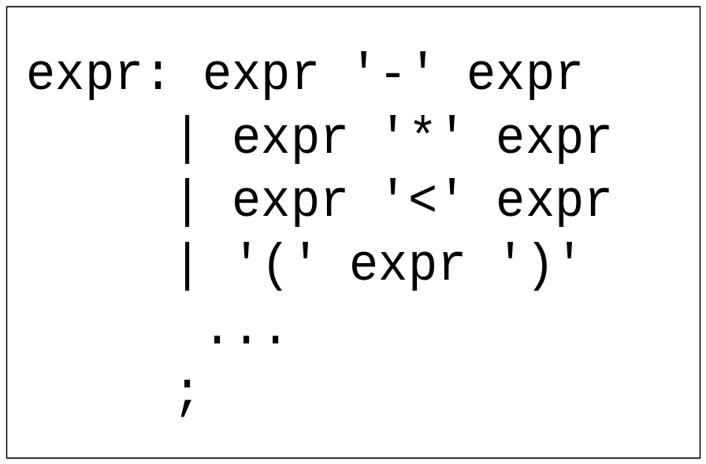
Precedence / Association
(1) 1 – 2 - 3
(2) 1 – 2 * 3
1-2-3 = (1-2)-3? or 1-(2-3)?
Define ‘-’ operator is left-association.
1-2*3 = 1-(2*3)
Define “*” operator is precedent to “-” operator

Slide 39
Precedence / Association
%left '+' '-'
%left '*' '/'
%noassoc UMINUS
expr : expr ‘+’ expr { $$ = $1 + $3; }
| expr ‘-’ expr { $$ = $1 - $3; }
| expr ‘*’ expr { $$ = $1 * $3; }
| expr ‘/’ expr { if($3==0)
yyerror(“divide 0”);
else
$$ = $1 / $3;
}
| ‘-’ expr %prec UMINUS {$$ = -$2; }

Slide 40
Precedence / Association
%right ‘=‘
%left '<' '>' NE LE GE
%left '+' '-‘
%left '*' '/'
highest precedence

Slide 41
Big trick
Getting YACC & LEX to work together!

Slide 42
LEX & YACC
cc/
gcc
lex.yy.c
a.out
y.tab.c

Slide 43
Building Example
Suppose you have a lex file called scanner.l and a yacc file called decl.y and want parser
Steps to build...
lex scanner.l
yacc -d decl.y
gcc -c lex.yy.c y.tab.c
gcc -o parser lex.yy.o y.tab.o -ll
Note: scanner should include in the definitions section: #include "y.tab.h"

Slide 44
YACC
Rules may be recursive
Rules may be ambiguous
Uses bottom-up Shift/Reduce parsing
  Get a token
  Push onto stack
  Can it be reduced (How do we know?)
    If yes: Reduce using a rule
    If no: Get another token
YACC cannot look ahead more than one token

Slide 45
Shift and reducing
stmt: stmt ‘;’ stmt
| NAME ‘=‘ exp
exp: exp ‘+’ exp
| exp ‘-’ exp
| NAME
| NUMBER
stack:
<empty>
input:
a = 7; b = 3 + a + 2

Slide 46
Shift and reducing
stmt: stmt ‘;’ stmt
| NAME ‘=‘ exp
exp: exp ‘+’ exp
| exp ‘-’ exp
| NAME
| NUMBER
SHIFT!
stack:
NAME
input:
= 7; b = 3 + a + 2

Slide 47
Shift and reducing
stmt: stmt ‘;’ stmt
| NAME ‘=‘ exp
exp: exp ‘+’ exp
| exp ‘-’ exp
| NAME
| NUMBER
SHIFT!
stack:
NAME ‘=‘
input:
7; b = 3 + a + 2

Slide 48
Shift and reducing
stmt: stmt ‘;’ stmt
| NAME ‘=‘ exp
exp: exp ‘+’ exp
| exp ‘-’ exp
| NAME
| NUMBER
SHIFT!
stack:
NAME ‘=‘ 7
input:
; b = 3 + a + 2

Slide 49
Shift and reducing
stmt: stmt ‘;’ stmt
| NAME ‘=‘ exp
exp: exp ‘+’ exp
| exp ‘-’ exp
| NAME
| NUMBER
REDUCE!
stack:
NAME ‘=‘ exp
input:
; b = 3 + a + 2

Slide 50
Shift and reducing
stmt: stmt ‘;’ stmt
| NAME ‘=‘ exp
exp: exp ‘+’ exp
| exp ‘-’ exp
| NAME
| NUMBER
REDUCE!
stack:
stmt
input:
; b = 3 + a + 2

Slide 51
Shift and reducing
stmt: stmt ‘;’ stmt
| NAME ‘=‘ exp
exp: exp ‘+’ exp
| exp ‘-’ exp
| NAME
| NUMBER
SHIFT!
stack:
stmt ‘;’
input:
b = 3 + a + 2

Slide 52
Shift and reducing
stmt: stmt ‘;’ stmt
| NAME ‘=‘ exp
exp: exp ‘+’ exp
| exp ‘-’ exp
| NAME
| NUMBER
SHIFT!
stack:
stmt ‘;’ NAME
input:
= 3 + a + 2

Slide 53
Shift and reducing
stmt: stmt ‘;’ stmt
| NAME ‘=‘ exp
exp: exp ‘+’ exp
| exp ‘-’ exp
| NAME
| NUMBER
SHIFT!
stack:
stmt ‘;’ NAME ‘=‘
input:
3 + a + 2

Slide 54
Shift and reducing
stmt: stmt ‘;’ stmt
| NAME ‘=‘ exp
exp: exp ‘+’ exp
| exp ‘-’ exp
| NAME
| NUMBER
SHIFT!
stack:
stmt ‘;’ NAME ‘=‘ NUMBER
input:
+ a + 2

Slide 55
Shift and reducing
stmt: stmt ‘;’ stmt
| NAME ‘=‘ exp
exp: exp ‘+’ exp
| exp ‘-’ exp
| NAME
| NUMBER
REDUCE!
stack:
stmt ‘;’ NAME ‘=‘ exp
input:
+ a + 2

Slide 56
Shift and reducing
stmt: stmt ‘;’ stmt
| NAME ‘=‘ exp
exp: exp ‘+’ exp
| exp ‘-’ exp
| NAME
| NUMBER
SHIFT!
stack:
stmt ‘;’ NAME ‘=‘ exp ‘+’
input:
a + 2

Slide 57
Shift and reducing
stmt: stmt ‘;’ stmt
| NAME ‘=‘ exp
exp: exp ‘+’ exp
| exp ‘-’ exp
| NAME
| NUMBER
SHIFT!
stack:
stmt ‘;’ NAME ‘=‘ exp ‘+’ NAME
input:
+ 2

Slide 58
Shift and reducing
stmt: stmt ‘;’ stmt
| NAME ‘=‘ exp
exp: exp ‘+’ exp
| exp ‘-’ exp
| NAME
| NUMBER
REDUCE!
stack:
stmt ‘;’ NAME ‘=‘ exp ‘+’ exp
input:
+ 2

Slide 59
Shift and reducing
stmt: stmt ‘;’ stmt
| NAME ‘=‘ exp
exp: exp ‘+’ exp
| exp ‘-’ exp
| NAME
| NUMBER
REDUCE!
stack:
stmt ‘;’ NAME ‘=‘ exp
input:
+ 2

Slide 60
Shift and reducing
stmt: stmt ‘;’ stmt
| NAME ‘=‘ exp
exp: exp ‘+’ exp
| exp ‘-’ exp
| NAME
| NUMBER
SHIFT!
stack:
stmt ‘;’ NAME ‘=‘ exp ‘+’
input:
2

Slide 61
Shift and reducing
stmt: stmt ‘;’ stmt
| NAME ‘=‘ exp
exp: exp ‘+’ exp
| exp ‘-’ exp
| NAME
| NUMBER
SHIFT!
stack:
stmt ‘;’ NAME ‘=‘ exp ‘+’ NUMBER
input:
<empty>

Slide 62
Shift and reducing
stmt: stmt ‘;’ stmt
| NAME ‘=‘ exp
exp: exp ‘+’ exp
| exp ‘-’ exp
| NAME
| NUMBER
REDUCE!
stack:
stmt ‘;’ NAME ‘=‘ exp ‘+’ exp
input:
<empty>

Slide 63
Shift and reducing
stmt: stmt ‘;’ stmt
| NAME ‘=‘ exp
exp: exp ‘+’ exp
| exp ‘-’ exp
| NAME
| NUMBER
REDUCE!
stack:
stmt ‘;’ NAME ‘=‘ exp
input:
<empty>

Slide 64
Shift and reducing
stmt: stmt ‘;’ stmt
| NAME ‘=‘ exp
exp: exp ‘+’ exp
| exp ‘-’ exp
| NAME
| NUMBER
REDUCE!
stack:
stmt ‘;’ stmt
input:
<empty>

Slide 65
Shift and reducing
stmt: stmt ‘;’ stmt
| NAME ‘=‘ exp
exp: exp ‘+’ exp
| exp ‘-’ exp
| NAME
| NUMBER
REDUCE!
stack:
stmt
input:
<empty>

Slide 66
Shift and reducing
stmt: stmt ‘;’ stmt
| NAME ‘=‘ exp
exp: exp ‘+’ exp
| exp ‘-’ exp
| NAME
| NUMBER
DONE!
stack:
stmt
input:
<empty>

Slide 67
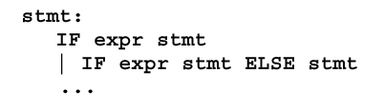
IF-ELSE Ambiguity
Consider following rule:
Following state :
IF expr IF expr stmt . ELSE stmt
Two possible derivations:
IF expr IF expr stmt . ELSE stmt
IF expr IF expr stmt ELSE . stmt
IF expr IF expr stmt ELSE stmt .
IF expr stmt
IF expr IF expr stmt . ELSE stmt
IF expr stmt . ELSE stmt
IF expr stmt ELSE . stmt
IF expr stmt ELSE stmt .

Slide 68
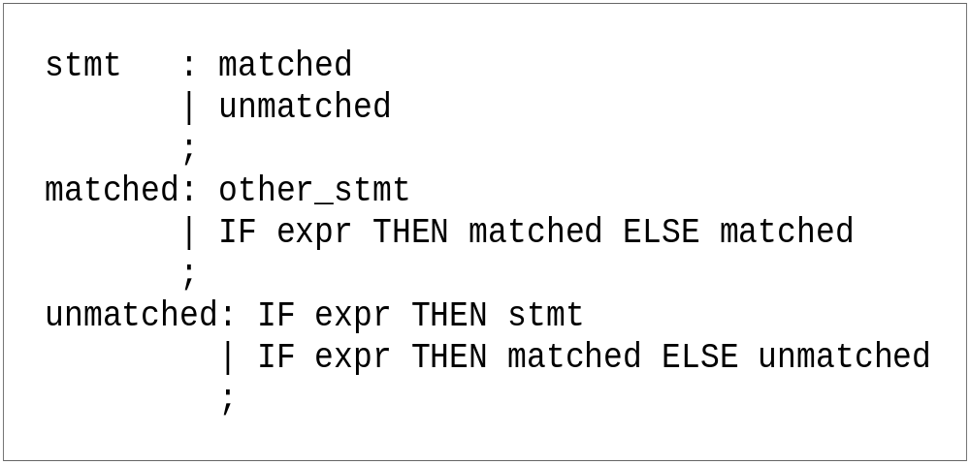
IF-ELSE Ambiguity
It is a shift/reduce conflict
YACC will always do shift first
Solution 1 : re-write grammar

Slide 69
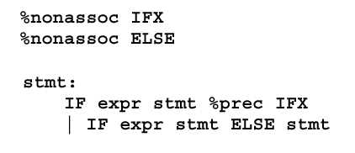
IF-ELSE Ambiguity
Solution 2:
the rule has the same precedence as token IFX

Slide 70
Shift/Reduce Conflicts
shift/reduce conflict
  occurs when a grammar is written in such a way that a decision between shifting and reducing can not be made.
  e.g.: IF-ELSE ambiguity
To resolve this conflict, YACC will choose to shift

Slide 71
Reduce/Reduce Conflicts
Reduce/Reduce Conflicts:
start : expr | stmt
;
expr : CONSTANT;
stmt : CONSTANT;
YACC (Bison) resolves the conflict by reducing using the rule that occurs earlier in the grammar. NOT GOOD!!
So, modify grammar to eliminate them

Slide 72
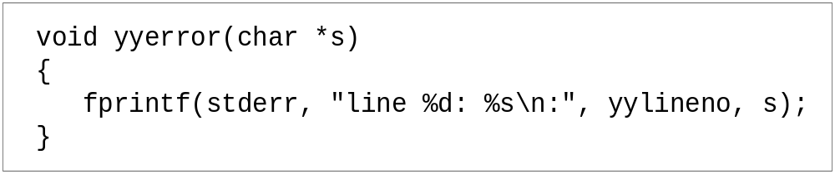
Error Messages
Bad error message:
  Syntax error
  Compiler needs to give programmer a good advice
It is better to track the line number in LEX:

Slide 73
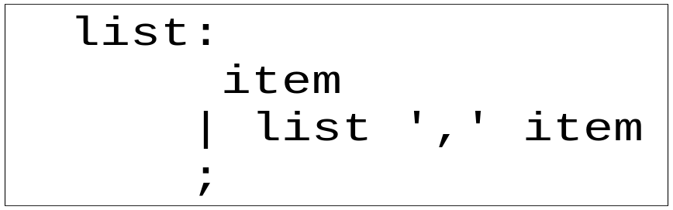
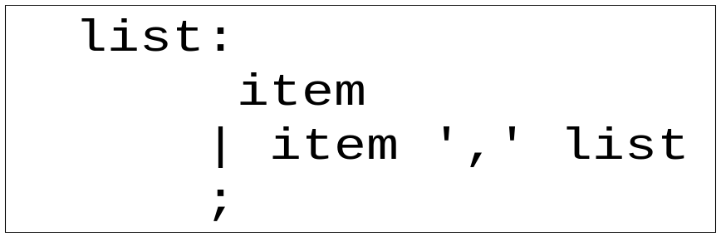
Recursive Grammar
Left recursion
Right recursion
LR parser prefers left recursion
LL parser prefers right recursion

Slide 74
YACC Example
Taken from LEX & YACC
Simple calculator
  a = 4 + 6
  a
  a=10
  b = 7
  c = a + b
  c
  c = 17
  pressure = (78 + 34) * 16.4
  $

Slide 75
Grammar
expression ::= expression '+' term |
expression '-' term |
term
term ::= term '*' factor |
term '/' factor |
factor
factor ::= '(' expression ')' |
'-' factor |
NUMBER |
NAME

Slide 76
parser.h

Slide 77
/*
* Header for calculator program
*/
#define NSYMS 20 /* maximum number
of symbols */
struct symtab {
char *name;
double value;
} symtab[NSYMS];
struct symtab *symlook();
0
name
value
1
name
value
2
name
value
3
name
value
4
name
value
5
name
value
6
name
value
7
name
value
8
name
value
9
name
value
10
name
value
11
name
value
12
name
value
13
name
value
14
name
value
parser.h

Slide 78
parser.y

Slide 79
%{
#include "parser.h"
#include <string.h>
%}
%union {
double dval;
struct symtab *symp;
}
%token <symp> NAME
%token <dval> NUMBER
%type <dval> expression
%type <dval> term
%type <dval> factor
%%
parser.y

Slide 80
statement_list: statement '\n'
| statement_list statement '\n‘
;
statement: NAME '=' expression { $1->value = $3; }
| expression { printf("= %g\n", $1); }
;
expression: expression '+' term { $$ = $1 + $3; }
| expression '-' term { $$ = $1 - $3; }
term
;
parser.y

Slide 81
term: term '*' factor { $$ = $1 * $3; }
| term '/' factor { if($3 == 0.0)
yyerror("divide by zero");
else
$$ = $1 / $3;
}
| factor
;
factor: '(' expression ')' { $$ = $2; }
| '-' factor { $$ = -$2; }
| NUMBER
| NAME { $$ = $1->value; }
;
%%
parser.y

Slide 82
/* look up a symbol table entry, add if not present */
struct symtab *symlook(char *s) {
char *p;
struct symtab *sp;
for(sp = symtab; sp < &symtab[NSYMS]; sp++) {
/* is it already here? */
if(sp->name && !strcmp(sp->name, s))
return sp;
if(!sp->name) { /* is it free */
sp->name = strdup(s);
return sp;
}
/* otherwise continue to next */
}
yyerror("Too many symbols");
exit(1); /* cannot continue */
} /* symlook */
parser.y

Slide 83
yyerror(char *s)
{
printf( "yyerror: %s\n", s);
}
parser.y

Slide 84
typedef union
{
double dval;
struct symtab *symp;
} YYSTYPE;
extern YYSTYPE yylval;
# define NAME 257
# define NUMBER 258
y.tab.h

Slide 85
calclexer.l

Slide 86
%{
#include "y.tab.h"
#include "parser.h"
#include <math.h>
%}
%%
calclexer.l

Slide 87
%%
([0-9]+|([0-9]*\.[0-9]+)([eE][-+]?[0-9]+)?) {
yylval.dval = atof(yytext);
return NUMBER;
}
[ \t] ; /* ignore white space */
[A-Za-z][A-Za-z0-9]* { /* return symbol pointer */
yylval.symp = symlook(yytext);
return NAME;
}
"$" { return 0; /* end of input */ }
\n |. return yytext[0];
%%
calclexer.l

Slide 88
Makefile

Slide 89
Makefile
LEX = lex
YACC = yacc
CC = gcc
calcu: y.tab.o lex.yy.o
$(CC) -o calcu y.tab.o lex.yy.o -ly -ll
y.tab.c y.tab.h: parser.y
$(YACC) -d parser.y
y.tab.o: y.tab.c parser.h
$(CC) -c y.tab.c
lex.yy.o: y.tab.h lex.yy.c
$(CC) -c lex.yy.c
lex.yy.c: calclexer.l parser.h
$(LEX) calclexer.l
clean:
rm *.o
rm *.c
rm calcu

Slide 90
YACC Declaration Summary
`%start' Specify the grammar's start symbol
`%union‘ Declare the collection of data types that semantic values may have
`%token‘ Declare a terminal symbol (token type name) with no precedence or associativity specified
`%type‘ Declare the type of semantic values for a nonterminal symbol

Slide 91
YACC Declaration Summary
`%right‘ Declare a terminal symbol (token type name) that is right-associative
`%left‘ Declare a terminal symbol (token type name) that is left-associative
`%nonassoc‘ Declare a terminal symbol (token type name) that is nonassociative (using it in a way that would be associative is a syntax error, e.g.:
x op. y op. z is syntax error)

